Slide 1
LECTURE 2 SOCIAL GROUPS AND SOCIETY

Slide 2

SOCIAL GROUPS AND SOCIETY

Slide 3

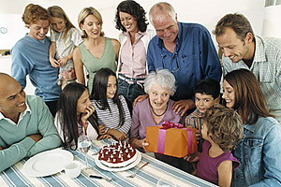
Sociology is the study of human social life.
A defining feature of human life is that
humans interact,
communicate and
construct social collectivities.

Slide 4

GROUPS ARE UNIVERSAL!!
every society whether ancient or feudal or modern, Asian or European or African human groups and collectivities exist.
Types of groups and collectivities are different in different societies.

Slide 5
Gathering of people does not necessarily constitute a social group; they could be aggregates.
Aggregates are simply collections of people who are in the same place at the same time, but share no definite connection with one another.
Such aggregates are often termed as quasi groups.

Slide 6
Quasi Group
A quasi group is an aggregate or combination,
which lacks structure or organisation
whose members may be unaware, or less aware, of the existence of groupings.
Example: Social classes, status groups, age and gender groups, crowds

Slide 7

Characteristics of GROUP
Persistent interaction to provide continuity;
a stable pattern of these interactions;
a sense of belonging to identify with other members,
i.e. each individual is conscious of the group itself and its own set of rules, rituals and symbols;
shared interest;
acceptance of common norms and values;
a definable structure.

Slide 8
TYPES OF GROUPS
Primary and Secondary Social Groups
Community and Society or Association
In-Groups and Out-Groups
Peer Groups
Reference Group

Slide 9
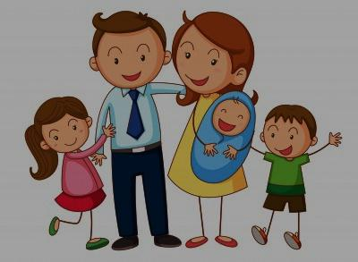
Primary and Secondary Social Groups
Primary Groups
small group of people
connected
face-to-face association
co-operation.
The members of primary groups have a sense of belonging.
Example: Family, village and groups of friends

Slide 10
Secondary groups
Secondary groups are relatively large in size,
Limited responsibility
Maintain formal and impersonal relationships.
The primary groups are person-oriented, whereas the secondary groups are goal oriented.
Example:- Schools, government offices, hospitals, students association etc.

Slide 11
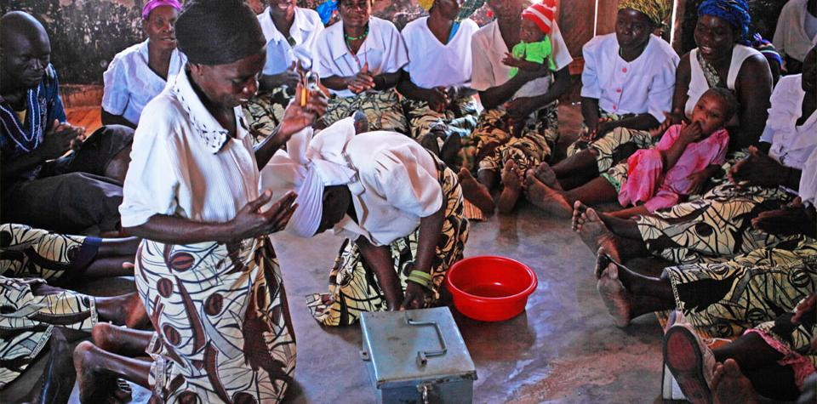

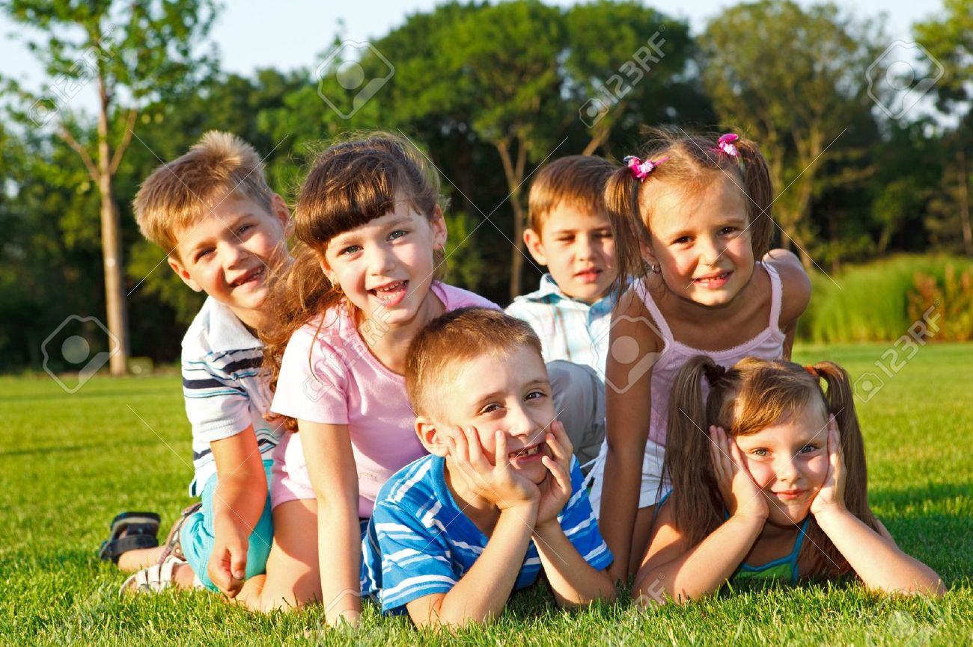
Primary Groups

Slide 12
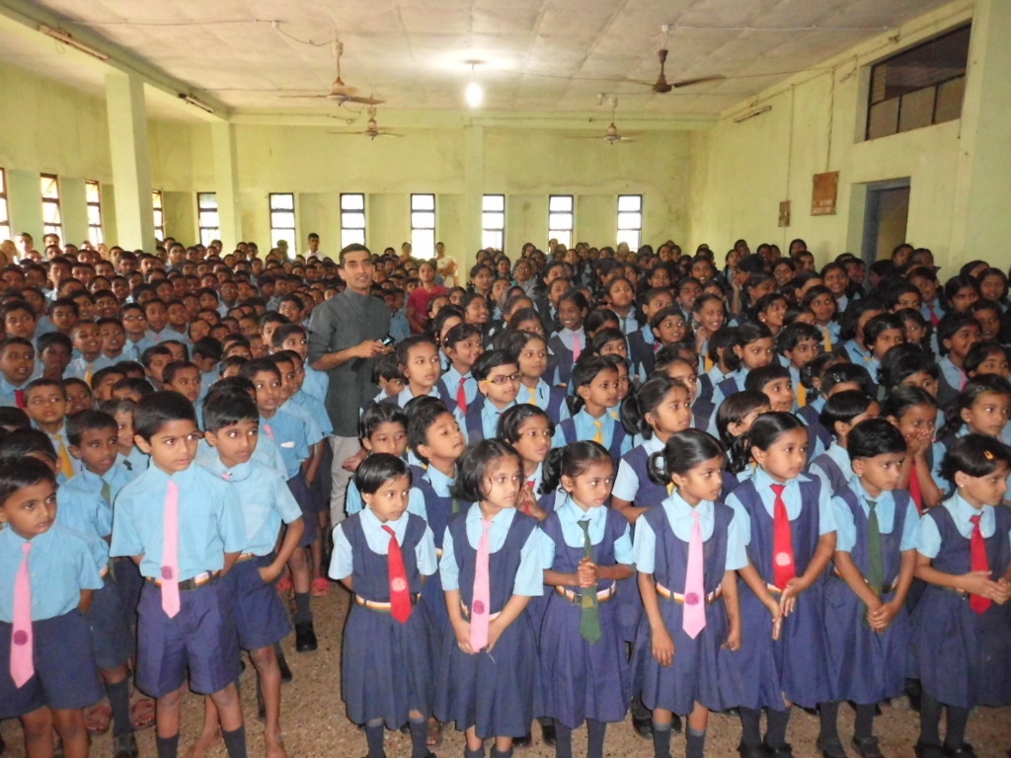
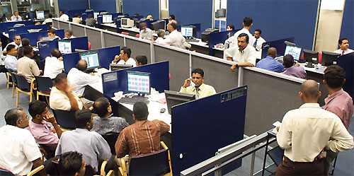
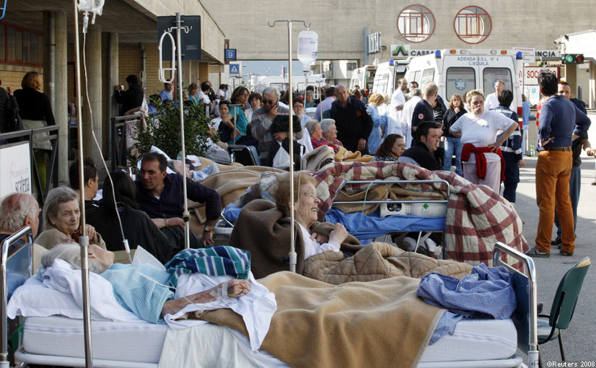
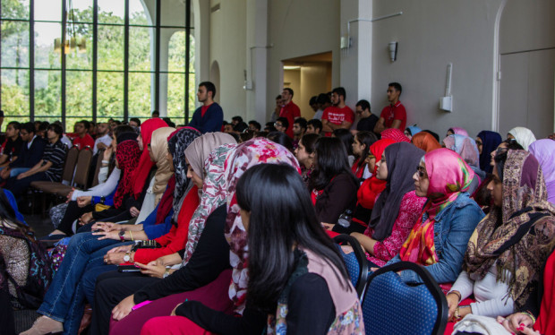
Secondary Groups

Slide 13
Community and Society or Association
Community is the living population within a limited geographical area carrying on a common interest.
The term ‘community’ refers to human relationships that are
highly personal,
intimate and
enduring,
Example: family, with real friends or a close-knit group.
Notes:
Community is the opposite of society and association

Slide 14
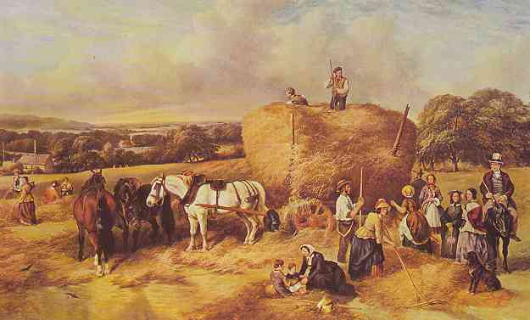

Slide 15
‘Society’ or ‘association’ refers to everything opposite of ‘community’,
Impersonal,
Superficial and
transitory relationships of modern urban life.

Slide 16


You may draw a parallel between the community with the primary group and the association with the secondary group.
=Primary Group
=Secondary Group

Slide 17
In-groups and Out-groups
In-groups | Out-Groups
We feeling exists (we) | Lack of We feeling (their)
Face to face relationship | Far relationship
Feeling sacrifice and cooperation among members | Lack of Feeling sacrifice and cooperation among members
Domestic and Perfect relationship | Working relationship and imperfection of relationship Ex: Migrants

Slide 18
??
People once considered members of an out-group become in-group members. Can you find out about such processes in history?

Slide 19
Reference Group
The groups whose life styles are imitated are known as reference groups.
Example:-
a person copies the life style of any film actor or artist.
In colonial period, many middle class Nigeriians tried to imitate English man.
Reference groups are important sources of information about culture, life style, aspiration and goal attainments.

Slide 20
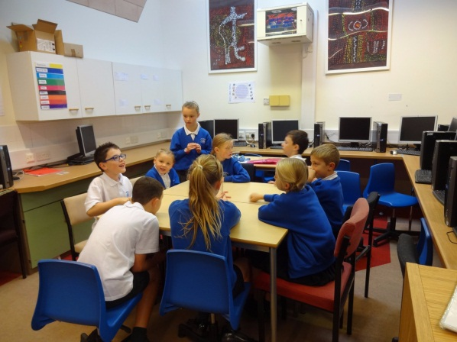
Peer Groups
A kind of primary group,
Usually formed between individuals
It is a group of people of the same age, status, interests, etc.
Example: classmates, school mates etc.
Often peer group influence on children is grater than parental influence.

Slide 21
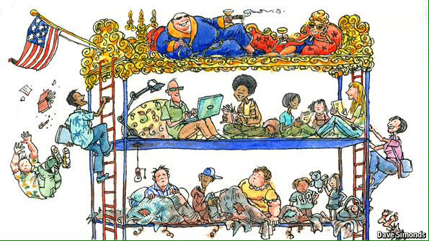
SOCIAL STRATIFICATION
Social stratification refers to structural inequalities between different groupings of people.

Slide 22
Society can be seen as consisting of ‘strata’ in a hierarchy,
more favoured at the top and
less privileged near the bottom.
Stratification plays a crucial role in the organization of the society
Every individual and every household in society are affected by stratification.

Slide 23
Four basic systems of stratification in the society.
Slavery
Caste
Estate and
Class

Slide 24
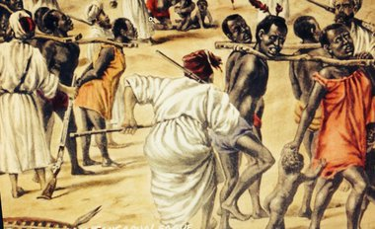
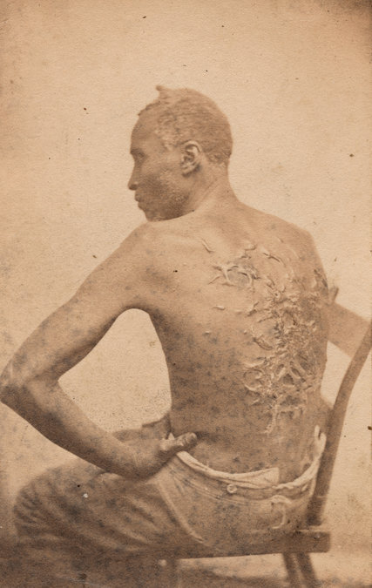
Slavery

Slide 25
Slavery is an extreme form of inequality in which some individuals are literally owned by others.
Example:-
Ancient Greece and Rome
Southern States of the USA in the 18th and 19th centuries.

Slide 26

What do you think is the base for stratification of Nigerian society?.
How can you classify people based on their Wealth?.

Slide 27
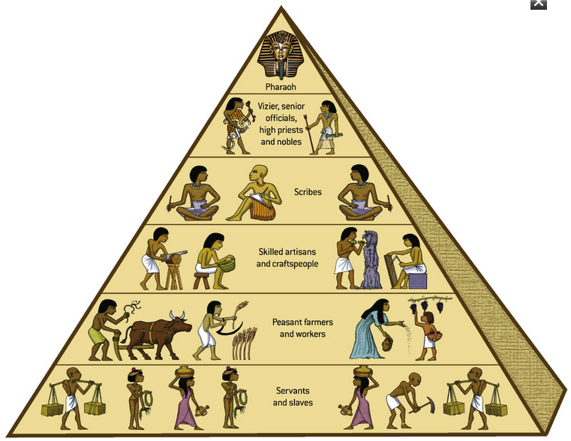
Caste

Slide 28
individual’s position totally depends on the status attributes ascribed by birth rather than achieved.
The traditional system is generally conceptualized in terms of origin
Yorubas
Ibos
Hausas and
Others

Slide 29
Class
Class is a typical social stratification found in Industrialized society.
Social Class is a stratum of people of similar social position with regard to
income,
occupation,
education and
wealth.

Slide 30
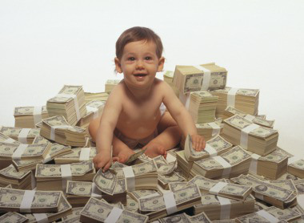
In a class, a person’s social status is based on his/her achievements.

Slide 31
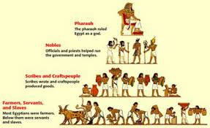
Stratification on the basis of class is not dependent on birth, but it depends on
profession,
ability,
skill,
education,
science etc.
Class is an open institution.
An individual can change his/her class and acquire high status in social stratification.
Kind of class: Higher class, Middle class, lower class, Agricultural class.

Slide 32
Difference between Cast and Class
Caste | Class
It depends on Birth | Depends on social circumstances
Closed group | Open system
Rigid rules in marriage, eating- habits etc. | No rigidity
Permanent/ Stable organisation. | Less stable than caste system
Inherited Membership | Never inherited

Slide 33

Class system allow social mobility.
One may go to higher to better class or go down to a lower class.

Slide 34
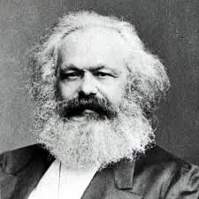
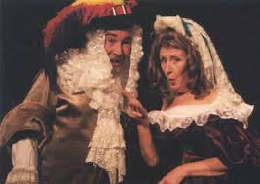
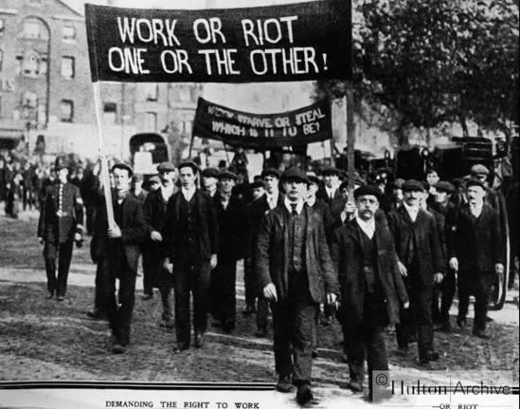
According to Karl Marx, capitalist society consists of two classes.
The Bourgeois
The Proletariat

Slide 35
The Bourgeois
The owners of means of production: factories, business, equipment.
The Proletariat
Workers
According to Marx, Bourgeois in capitalist societies exploit workers.

Slide 36
Life chance – Max Weber.
Life chance is the social science theory of opportunities, each individual has to improve his quality of life.
Inequality, Weber argued might be based on economic relations. But it could also be based on prestige or on the political power.

Slide 37
Status and Role
Twin concept
Status
A position in a society or in a group.
It refers social position with defined rights and duties assigned to these positions.
Role
Dynamic, Behavioral aspects of status.
Status is occupied, while role is played.

Slide 38
In modern society an individual occupies different positions or status during life

Slide 39
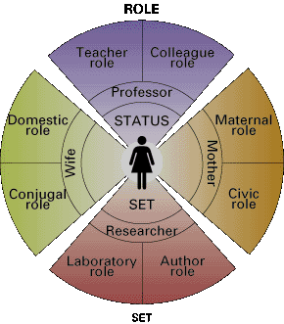
Status set
Individual occupies multiple status in modern society…
Ex: Son-father-grandfather

Slide 40
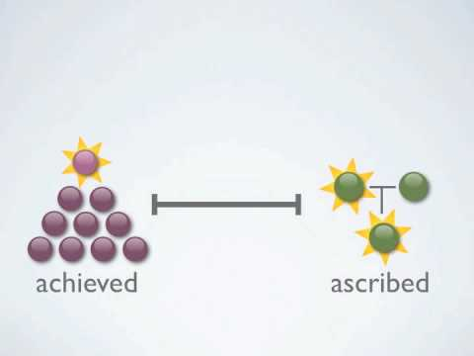
Ascribed status and Achieved status
Ascribed status
Depends on birth
Granted without any struggle
Bases of ascribed status
Caste
Kinship
Birth
Gender discrimination
Age discrimination

Slide 41
Achieved status
Achieved by the person on the basis of personal merits or qualifications is called….
Bases of achieved status
Education
Training
Wealth
Occupation
Political power

Slide 42
Status and prestige
Status and prestige are inter connected.
Every status is accorded certain rights and values. Values are attached to social position.
Ex: Professor, Doctor (high value), shopkeeper
The value attached to the status is called prestige.
People can rank status in terms of their high and low prestige.

Slide 43

Find out the prestigious job in your society

Slide 44
Role conflict
It occurs when status and role do not agree
Role stereotyping
It is a process of fixing a particular role for a particular person- man and women.
Role and status are not fixed. People fight against discrimination based on cast and gender.

Slide 45
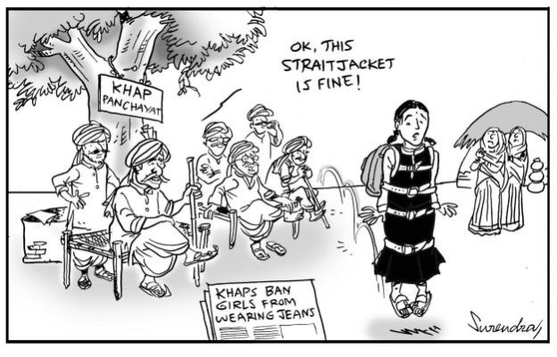
Society and Social control
Social control means, different methods used by society to control disobedient member in society and bring them back to their norms.

Slide 46
Use of force to regulate behaviour of individuals and group
For maintaining order in the society
It reduce the tension and conflict among individual and group
It helps maintain stability
Social control uses social processes, techniques and strategies to regulate the behaviour of individual and group.

Slide 47
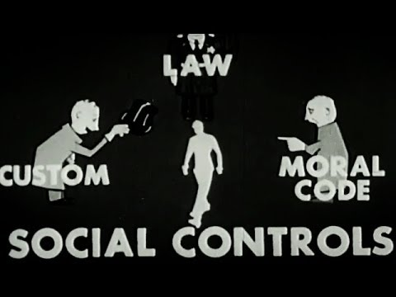
Formal and informal social control
Formal Social Control
It means official, codified and systematic means of social control.
Informal Social Control
Personal, unofficial and un codified.

Slide 48
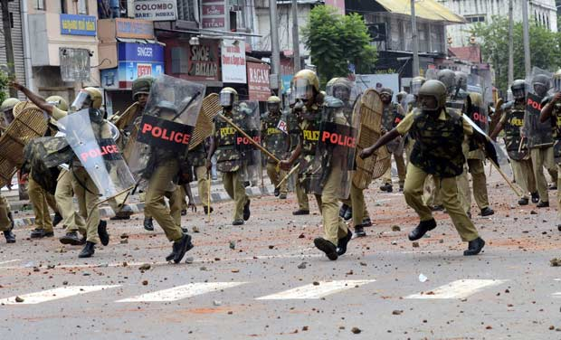

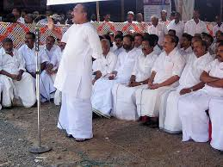

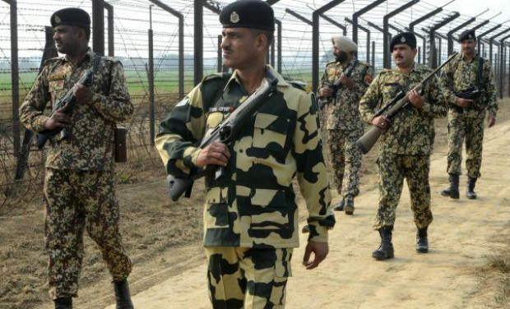
Formal Social Control includes control by state, law, police, bureaucracy, army, political power, educate etc.

