Slide 1
PARTIAL FRACTIONS
PRESENTED BY:
MUTAIRU KAYODE, KOLAWOLE, Ph.D.
BEING A LECTURE SERIES PRESENTED BY THE DEPARTMENT OF
MATHEMATICAL SCIENCES, OSUN STATE UNIVERSITY, OSOGBO
JANUARY 11, 2024

Slide 2
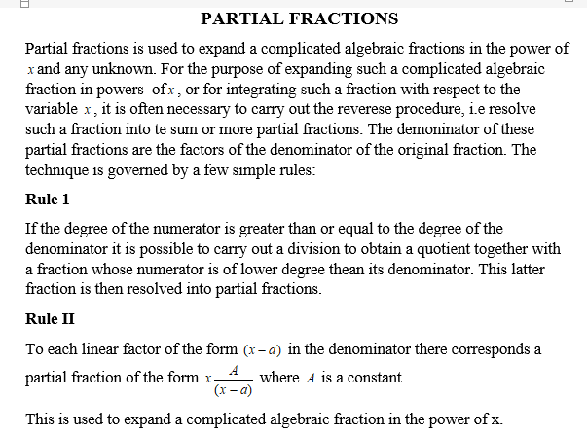

Slide 3
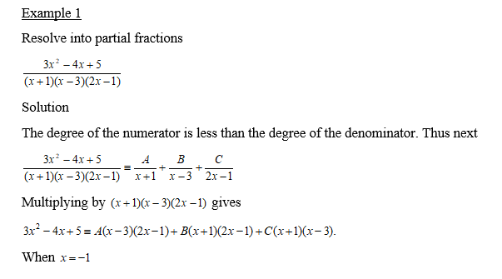

Slide 4
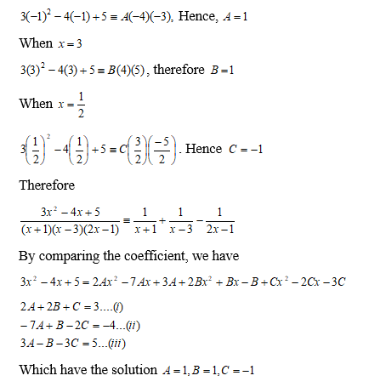

Slide 5
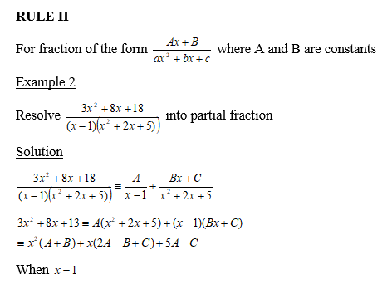
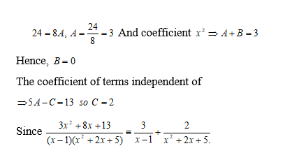

Slide 6
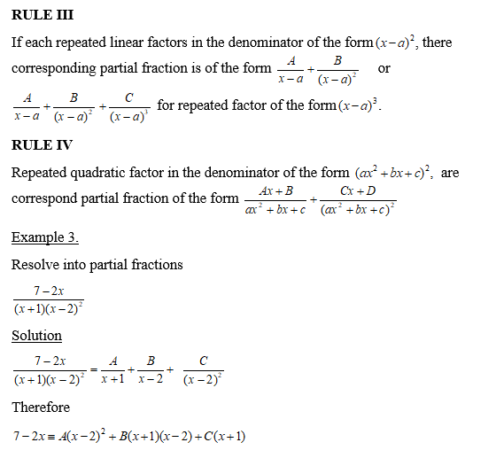

Slide 7


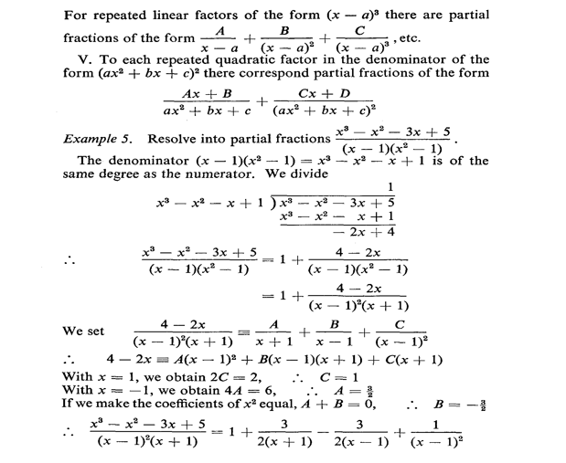

Slide 8
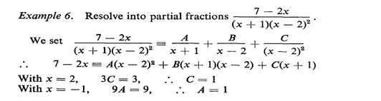


Slide 9
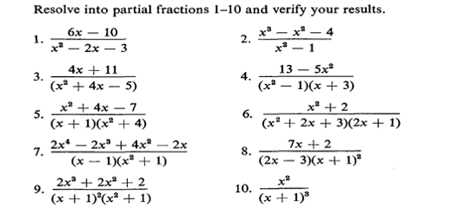

Slide 10


