Slide 1



Slide 2

Scientific
Study of
Society

Slide 3

?
What is
Society

Slide 6





Inter-connected relationships

Slide 7


Socialisation
Society
New Born baby

Slide 8







Religion
Family
School
Peer group

Slide 9


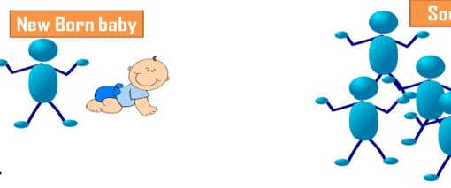
Society
Web of Social Relationships
Sociology
Scientific study of Human society and social Interactions
Socialisation
Process; Newborn baby to social animal

Slide 10

I am a member of Society
Prior Knowledge
Peer group
Social Status
Culture
Family

Slide 11
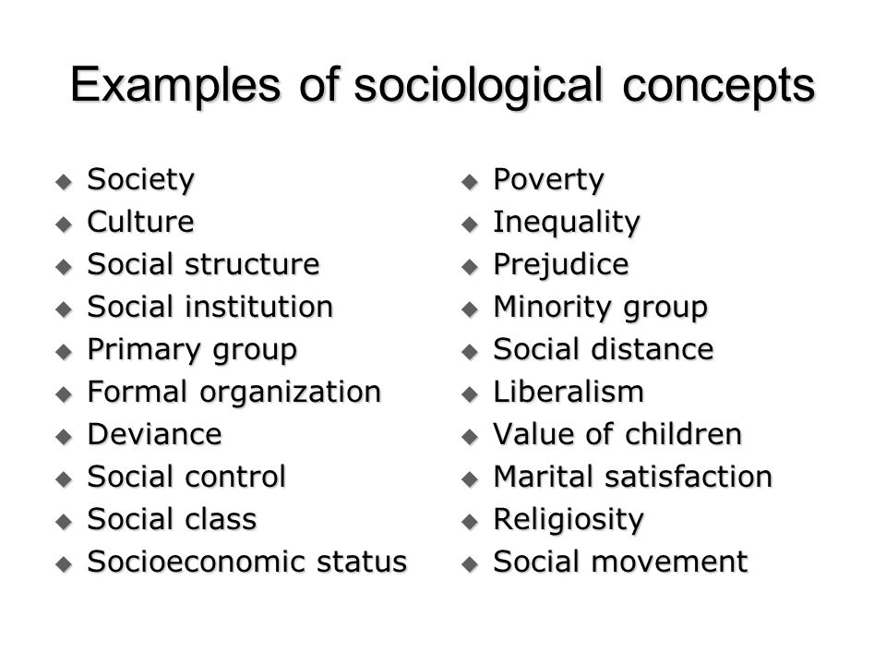

Slide 12


Sociology is the study of human social life.
A defining feature of human life is that
  humans interact,
  communicate and
  construct social collectivities.

Slide 13

every society whether ancient or feudal or modern, Asian or European or African human groups and collectivities exist.
Types of groups and collectivities are different in different societies

Slide 14
youngest of all Social Sciences.
only in the second half of the 19th century.
Enlightment
French Revolution
Industrial Revolution

Slide 15
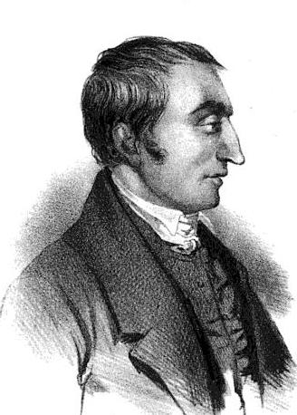
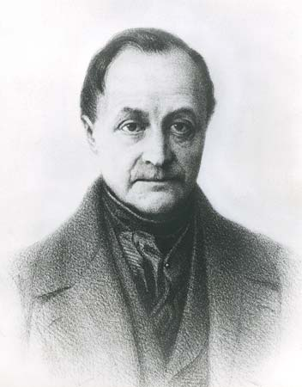
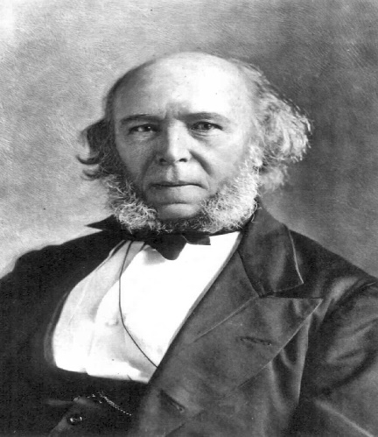
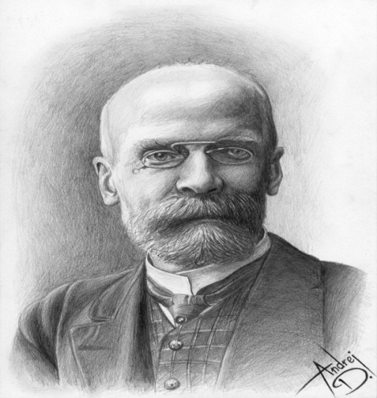
HISTORY
Saint Simon, Auguste Comte, Herbert Spencer and Emile Durkhiem are immense in the development of this distinct discipline.

Slide 16

Social Physics
1839 – Word ‘Sociology’ Introduced

Slide 17
Sociology
‘Socius’
‘Logos’
Latin Word
Meaning: Companion
Association
Greek Word
Meaning: Study of

Slide 18

Father of Sociology

Slide 19


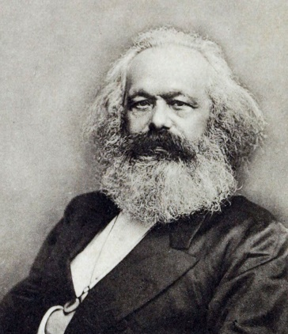
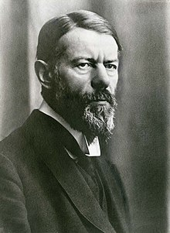
Auguste Comte
Herbert Spencer
Emile Durkheim
Classical Sociologists
(Founding Fathers)
Karl Marx
Max weber

Slide 20
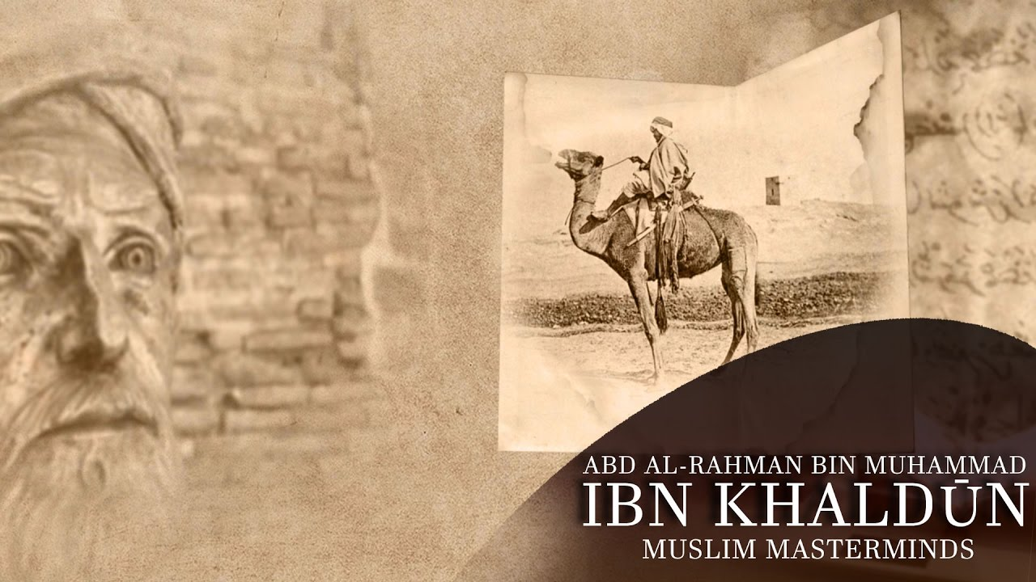
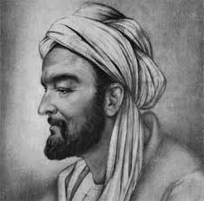
AD 1406

Slide 21
Why Sociology ?
Social Problems
Social Research
Social Demography
Social Diversities

Slide 22


Slide 23
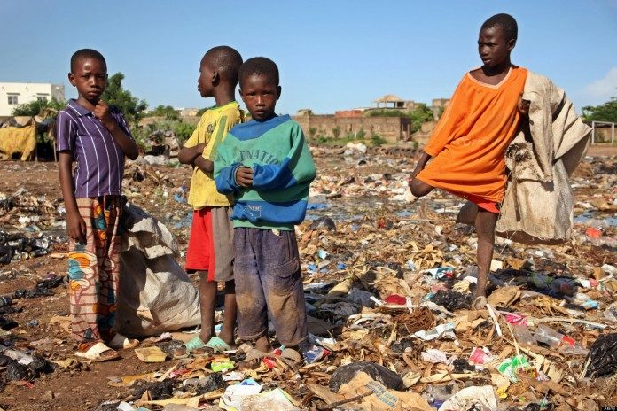

Slide 24
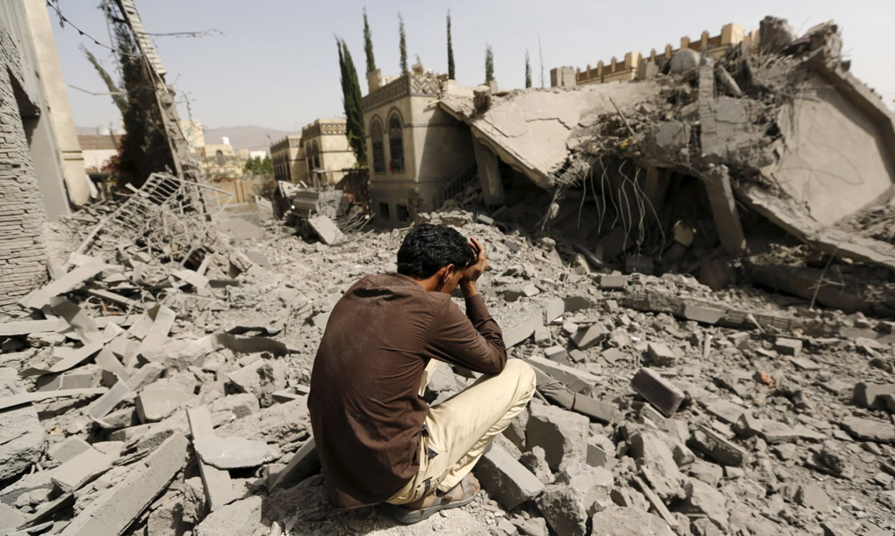


Slide 25


Slide 26


Slide 27


Slide 28


Slide 29
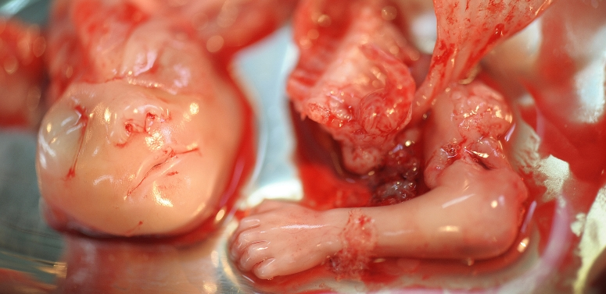


Slide 30
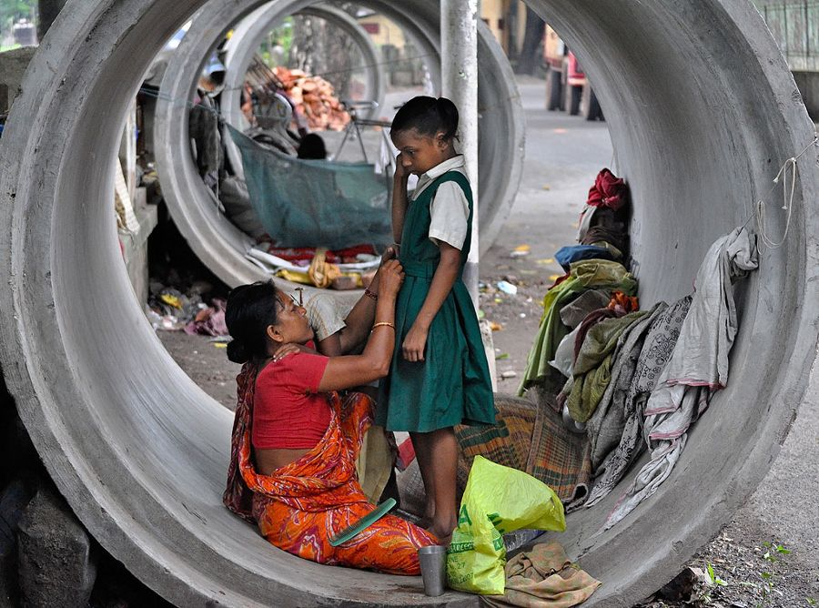

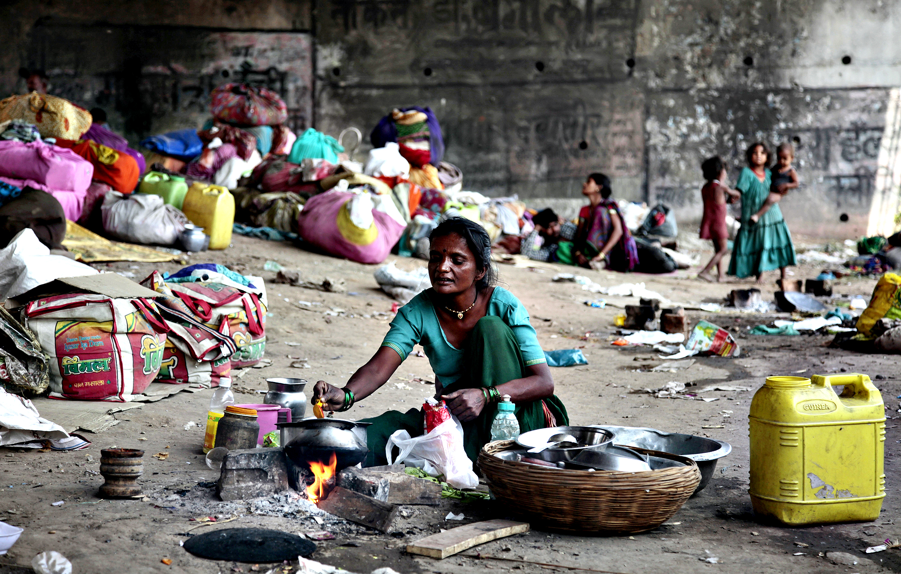

Slide 31


Slide 32





Slide 33


Slide 34


Slide 35


Slide 36
Schools of Sociological thought
Macro theories
Conflict Theory
Micro theories
Exchange Theory
Symbolic Interactionism
Structuralism
Critical Theory
Phenomenology
Ethnomethodology
Functionalism
Micro –Macro Integration

Slide 37
Schools of Sociological thought
Macro theories
Conflict Theory
Micro theories
Exchange Theory
Symbolic Interactionism
Structuralism
Critical Theory
Phenomenology
Ethnomethodology
Functionalism
Micro –Macro Integration
Functionalism
Conflict Theory

Slide 38
Potentials
Labour Officer in Labour Department
Human Relation Officer
Employment officer
Probation Officer
Professor in Art/Science Colleges, Law College, Nursing college.
Superintendent in juvenile home
Social Scientist in Medical colleges
Psychiatric social worker
Welfare officer in social welfare dpt.
Child development Project officer in Social welfare dpt.
Tribal Development officer
Family planning officer in Medical colleges
Sociology teacher in Army etc.

