Slide 2

What is institution?

Slide 3
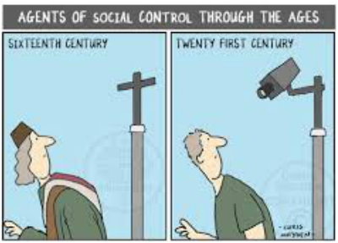
Institution
Something that works according to rules or customs.
It control on individuals
It gives individual opportunities

Slide 4
There are social institutions that constrain and
control, punish and reward.
‘macro’ social institutions -state
‘micro’ -family.
1. Family, Marriage, Kinship
2. Politics
3. Religion
4. Education
5. Economics

Slide 5
Functionalism | Conflict theory
 | Karl Marx

Slide 6
A functionalist view
social institutions as a complex set of social norms, beliefs, values and role relationship that arise in response to the needs of society.
Social institutions exist to satisfy social needs.
We find informal and formal social institutions in societies.
informal social institutions
family and religion
formal social institutions.
Law, education

Slide 7
Conflict view
all individuals are not placed equally in society.
All social institutions whether familial, religious, political, economic, legal or educational will operate in the interest of the dominant sections of society be it class, caste, tribe or gender.
The dominant social section not only dominates political and economic institutions but also ensures that the ruling class ideas become the ruling ideas of a society.

Slide 8
The important social institutions are :
Family, Marriage and Kinship
Politics
Economics;
Religion; and
Education.
Social Institutions
family, marriage and kinship (informal)
law, education, etc. (formal)

Slide 9
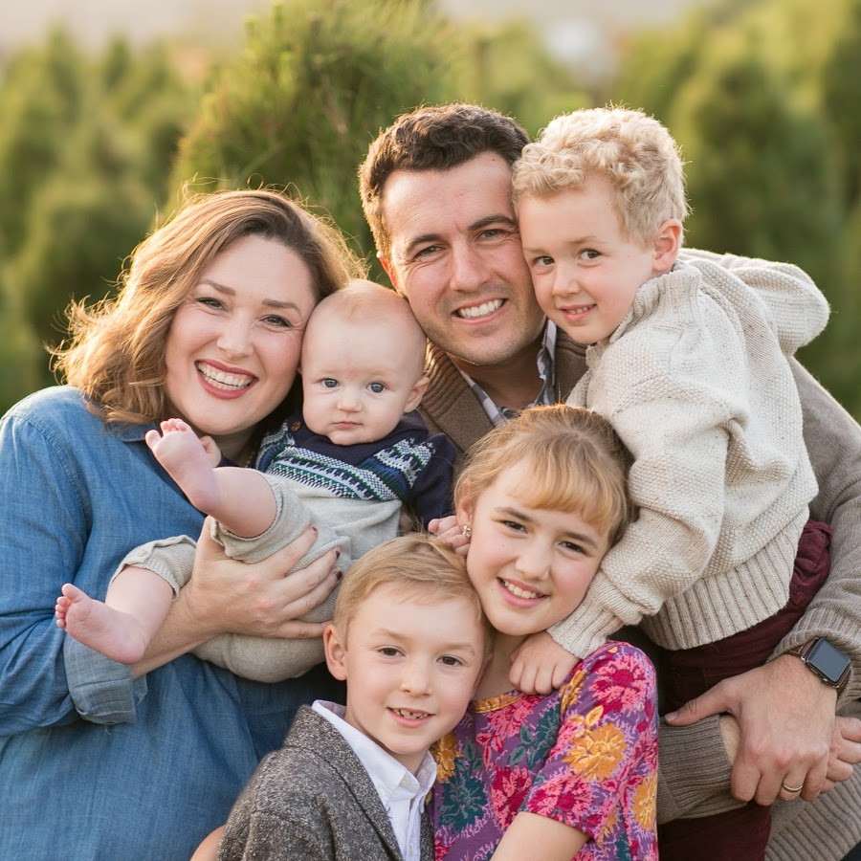
Family, marriage and kinship
Family
A family is a group of persons directly linked by kin connections
Basic unit of the society
Simplest form of society
Latin origin: ‘famulus’ and ‘familia’ –means servant and household.

Slide 10

Economical
Educational
Political
Cultural

Slide 11

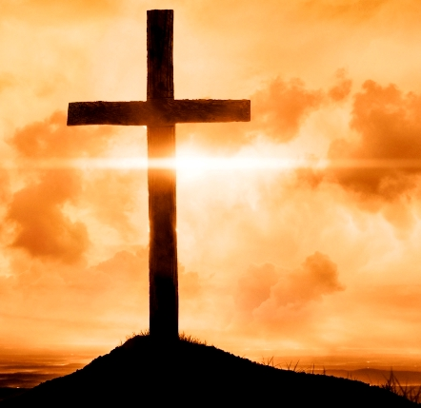
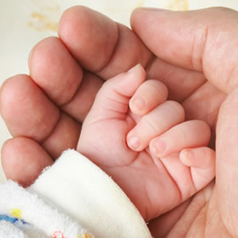

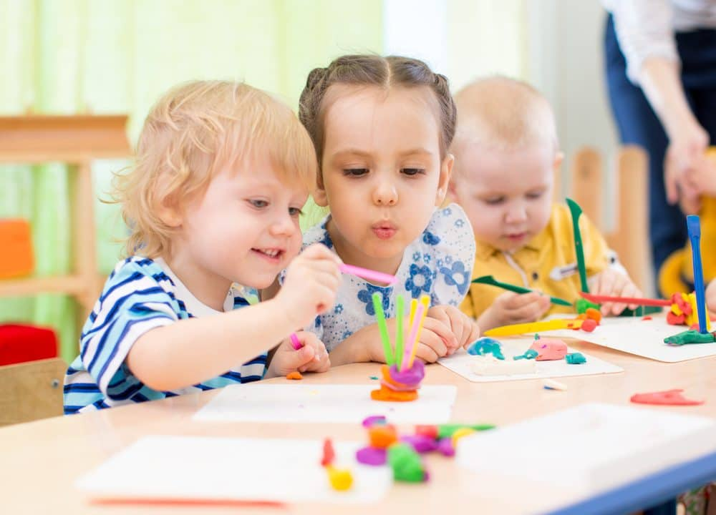

Functions of family
Affectional
Economic
Protective
Religious
Educational
Socialization

Slide 12
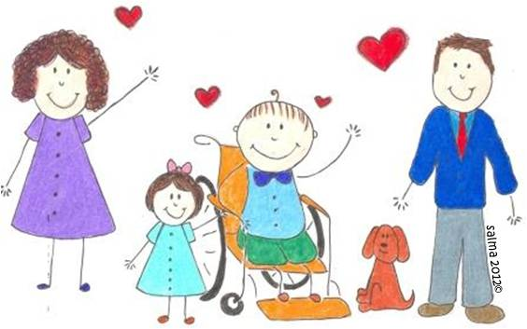
Human society cannot function without family.
A child learns the norms and culture in the family

Slide 13

Sociologist consider the family as the cornerstone of the society.

Slide 14

It is universal, found in all communities.
It is based on emotion and sentiments .

Slide 15
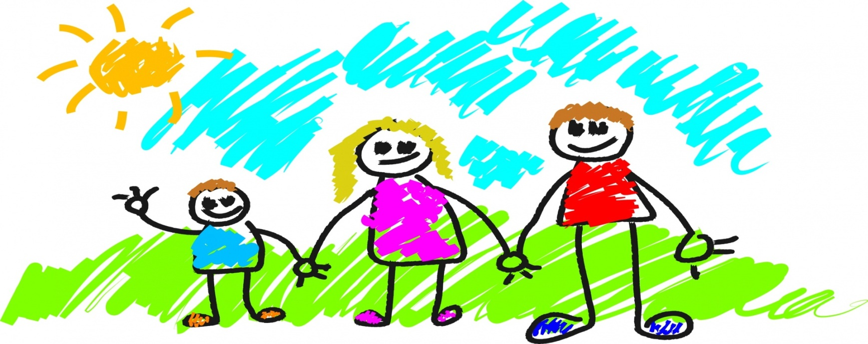
It moulds the character of its members and influences the whole life of society.
It is permanent

Slide 16
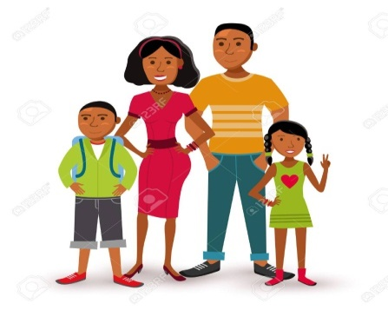
Functionalists View on Family:
Performs important functions,
Contribute to society’s basic needs
Helps maintain social order.
They also argue that nuclear family is best to handle the demands of Industrial Society
Ie, Husband adopts instrumental role as bread winner and wife assuming affectionate, emotional role in domestic settings.

Slide 17
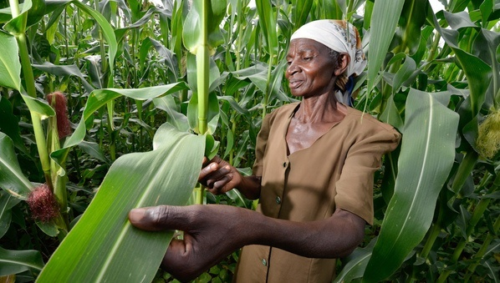
Discussion
Female headed households
households
Migration
widows
abroad

Slide 18
Variation in family form
Modern societies there is a shift from nuclear families to joint families

Slide 19

Discussion
Family and Gender

Slide 20
How gendered is the family?
The belief is that the male child will support the parents in the old age and the female child will leave on marriage results in families investing more in a male child.
Despite the biological fact that a female baby has better chances of survival than a male baby the rate of infant mortality among female children is higher in comparison to male children in lower age group

Slide 21
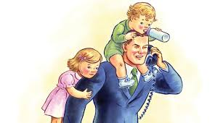
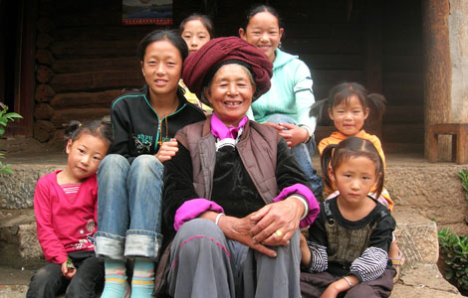
Male-headed Family
Female-headed Family

Slide 22

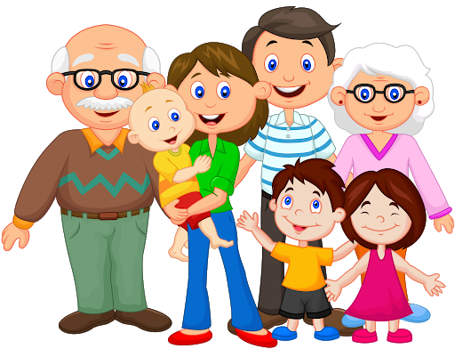
Nuclear Family
Structure
Extended Family
A nuclear family consists of only one set of parents and their children.
An extended family (commonly known as the ‘joint family’) - more than one couple, and often more than two generations, living together.

Slide 23
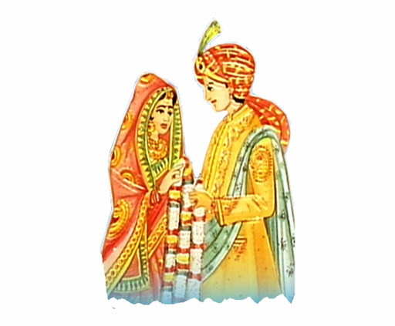



Patrilocal Family
Residence
Matrilocal Family
Newly married couple stay with the bridegroom’s parents.
Newly married couple lives with the bride’s parents.

Slide 24

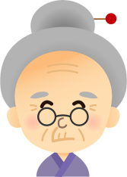
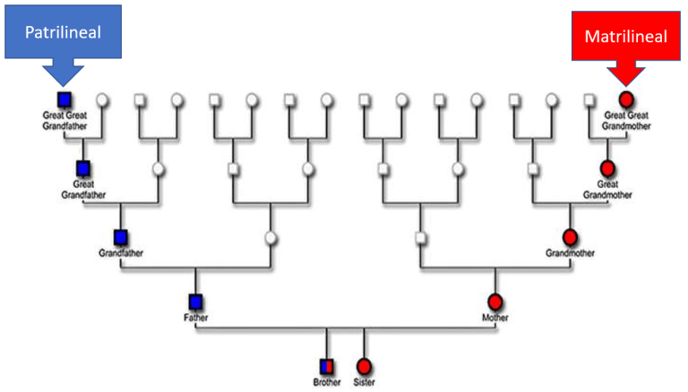
Inheritance
Family’s inheritance through father
Family’s inheritance through Mother

Slide 25
Patriarchal Family
Matriarchal Family
Authority
In the family men exercise authority and dominance
Women play major role in decision making

Slide 26
Forms of family (Various Dimensions)
Structure | Father, Mother and Unmarried children only | Nuclear
 | Minimum three generation live together | Joint
Residence | Newly married couple stay with the bridegrooms parents. | Patrilocal
 | Newly married couple lives with the brides parents. | Matrilocal
Authority | In the family men exercise authority and dominance | Patriarchal
 | Women play major role in decision making | Matriarchal
Inheritance | Family’s inheritance through father | Patrilineal
 | Family’s inheritance through Mother | Matrilineal
Orientation | Family of Birth | Family of orientation
 | Family formed through marriage | Family of procreation

Slide 27

Marriage
Marriage, also called matrimony or wedlock,
It is a socially or ritually recognized union or
legal contract between spouses that establishes rights and obligations between them

Slide 28
Men and women get social sanction to live together through the institution of the marriage.
It is universal

Slide 29
Forms of marriage
Marriage
Monogamy
Polygamy
Polygyny
Polyandry
Endogamy
Exogamy
Arranged Marriage

Slide 30
Forms of Marriage
Monogamy
One person marries one women Most common form of marriage
Polygamy
One person marries more than one person of opposite sex at one time. Man can marries more than one women and Women can marries more than one men.
Polygyny | Polyandry
One Men marries more than one Women | One women marries more than one men. Eg: Tibetans, Todas, Kotas tribes in India.

Slide 31
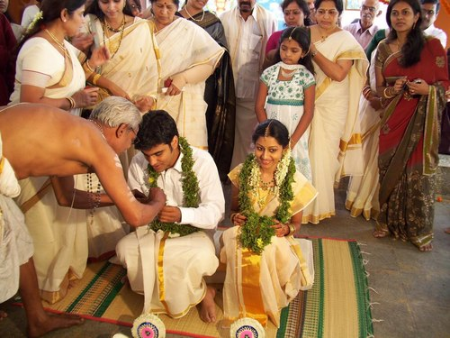
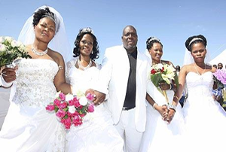
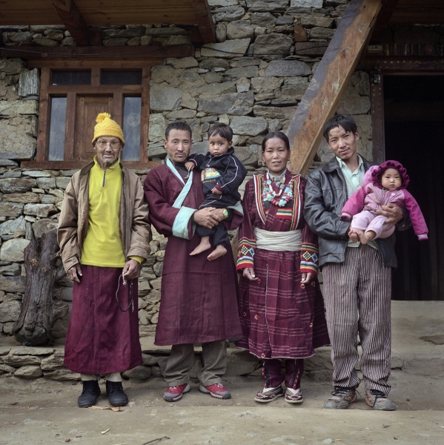
Polygyny
Monogamy
Polyandry

Slide 32

Serial Monogamy
Individual can marry again on the death of first spouse or after divorce at the same time they cannot have more than one spouse.

Slide 33
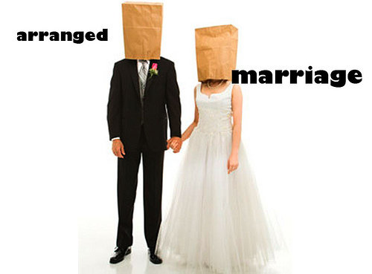
Arranged marriage
In some societies parents or relatives arrange partners and the girl and boy has no choice.

Slide 34
Rules of Endogamy and Exogamy
Endogamy
Life partners can be selected only from within their group.
Marrying a person from within one’s own group
(cast, class, religion, tribe, village etc.)
Exogamy
Some one marries from outside the group
Marriage form within group is not allowed
Marriage between close blood-relation is not permitted.
Exogamy brings people of different castes, races and religion together.
Village exogamy ensured that daughters were married into families from villages far away from home.

Slide 35
Discussion……..
Is endogamy Still prevalent?
What changes in society do the ads reflect?

Slide 36
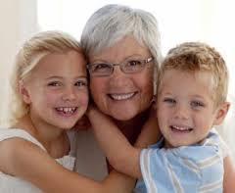
Kinship
It is connection by blood or marriage or adoption.
“the bond of blood or marriage which binds people together in group”
Kinship bonds are very strong in tribal societies and rural communities.

Slide 37
Types of Kinship
Affinal Kinship
Consanguineous Kinship
1. Affinal Kinship
Kinship by Marriage
When a man marries, he establishes a relationship not only with the women he marries but also with a number of other people in her family. Vise versa.
Eg: Husband and Wife
Father- in- law
Mother- in- law
Daughter- in- law
Son –in-law
2. Consanguineous Kinship
Relation by blood or common ancestry.
The bond between parents and their children

Slide 38
Economic Institutions

Slide 39

Work and Economic Life

Slide 40
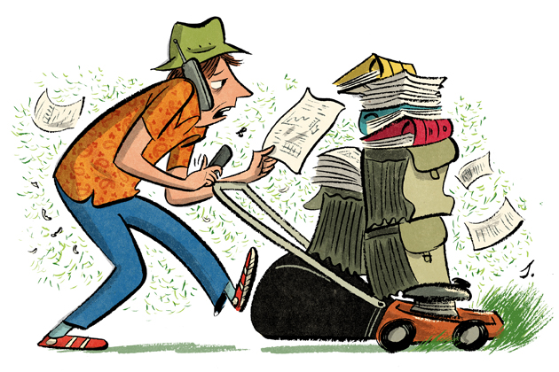
What is Work?
‘Work’ refers to “paid or unpaid, is the carrying out of tasks that require expenditure of mental and physical effort and which aims at production of goods and services for human needs”.

Slide 41
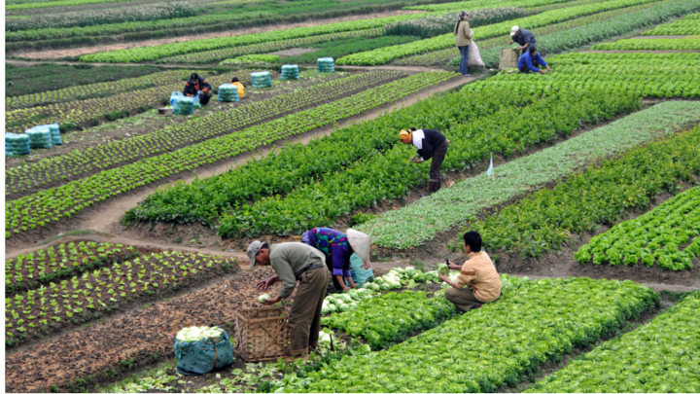
In pre-modern forms of society most people worked in the field or cared for the livestock.

Slide 42
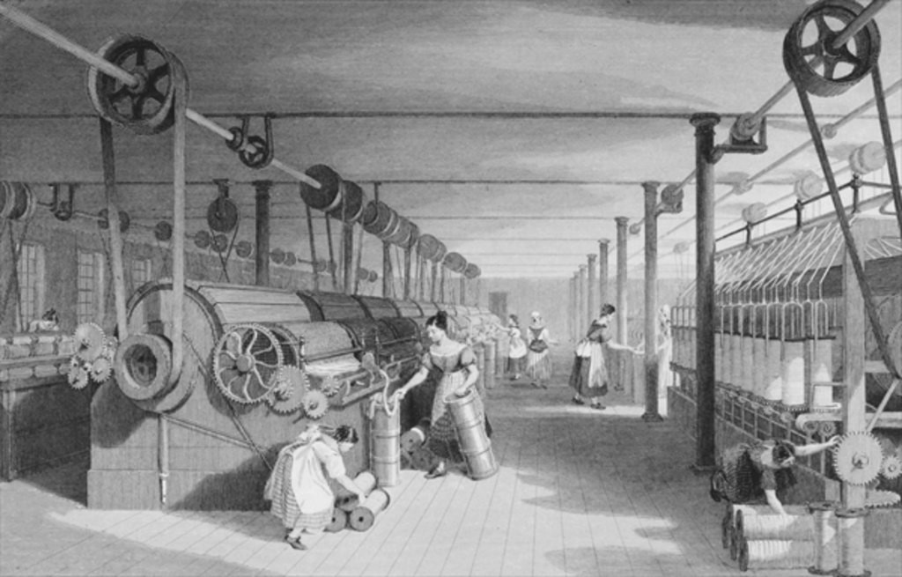
Industrialised-machines-expansion of the service sector.

Slide 43
In pre-modern forms of society most people worked in the field or cared for the livestock.
Industrialised-machines-expansion of the service sector.
highly complex division of labour. Work has been divided into an enormous number of different occupations in which people specialise.
Modern society also witnesses a shift in the location of work.- machinery operating on electricity and coal.
People seeking jobs in factories were trained to perform a specialized task and receive a wage for this work.
Managers supervised the work, for their task was to enhance worker productivity and discipline.
One of the main features of modern societies is an enormous expansion of economic interdependence.

Slide 44
Transformation of Work
Industrial processes were broken down into simple operations.
Mass production demands mass markets.
Construction of a moving assembly line.
Modern industrial production needed expensive equipment and continuous monitoring of employees through monitoring or surveillance systems.
‘flexible production’ and ‘decentralisation of work’.

Slide 45
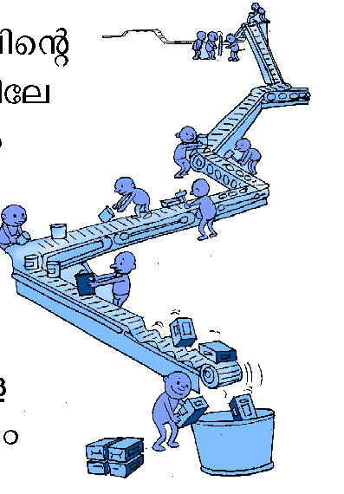

Slide 46
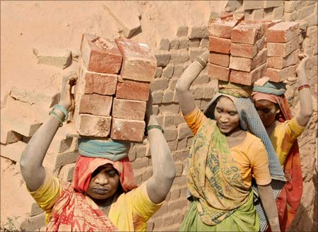
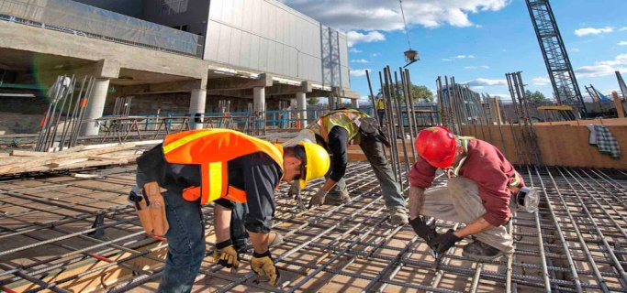
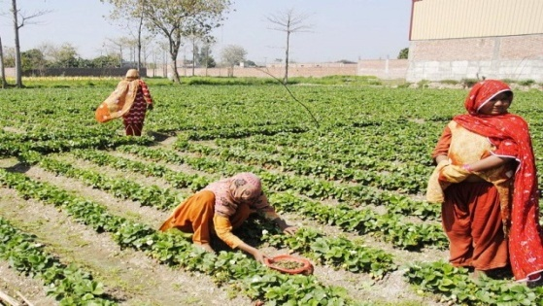

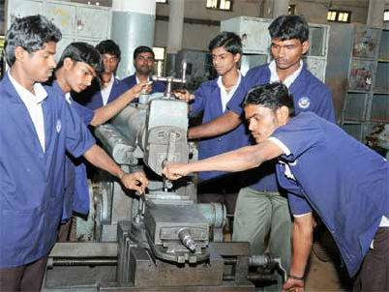

Modern forms of work and Division of Labour

Slide 47
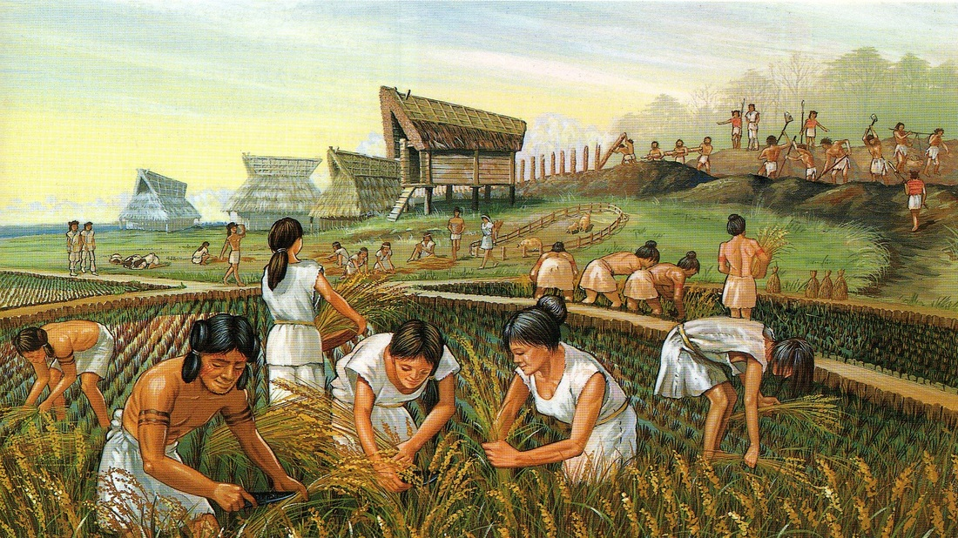
Trend
In industrialized society few people work in agriculture and farming.
The economic system of modern societies is characterized by a complex division of labour.

Slide 48
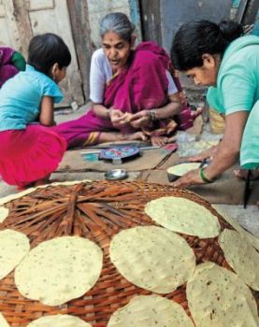
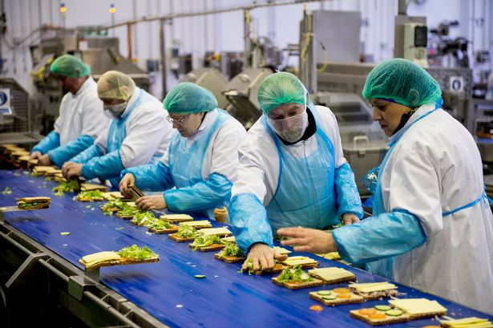
After the industrialization there was shift of work from home to workshop or factories.

Slide 49
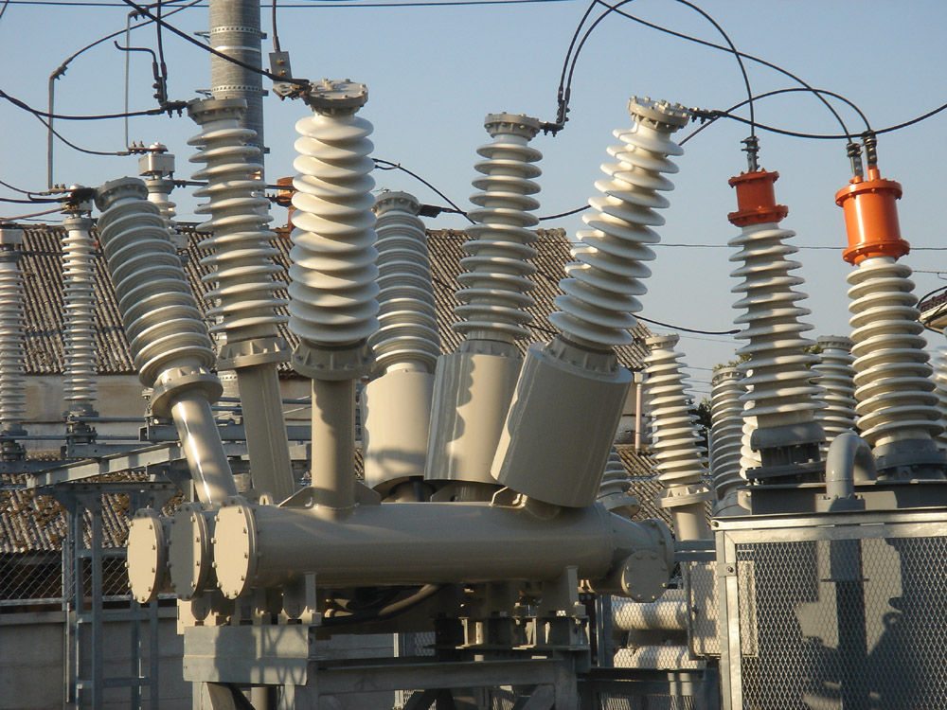
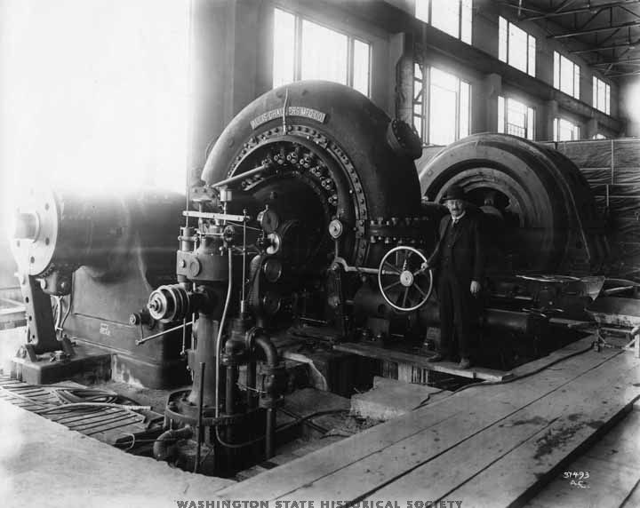
Different machinery using steam power or electricity made production easy and less laborious.

Slide 50
Shawl making

Slide 51
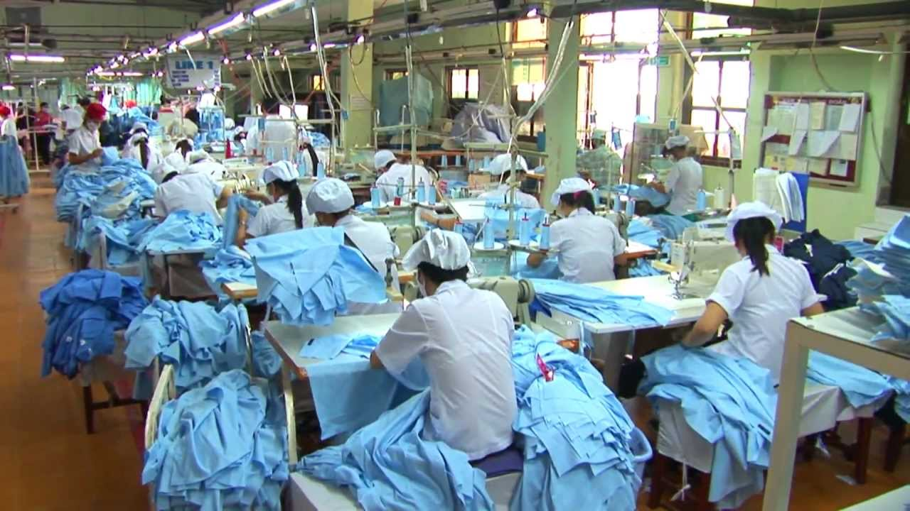
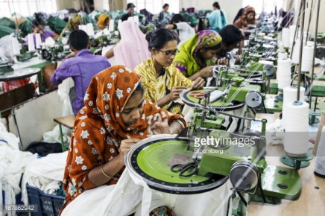
Transformation of work

Slide 52
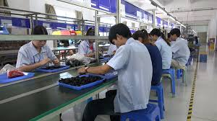
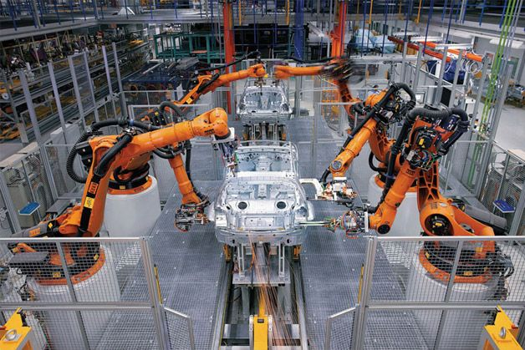
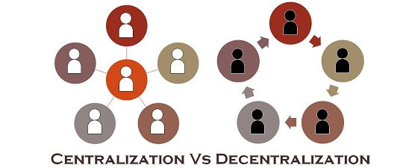
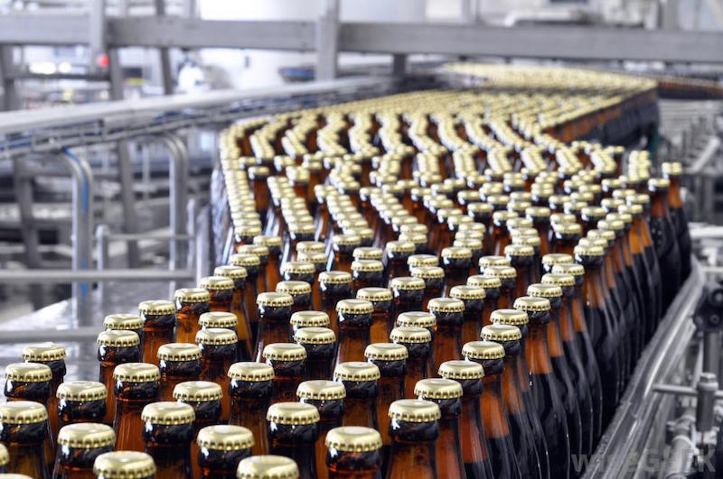
Industrial processes were broken down into simple operations.
Significant innovation was production through assembly line.
Mass production demands mass markets.
Decentralization of work.

Slide 53
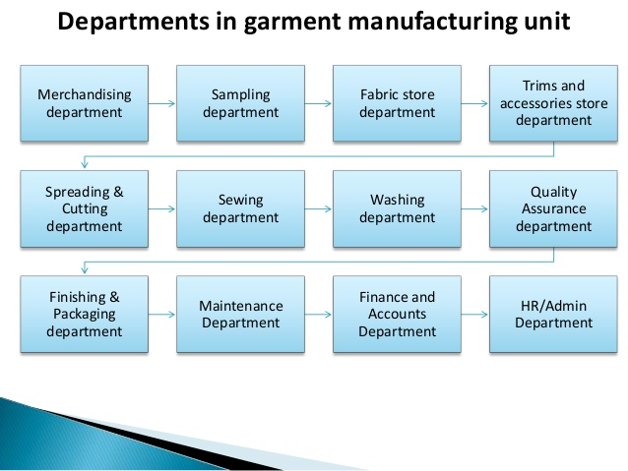

Slide 54
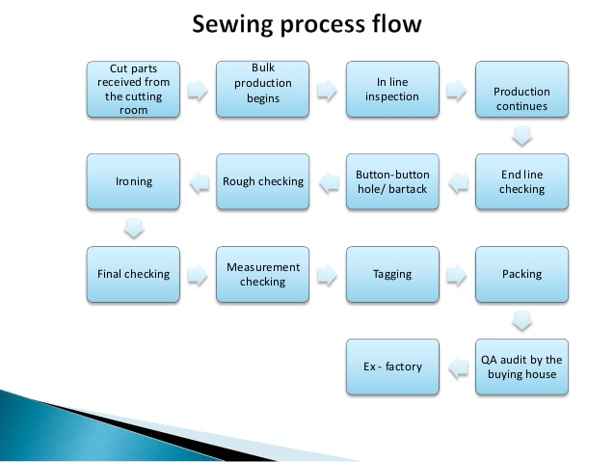

Slide 55
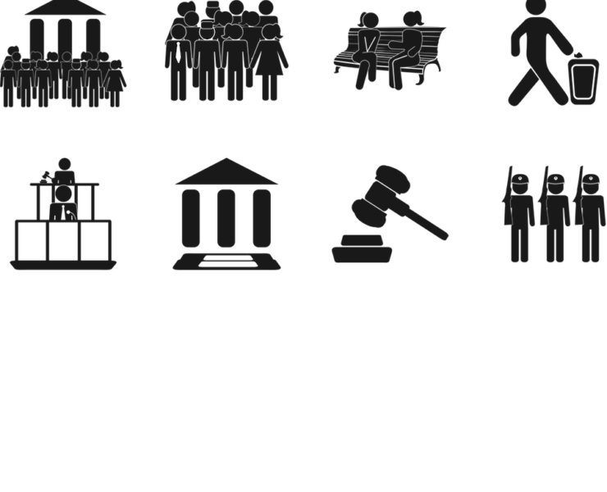
POLITICS
Political institutions are concerned with the distribution of power in society.

Slide 56
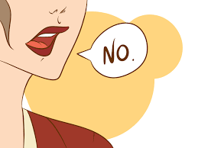
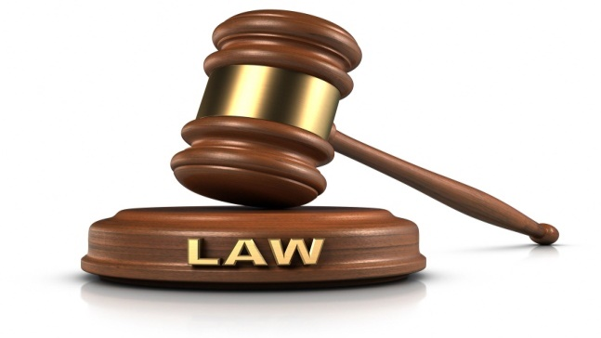
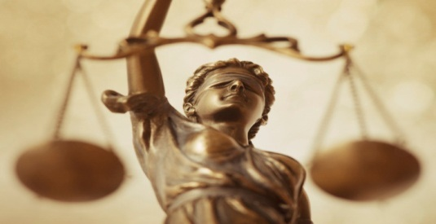
Society must have control over people.
In primitive societies, the family control over the people.
Modern society, social control comes through laws- both written and unwritten.
The state has the legitimate power to pass laws to control the people.

Slide 57
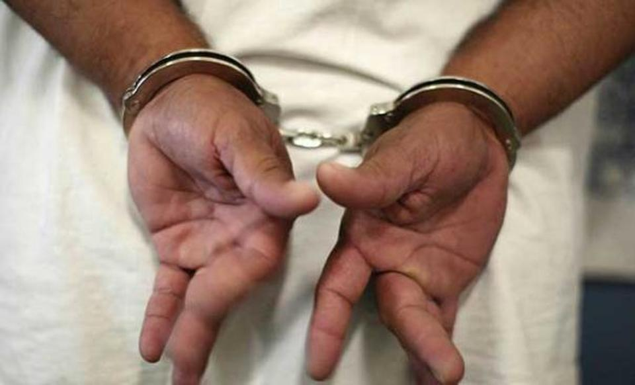
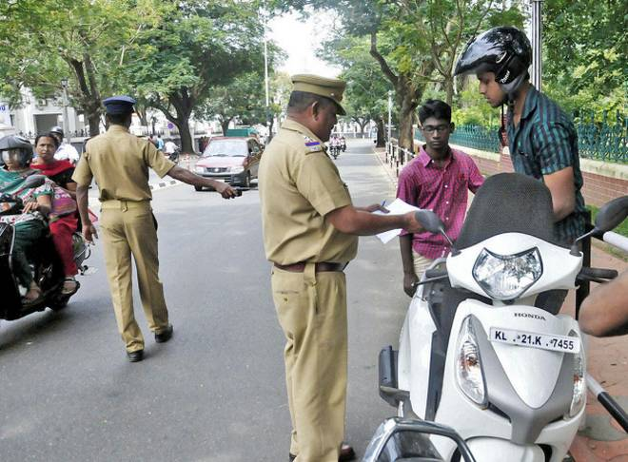
Political institutions perform a twofold function.
It implements the rules and regulations in the country
It punishes the lawbreaker

Slide 58
Two concepts, which are critical to the understanding of political institutions, are power and authority.
Power
Authority

Slide 59

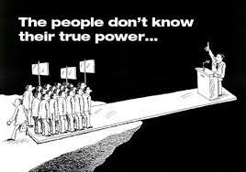
Power

Slide 60
Power and Authority
Power
It is the ability of individuals or groups to carry out their will even when opposed by others.
There is a fixed amount of power in a society and if some wield power others do not.
An individual or group does not hold power in isolation, they hold it in relation to others.
The principal has power to maintain discipline in school. The president of a political party possesses power to expel a member from the party.

Slide 61


Authority.

Slide 62
Authority
Power is exercised through authority.
Authority is that form of power, which is accepted as legitimate.

Slide 63
The concept of the State.
A state exists where there is a political apparatus of ruling over a given territory. Meaning:
According to the Oxford Dictionary of Sociology (1994), ‘The state is a distinct set of institutions that has the authority to make rules which govern society.’ These institutions, according to Miliband (1969), are the government, the administration (the civil service), the judiciary and parliamentary assemblies. State power lies in these institutions.
Max Weber defined it as ‘the social insti­tution that holds a monopoly over the use of force’. It has a ‘monopoly’ of legitimate violence ‘within a specific territory”. Hence, the state includes such institutions as the armed forces, civil service or bureaucracy, police, judiciary and local and national councils of elected representatives, such as parliament.
Consequently, the state is not a unified entity. It is rather a set of institutions which describe the terrain and parameters for political conflicts between various interests over the use of resources and the direction of public policy.
Sociologists have been particularly concerned with the state, but they have examined it in relation to society as a whole, rather than in isolation. Their main concern is the description analysis, and explanation of the state as an institution which claims a monopoly of the legitimate use of force within a given territory.
What are the state’s interests or the boundaries of the state? It is very difficult to identify them clearly, since different parts of the state apparatus can have different interests and conflicting preferences. Because of this diffi­culty, there are frequently conflicts between elected politicians and non-elected civil servants or the judiciary over policy and resources.

Slide 64
Characteristics of State
State
Population
Definite area
Government
Sovereignty

Slide 65
Stateless Societies
Order is maintained without a modern governmental apparatus.
It maintained through alliances, kinship marriage etc.

Slide 66
The functionalist perspective
State as representing the interests of all sections of society.
The conflict perspective
State as representing the dominant sections of society.

Slide 67
Modern states are
very different from traditional states.
Characteristics of Modern State
1. Population
2. Territory
3. Political Sovereignty
4. Government
5. Permanence
6. Legal Personality
7. Recognition
8. Head of State

Slide 68
Sovereignty
Sovereignty refers to the undisputed political rule of a state over a given territorial area.

Slide 69
Citizenship
Citizenship rights include
Civil rights:- the freedom of individuals to live where they choose; freedom of speech and religion; the right to own property; and the right to equal justice before the law.
Political Rights:- the right to participate in elections and to stand for public office.
Social rights:- health benefits, unemployment allowance, setting of minimum level of wages.

Slide 70
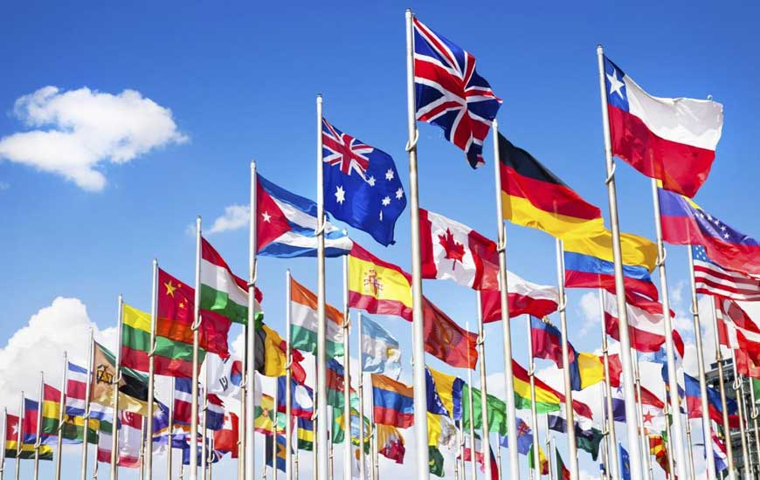
Nationalism
It can be defined as a set of symbols and beliefs providing the sense of being part of a single political community.
Thus, individuals feel a sense of pride and belonging, in being ‘Nigerian’,‘British’, ‘Indian’, ‘Indonesian’ or ‘French’.

Slide 71
Modern states are
very different from traditional states.
Characteristics of Modern State
Sovereignty
Citizenship (Civil, Political, Social Rights)
Nationalism

Slide 72
Politics
Power
Authority
State
Stateless society
Characteristics of modern state
Sovereignty
Citizenship (Civil, Political, Social)
Nationalism

Slide 73
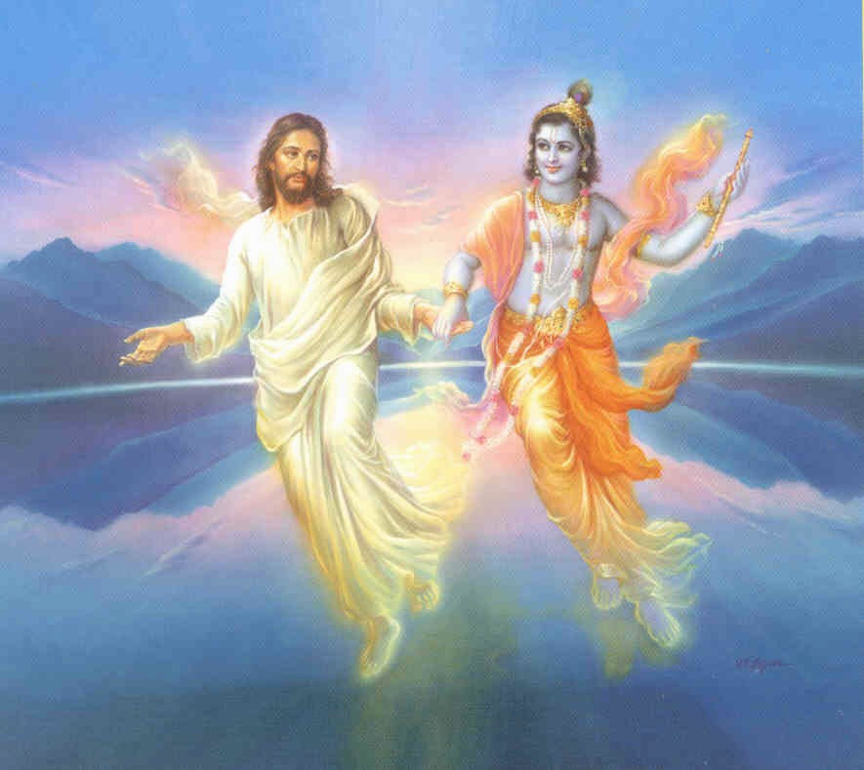

Religion
Religion is a system of belief in the existence of supernatural beings.

Slide 74
The sociological study of religion is different from a religious or theological study of religion in many ways.
It conduct empirical studies
It uses a comparative method.
It investigates religious believes, practices and institutions in relation to other aspects of society and culture.

Slide 75
Religion
Family
Economic
Political
Social

Slide 76
Religion exists in all known societies, although religious beliefs and practices vary from culture to culture.
Common Characteristics of all Religion:-
Set of symbols, Invoking feelings of reverence or awe
Rituals or ceremonies
A community of believers.

Slide 77


set of symbols
rituals or ceremonies;
´ a community of believers.

Slide 78




The rituals associated with religion are very diverse.

Slide 79
The term religion (from Latin: religio meaning "bind, connect") denotes a set of common beliefs and practices pertaining to the supernatural (and its relationship to humanity and the cosmos), which are often codified into prayer, ritual, scriptures, and religious law. These beliefs and practices are typically defined in light of a shared canonical vocabulary of venerable traditions, writings, history, and mythology.
Religion is mediated by institutions and technologies, and also by the body and the senses.
The brain shapes thinking and feeling. It orients adherents in time and space and shapes how sensory input is classified and how emotions are expressed.
The embodied experience of religion is expressed through sound, smell, taste, touch, and sight.
Religion is also expressed in diverse cultural forms.
There are eight modes of religious expression: experiencing, imagining, making, narrating, conceptualizing, enacting, performing, and gathering.

Slide 80



Emile Durkheim,
Sociologists of religion, following Emile Durkheim, are interested in understanding this sacred realm which every society distinguishes from the profane.
Profane

Slide 81
Studying religion sociologically : the relationship of religion with other social institutions.

Slide 82

Religion has had a very close relationship with power and politics.
For instance periodically in history there have been religious movements for social change, like various anti-caste movements or movements against gender discrimination.
Religion is not just a matter of the private belief of an individual but it also has a public character.

Slide 83
Classical sociologists believed that as societies modernised, religion would become less influential over the various spheres of life. The concept secularisation describes this process.

Slide 84


Max Weber (1864-1920) demonstrates how sociology looks at religion in its relationship to other aspects of social and economic behaviour.

Slide 85

Comparative Study

Slide 86




(a branch of Protestant Christianity)
world was created for the glory of God, any work in this world had to be done for His glory
whether one will go to heaven or hell was pre-ordained. Since there was no way of knowing whether one has been assigned heaven or hell

Slide 87



investment became something like a holy creed
if a person in whatever profession, was consistent and successful in his or her work, it was interpreted as a sign of God’s happiness.
At the heart of capitalism is the concept of investment.

Slide 88
To conclude…
Religion cannot be studied as a separate entity.
Social forces always and invariably influence religious institutions.
Political debates, economic situations and gender norms will always influence religious behaviour.
In traditional societies, religion usually plays a central part in social life.

Slide 89

EDUCATION
Education is a life long process, involving both formal and informal institutions of learning.

Slide 90




Simple Society
Complex Society
Children learnt customs and the broader way of life by participating in activities with their adults.
increasing economic division of labour, separation of work from home
How do you get educated informally in such a context?

Slide 91

Functionalists (Education)
education maintain and renews the social structure transmits and develops culture.
The educational system is an important mechanism for the selection and allocation of the individuals in their future roles in the society.
It is also regarded as the ground for proving one’s ability
Selective agency for different status according to their abilities.

Slide 92
Conflict theorists
education functions as a main stratifying agent.
The inequality of educational opportunity is also a product of social stratification.

Slide 93
Religion
Sociological study of religion (Empirical, Comparative, Relation)
Common features of religion (Symbols, rituals or ceremonies, believers)
Emile Durkheim- Sacred and Profane
Relationship with power and politics.
Max weber- Religion – Social and Economic relation (Calvinism)
Education
Life long process
Formal and informal
Functionalist and Conflict

