Slide 1

OSUN STATE UNIVERSITY
3080
COLLEGE OF SCIENCE, ENGINEERING AND TECHNOLOGY
FACULTY OF BASIC AND APPLIED SCIENCES
DEPARTMENT OF PHYSICS
2024/2025 HARMATTAN SEMESTER
COURSE: GENERAL PHYSICS CODE: PHY 101 UNIT: 3
LECTURER: I.A. AKANNI (PhD)

Slide 2
Course Contents
3080
Newton’s law of gravitation
Kepler’s law of planetary motion
Gravitational potential energy
Escape Velocity
Satellites motion and orbits

Slide 3
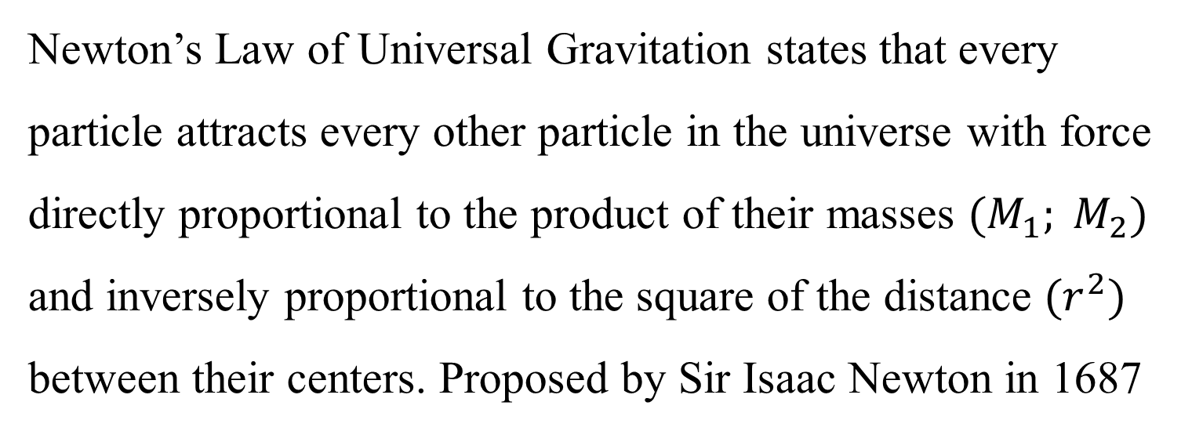
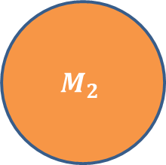
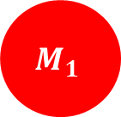
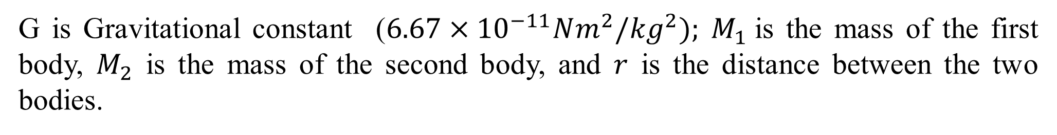
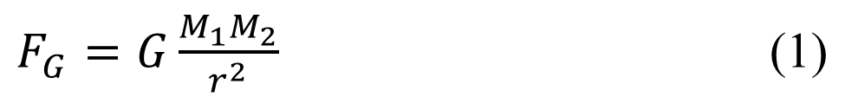
Newton’s Law of Gravitation
What is the Universal law of gravitation?
3080
Newton’s Law of Universal Gravitation states that every particle attracts every other particle in the universe with force directly proportional to the product of their masses ${(M}_{1}; M_{2})$ and inversely proportional to the square of the distance ${(r}^{2})$ between their centers. Proposed by Sir Isaac Newton in 1687
r
$$M_{1}$$
$$M_{2}$$
$F_{G}=G\frac{M_{1}M_{2}}{r^{2}}$ (1)
G is Gravitational constant ($6.67×{10}^{−11}Nm^{2}/{kg}^{2}); M_{1}$is the mass of the first body, $M_{2}$ is the mass of the second body, and $r$ is the distance between the two bodies.

Slide 4
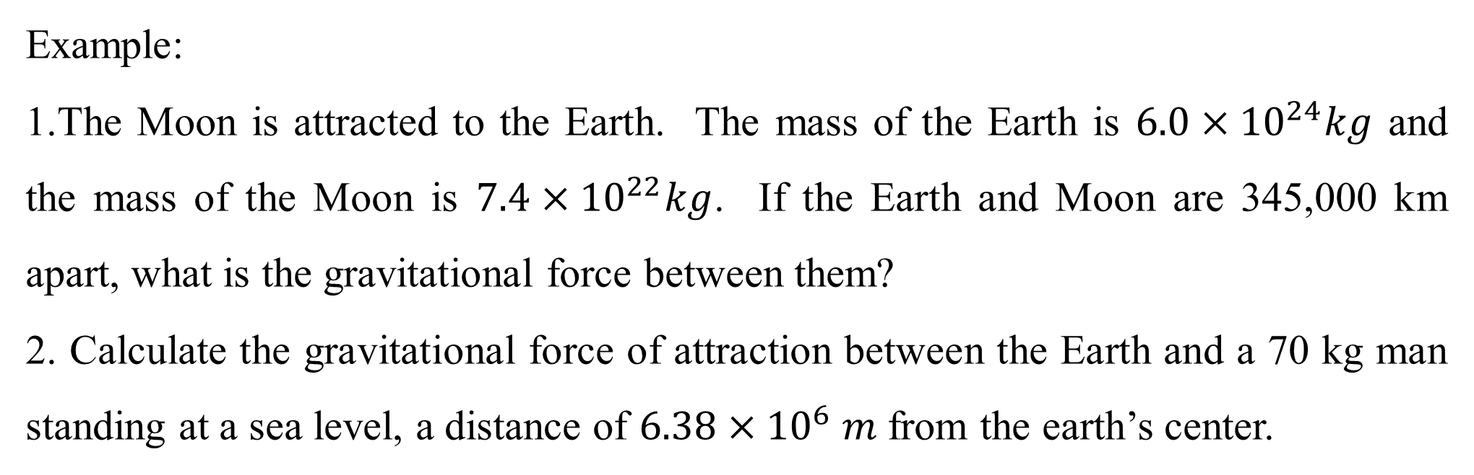
Law of Universal Gravitation
3080
Gravity varies depending on two factors: (i) The mass of an object doing the pulling (ii) The distance from the center of that object
Example:
1.The Moon is attracted to the Earth. The mass of the Earth is $6.0×{10}^{24}kg$ and the mass of the Moon is $7.4×{10}^{22}kg$. If the Earth and Moon are 345,000 km apart, what is the gravitational force between them?
2. Calculate the gravitational force of attraction between the Earth and a 70 kg man standing at a sea level, a distance of $6.38{×10}^{6}m$from the earth’s center.

Slide 5
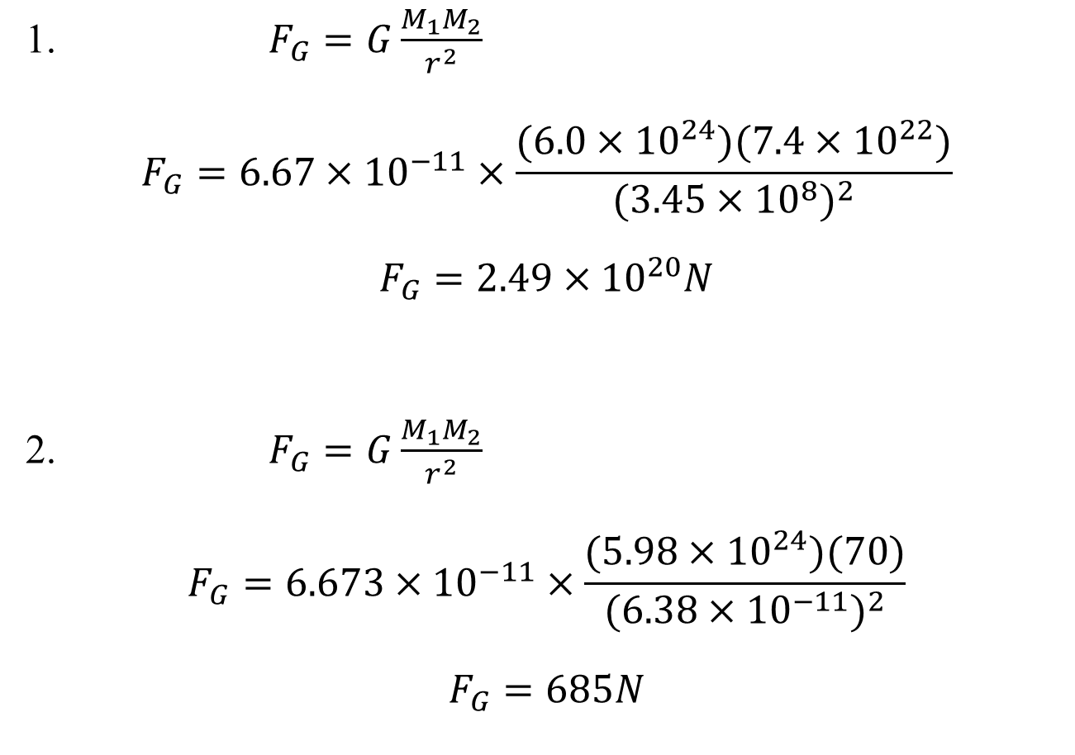
Law of Universal Gravitation
3080
1. $F_{G}=G\frac{M_{1}M_{2}}{r^{2}}$
$$F_{G}=6.67×{10}^{−11}×\frac{(6.0×{10}^{24})(7.4×{10}^{22})}{{(3.45×{10}^{8})}^{2}}$$
$$F_{G}=2.49×{10}^{20}N$$
2. $F_{G}=G\frac{M_{1}M_{2}}{r^{2}}$
$$F_{G}=6.673×{10}^{−11}×\frac{(5.98×{10}^{24})(70)}{{(6.38×{10}^{−11})}^{2}}$$
$$F_{G}=685N$$

Slide 6
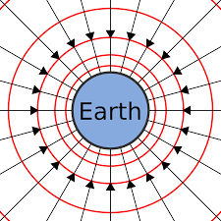
Gravitational Field
3080
A gravitational field is a region where a mass experiences a force due to gravitational attraction.
Note:
A gravitational field is a region of space surrounding a body that has the property of mass. Any other body with mass will experience a force of attraction in this region.
All bodies near the surface of Earth experience gravitation attraction exerted by Earth. The gravitational force or the weight acting on a mass m, in the gravitational field g, is given by:
F = mg (2)

Slide 7
Gravitational Field
3080
  The direction of the gravitational field is always towards the center of the mass, causing the field.
  Gravitational forces are always attractive.
  Gravity has an infinite range, meaning it affects all objects in the universe
  There is a greater gravitational force around objects with a large mass (such as planets)
  There is a smaller gravitational force around objects with a small mass (almost negligible for atoms)

Slide 8
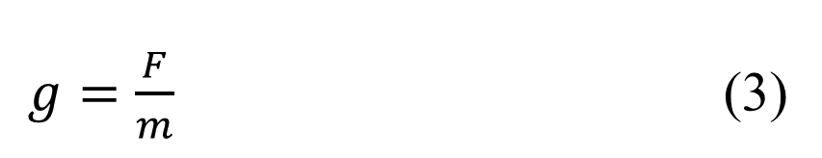
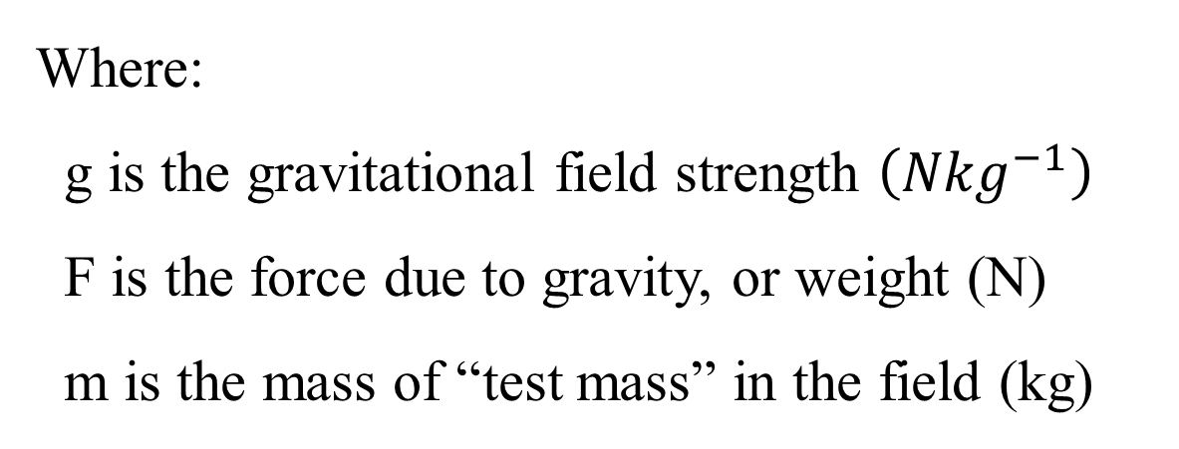
Gravitational Field
3080
The gravitational field strength (gravitational acceleration) at a point is defined as the force per unit mass experienced by a test mass at that point.
This can be written in equation form as:
$g=\frac{F}{m}$ (3)
Where:
g is the gravitational field strength $\left({Nkg}^{−1}\right)$
F is the force due to gravity, or weight (N)
m is the mass of “test mass” in the field (kg)

Slide 9
Gravitational Field
3080
Interpretation:
An object’s mass remains the same at all points in space. However, on planets such as Jupiter, the weight of an object will be greater than on a less massive planet such as Earth. This means the gravitational force would be so high that humans, for example, would not be able to stand up fully
This is due to the increase in F, while m remains constant, ultimately leading to an increase in g felt
Exercise: Differentiate between mass and weight

Slide 10
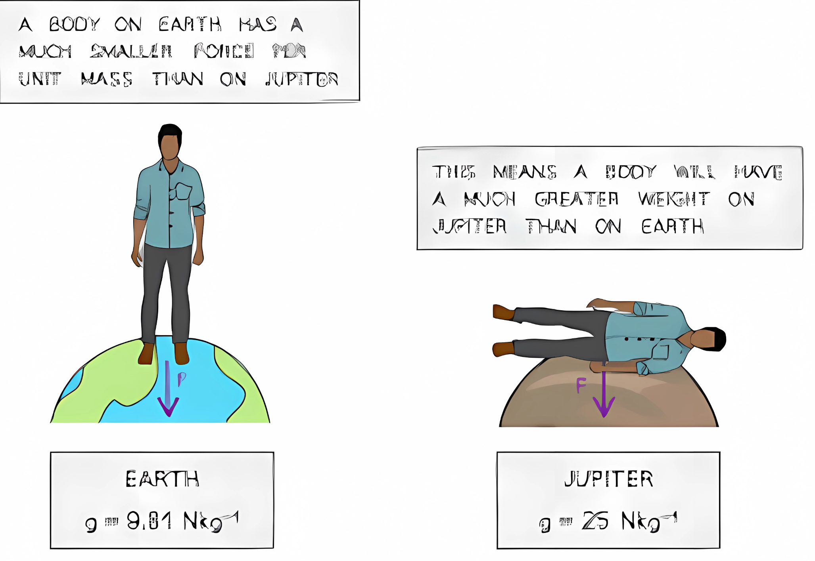


Gravitational Field
3080
A body on Earth has a much smaller force per unit mass than on Jupiter
This means the body will have a much greater weight on Jupiter than on Earth
Earth
$$g_{Earth}=9.81 N{kg}^{−1}$$
Jupiter
$$g_{Jupiter}=24.79 N{kg}^{−1}$$

Slide 11
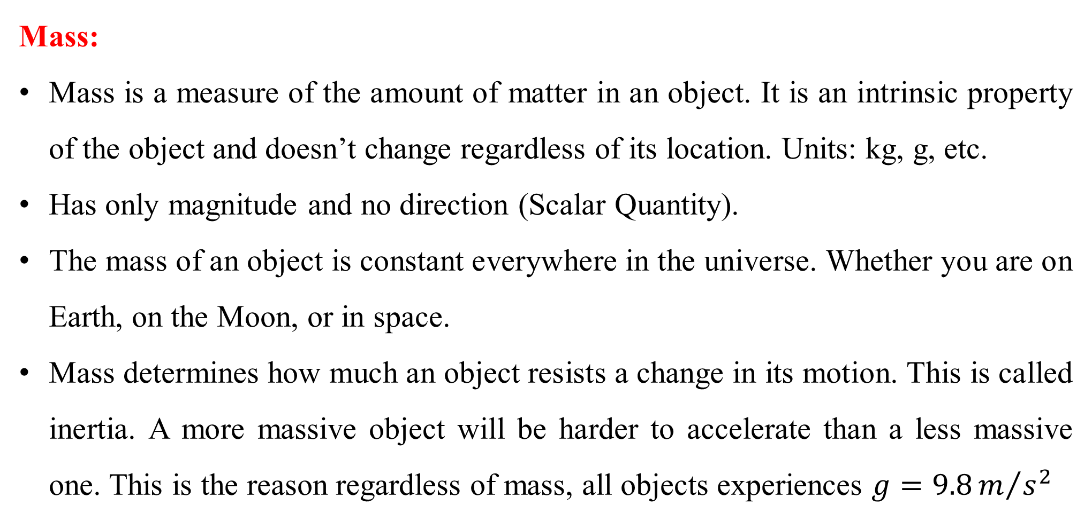
Gravitational Field
3080
Mass:
Mass is a measure of the amount of matter in an object. It is an intrinsic property of the object and doesn’t change regardless of its location. Units: kg, g, etc.
Has only magnitude and no direction (Scalar Quantity).
The mass of an object is constant everywhere in the universe. Whether you are on Earth, on the Moon, or in space.
Mass determines how much an object resists a change in its motion. This is called inertia. A more massive object will be harder to accelerate than a less massive one. This is the reason regardless of mass, all objects experiences $g=9.8m/{s^{2}}$

Slide 12
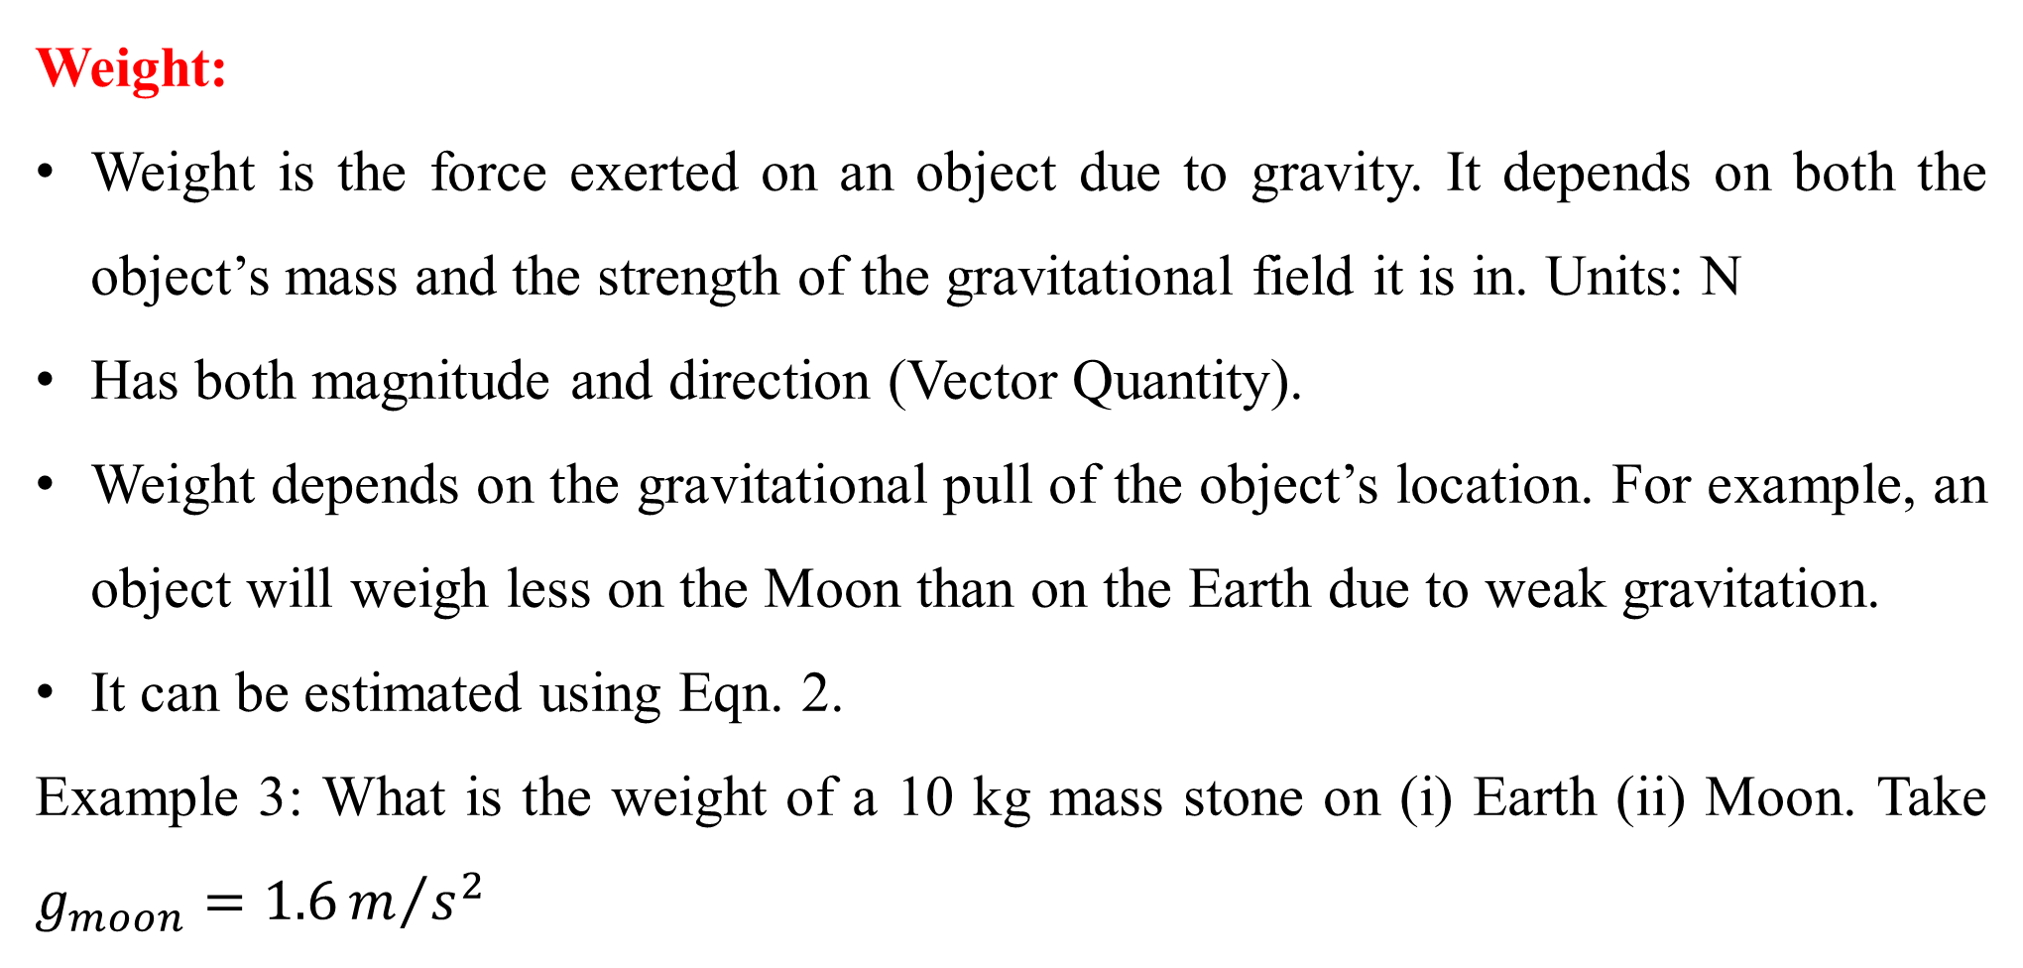
Gravitational Field
3080
Weight:
Weight is the force exerted on an object due to gravity. It depends on both the object’s mass and the strength of the gravitational field it is in. Units: N
Has both magnitude and direction (Vector Quantity).
Weight depends on the gravitational pull of the object’s location. For example, an object will weigh less on the Moon than on the Earth due to weak gravitation.
It can be estimated using Eqn. 2.
Example 3: What is the weight of a 10 kg mass stone on (i) Earth (ii) Moon. Take $g_{moon}=1.6m/{s^{2}}$

Slide 13

Gravitational Field
3080
Solution:
From Eqn. 2; $W=mg$
$W=10kg X 9.81\frac{N}{kg}=98.1 N$
$W=10kg X 1.6\frac{N}{kg}=16N$
Since Eqn. 1 and 2 refers to the same force, equating them results in:
$F=G\frac{Mm}{r^{2}}=mg$ (4)
$g=G\frac{M}{r^{2}}$ (5)
Where:
G = Newton’s Gravitational Constant
M = mass of the body causing the field (kg)
r = distance from the mass where you are calculating the field strength (m)

Slide 14
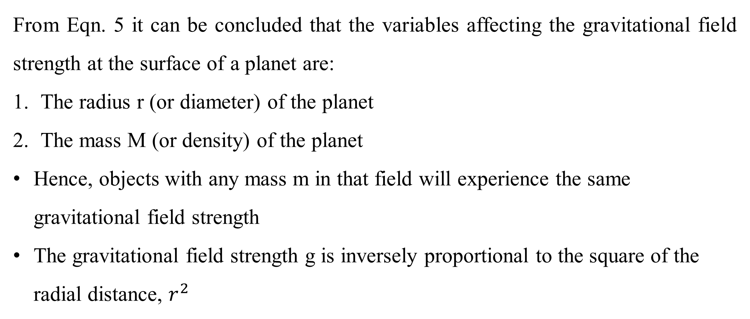
Gravitational Field
3080
From Eqn. 5 it can be concluded that the variables affecting the gravitational field strength at the surface of a planet are:
The radius r (or diameter) of the planet
The mass M (or density) of the planet
Hence, objects with any mass m in that field will experience the same gravitational field strength
The gravitational field strength g is inversely proportional to the square of the radial distance, $r^{2}$

Slide 15
Kepler’s law of Planetary motion
3080
Kepler’s Laws of Planetary Motion are three fundamental principles that describe the motion of planets around the Sun. They describe the motion and basic orbital mechanics of two-point source masses.
In the Solar System, 8 planets orbit around one mass – the Sun. As the mass of the Sun is ~98% the mass of the entire Solar System, the gravitational forces on planets due to the mass of the other planets are negligible.
Therefore, the scenario can be treated mathematically as two-point source masses when investigating the gravitational effects between the Sun and an orbiting planet.

Slide 16
Kepler’s law of Planetary motion
3080
These laws were formulated by the German astronomer Johannes Kepler in the early 17th century, based on the detailed observations of planetary positions made by the Danish astronomer Tycho Brahe.
Therefore, the scenario can be treated mathematically as two-point source masses when investigating the gravitational effects between the Sun and an orbiting planet.
1. The Law of Orbits
Kepler’s 1st law: Kepler’s First Law of Planetary Motion is also known as the Law of Ellipses, states that all planets in the Solar System orbit the Sun in an elliptical

Slide 17
Kepler’s law of Planetary motion
3080
1. The Law of Orbits
An ellipse is an elongated or stretched circle. Unlike a circle with a constant radius, an ellipse has two axes.
The semi-major axis: The longest radius of the ellipse, stretching from the center to the farthest point on the ellipse.
The semi-minor axis: The shortest radius, stretching from the center to the closest point on the ellipse.
Every ellipse has two focal points (or foci), which do not lie at the ellipse’s center. In Kepler’s First Law, the Sun is positioned at one of these foci.

Slide 18

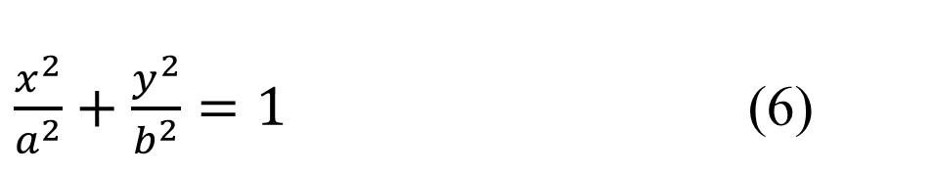

Kepler’s law of Planetary motion
3080
1. The Law of Orbits
When a planet is closer to the Sun, it is at perihelion
when it is farther away, it is at aphelion
the general equation for an ellipse in a coordinate system (where the Sun is located at one of the foci) is:
$$ε=0$$
$$ε→1$$
$\frac{x^{2}}{a^{2}}+\frac{y^{2}}{b^{2}}=1$ (6)

Slide 19
Kepler’s law of Planetary motion
3080
x and y are two points on the ellipse, a is the semi-major axis (half of the longest diameter of the ellipse), and b is the semi-minor axis (half of the shortest diameter of the ellipse).
Summary from First Law:
The Sun is not at the center of the planetary orbit but at one of the two foci of an elliptical orbit.
A planet’s distance from the Sun varies as it orbits, meaning its speed changes as it moves closer to or farther from the Sun.

Slide 20
Kepler’s law of Planetary motion
3080
2. Law of Equal Areas
Kepler’s 2nd law: A line drawn from the center of the Sun to the center of an orbiting body (known as the radius vector) will sweep out equal areas in equal intervals of time.
Interpretation:
The planet moves faster when it is closer to the Sun (at perihelion - early January) and slower when it is farther from the Sun (at aphelion - early July). A consequence of the gravitational force between the planet and the Sun, which is stronger when the planet is closer to the Sun.

Slide 21
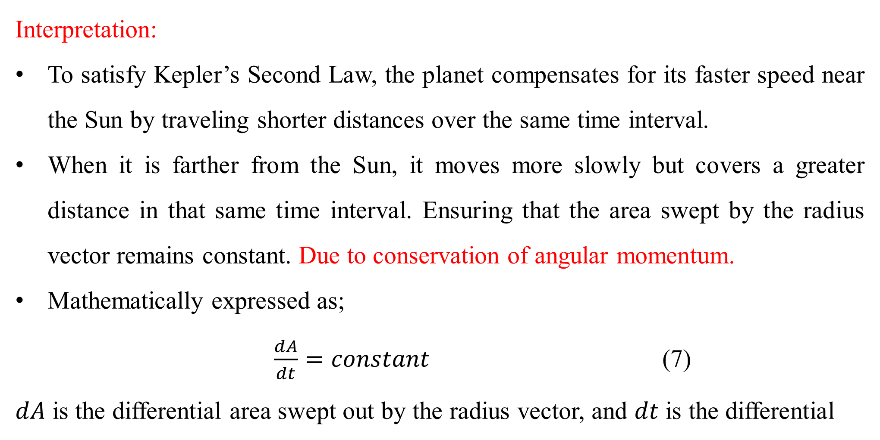
Kepler’s law of Planetary motion
3080
Interpretation:
To satisfy Kepler’s Second Law, the planet compensates for its faster speed near the Sun by traveling shorter distances over the same time interval.
When it is farther from the Sun, it moves more slowly but covers a greater distance in that same time interval. Ensuring that the area swept by the radius vector remains constant. Due to conservation of angular momentum.
Mathematically expressed as;
$\frac{dA}{dt}=constant$ (7)
$dA$ is the differential area swept out by the radius vector, and $dt$ is the differential

Slide 22
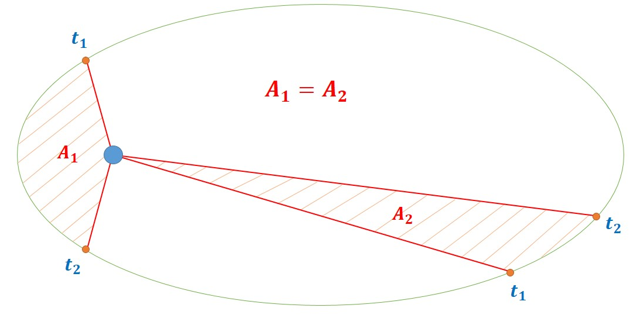
Kepler’s law of Planetary motion
3080
Interpretation:
time interval.
Aphelion
perihelion

Slide 23
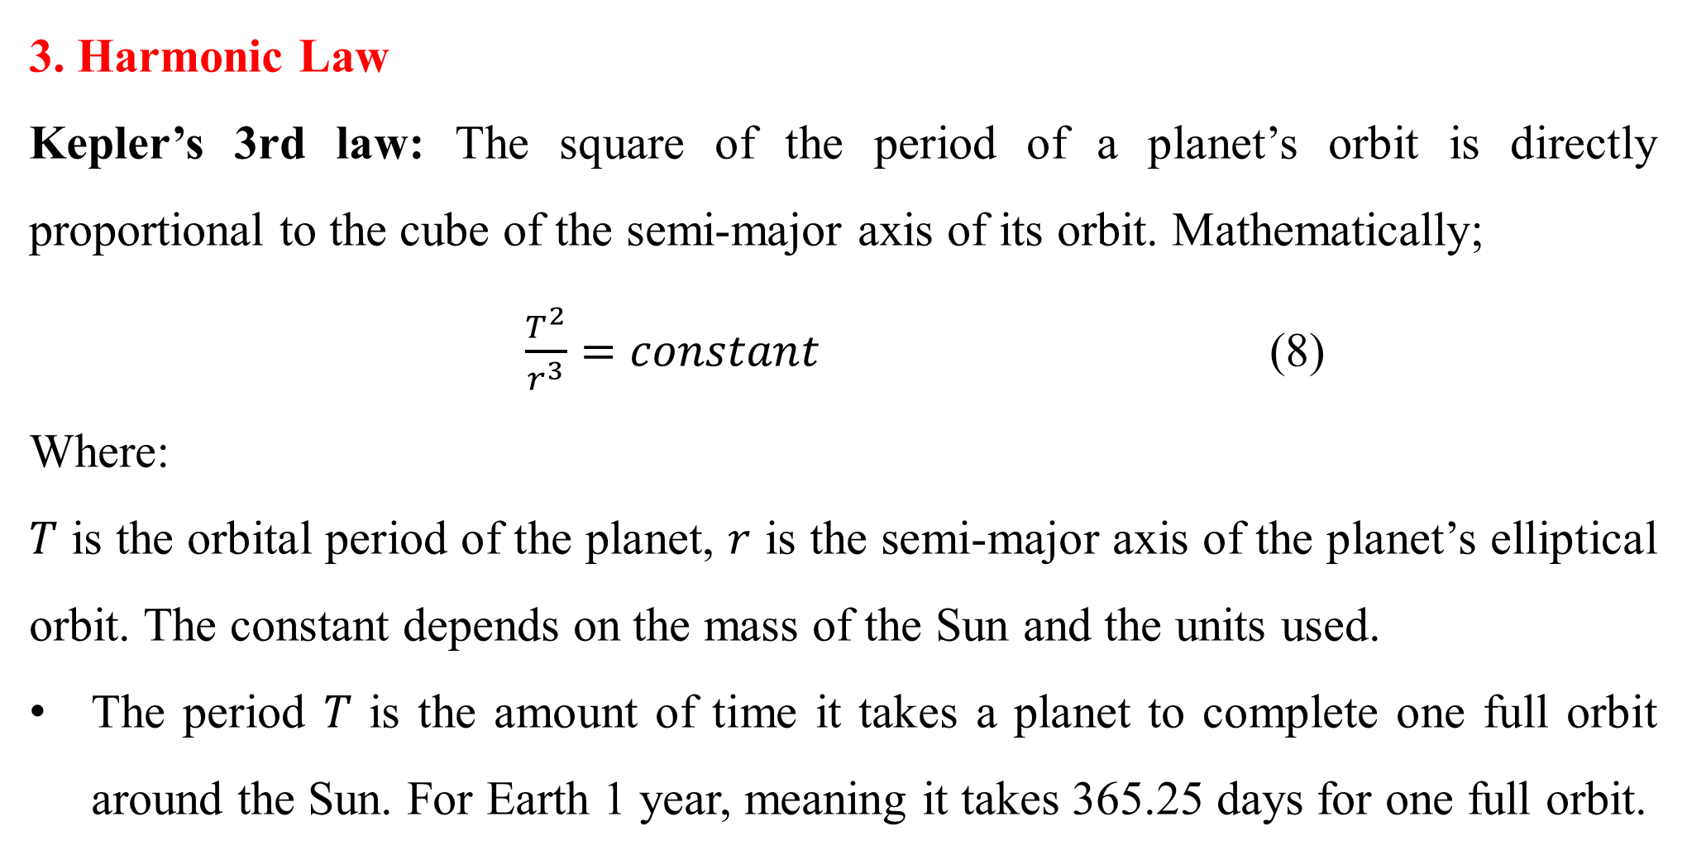
Kepler’s law of Planetary motion
3080
3. Harmonic Law
Kepler’s 3rd law: The square of the period of a planet’s orbit is directly proportional to the cube of the semi-major axis of its orbit. Mathematically;
$\frac{T^{2}}{r^{3}}=constant$ (8)
Where:
𝑇 is the orbital period of the planet, $r$ is the semi-major axis of the planet’s elliptical orbit. The constant depends on the mass of the Sun and the units used.
The period 𝑇 is the amount of time it takes a planet to complete one full orbit around the Sun. For Earth 1 year, meaning it takes 365.25 days for one full orbit.

Slide 24
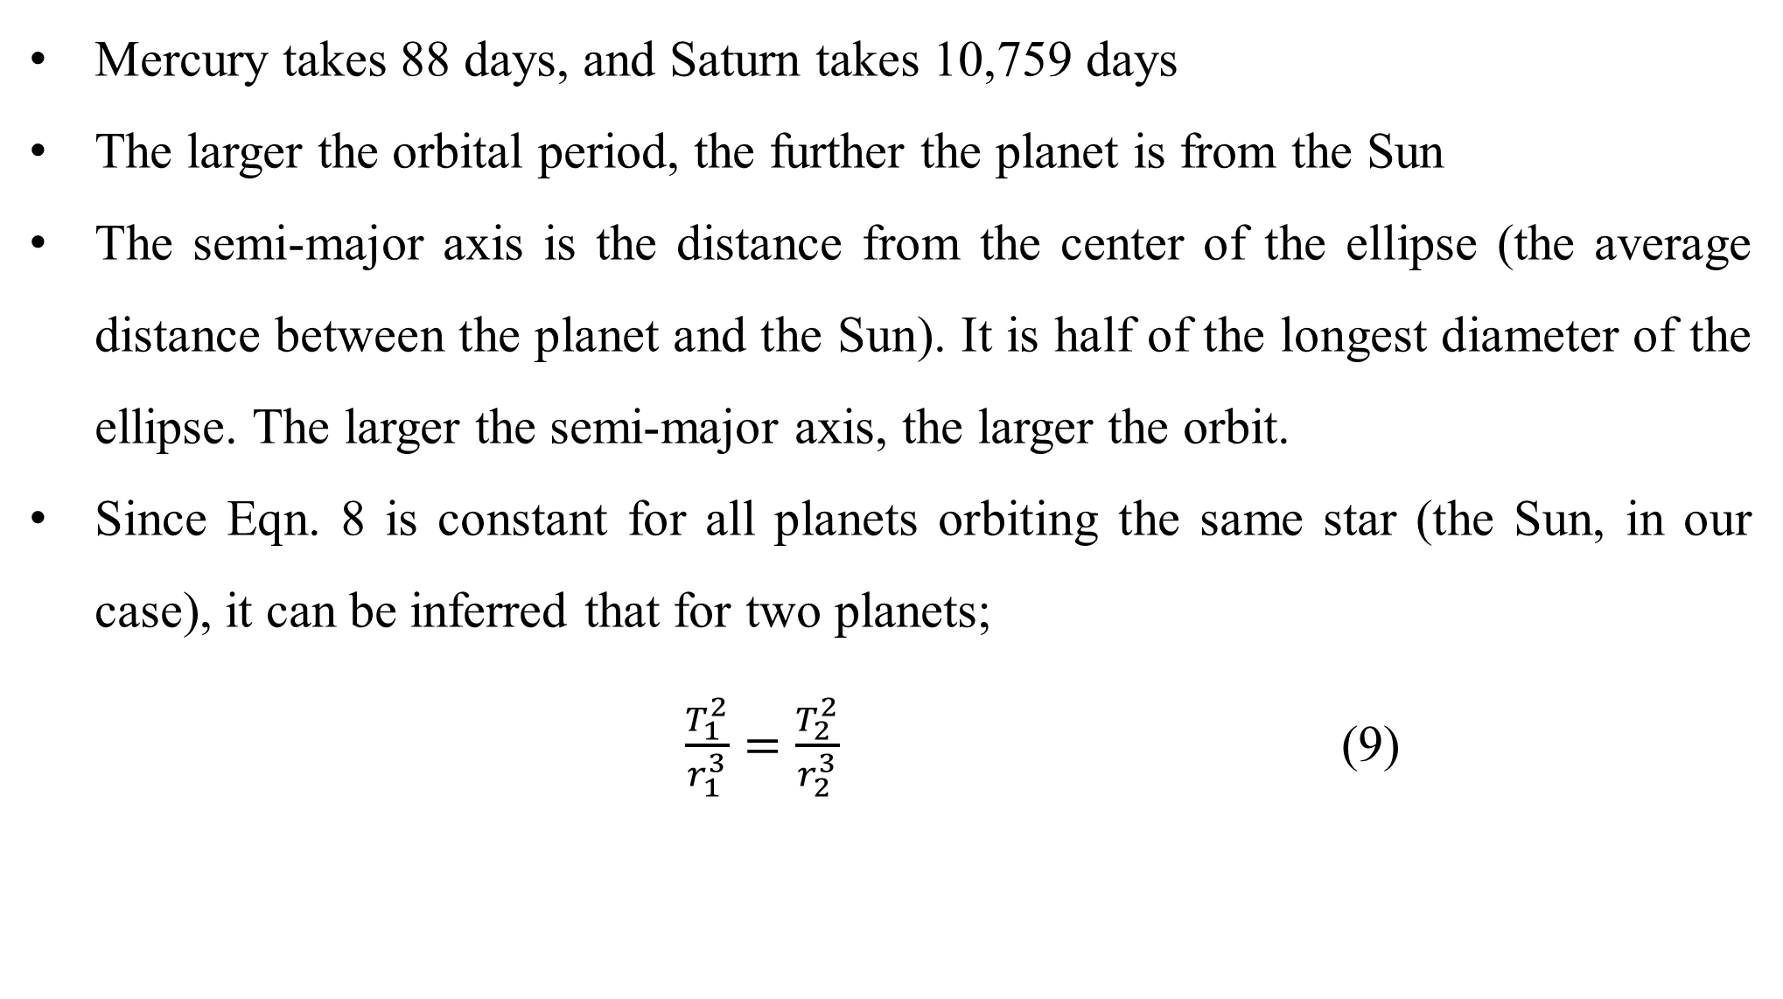
Kepler’s law of Planetary motion
3080
Mercury takes 88 days, and Saturn takes 10,759 days
The larger the orbital period, the further the planet is from the Sun
The semi-major axis is the distance from the center of the ellipse (the average distance between the planet and the Sun). It is half of the longest diameter of the ellipse. The larger the semi-major axis, the larger the orbit.
Since Eqn. 8 is constant for all planets orbiting the same star (the Sun, in our case), it can be inferred that for two planets;
$\frac{T_{1}^{2}}{r_{1}^{3}}=\frac{T_{2}^{2}}{r_{2}^{3}}$ (9)

Slide 25
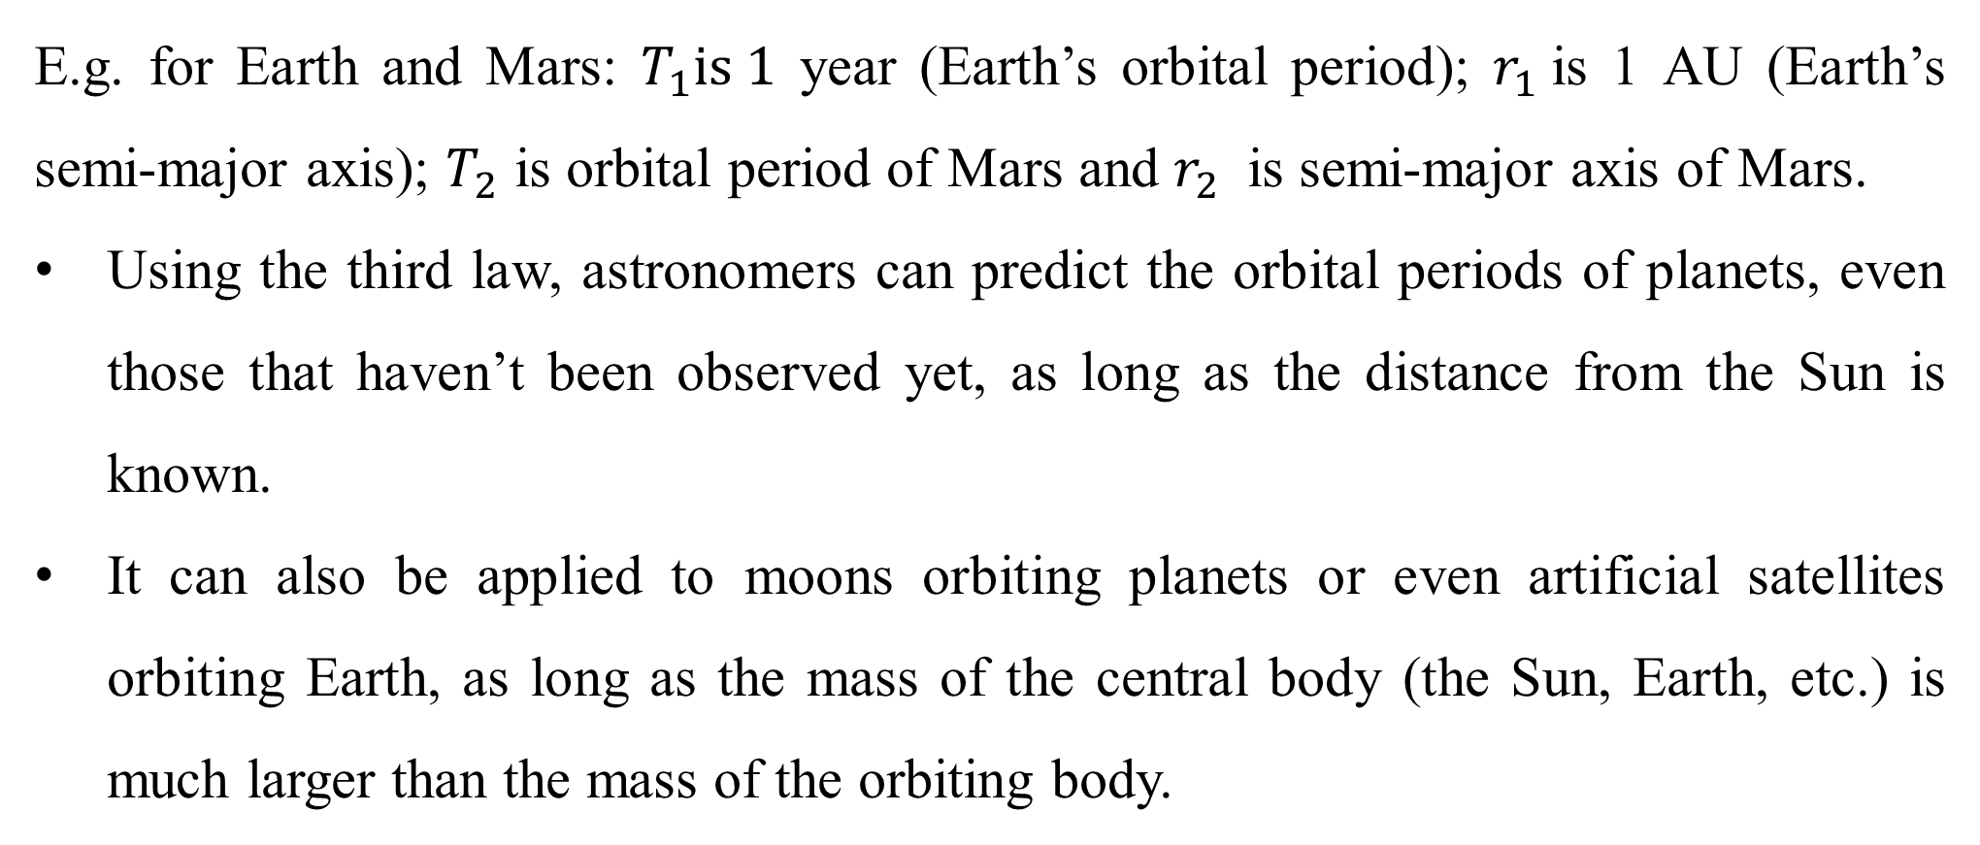
Kepler’s law of Planetary motion
3080
E.g. for Earth and Mars: $T_{1}is 1$ year (Earth’s orbital period); $r_{1}$is 1 AU (Earth’s semi-major axis); $T_{2}$​ is orbital period of Mars and $r_{2}$​ is semi-major axis of Mars.
Using the third law, astronomers can predict the orbital periods of planets, even those that haven’t been observed yet, as long as the distance from the Sun is known.
It can also be applied to moons orbiting planets or even artificial satellites orbiting Earth, as long as the mass of the central body (the Sun, Earth, etc.) is much larger than the mass of the orbiting body.

Slide 26
Kepler’s law of Planetary motion
3080
Semi-Major axis (r)
Ellipse centre
Minor axis (r)
Semi-minor axis (r)
Major axis (r)

Slide 27
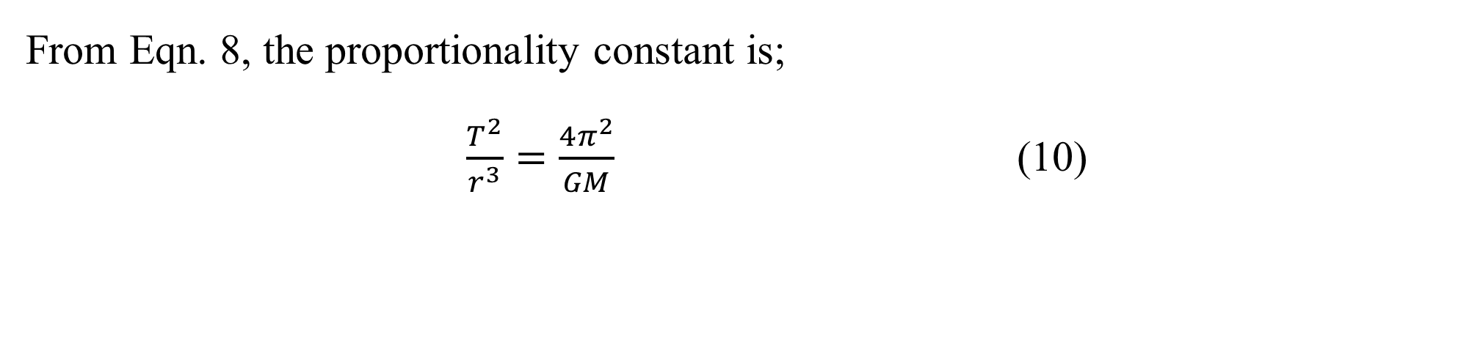
Kepler’s law of Planetary motion
3080
From Eqn. 8, the proportionality constant is;
$\frac{T^{2}}{r^{3}}=\frac{4π^{2}}{GM}$ (10)
The Law of Periods
Example 4: Consider a planet in orbit around the Sun. If the planet’s orbit is elliptical with a semi-major axis of 2 AU, what is the shape of the orbit based on the axes values? Assume the eccentricity is 0.3.

Slide 28
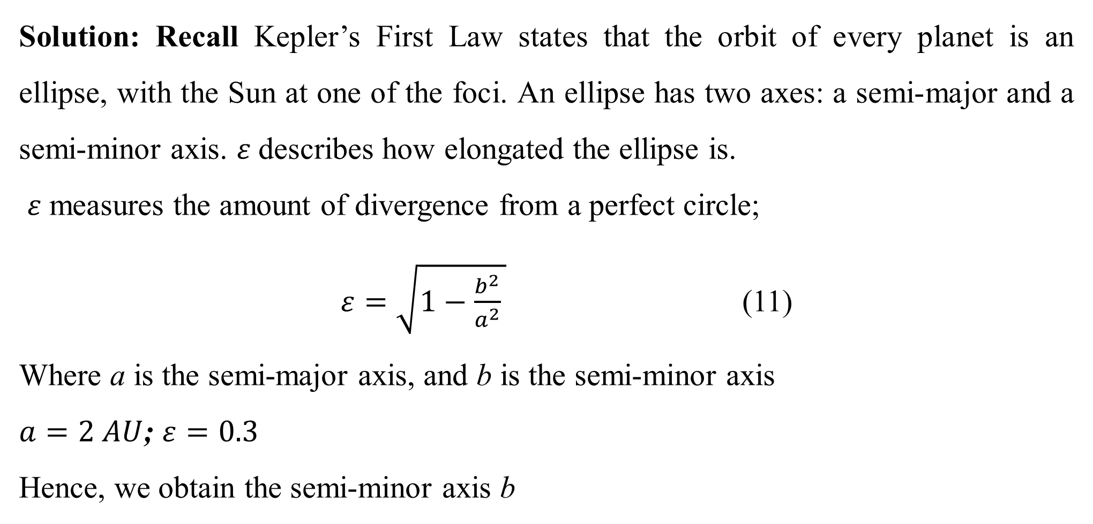
Kepler’s law of Planetary motion
3080
Solution: Recall Kepler’s First Law states that the orbit of every planet is an ellipse, with the Sun at one of the foci. An ellipse has two axes: a semi-major and a semi-minor axis. $ε$describes how elongated the ellipse is.
$ε$ measures the amount of divergence from a perfect circle;
$ε=\sqrt{1−\frac{b^{2}}{a^{2}} }$ (11)
Where a is the semi-major axis, and b is the semi-minor axis
$a=2 AU$; $ε=0.3$
Hence, we obtain the semi-minor axis b

Slide 29

Kepler’s law of Planetary motion
3080
$0.3=\sqrt{1−\frac{b^{2}}{2^{2}} }$
Square both sides,
$$0.09=1−\frac{b^{2}}{2^{2}}⇒b^{2}=0.91×4=3.64$$
$$b≈1.91AU$$
Thus, the semi-minor axis b is approximately 1.91 AU. Since $ε$is 0.3, the orbit is elliptical, but only slightly elongated.

Slide 30
Kepler’s law of Planetary motion
3080
Example 5: Teaser question: A planet in orbit around the Sun moves from position A (at perihelion) to position B (at aphelion). If it takes 50 days to travel from A to B, how long will it take to travel from point B to the opposite side of the orbit (from aphelion to perihelion)?
Solution: ??

Slide 31
Kepler’s law of Planetary motion
3080
Solution: Kepler’s Second Law (Law of Equal Areas) states that a line joining the planet and the Sun sweeps out equal areas during equal time intervals. This means that the planet moves faster when it is closer to the Sun (at perihelion) and slower when it is farther away (at aphelion), but the areas swept by the radius vector are always equal. Since the planet sweeps out equal areas in equal time intervals, it will take the same time to travel from B to perihelion (opposite side of the orbit) as it did from A to B. Therefore, the time taken to travel from B to perihelion is also 50 days.

Slide 32
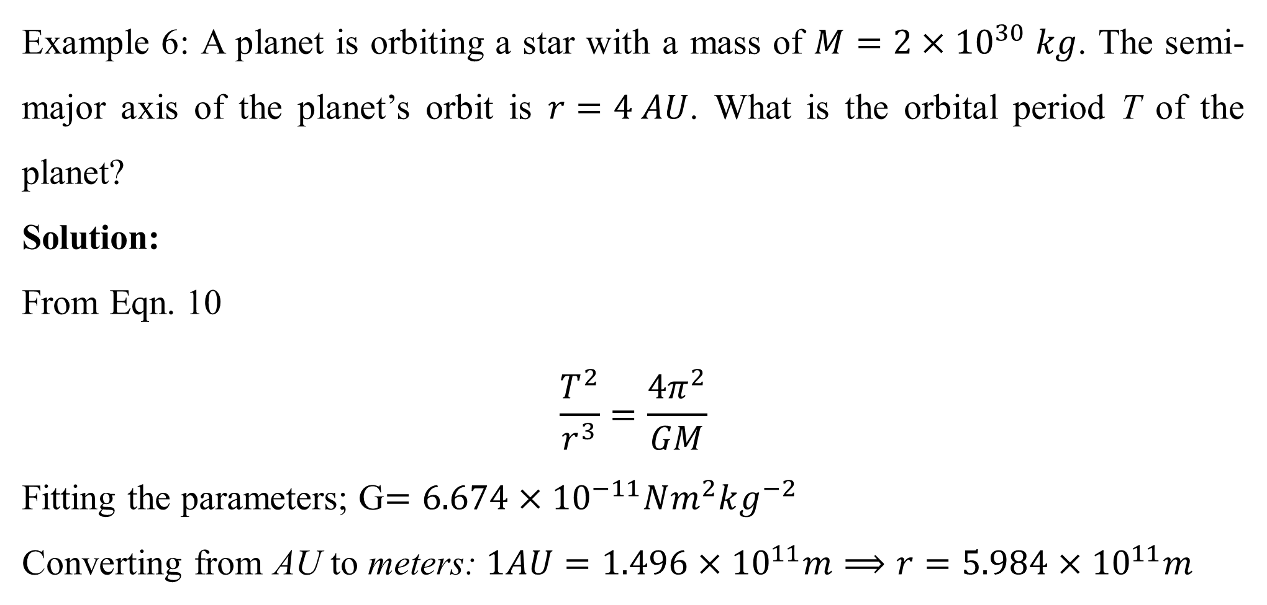
Kepler’s law of Planetary motion
3080
Example 6: A planet is orbiting a star with a mass of $M=2×{10}^{30} kg$. The semi-major axis of the planet’s orbit is $r=4 AU$. What is the orbital period T of the planet?
Solution:
From Eqn. 10
$$\frac{T^{2}}{r^{3}}=\frac{4π^{2}}{GM}$$
Fitting the parameters; G$=6.674×{10}^{−11}Nm^{2}kg^{−2}$
Converting from AU to meters: $1AU=1.496×{10}^{11}m⟹r=5.984×{10}^{11}m$

Slide 33
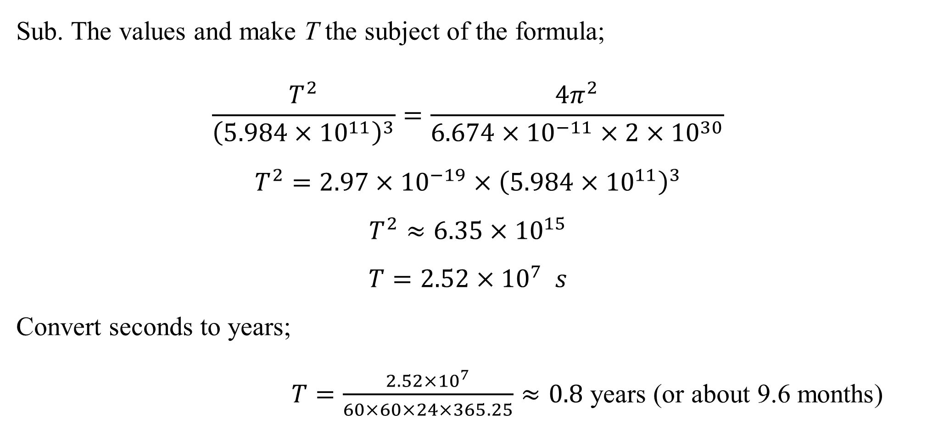
Kepler’s law of Planetary motion
3080
Sub. The values and make T the subject of the formula;
$$\frac{T^{2}}{{\left(5.984×{10}^{11}\right)}^{3}}=\frac{4π^{2}}{6.674×{10}^{−11}×2×{10}^{30}}$$
$$T^{2}=2.97×{10}^{−19}×{\left(5.984×{10}^{11}\right)}^{3}$$
$$T^{2}≈6.35×{10}^{15}$$
$$T=2.52{×10}^{7} s$$
Convert seconds to years;
$T=\frac{2.52{×10}^{7}}{60×60×24×365.25}≈0.8$ years (or about 9.6 months)

Slide 34
Kepler’s law of Planetary motion
3080
Kepler’s third law summary:
The larger the orbit (greater semi-major axis r), the longer the planet’s orbital period T . This relationship holds for any planet in the same star system.
It was one of the major discoveries that laid the foundation for understanding the dynamics of planetary motion and helped in the later development of Newton’s law of universal gravitation.

Slide 35
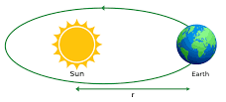
Gravitational Potential Energy
3080
Gravitational potential energy is the energy possessed or acquired by an object due to a change in its position when it is present in a gravitational field. In simple terms, it can be said that gravitational potential energy is an energy that is related to gravitational force or to gravity.
When a body of mass (m) is moved from infinity to a point inside the gravitational influence of a source mass (M) without accelerating it, the amount of work done in displacing it into the source field is stored in the form of potential energy.

Slide 36
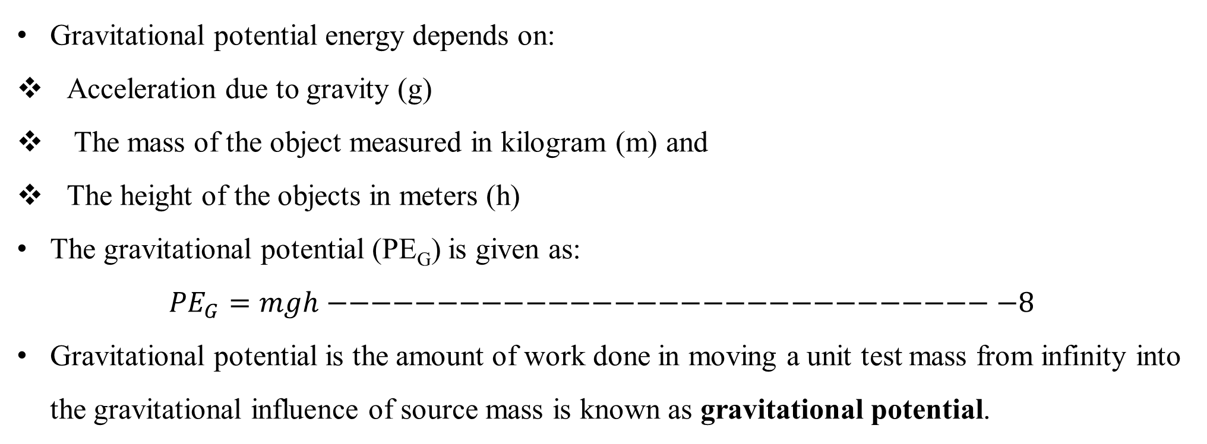
Gravitational Potential Energy
3080
Gravitational potential energy depends on:
Acceleration due to gravity (g)
The mass of the object measured in kilogram (m) and
The height of the objects in meters (h)
The gravitational potential (PE_{G}) is given as:
$${PE}_{G}=mgh−−−−−−−−−−−−−−−−−−−−−−−−−−−−−−−8$$
Gravitational potential is the amount of work done in moving a unit test mass from infinity into the gravitational influence of source mass is known as gravitational potential.

Slide 37
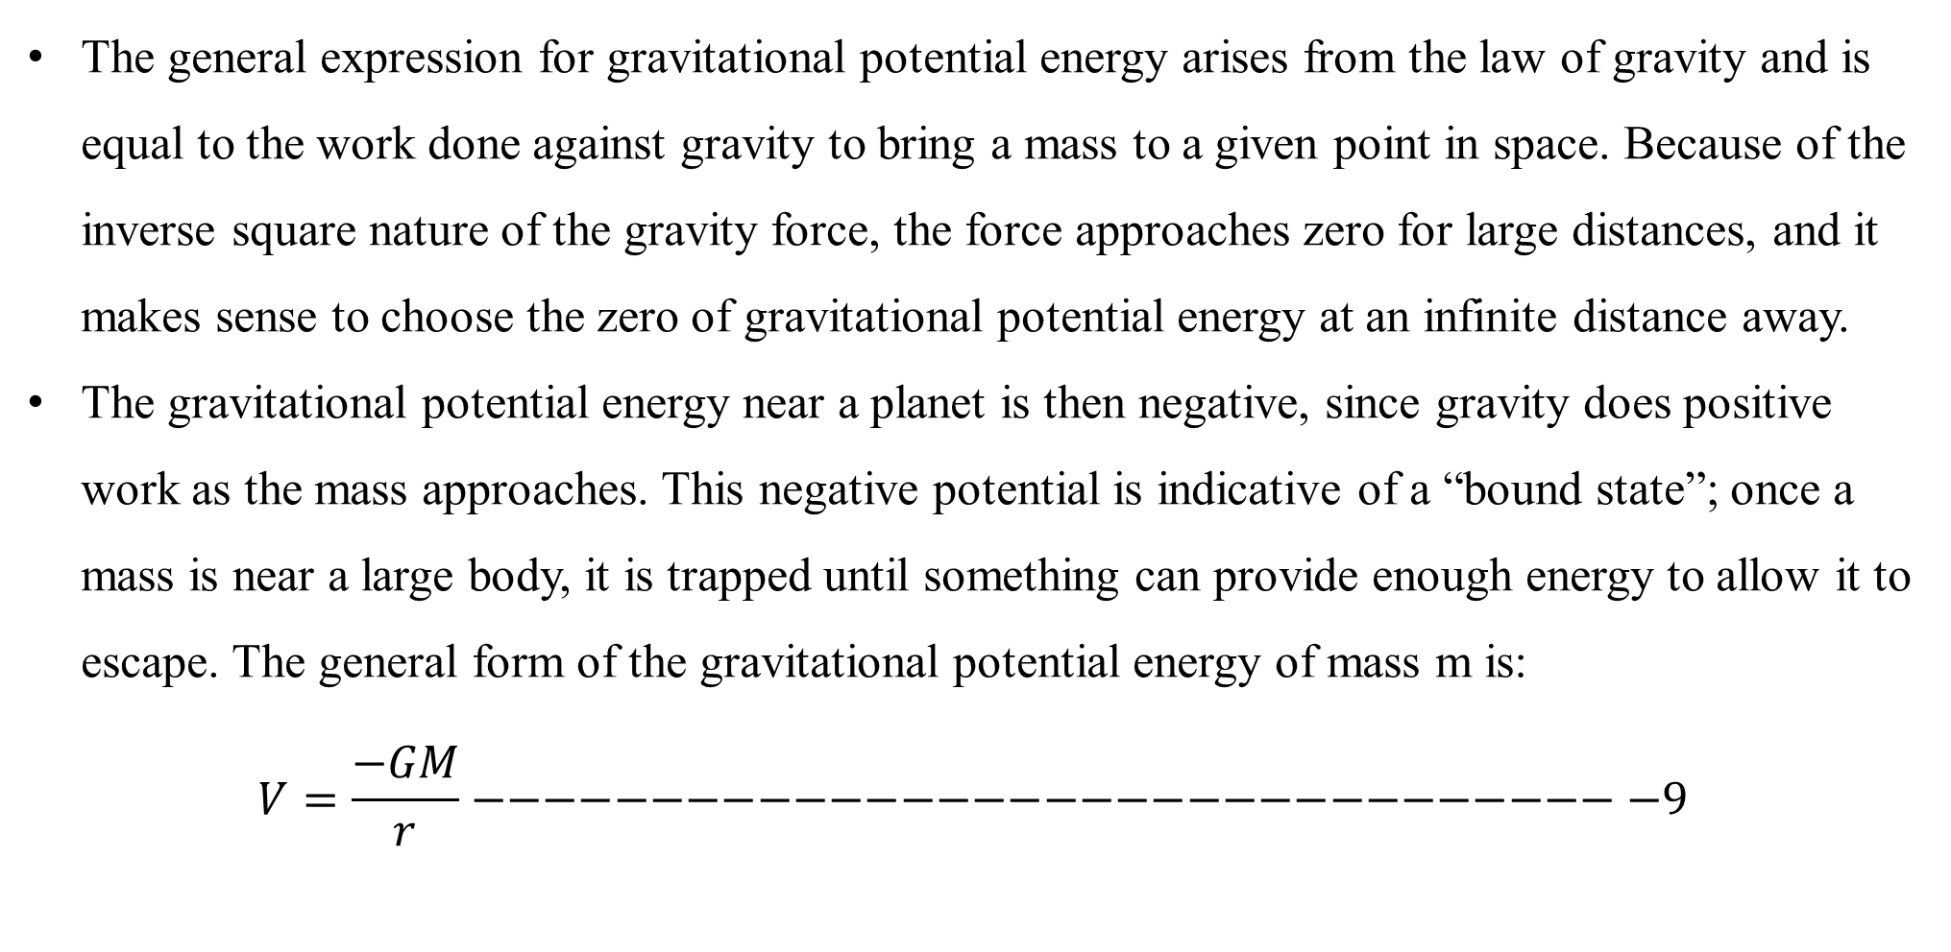
Gravitational Potential Energy
3080
The general expression for gravitational potential energy arises from the law of gravity and is equal to the work done against gravity to bring a mass to a given point in space. Because of the inverse square nature of the gravity force, the force approaches zero for large distances, and it makes sense to choose the zero of gravitational potential energy at an infinite distance away.
The gravitational potential energy near a planet is then negative, since gravity does positive work as the mass approaches. This negative potential is indicative of a “bound state”; once a mass is near a large body, it is trapped until something can provide enough energy to allow it to escape. The general form of the gravitational potential energy of mass m is:
$$V=\frac{−GM}{r}−−−−−−−−−−−−−−−−−−−−−−−−−−−−−−−−−9$$

Slide 38
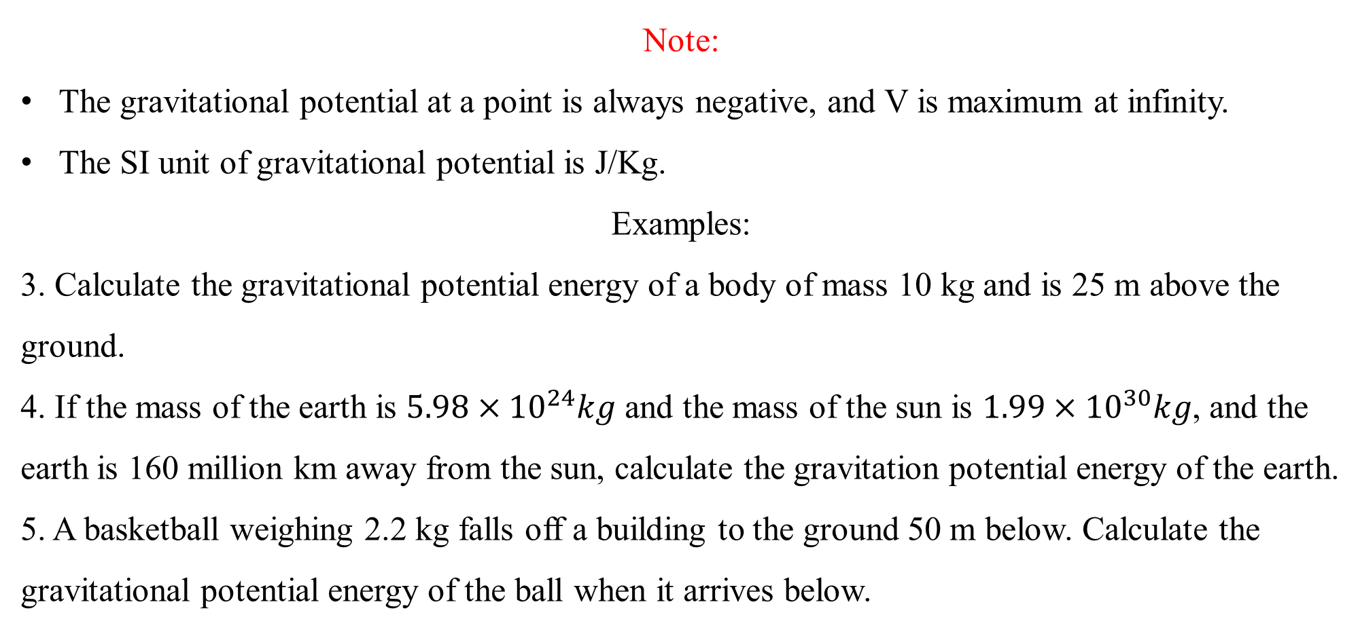
Gravitational Potential Energy
Note:
The gravitational potential at a point is always negative, and V is maximum at infinity.
The SI unit of gravitational potential is J/Kg.
Examples:
3. Calculate the gravitational potential energy of a body of mass 10 kg and is 25 m above the ground.
4. If the mass of the earth is $5.98×{10}^{24}kg$ and the mass of the sun is $1.99×{10}^{30}kg$, and the earth is 160 million km away from the sun, calculate the gravitation potential energy of the earth.
5. A basketball weighing 2.2 kg falls off a building to the ground 50 m below. Calculate the gravitational potential energy of the ball when it arrives below.
3080

Slide 39
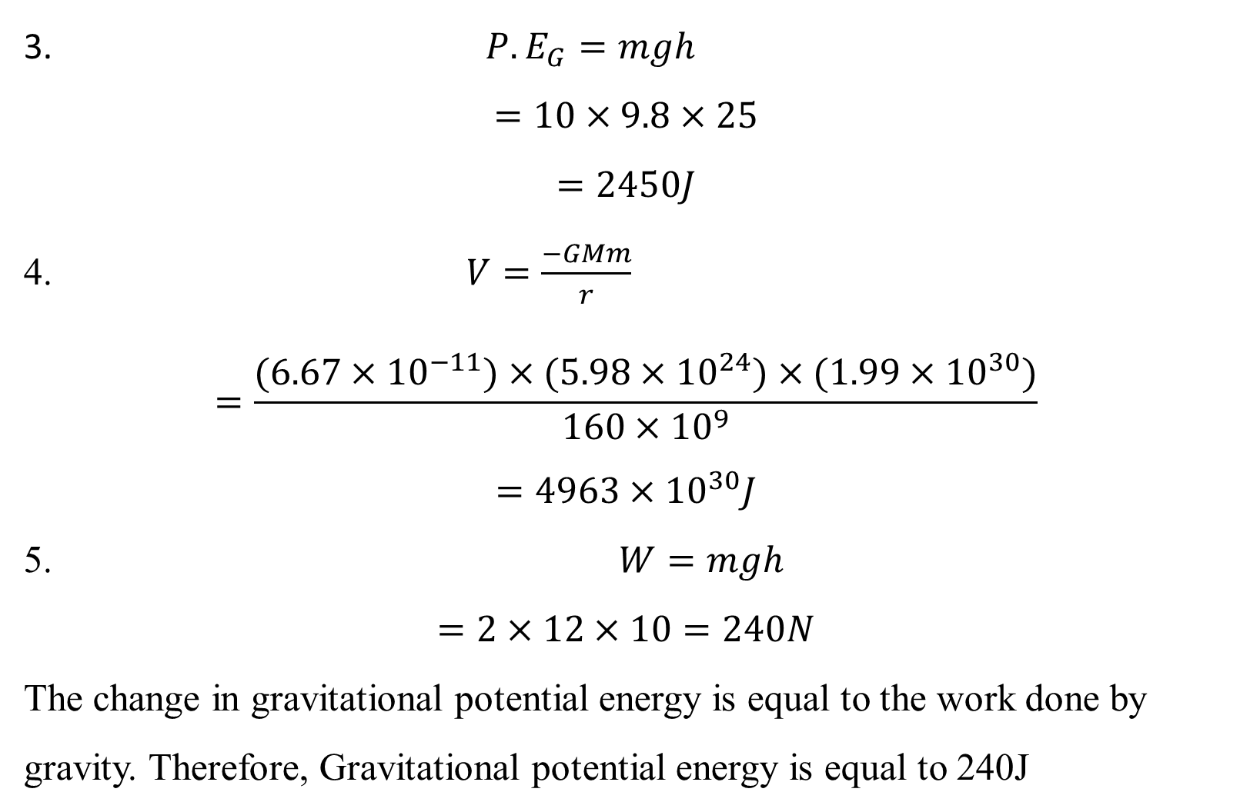
Gravitational Potential Energy
3. ${P.E}_{G}=mgh$
$$=10×9.8×25$$
$$=2450J$$
4. $V=\frac{−GMm}{r}$
$$=\frac{(6.67×{10}^{−11})×(5.98×{10}^{24})×(1.99×{10}^{30})}{160×{10}^{9}}$$
$$=4963×{10}^{30}J$$
5. $W=mgh$
$$=2×12×10=240N$$
The change in gravitational potential energy is equal to the work done by gravity. Therefore, Gravitational potential energy is equal to 240J
3080

Slide 40
Escape Velocity
3080
Escape Velocity is referred to as the minimum velocity needed by anybody or object to be projected to overcome the gravitational pull of the planet earth. In other words, the minimum velocity that one requires to escape the gravitational field is escape velocity.
It refers to the initial velocity a particle must have at the surface of a planet in order to leave the planet forever, and never be pulled back by the planet’s gravity.
If a particle leaves the surface of a planet with an initial velocity equal to the escape velocity, then the body will move more and more slowly as the particle moves farther from the planet, finally reaching a velocity of zero at r=∞. (We assume only the particle and the planet are present, and ignore all other bodies.)

Slide 41
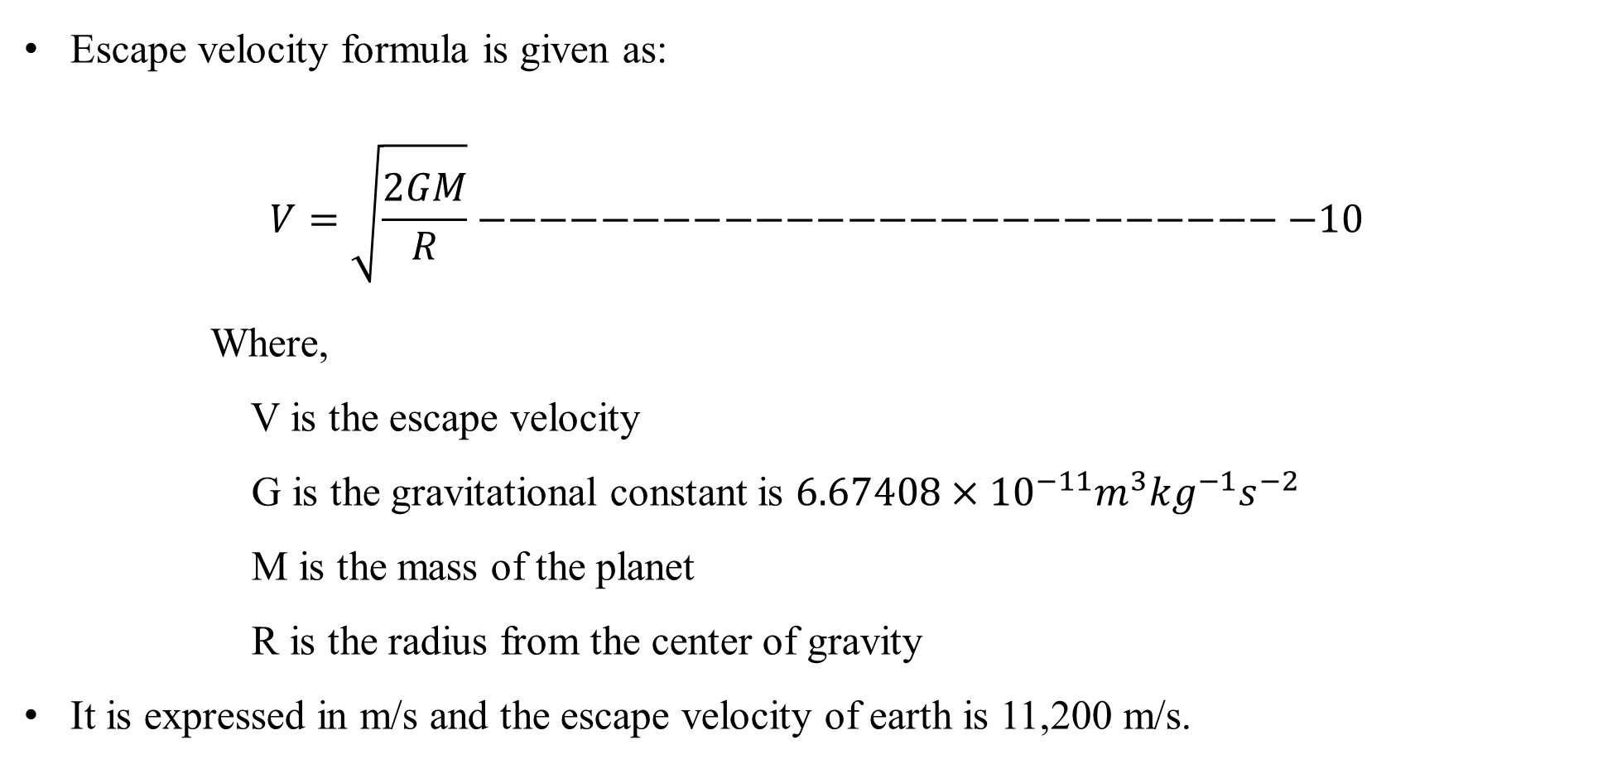
Escape Velocity
3080
Escape velocity formula is given as:
$$V=\sqrt{\frac{2GM}{R}}−−−−−−−−−−−−−−−−−−−−−−−−−−−10$$
      Where,
      V is the escape velocity
      G is the gravitational constant is $6.67408×{10}^{−11}m^{3}{kg}^{−1}s^{−2}$
      M is the mass of the planet
      R is the radius from the center of gravity
It is expressed in m/s and the escape velocity of earth is 11,200 m/s.

Slide 42
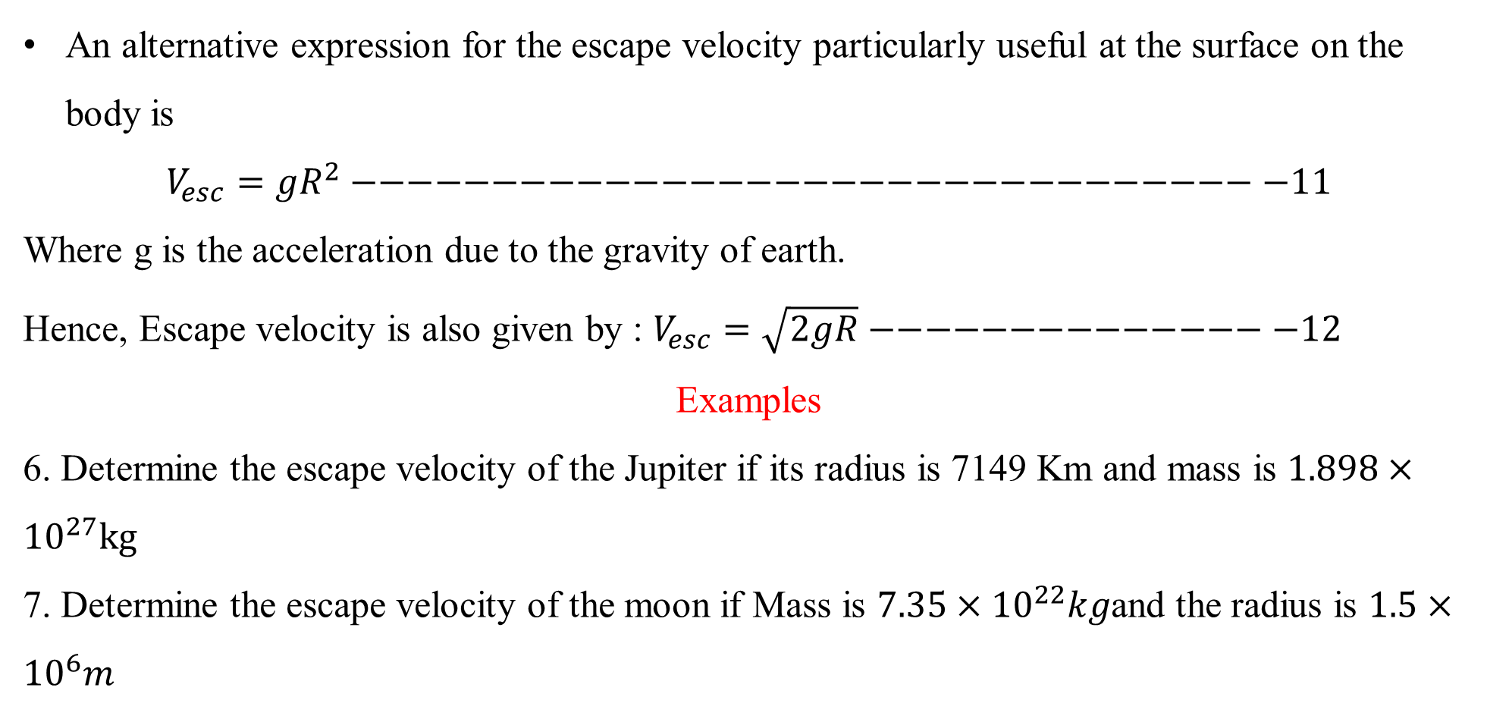
Escape Velocity
3080
An alternative expression for the escape velocity particularly useful at the surface on the body is
$$V_{esc}={gR}^{2}−−−−−−−−−−−−−−−−−−−−−−−−−−−−−−−−−11$$
Where g is the acceleration due to the gravity of earth.
Hence, Escape velocity is also given by : $V_{esc}=\sqrt{2gR}−−−−−−−−−−−−−−−12$
Examples
6. Determine the escape velocity of the Jupiter if its radius is 7149 Km and mass is $1.898×{10}^{27}kg$
7. Determine the escape velocity of the moon if Mass is $7.35×{10}^{22}kg$and the radius is $1.5×{10}^{6}m$

Slide 43
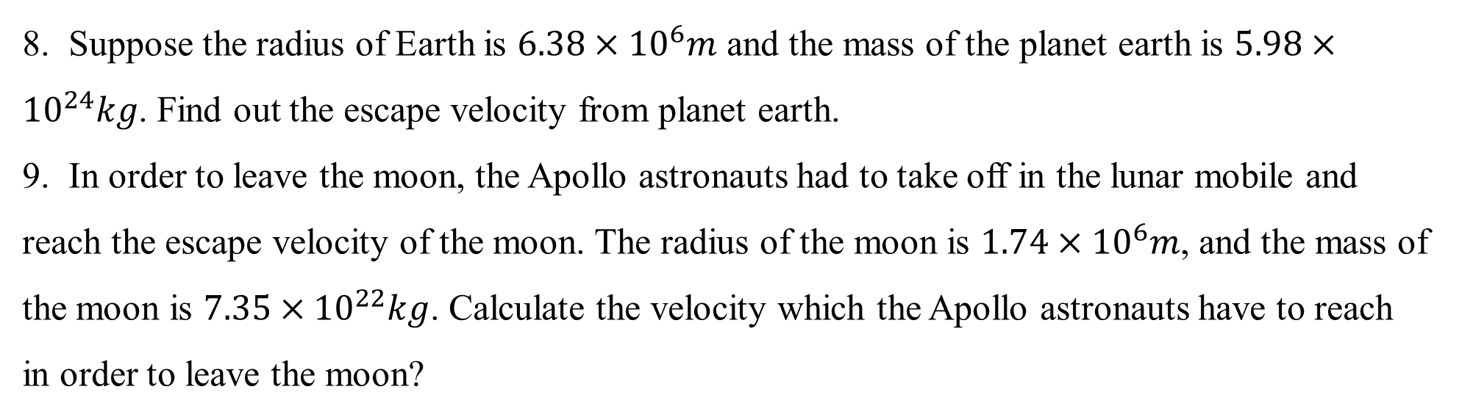
Escape Velocity
3080
8. Suppose the radius of Earth is $6.38×{10}^{6}m$ and the mass of the planet earth is $5.98×{10}^{24}kg$. Find out the escape velocity from planet earth.
9. In order to leave the moon, the Apollo astronauts had to take off in the lunar mobile and reach the escape velocity of the moon. The radius of the moon is $1.74×{10}^{6}m$, and the mass of the moon is $7.35×{10}^{22}kg$. Calculate the velocity which the Apollo astronauts have to reach in order to leave the moon?

Slide 44

Escape Velocity
6. $V_{esc}=\sqrt{\frac{2GM}{R}}$
$$=\sqrt{\frac{2×(6.67408×{10}^{−11})×(1.898×{10}^{27})}{7149×{10}^{3}}}$$
$$=188251m/s$$
7. $V_{esc}=\sqrt{\frac{2GM}{R}}$
$$=\sqrt{\frac{2×(6.67408×{10}^{−11})×(7.35×{10}^{22})}{1.5×{10}^{6}}}$$
$$=2557m/s$$
3080

Slide 45

Escape Velocity
8. $V_{esc}=\sqrt{\frac{2GM}{R}}$
$$=\sqrt{\frac{2×(6.67408×{10}^{−11})×(5.98×{10}^{24})}{6.38×{10}^{6}}}$$
$$=11185m/s$$
9. $V_{esc}=\sqrt{\frac{2GM}{R}}$
$$=\sqrt{\frac{2×(6.67408×{10}^{−11})×(7.35×{10}^{22})}{1.74×{10}^{6}}}$$
$$=2374m/s$$
3080

Slide 46
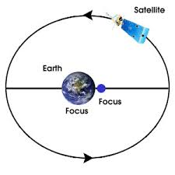
Satellite Motion and Orbits
3080
The satellites revolve around the earth, making a circular or elliptical path called the orbit.
Any heavenly or human-made body that revolves around a central body, such as the Earth, Sun, or other bodies in the solar system, is known to be a satellite. However, these satellites revolve around and make either circular or elliptical orbits when it comes to Earth. The earth, in this case, is said to be the central body.
Satellites are objects or bodies that revolve around the heavier body in space.

Slide 47
Satellite Motion and Orbits
There are two types of satellites:
Natural Satellites: Satellites naturally present in space, such as comets and the Moon.
Artificial Satellites: Satellites made by humans for various purposes such as weather forecasting, communication, etc.
Every planet has at least one of its natural satellites. The earth has only one, the Moon, while other planets such as Jupiter are known to have 53 natural satellites (moons).
The Soviet Union, now Russia, launched the first artificial satellite into space on Oct 4, 1957, named Sputnik 1. The launch of Sputnik 1 triggered what was called the Space Race.
3080

Slide 48
Motion of Satellite around the earth
The satellite orbiting the earth has a velocity and acceleration component similar to an object moving on a circular path. While revolving around the earth, satellites make a circular path.
The tangent to this circular path gives the direction of the satellite’s velocity, whereas acceleration is towards the centre of the circle.
Various forces act between the Earth and the satellite, making them orbit on a circular path. The net force that acts in the inward direction of the circle makes the satellite accelerate around the Earth.
3080

Slide 49
Motion of Satellite around the earth
The gravitational force that acts between the Earth and the satellite and centripetal force are two main forces causing the motion of satellites around Earth.
If there is no centripetal force, satellites will keep moving at the same speed and direction. In such a case, the satellite will move on a straight path, and there will be no circular motion.
However, some satellites move along an elliptical orbit. In that case, unlike the circular motion, the central body is positioned at foci of the ellipse.
The velocity component of the satellite acts along the tangent of the ellipse. At the same time, the acceleration acts towards the focus.
3080

Slide 50
Motion of Satellite around the earth
Based on Newton’s Second Law of Motion, the direction of the net force will be towards the focus.
This is because, along with centripetal force and gravitational force, a force component acts either in the same or opposite direction.
This component of force changes the speed of the satellite. Hence, satellites with elliptical motion do not have a constant speed.
Orbital Velocity of Satellite
The velocity with which satellites move around the earth is known as the orbital velocity of satellites.
Orbital velocity is also known as critical velocity. The minimum velocity required to make a satellite move around the earth with stability.
3080

