Slide 1
Electrolysis
When an electric current is passed through an electrolyte solution, the ions of the electrolyte undergo chemical changes at the respective electrodes. The chemical reaction carried out by passing electricity is called electrolysis.

Slide 2
LIST OF TERMS
Conductor: A solid substance that allows electricity to pass through it. All metals are included in this class.
Non-conductor or insulator: A solid substance that does not allow electricity to flow through it. All non-metals fall in this class.
Electrolyte: A substance which,when dissolved or molten, conducts electricity and is decomposed by it.
Anion:a negative ion which moves to the anode during electrolysis

Slide 3
Nonelectrolyte: A compound which cannot conduct electricity, be it in molten or solution state. Electrode: A graphite or metal pole (rod) or plate through which the electric current enters or leaves the electrolyte.
Cathode: A negative electrode which leads electrons into the electrolyte.
Anode: A positive electrode which leads electrons out of the electrolyte.
Ion: A positively or negatively charged atom or radical (group of atoms).
Cation: A positive ion which moves to the cathode during electrolysis.

Slide 4
The electrolytic cell (voltameter) The apparatus in which electrolysis is carried out is called electrolytic cell. A battery supplies the direct current. Graphite electrodes carry the current into and out of the liquid electrolyte. Graphite is chosen because it is quite un reactive (inert). It will not react with the electrolyte or with products of electrolysis. Electrons flow from the negative terminal (cathode) of the battery around the circuit and back to the positive terminal (anode). In the electrolyte it is the ions that move to carry the current.

Slide 5
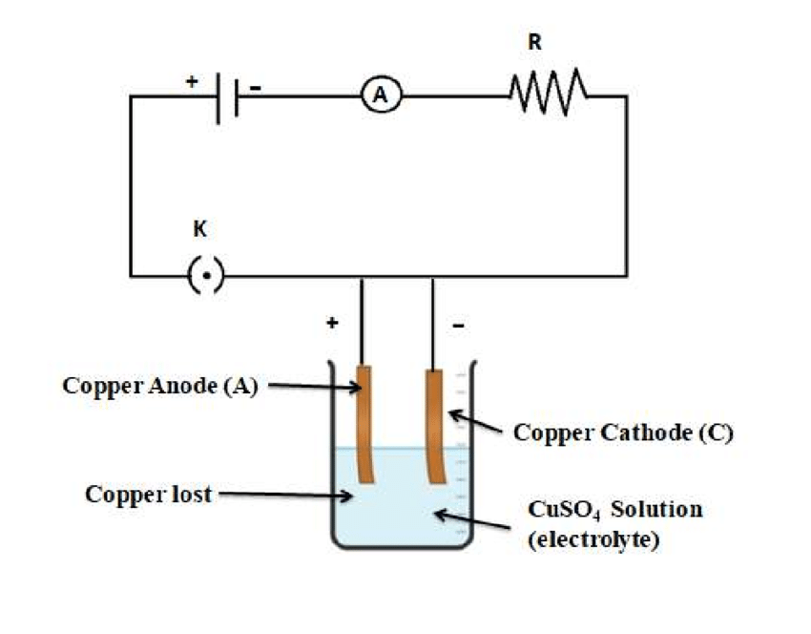

Slide 6
FARADAY’S LAW OF ELECTROLYSIS
Faraday’s first law states that the mass,M of a substance liberated in an electrolysis is directly proportional to the quantity of electricity Q, which has passed through the electrolyte.
M∞ Q;
M=Zit where Q is the quantity of electricity in coulombs, I is the current (ampere),t is time (seconds) and Z is a constant proportionality known as the electrochemical equivalent (e.c.e) of the substance.

Slide 7
The electrochemical equivalent of a substance is the mass of that substance deposited by one coulomb of electricity in a process of electrolysis.
Faraday’s second law states that the mass of a different substance deposited or liberated by the same quantity of electricity are directly proportional to the chemical equivalents of the substances.
Na+ + e- Na (equivalent to I faraday = 96500 C/mol)
Mg2+ + 2e- Mg (equivalent to 2 faraday = 2 x 96500 C/mol)

Slide 8
Examples 1
A current of 2A is passed through a copper voltameter for 5 minutes. If the electrochemical equivalent of copper is 3.27x10-7 KgC-1. determine the mass of copper deposited.
Solution
M=Zit
=3.27 x 10-7 x 2x (60x5)= 1.962x10-4 Kg.
Example 2
In an electrolysis experiment, a cathode of mass 5 g is found to weigh 5.01 g after a current of 5A flows for 50 seconds. What is the electrochemical equivalent of the deposited substance?
Solution
Mass deposited = 5.01–5.00=0.01 g
Z=M/It
0.01/5x50=0.01/250=0.00004 kgc-1

Slide 9
Question 3: How much Al would be precipitated if an AlCl₃ solution was electrolyzed for 1.00 hours with 5.00 amps?
Uses of electrolysis
i. Electroplating
ii. Extraction of some metals (aluminium)
iii. Purification of some metals (copper)
iv. Production of some gases (hydrogen)

