Slide 1

OSUN STATE UNIVERSITY
3080
COLLEGE OF SCIENCE, ENGINEERING AND TECHNOLOGY
FACULTY OF BASIC AND APPLIED SCIENCES DEPARTMENT OF PHYSICS
2024/2025 HARMATTAN SEMESTER
COURSE CODE: PHY 101 COURSE: GENERAL PHYSICS
UNIT: 3
LECTURER: DR. Y.A AJAYEOBA

Slide 2
Course Contents
3080
Elasticity
Hydrostatics

Slide 3
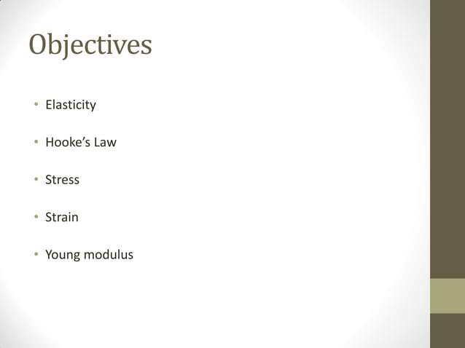

Slide 4
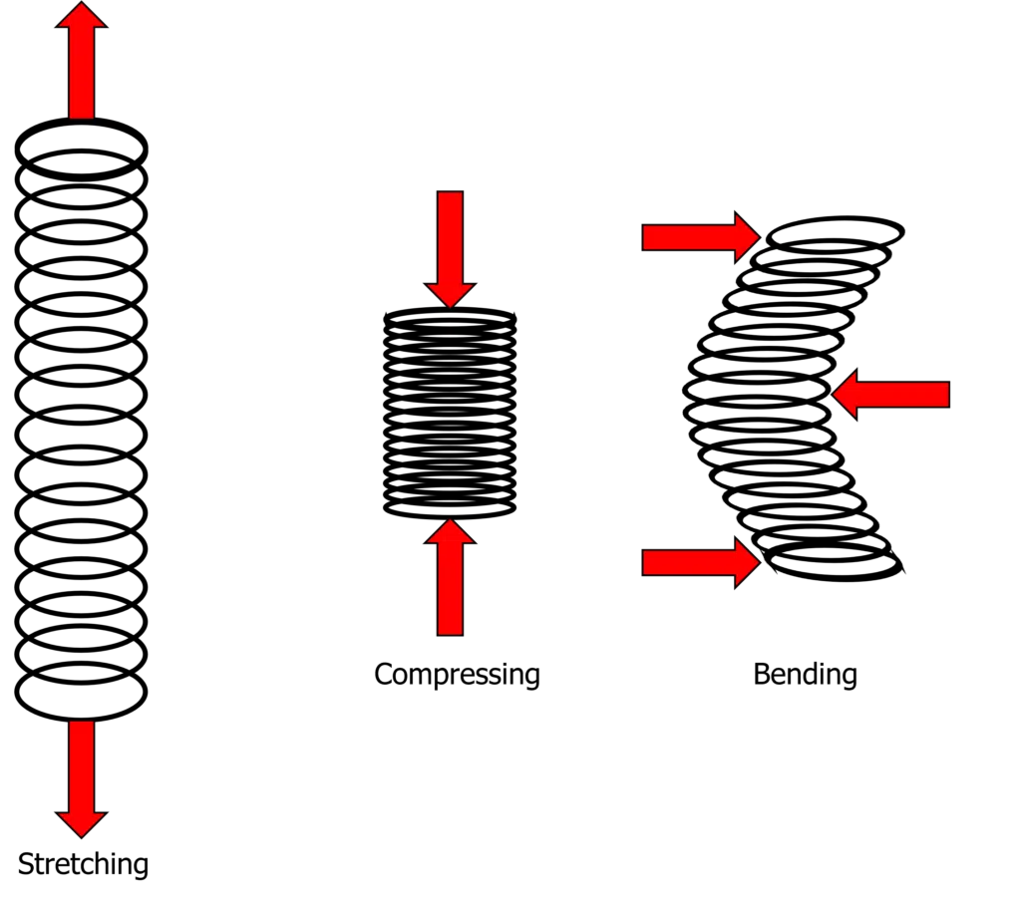
ELASTICITY
3080
Elasticity is the ability of a deformed material body to return to its original shape and size when the forces causing the deformation are removed. A body with this ability is said to behave (or respond) elastically.
Most solid materials exhibit elastic behaviour, but there is a limit to the magnitude of the force and the accompanying deformation within which elastic recovery is possible for any given material. This limit is called the elastic limit

Slide 5
ELASTICITY
3080
Elastic limit is the maximum stress or force per unit area within a solid material that can arise before the onset of permanent deformation. Stresses beyond the elastic limit cause a material to yield or flow.
For such materials the elastic limit marks the end of elastic behaviour and the beginning of plastic behaviour. For most brittle materials, stresses beyond the elastic limit result in fracture with almost no plastic deformation.

Slide 6
ELASTICITY
3080
Elastic deformation is when an object has a force applied but can still go back to its original length and shape after the force has been removed.
Inelastic deformation is when the object with an applied force doesn’t return to its original length and shape when the force is removed.

Slide 7
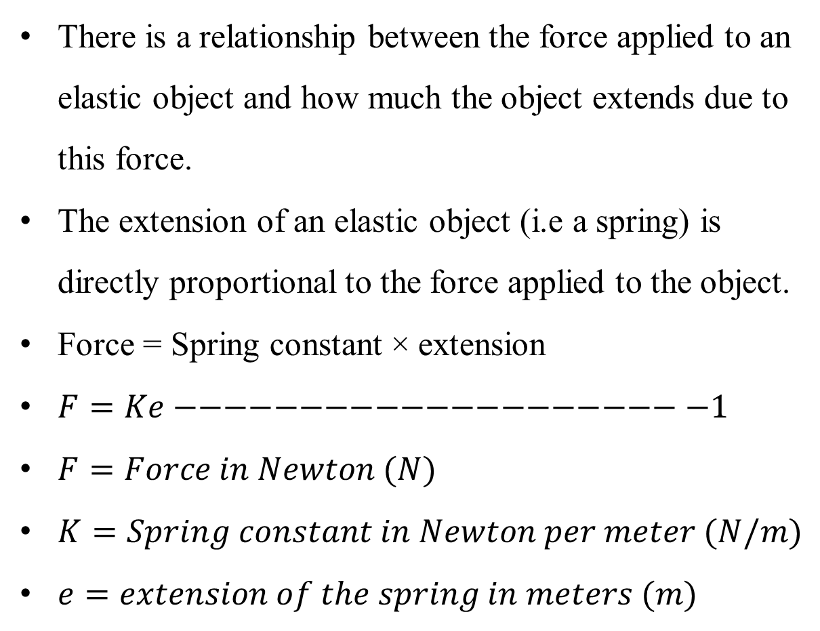
ELASTICITY
3080
There is a relationship between the force applied to an elastic object and how much the object extends due to this force.
The extension of an elastic object (i.e a spring) is directly proportional to the force applied to the object.
Force = Spring constant × extension
$F=Ke−−−−−−−−−−−−−−−−−−−−−1$
$F=Force in Newton (N)$
$K=Spring constant in Newton per meter (N/m)$
$e=extension of the spring in meters (m)$

Slide 8
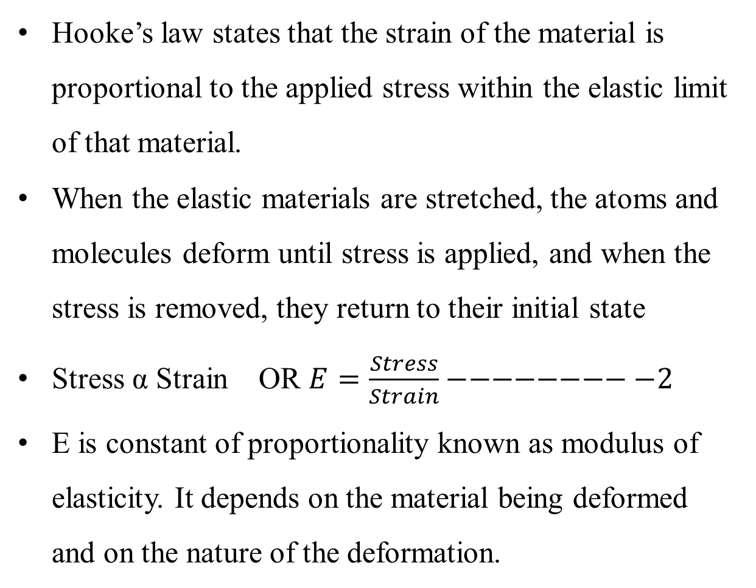
HOOKE’S LAW
3080
Hooke’s law states that the strain of the material is proportional to the applied stress within the elastic limit of that material.
When the elastic materials are stretched, the atoms and molecules deform until stress is applied, and when the stress is removed, they return to their initial state
Stress α Strain OR $E=\frac{Stress}{Strain}−−−−−−−−−2$
E is constant of proportionality known as modulus of elasticity. It depends on the material being deformed and on the nature of the deformation.

Slide 9
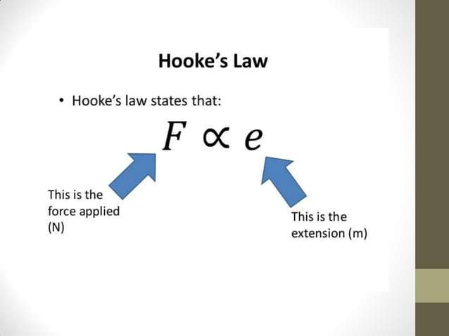

Slide 10
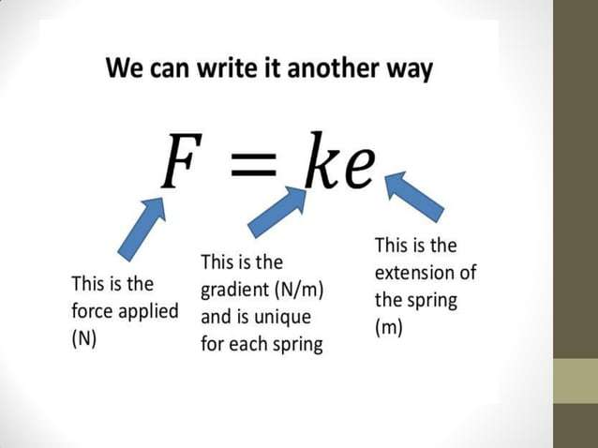

Slide 11
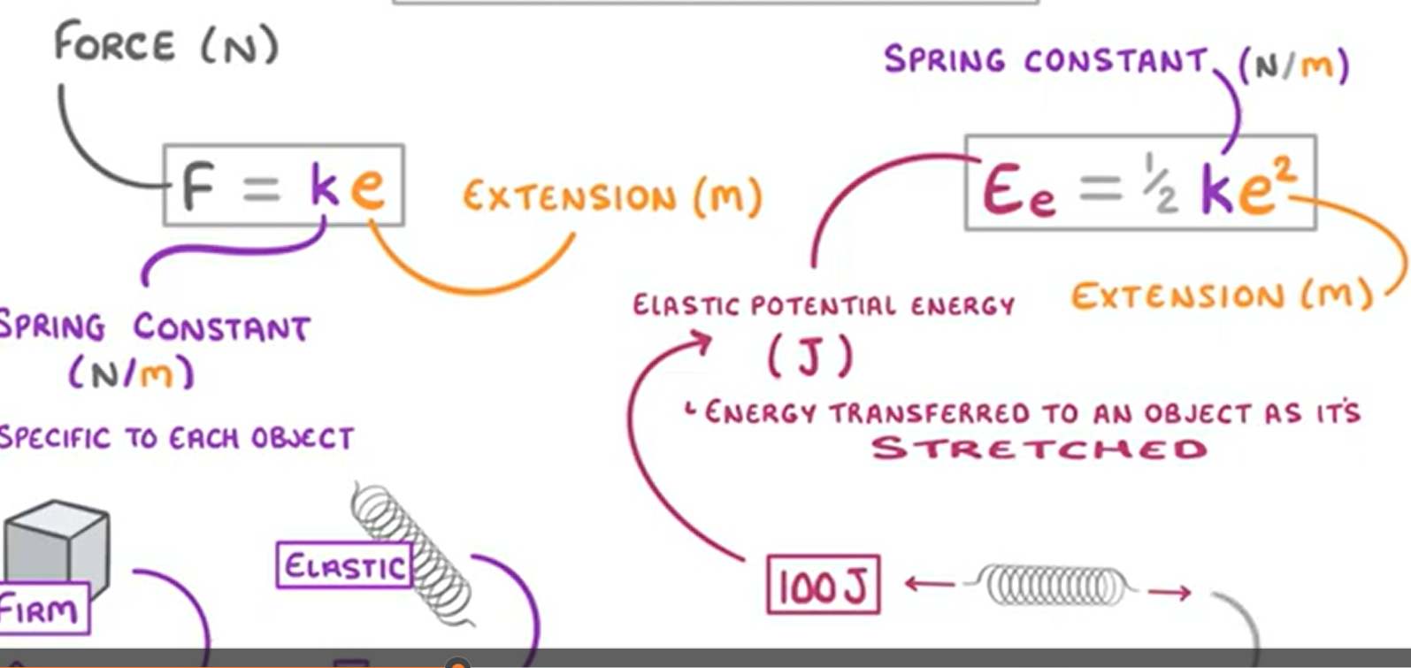
ELASTICITY
3080

Slide 12
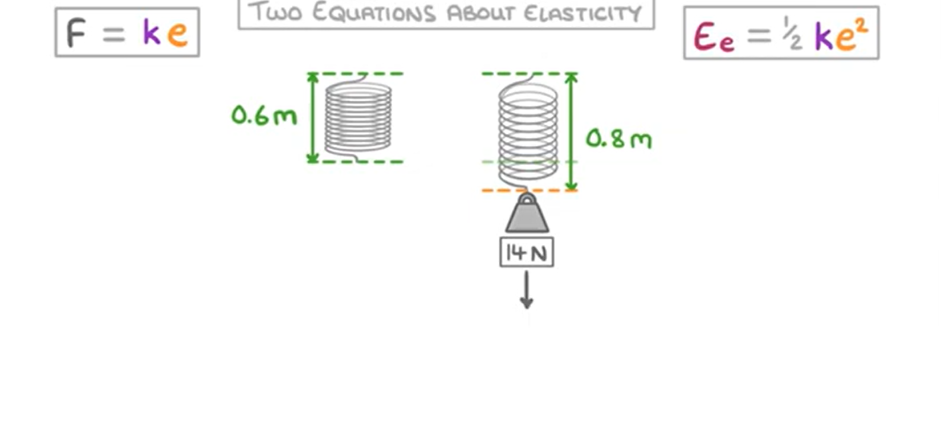
ELASTICITY
3080

Slide 13
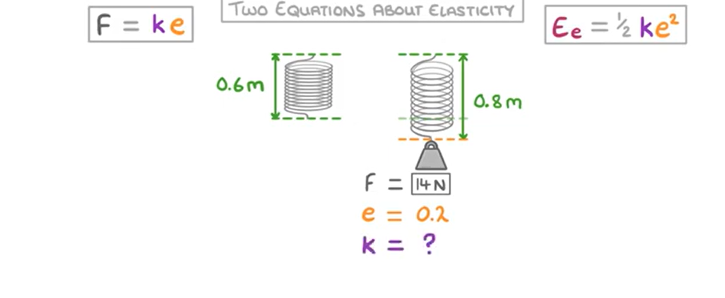
ELASTICITY
3080

Slide 14
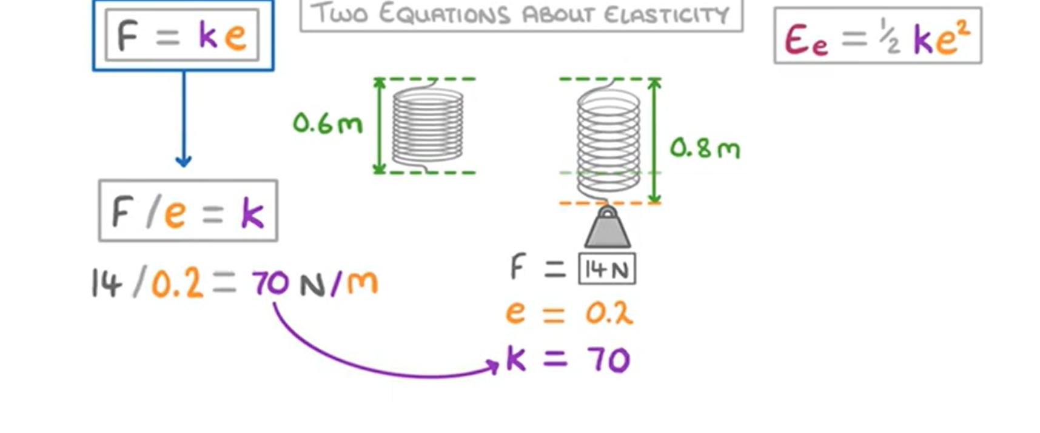
ELASTICITY
3080

Slide 15
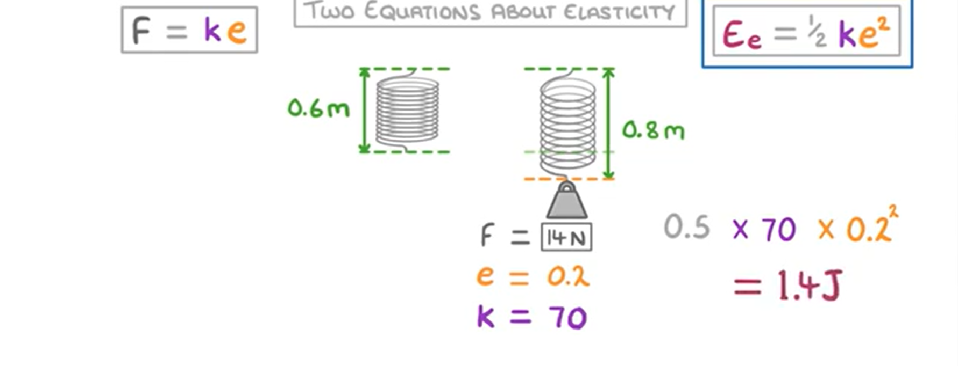
ELASTICITY
3080

Slide 16
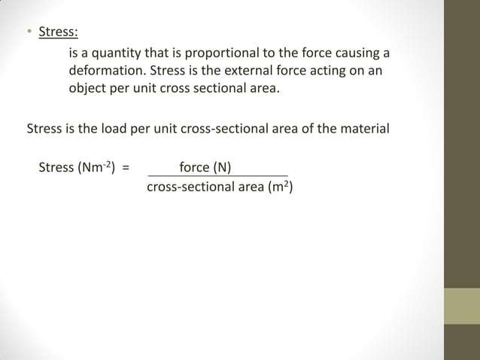

Slide 17
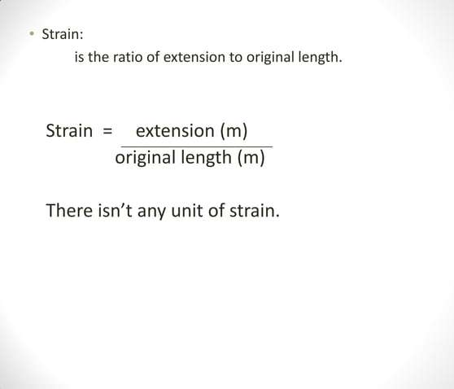

Slide 18
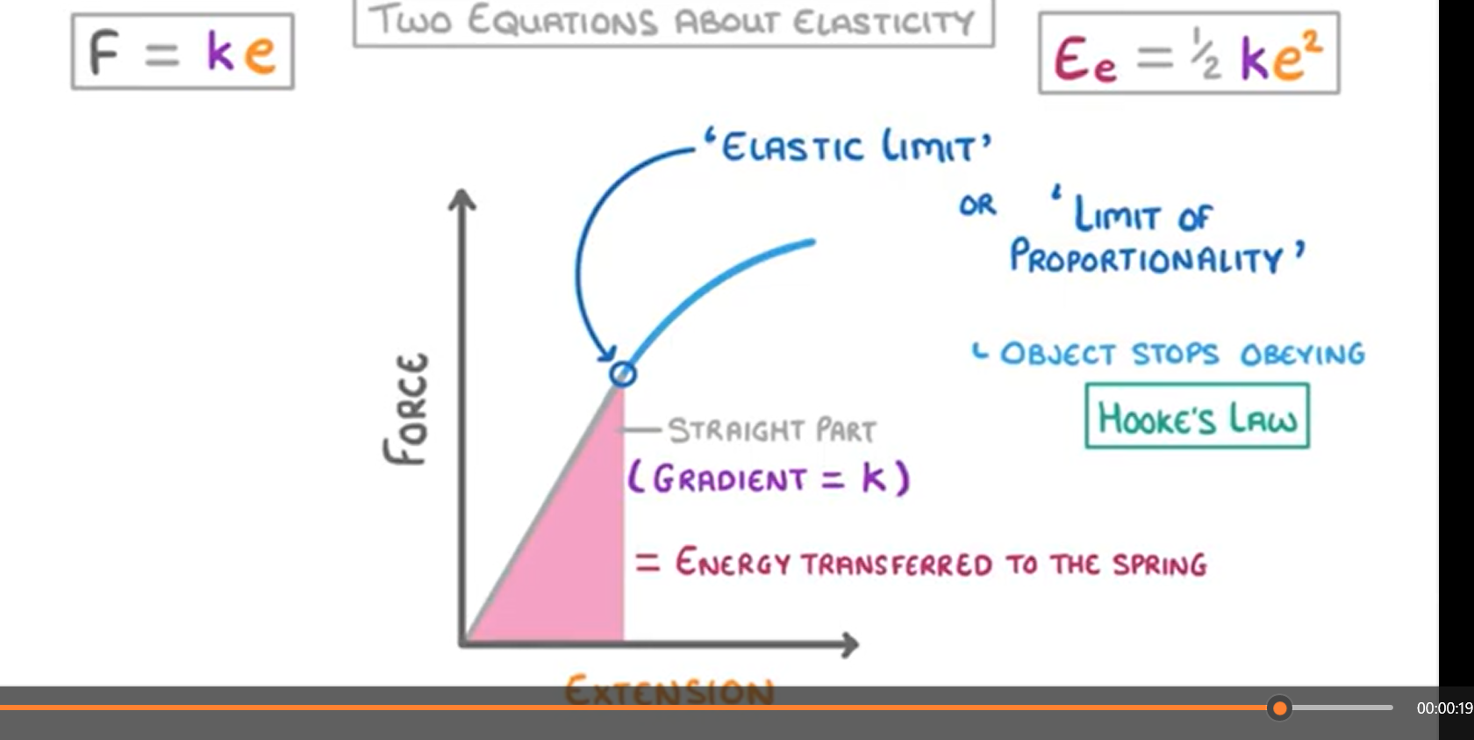

Slide 19
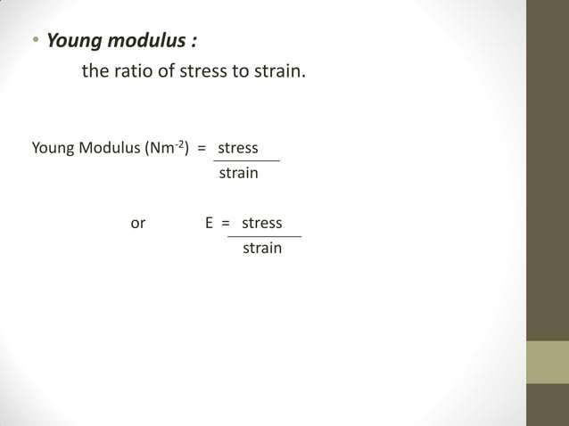

Slide 20
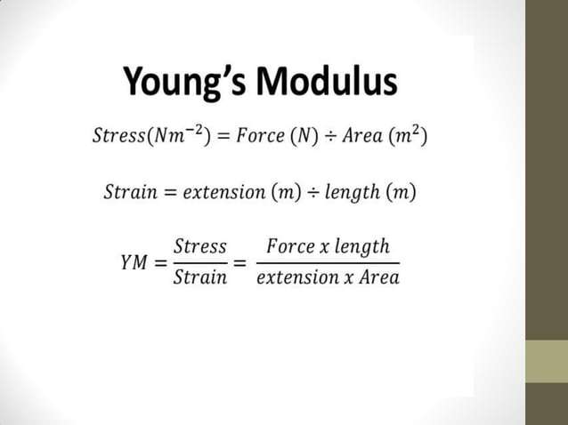

Slide 21
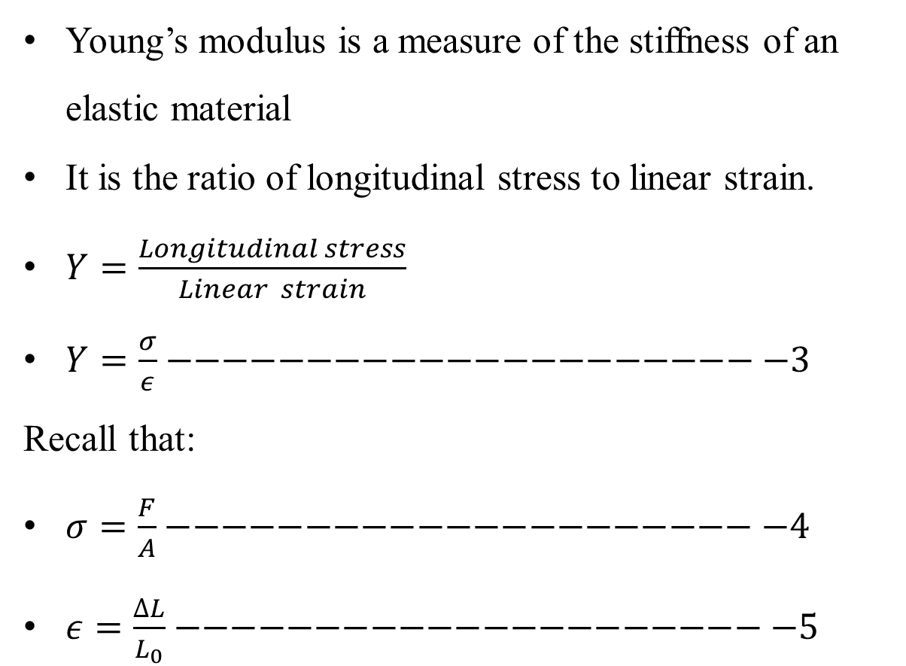
YOUNG’S MODULUS OF ELASTICITY
3080
Young’s modulus is a measure of the stiffness of an elastic material
It is the ratio of longitudinal stress to linear strain.
$Y=\frac{Longitudinal stress}{Linear strain}$
$Y=\frac{σ}{ε}−−−−−−−−−−−−−−−−−−−−−−3$
Recall that:
$σ=\frac{F}{A}−−−−−−−−−−−−−−−−−−−−−−4$
$ε=\frac{∆L}{L_{0}}−−−−−−−−−−−−−−−−−−−−−−5$

Slide 22
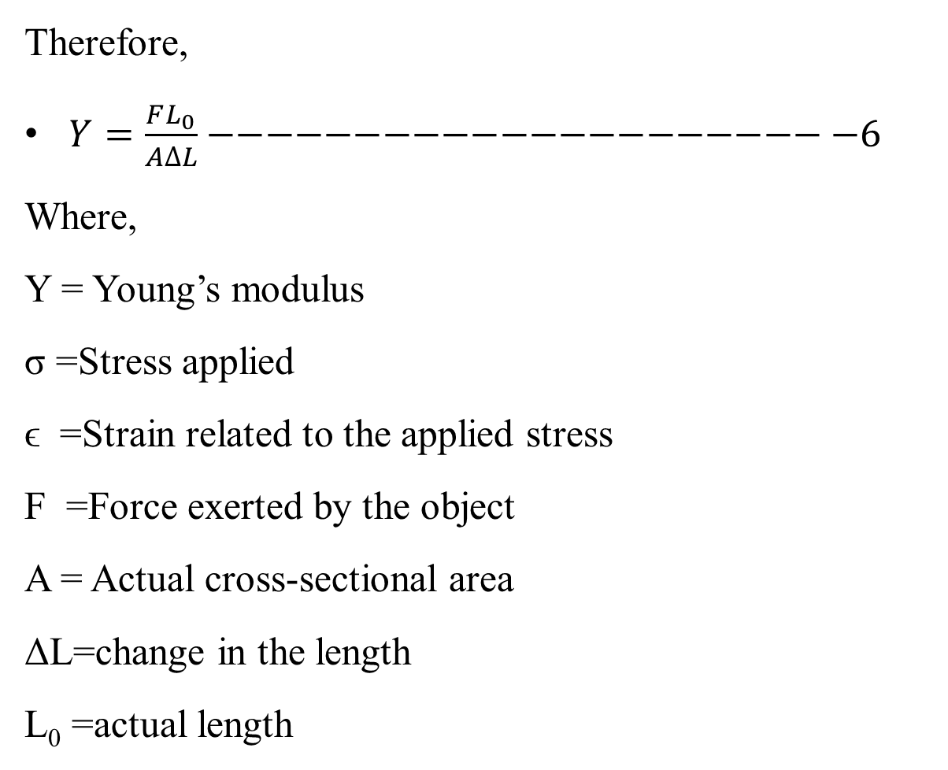
YOUNG’S MODULUS OF ELASTICITY
3080
Therefore,
$Y=\frac{FL_{0}}{A∆L}−−−−−−−−−−−−−−−−−−−−−−6$
Where,
Y = Young’s modulus
σ =Stress applied
ϵ =Strain related to the applied stress
F =Force exerted by the object
A = Actual cross-sectional area
ΔL=change in the length
L₀ =actual length

Slide 23
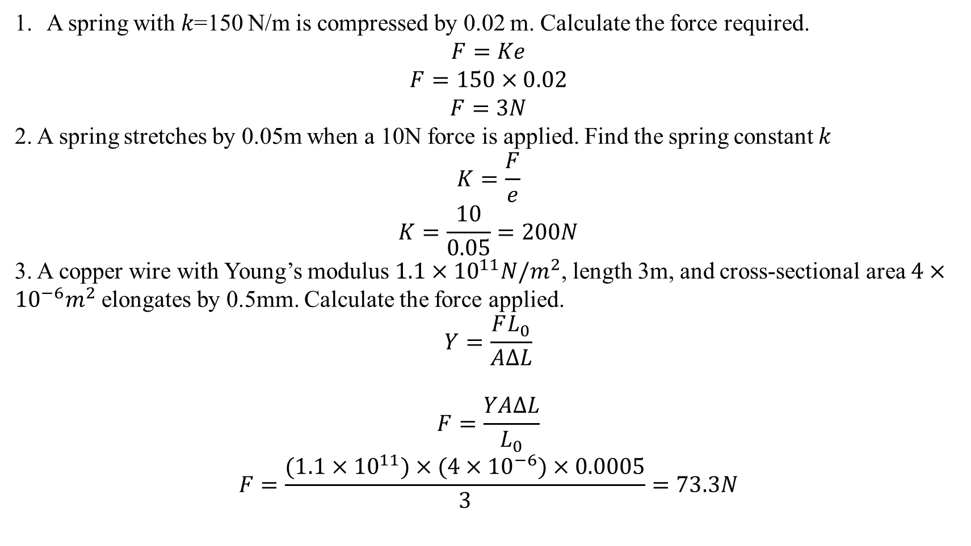
EXAMPLES
3080
A spring with 𝑘=150 N/m is compressed by 0.02 m. Calculate the force required.
$$F=Ke$$
$$F=150×0.02$$
$$F=3N$$
2. A spring stretches by 0.05m when a 10N force is applied. Find the spring constant 𝑘
$$K=\frac{F}{e}$$
$$K=\frac{10}{0.05}=200N$$
3. A copper wire with Young’s modulus $1.1×{10}^{11}N/m^{2}$, length 3m, and cross-sectional area $4×{10}^{−6}m^{2}$ elongates by 0.5mm. Calculate the force applied.
$$Y=\frac{FL_{0}}{A∆L}$$
$$F=\frac{YA∆L}{L_{0}}$$
$$F=\frac{(1.1×{10}^{11})×(4×{10}^{−6})×0.0005}{3}=73.3N$$

Slide 24
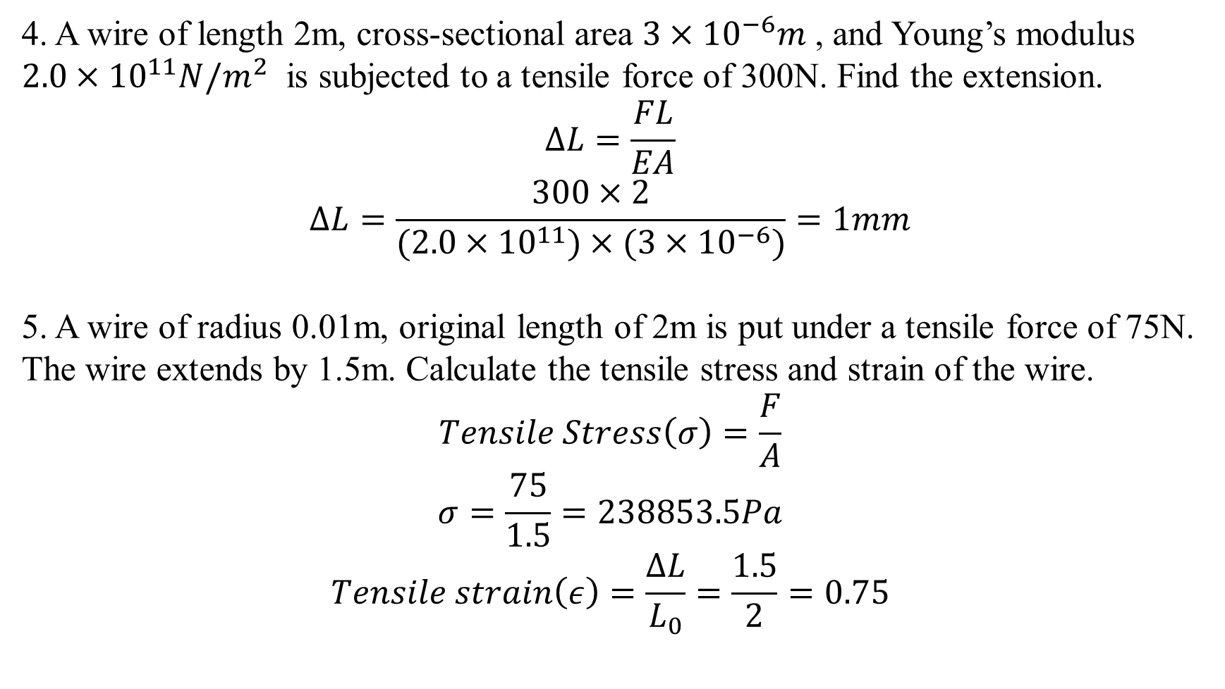
EXAMPLES
3080
4. A wire of length 2m, cross-sectional area $3×{10}^{−6}m$ , and Young’s modulus $2.0×{10}^{11}N/m^{2}$ is subjected to a tensile force of 300N. Find the extension.
$$∆L=\frac{FL}{EA}$$
$$∆L=\frac{300×2}{(2.0×{10}^{11})×(3×{10}^{−6})}=1mm$$
5. A wire of radius 0.01m, original length of 2m is put under a tensile force of 75N. The wire extends by 1.5m. Calculate the tensile stress and strain of the wire.
$$Tensile Stress\left(σ\right)=\frac{F}{A}$$
$$σ=\frac{75}{1.5}=238853.5Pa$$
$$Tensile strain\left(ε\right)=\frac{∆L}{L_{0}}=\frac{1.5}{2}=0.75$$

Slide 25
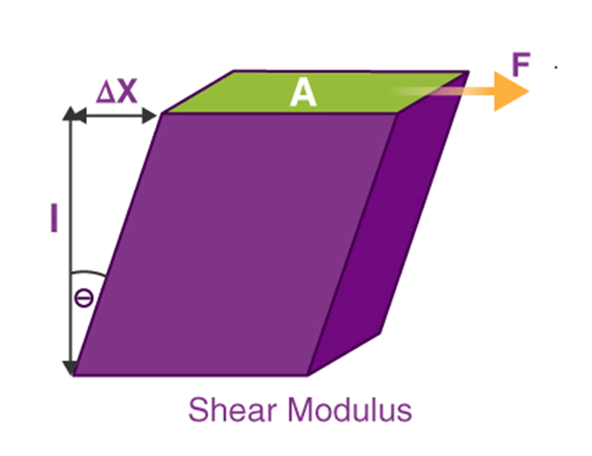
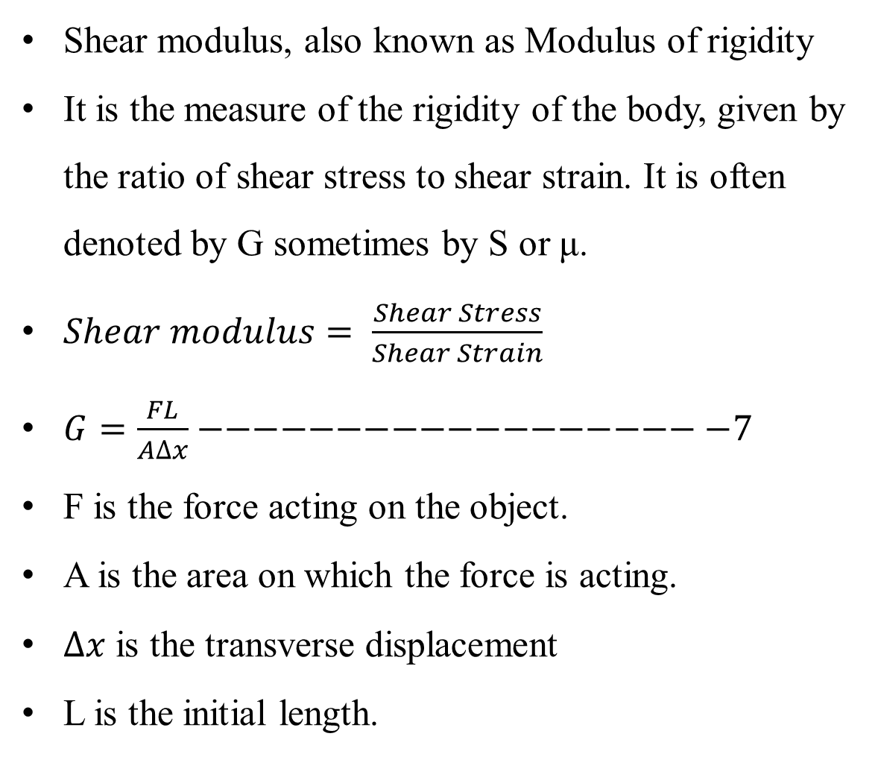
SHEAR MODULUS
Shear modulus, also known as Modulus of rigidity
It is the measure of the rigidity of the body, given by the ratio of shear stress to shear strain. It is often denoted by G sometimes by S or μ.
$Shear modulus= \frac{Shear Stress}{Shear Strain}$
$G=\frac{FL}{A∆x}−−−−−−−−−−−−−−−−−−−7$
F is the force acting on the object.
A is the area on which the force is acting.
$∆x$ is the transverse displacement
L is the initial length.
3080

Slide 26
SHEAR MODULUS
The modulus of rigidity is the elastic coefficient when a shear force is applied resulting in lateral deformation. It gives us a measure of how rigid a body is.
The following example will give you a clear understanding of how the shear modulus helps in defining the rigidity of any material.
Shear modulus of wood is 6.2×108 Pa
Shear modulus of steel is 7.2×1010 Pa
Thus, it implies that steel is a lot more rigid than wood, around 127 times more!
3080

Slide 27
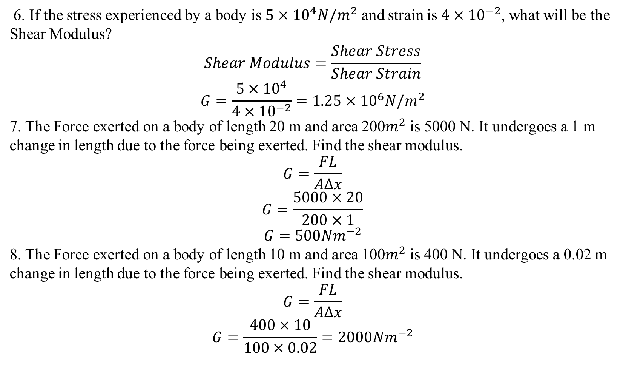
EXAMPLES
3080
6. If the stress experienced by a body is $5×{10}^{4}N/m^{2}$ and strain is $4×{10}^{−2}$, what will be the Shear Modulus?
$$Shear Modulus=\frac{Shear Stress}{Shear Strain}$$
$$G=\frac{5×{10}^{4}}{4×{10}^{−2}}=1.25×{10}^{6}N/m^{2}$$
7. The Force exerted on a body of length 20 m and area 200$m^{2}$ is 5000 N. It undergoes a 1 m change in length due to the force being exerted. Find the shear modulus.
$$G=\frac{FL}{A∆x}$$
$$G=\frac{5000×20}{200×1}$$
$$G=500{Nm}^{−2}$$
8. The Force exerted on a body of length 10 m and area 100$m^{2}$ is 400 N. It undergoes a 0.02 m change in length due to the force being exerted. Find the shear modulus.
$$G=\frac{FL}{A∆x}$$
$$G=\frac{400×10}{100×0.02}=2000{Nm}^{−2}$$

Slide 28
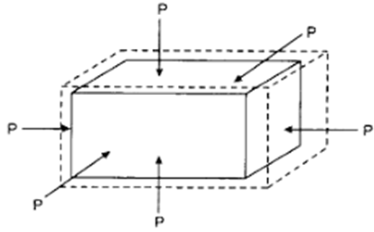
BULK MODULUS
3080
The bulk modulus is the measure of how resistant a material (solid or fluid) is to compression. It is defined as the ratio of pressure increase to the relative decrease of the material volume. It therefore represents how resistant a material is to changing volume under compression that is applied on all sides
It is given by the ratio of pressure applied to the corresponding relative decrease in the volume of the material

Slide 29
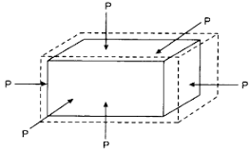
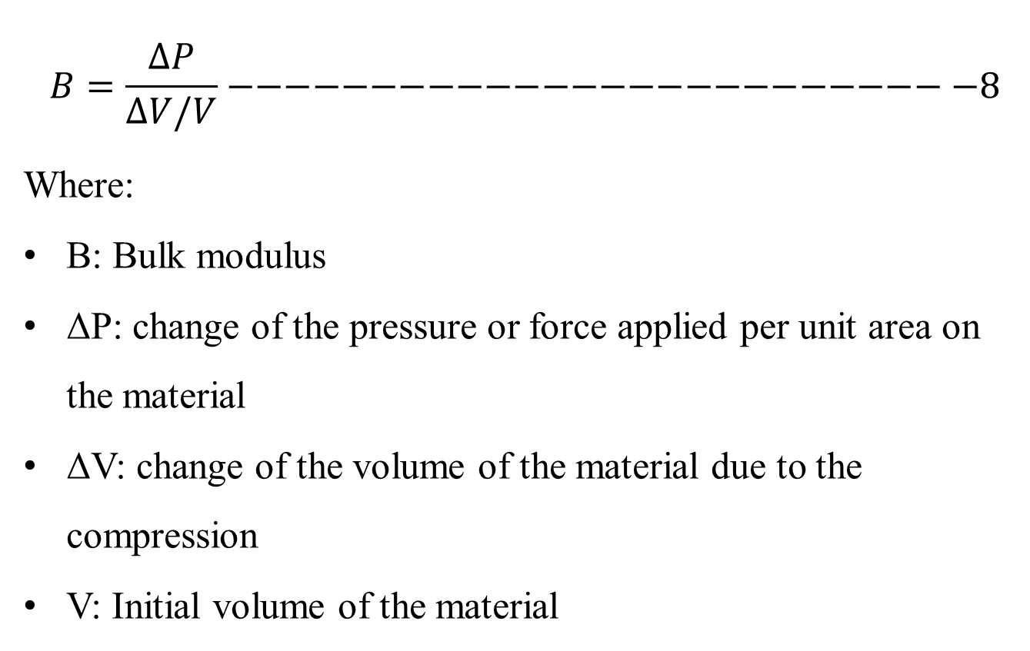
BULK MODULUS
3080
$$B=\frac{∆P}{∆V/V}−−−−−−−−−−−−−−−−−−−−−−−−−−8$$
Where:
B: Bulk modulus
ΔP: change of the pressure or force applied per unit area on the material
ΔV: change of the volume of the material due to the compression
V: Initial volume of the material

Slide 30
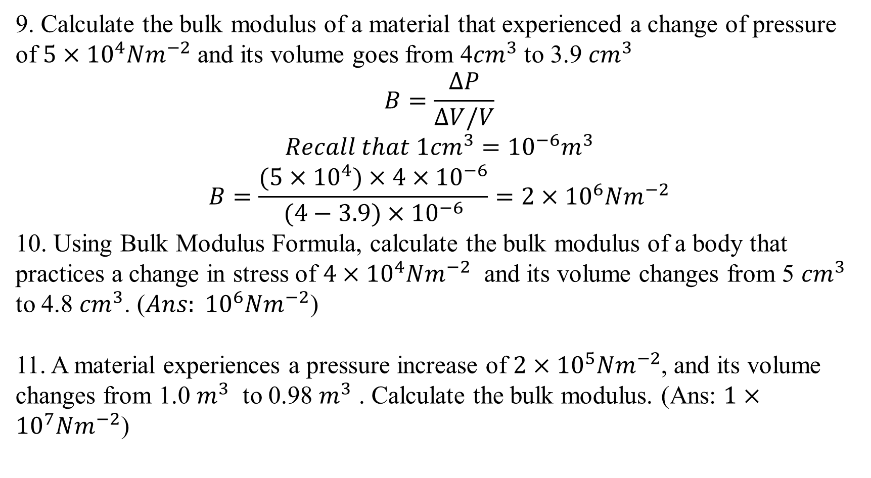
EXAMPLES
3080
9. Calculate the bulk modulus of a material that experienced a change of pressure of $5×{10}^{4}{Nm}^{−2}$ and its volume goes from 4${cm}^{3}$ to 3.9 ${cm}^{3}$
$$B=\frac{∆P}{∆V/V}$$
$$Recall that 1{cm}^{3}={10}^{−6}m^{3}$$
$$B=\frac{(5×{10}^{4})×4×{10}^{−6}}{(4−3.9)×{10}^{−6}}=2×{10}^{6}Nm^{−2}$$
10. Using Bulk Modulus Formula, calculate the bulk modulus of a body that practices a change in stress of $4×{10}^{4}Nm^{−2}$ and its volume changes from 5 ${cm}^{3}$ to 4.8 ${cm}^{3}$. (${Ans: 10}^{6}Nm^{−2}$)
11. A material experiences a pressure increase of $2×{10}^{5}{Nm}^{−2}$, and its volume changes from 1.0 $m^{3}$ to 0.98 $m^{3}$ . Calculate the bulk modulus. (Ans: $1×{10}^{7}Nm^{−2}$)

Slide 31

3080
HYDROSTATIC PRESSURE
Hydrostatic pressure is defined as the pressure exerted by a fluid at equilibrium at any point of time due to the force of gravity.
Hydrostatic pressure is proportional to the depth measured from the surface as the weight of the fluid increases when a downward force is applied.
The fluid pressure can be caused by gravity, acceleration or forces when in a closed container.

Slide 32
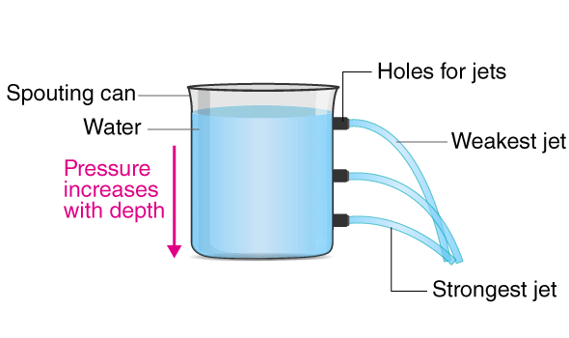
3080
Consider a layer of water from the top of the bottle. There is the pressure exerted by the layer of water acting on the sides of the bottle. As we move down from the top of the bottle to the bottom, the pressure exerted by the top layer on the bottom adds up. This phenomenon is responsible for more pressure at the bottom of the container.

Slide 33
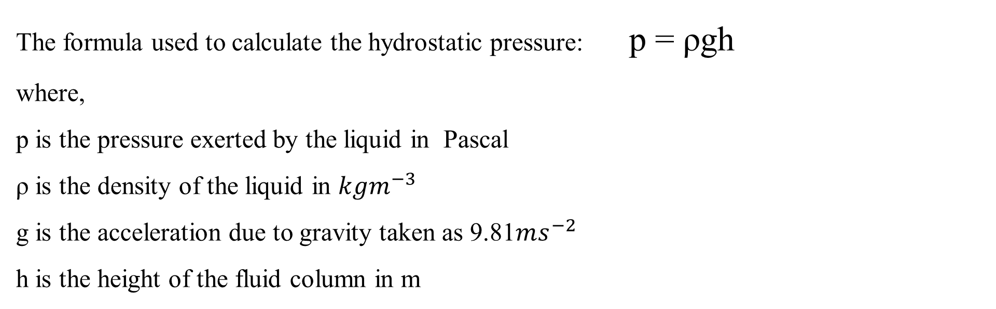
3080
The formula used to calculate the hydrostatic pressure: p = ρgh
where,
p is the pressure exerted by the liquid in Pascal
ρ is the density of the liquid in $kgm^{−3}$
g is the acceleration due to gravity taken as 9.81$ms^{−2}$
h is the height of the fluid column in m

Slide 34
BUOUANCY
3080
Buoyancy is the tendency of an object to float in a fluid. All liquids and gases in the presence of gravity exert an upward force known as the buoyant force on any object immersed in them.
Buoyancy results from the differences in pressure acting on opposite sides of an object immersed in a static fluid.
The buoyant force is the upward force exerted on an object wholly or partly immersed in a fluid. This upward force is also called Upthrust. Due to the buoyant force, a body submerged partially or fully in a fluid appears to lose its weight, i.e. appears to be lighter

Slide 35
3080
FACTORS AFFECTING BUOYANT FORCE
The density of the fluid
The volume of the fluid displaced
The local acceleration due to gravity
An object whose density is greater than that of the fluid in which it is submerged tends to sink. If the object is either less dense than the liquid or is shaped appropriately (as in a boat), the force can keep the object afloat. In terms of relative density, if the relative density is less than one, it floats in water and substances with a relative density greater than one sink in water.

Slide 36
What Causes Buoyant Force?
3080
When an object is immersed in water or any other fluid, the object experiences a force from the downward direction opposite to the gravitational pull, which is responsible for the decrease in its weight. This upward force exerted by the fluid opposes the weight of an object immersed in a fluid. The pressure in a fluid column increases with depth. Thus, the pressure at the bottom of an object submerged in the fluid is greater than that at the top. The difference in this pressure results in a net upward force on the object, which we define as buoyancy

Slide 37
ARCHIMEDES’ PRINCIPLES
3080
Archimedes’ principle states that:
“The upward buoyant force that is exerted on a body immersed in a fluid, whether partially or fully submerged, is equal to the weight of the fluid that the body displaces and acts in the upward direction at the center of mass of the displaced fluid”
When an object is partially or fully immersed in a liquid, the apparent loss of weight is equal to the weight of the liquid displaced by it.

Slide 38
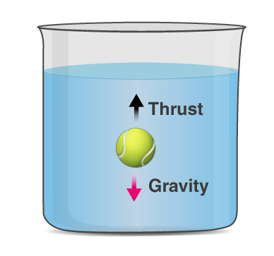
3080
If you look at the figure, the weight due to gravity is opposed by the thrust provided by the fluid. The object inside the liquid only feels the total force acting on it as the weight. Because the actual gravitational force is decreased by the liquid’s upthrust, the object feels as though its weight is reduced. The apparent weight is thus given by:
Apparent weight= Weight of object (in the air) – Thrust force (buoyancy)

Slide 39
Archimedes’ Principle Formula
3080
In simple form, the Archimedes law states that the buoyant force on an object is equal to the weight of the fluid displaced by the object. Mathematically written as:
Fb = ρ x g x V
Where
Fb is the buoyant force,
ρ is the density of the fluid,
V is the submerged volume, and
g is the acceleration due to gravity

Slide 40
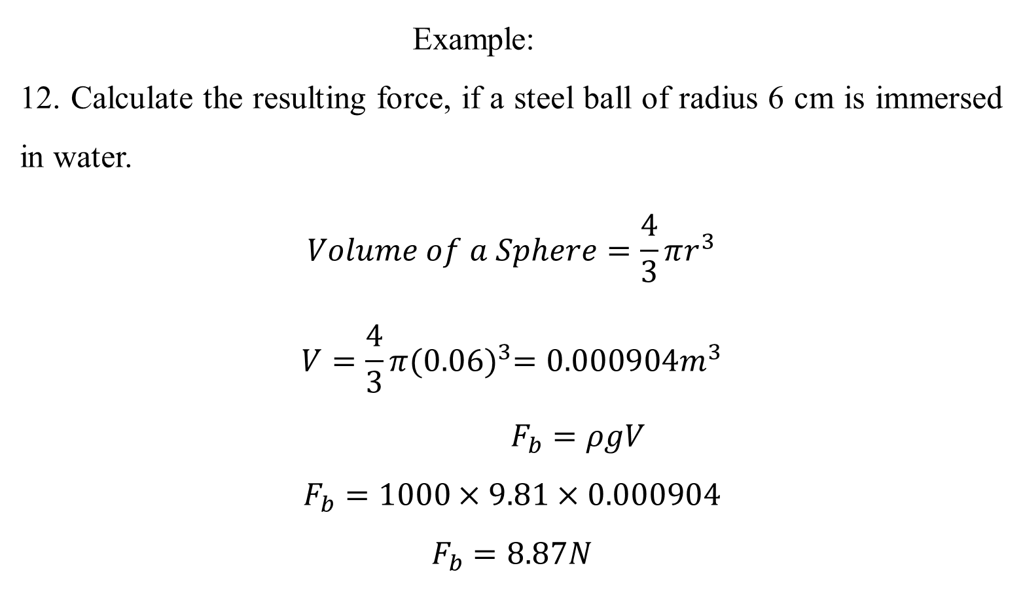
Example:
12. Calculate the resulting force, if a steel ball of radius 6 cm is immersed in water.
$$Volume of a Sphere=\frac{4}{3}πr^{3}$$
$$V=\frac{4}{3}π{(0.06)}^{3}=0.000904m^{3}$$
$F_{b}=ρgV$
$$F_{b}=1000×9.81×0.000904$$
$$F_{b}=8.87N$$
3080

Slide 41
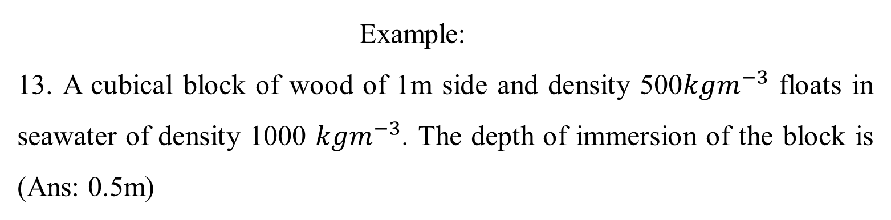
Example:
13. A cubical block of wood of 1m side and density 500$kgm^{−3}$ floats in seawater of density 1000 $kgm^{−3}$. The depth of immersion of the block is (Ans: 0.5m)
3080

