Slide 1
PHY 101: GENERAL PHYSICS I Mechanics and Rigid Body By Dr. Fakunle M.A

Slide 2
COURSE OUTLINE
Space and time,
Units and dimensions.
Kinematics.
Fundamental laws of Mechanics,
Statics and Dynamics.

Slide 3
OBJECTIVES OF THE STUDY
Students should be able to
Differentiate between Fundamental and derived quantity
Give two examples of each of these quantities
Explain Dimension and differentiate it from Unit of fundamental derived quantity
Apply Dimension to validate a given equation
Use dimension to determine the relationship among quantity
Solve problems on dimension
Define and distinguish between velocity and acceleration
Explain instantaneous velocity and instantaneous acceleration
Solve problems on instantaneous velocity and acceleration
Explain Newton’s laws of motion
Explain the concept Momentum and Impulse
State and identify areas where Newton’s second law is applied in life
Define Rigid body
State conditions necessary for rigid body to be in equilibrium
Solve problems associated with rigid body

Slide 4
QUANTITIES AND THEIR DIMENSIONS
Quantity is a term used when referring to the measurement of a scalar ,vector , number of items.
There are two district kinds of measurement in physics.
First kind is called fundamental quantity, examples are mass, time, length, temperature, amount of substance, luminous intensity, current.
The second kind is called derived quantities, examples are density, force, resistance, energy, displacement, acceleration, density, weight, pressure, area, volume, Resistance
DIMENSIONS
The dimension of a physical quantity is the expression which shows how the quantity is related to the fundamental units from which it has been derived.
In Mechanics the three fundamental quantities are Length , Mass and Time
Their respective dimensions are L, M and T
Dimensions of all other quantities are derived from these three examples include
Area = Volume = Density = Velocity = Acceleration =
APPLICATIONS OF DIMENSIONS
Checking the validity of equations: The principle is that all terms in a particular equation must have the same dimension
For example

Slide 5
APPLICATION OF DIMENSION CONTINUED
Since each term of equation has the same dimension of , the equation is homogeneous
and hence dimensionally valid
The second application is to determine the relationship between physical quantities
For Example, The period of a simple pendulum depends on
The length l of the pendulum,
The mass m of the bob and
The acceleration due to gravity g ,find the actual equation

Slide 6
APPLICATION OF DIMENSION CONTINUED
The value of K can be determined from experiment or theory as 2π
KINEMATICS
Kinematics is the study of motion of objects
Displacement
Assume a body moves from one point in space to another point
The displacement S is given by
In two dimension i.e a plane, the displacement from point P(2,2) to P(6,3) is
S = (6 – 2, 3 – 2)
= (4, 1)
Average Velocity during the motion is define as where t is the time taken
The time rate of change of displacement at any point is called the instantaneous velocity
with then . If S is plotted against t , the instantaneous velocity is equal to the slope at any point
Example: A particle moving in a plane has its motion described by where distances are in m and time in seconds. Find the magnitude and direction of its velocity at the instant when t =3s
Solution: The velocity at an instant has both x and y components. That is

Slide 7
KINEMATICS CONTD
When the velocity of the body is increasing either in magnitude or direction or both, the body is said to be undergoing Acceleration. The acceleration is the time rate of increase in velocity i.e
Instantaneous Acceleration is given by and zero when velocity is constant
The motion is uniform when acceleration is constant. In complex motion acceleration may not be uniform and each of such motions can be treated uniquely with its own equation. For all uniform motions , the uniform acceleration is

Slide 9
NEWTON’S LAWS OF MOTION
First Law: States that a body at rest will remain at rest and a body in motion will maintain the motion with a constant speed in a straight line, as long as no net force acts on it.
This law implies that all objects have property which is a tendency to remain at rest when at rest or to continue moving when in motion. This property is called its INERTIA and it is measured by the mass of the body
Second Law: This law state that when a body is acted upon by a force , the body will be accelerated, the magnitude of the acceleration being proportional to the magnitude of the force and its direction, being the same as that of the force.
Before we discuss this law let us discuss the concept called Momentum
Momentum is define as the product of mass and velocity
P = m v
With this concept, it means that the net force is necessary to produce a change in momentum, either in magnitude or in direction or both.
Second law implies that when a change in momentum is produced by a net force, the magnitude of the change is proportional to the net force and the change is in the direction of the force
But in S.I. Units, 1 newton is that force that will produce an acceleration of 1m/s2 on a body of 1kg
When the applied force is not steady as that on a ball hitting a wall, the effect of the force F can be studied by considering the force and the time interval ∆t for which it acts
The product of F and ∆t is called the Impulse (∆j). That is

Slide 10
The product of F and ∆t is called the Impulse (∆j)
∆j = F ∆t
When an impulsive force acts on a body, the impulse is equal to the difference in the final momentum and initial momentum
It is easier to observer changes in momentum than to measure impulse
Example
A man of mass 80kg jumps from a height of 4 m unto the ground. Compare the forces that act on the man if (i) he lands barefooted and the landing takes place in 0.01s (ii) he lands on a cushion such that the landing is delayed to 0.08s (g = 10mls2)
Solution:
Velocity on landing

Slide 11
The minus sign implies that the impulse opposes a change in momentum caused by the upward reaction of the ground
Newton Third law of motion state that whenever a body exerts a force on another, the second body exerts a force equal in magnitude and opposite in direction on the first body
SOME ILLUSTRATIONS OF SECOND LAW OF MOTION
Suppose two bodies were suspended by a rope passing over a frictionless fixed pulley. We can apply second law to determine both the acceleration and the tension in the rope

Slide 12
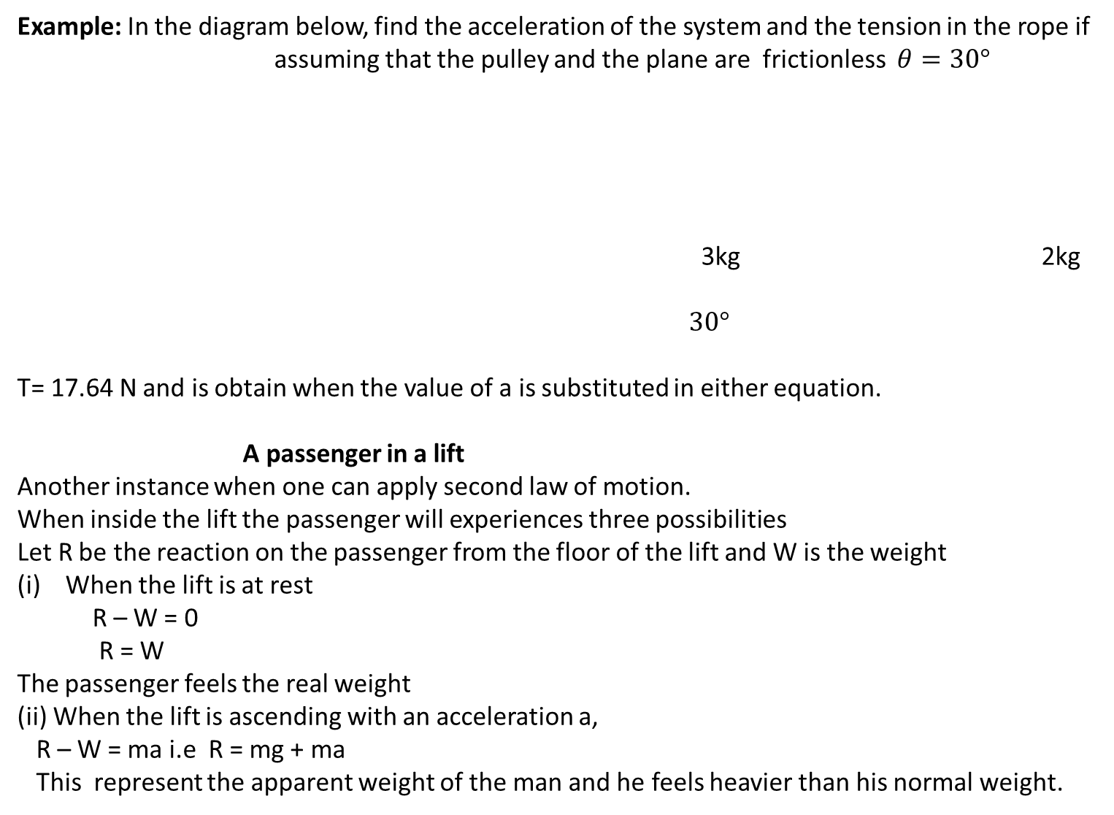
Example: In the diagram below, find the acceleration of the system and the tension in the rope if
assuming that the pulley and the plane are frictionless $θ=30°$
3kg 2kg
$$30°$$
T= 17.64 N and is obtain when the value of a is substituted in either equation.
A passenger in a lift
Another instance when one can apply second law of motion.
When inside the lift the passenger will experiences three possibilities
Let R be the reaction on the passenger from the floor of the lift and W is the weight
When the lift is at rest
R – W = 0
R = W
The passenger feels the real weight
(ii) When the lift is ascending with an acceleration a,
R – W = ma i.e R = mg + ma
This represent the apparent weight of the man and he feels heavier than his normal weight.

Slide 13
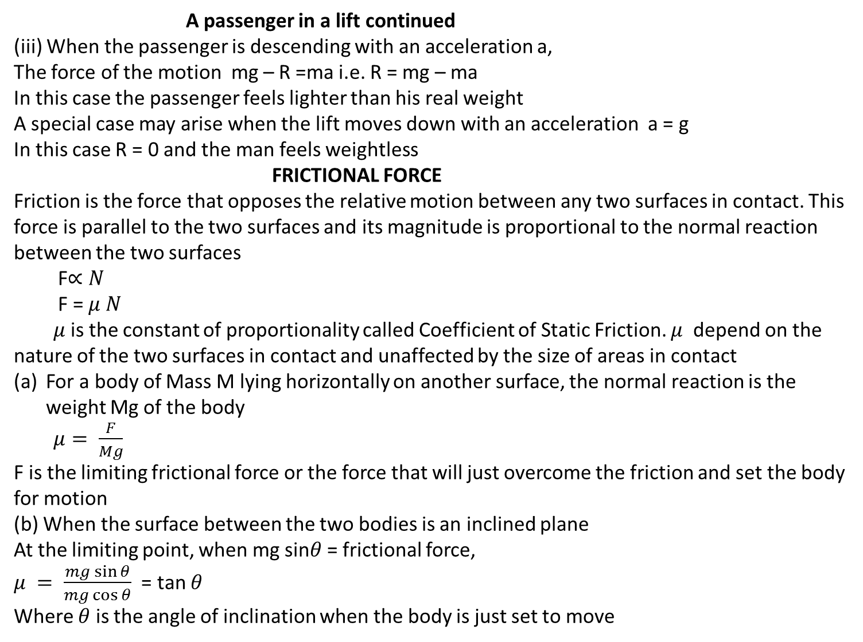

Slide 14

Where $θ$ R
F
mg sin$θ$
mg mgcos$θ$
Example : Calculate the acceleration and the tension of the system below if $μ$ = 0.3 between and the plane. The masses and are 15kg and 10kg respectively
Solution: For masses and
Kinetic Friction is the friction that exists between bodies moving relative to each other.

Slide 15
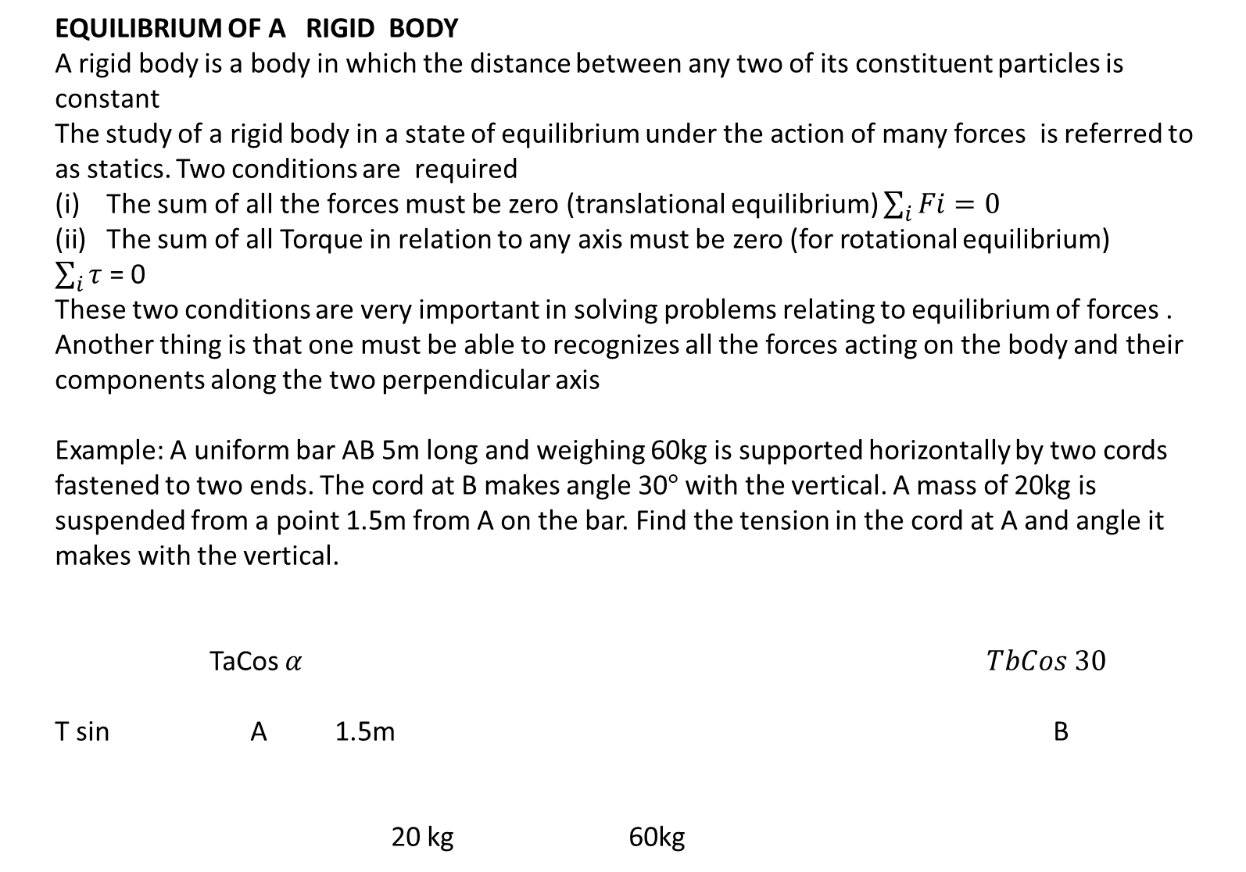
EQUILIBRIUM OF A RIGID BODY
A rigid body is a body in which the distance between any two of its constituent particles is constant
The study of a rigid body in a state of equilibrium under the action of many forces is referred to as statics. Two conditions are required
The sum of all the forces must be zero (translational equilibrium) $\sum_{i}{Fi=0}$
The sum of all Torque in relation to any axis must be zero (for rotational equilibrium)
$\sum_{i}{τ}$ = 0
These two conditions are very important in solving problems relating to equilibrium of forces .
Another thing is that one must be able to recognizes all the forces acting on the body and their components along the two perpendicular axis
Example: A uniform bar AB 5m long and weighing 60kg is supported horizontally by two cords fastened to two ends. The cord at B makes angle 30$°$ with the vertical. A mass of 20kg is suspended from a point 1.5m from A on the bar. Find the tension in the cord at A and angle it makes with the vertical.
TaCos$α TbCos 30$
T sin A 1.5m B
20 kg 60kg

Slide 17
END OF STUDY

