Slide 1
CHEMICAL EQUATIONS
Chemical equations are symbolic representations of chemical reactions in which the reactants and the products are expressed in terms of their respective chemical formulae.
Chemical equations make use of symbols to represent factors such as the direction of the reaction and the physical states of the reacting entities. Chemical equations were first formulated by the French chemist Jean Beguin in the year 1615.

Slide 2
Chemical reactions are represented on paper by chemical equations. For example, hydrogen gas (H₂) can react (burn) with oxygen gas (O₂) to form water (H₂O). The chemical equation for this reaction is written as: 2H2+O2→2H2O
This is an example of a , which is a concise way of representing a chemical reaction. The initial substances are called , and the final substances are called .

Slide 3
Representing the Direction of the Chemical Reaction
The reactants and the products (for which the chemical formulae are written in chemical equations) can be separated by one of the following four symbols.
In order to describe a net forward reaction, the symbol ‘→’ is used.
In order to describe a state of chemical equilibrium, the symbol ‘⇌’ is used.
To denote stoichiometric relationships, the ‘=’ symbol is used.
In order to describe a reaction that occurs in both forward and backward directions, the symbol ‘⇄’ is used.

Slide 4
Representing the Physical States of the Reacting Entities
The symbol (s) describes an entity in the solid state
The symbol (l) denotes the liquid state of an entity
The symbol (g) implies that the entity is in the gaseous state.
The (aq) symbol corresponding to an entity in a chemical equation denotes an aqueous solution of that entity.

Slide 5
Balancing Simple Chemical Equations
When a chemist encounters a new reaction, it does not usually come with a label that shows the balanced chemical equation. Instead, the chemist must identify the reactants and products and then write them in the form of a chemical equation that may or may not be balanced as first written.

Slide 6
The fundamental principle behind balancing equations is the law of conservation of mass, which states that matter, meaning physical substances like atoms and molecules, cannot be created or destroyed.

Slide 7
This means there must be the same mass of atoms on both sides of a chemical equation, and therefore the same number of atoms.
Ca + Cl₂ → CaCl₂
REACTANT: 1 atom of Ca and 2 atoms of Cl
PRODUCT: 1 atom of Ca and 2 atoms of Cl
The equation is balanced because the number of atoms on the reactant side is same as those on the product side

Slide 8
The subscript represents the number of atoms of a given element in each molecule. For example, in 3O₂, the coefficient is 3 and the subscript is 2.
STEPS FOR BALANCING OF EQUATION:
First, count the atoms on each side. Second, change the coefficient of one of the substances. Third, count the numbers of atoms again and, from there, repeat steps two and three until you’ve balanced the equation.

Slide 9
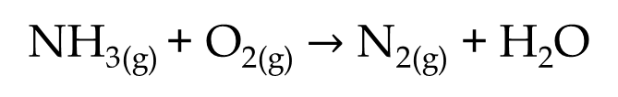
H₂ + O₂ → H₂O.
CO₂ + H₂O → C₆H₁₂O₆ + O₂
NH_{3(g)} + O_{2(g)} $→$ N_{2(g)} + H₂O

Slide 10
STOICHIOMETRY
Stoichiometry is the quantitative relation between the number of moles (and therefore mass) of various products and reactants in a chemical reaction. Chemical reactions must be balanced or, in other words, must have the same number of various atoms in the products as in the reactants.

Slide 11
Mass Relations from Equation
The relative numbers of reactant and product molecule are indicated by the coefficient of a balance chemical equations. Using molar masses, we can compare the relative masses of reactants and products in a chemical equation.

Slide 12
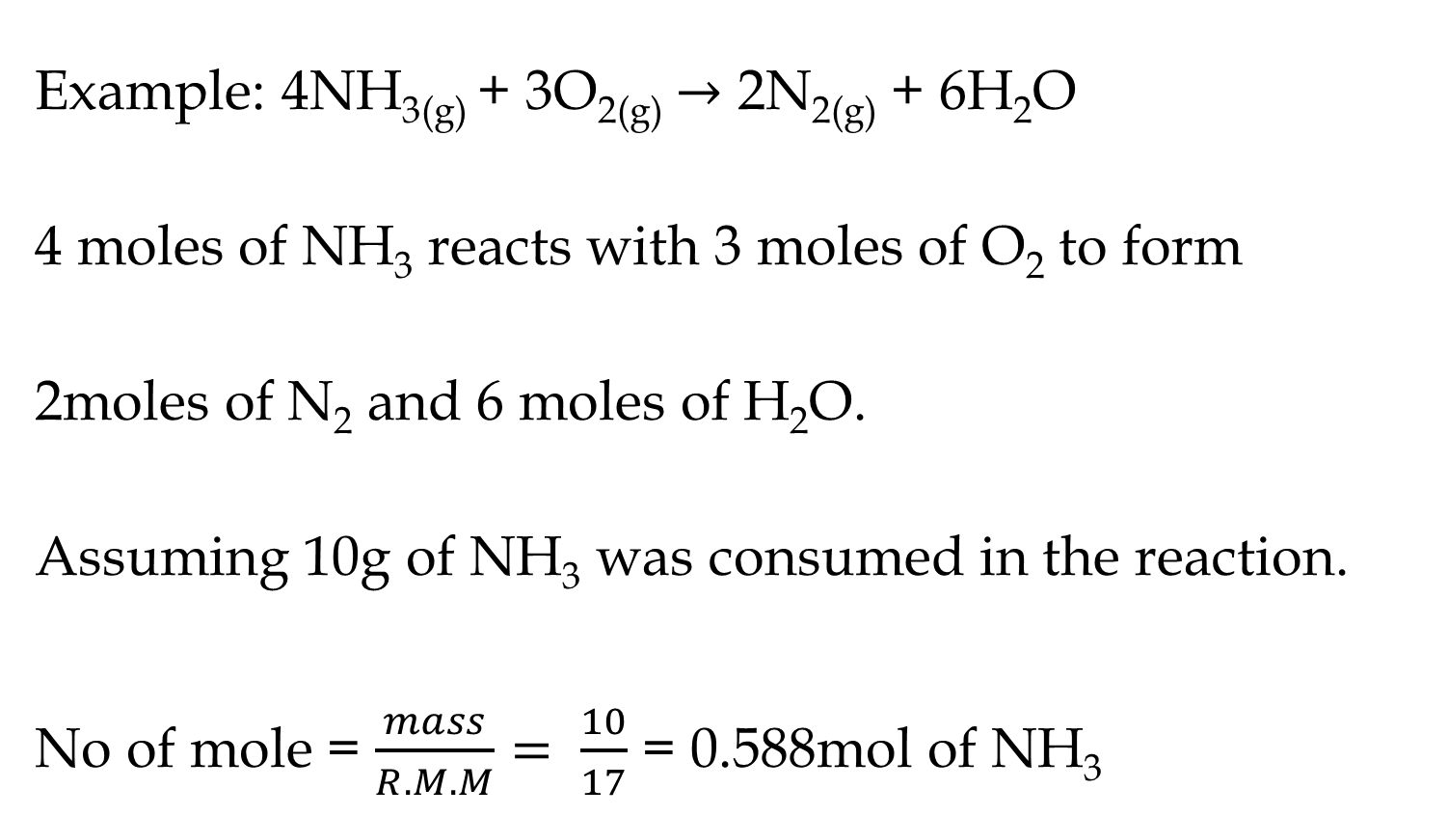
Example: 4NH_{3(g)} + 3O_{2(g)} $→$ 2N_{2(g)} + 6H₂O
4 moles of NH₃ reacts with 3 moles of O₂ to form
2moles of N₂ and 6 moles of H₂O.
Assuming 10g of NH₃ was consumed in the reaction.
No of mole = $\frac{mass}{R.M.M}= \frac{10}{17}$ = 0.588mol of NH₃

Slide 13
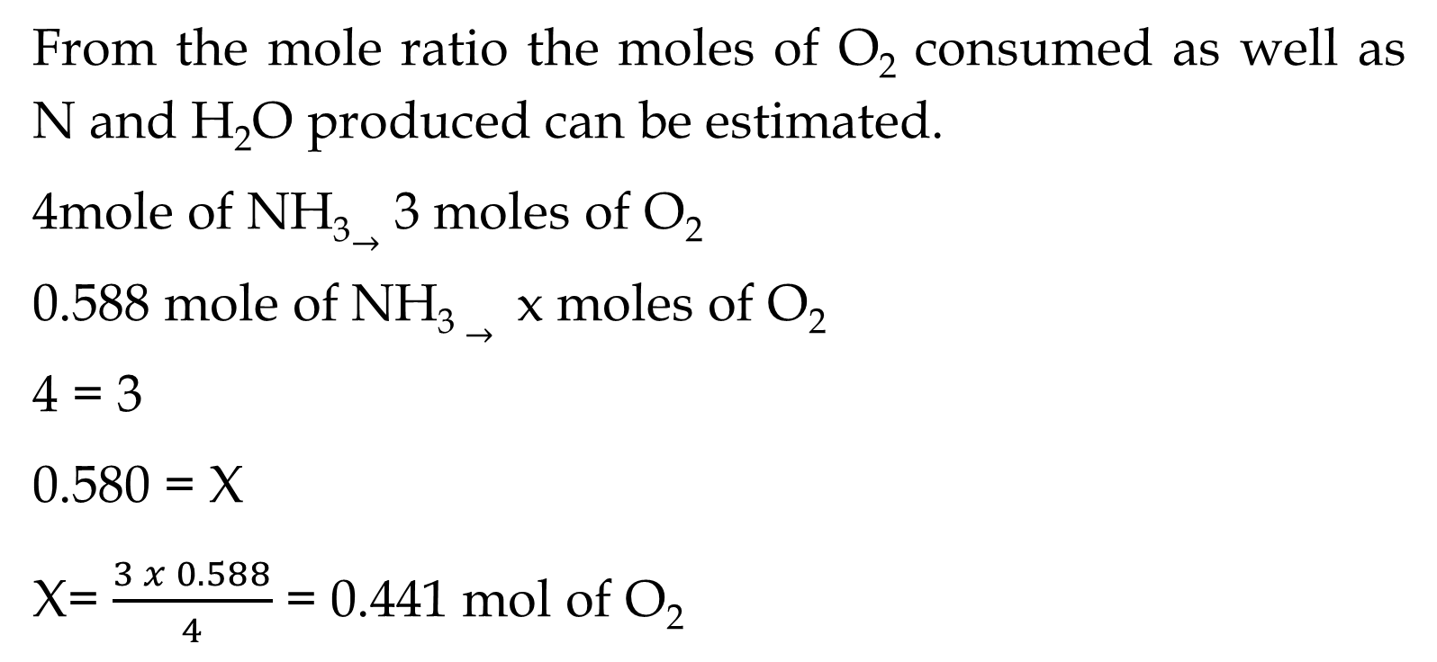
From the mole ratio the moles of O₂ consumed as well as N and H₂O produced can be estimated.
4mole of NH₃$→$ 3 moles of O₂
0.588 mole of NH_{3 ­}$→$ x moles of O₂
4 = 3
0.580 = X
X= $\frac{3 x 0.588}{4}$ = 0.441 mol of O₂

Slide 14
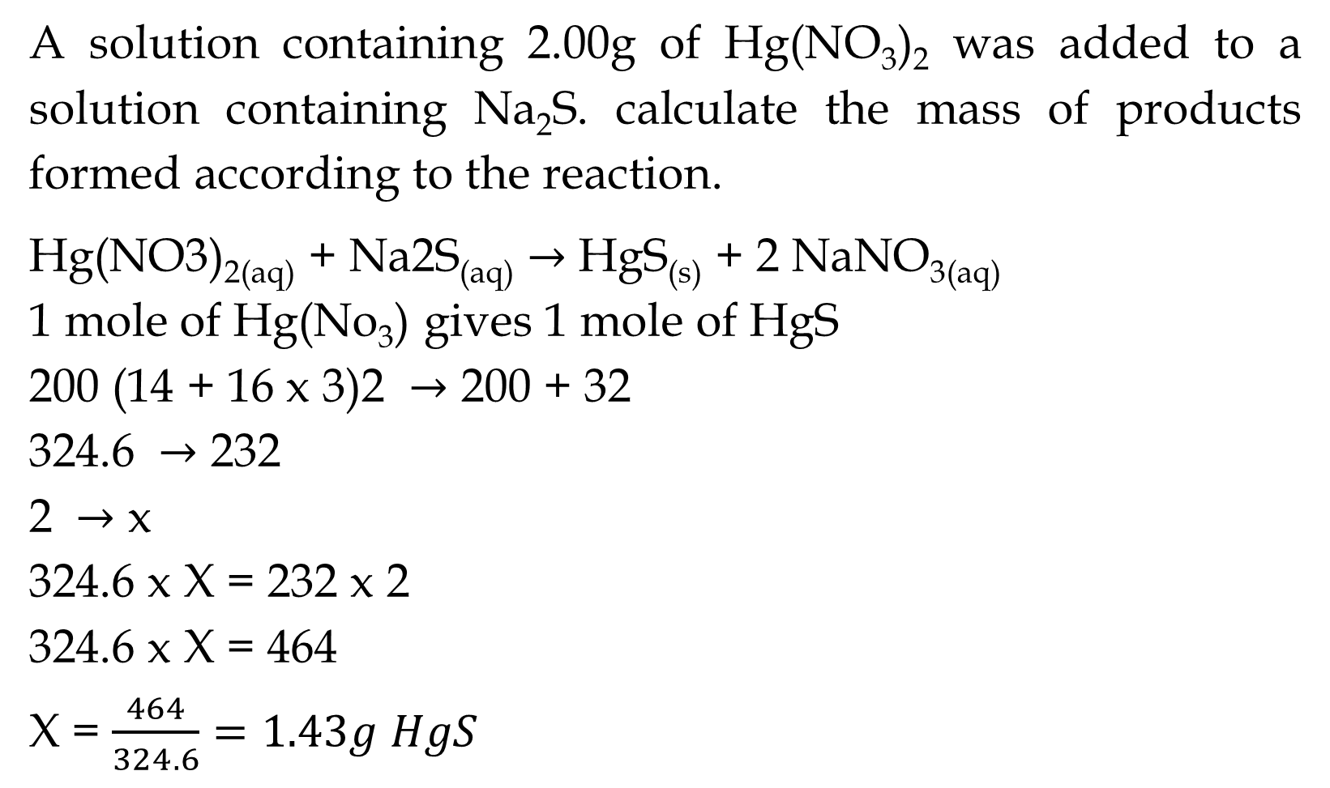
A solution containing 2.00g of Hg(NO₃)₂ was added to a solution containing Na₂S. calculate the mass of products formed according to the reaction.
Hg(NO3)_{2(aq)} + Na2S_{(aq)} $→$ HgS_{(s)} + 2 NaNO_{3(aq)}
1 mole of Hg(No₃)­ gives 1 mole of HgS
200 (14 + 16 x 3)2 $→$ 200 + 32
324.6 $→$ 232
2 $→$ x
324.6 x X = 232 x 2
324.6 x X = 464
X = $\frac{464}{324.6}=1.43g HgS$

Slide 15
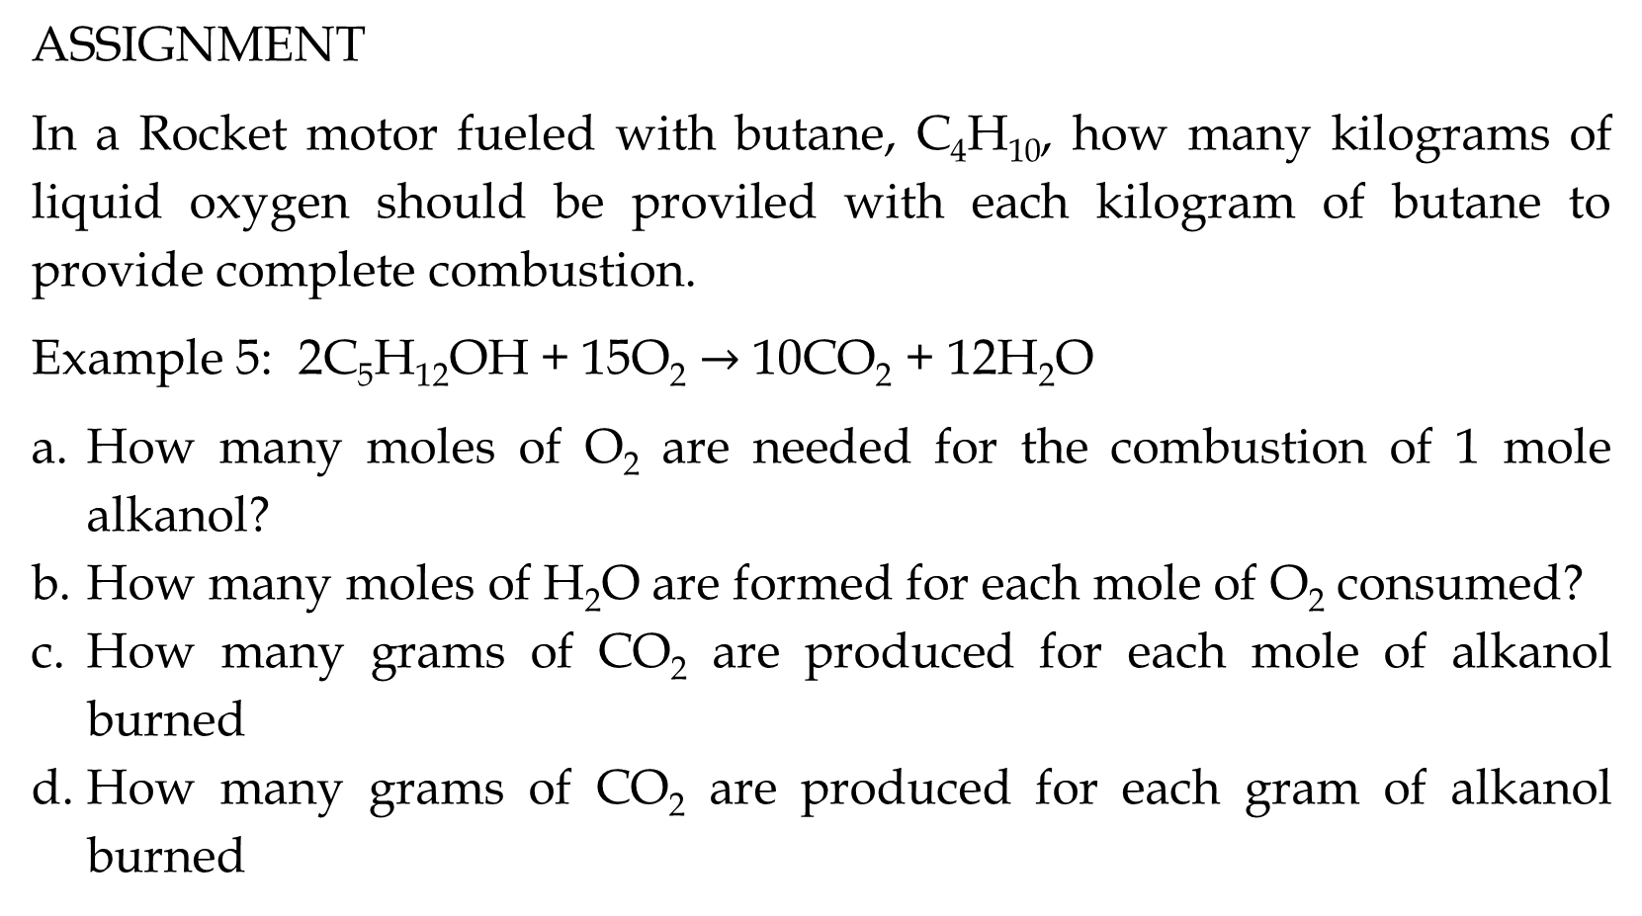
ASSIGNMENT
In a Rocket motor fueled with butane, C₄H₁₀, how many kilograms of liquid oxygen should be proviled with each kilogram of butane to provide complete combustion.
Example 5: 2C₅H₁₂OH + 15O₂ $→$ 10CO₂ + 12H₂O
How many moles of O₂ are needed for the combustion of 1 mole alkanol?
How many moles of H₂O are formed for each mole of O₂ consumed?
How many grams of CO₂ are produced for each mole of alkanol burned
How many grams of CO₂ are produced for each gram of alkanol burned

Slide 16
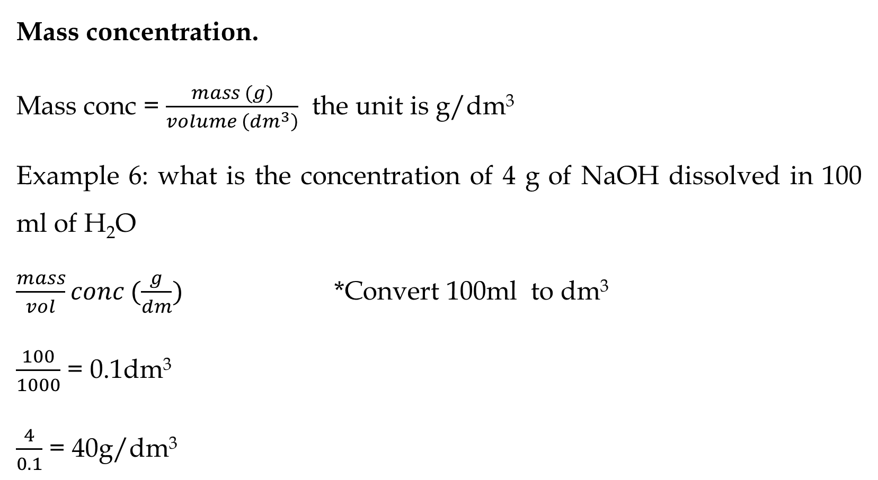
Mass concentration.
Mass conc = $\frac{mass (g)}{volume \left({dm}^{3}\right)}$ the unit is g/dm³
Example 6: what is the concentration of 4 g of NaOH dissolved in 100 ml of H₂O
$\frac{mass}{vol}conc (\frac{g}{dm})$ *Convert 100ml to dm³
$\frac{100}{1000}$ = 0.1dm³
$\frac{4}{0.1}$ = 40g/dm³

Slide 17
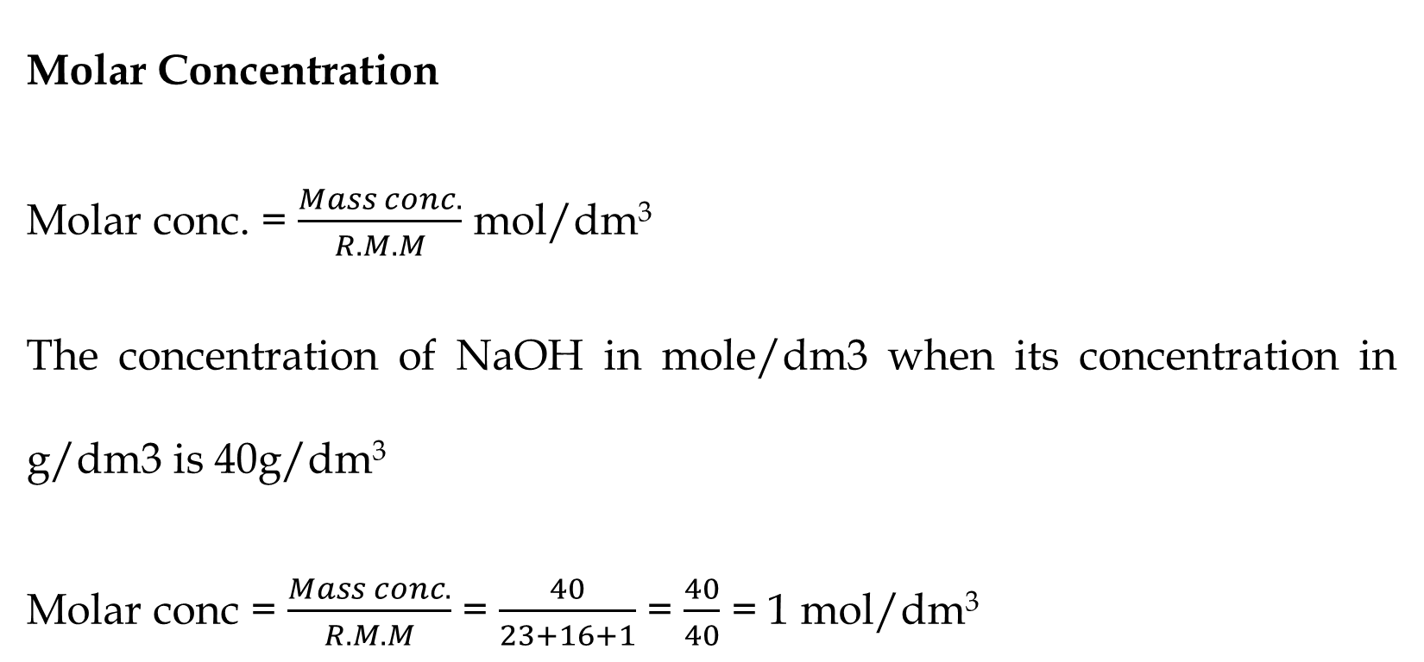
Molar Concentration
Molar conc. = $\frac{Mass conc.}{R.M.M}$ mol/dm³
The concentration of NaOH in mole/dm3 when its concentration in g/dm3 is 40g/dm³
Molar conc = $\frac{Mass conc.}{R.M.M}$ = $\frac{40}{23+16+1}$ = $\frac{40}{40}$ = 1 mol/dm³

Slide 18
You are provided with anhydrous Na₂CO₂ of O.52g which was dissolved in 100ml of distilled water. 25ml of the stock solution of Na₂CO₃ prepared was titrated against HCL to arrive at an average titre value of 20cm³. Calculate
The number of mole of Na₂CO₃ in the stock solution
The number of moles of Na₂CO₃ in the 25cm³
The molarity of the HCl
The molarity of the Na₂CO₃

