Slide 1
CHM 101
GENERAL CHEMISTRY I
COURSE LECTURER: Hassan K. Busari

Slide 2
COURSE SYNOPSIS
Chemical Bonding: Electrovalent bond between ions. Covalent bonds. Coordinate covalent bond. Metallic bonds. Intermolecular forces. Hydrogen bonding and its influence on properties. Kinetic theory of matter

Slide 3
CHEMICAL BONDING
IONIC BONDING: involves transfer of electrons from metal (forming positive ion) to non-metal (forming negative ion). Example
1s²2s²2p⁶3s¹
1s²2s²2p⁶3s²3p⁵
1s²2s²2p⁶
1s²2s²2p⁶3s²3p⁶
Na looses an electron while Cl gains an electron to attain octet configuration. Other examples: MgCl₂, Li₂O
COVALENT BONDING: involves sharing of electrons. Other examples: O₂, H₂, N₂
Chlorine molecule (Cl₂)
Coordinate Covalent Bonding: the shared pair of electrons is donated by only one of the bonded atoms

Slide 4
Properties of ionic compounds
Solid with high melting and boiling points
Conduct electricity when molten, but not as a solid
It is made from a combination of metal and non-metal elements
Properties of covalent compounds
Low boiling/melting points
Soft in nature and relatively flexible
Poor conductors of heat and electricity
It is made from combination of non-metal elements

Slide 5
Metallic bonding: is the electrostatic attraction between the delocalized electron cloud and metal ions. It holds metal ion tightly and confers high melting point.
Factors affecting metallic bonding
Size of the metal ion: it increases with decrease in size of metal ion
Number of valence electrons: it increases with increase in number of valence electrons
Intermolecular forces: two types – van der Waal’s forces and hydrogen bonding. Both describe electrostatic attraction between dipoles i.e. the attraction between the positive end of one molecule and negative end of another molecule
Types of Dipoles:
Permanent dipole: it exits in all polar molecules due to difference in electronegativity
Instantaneous dipole: it occurs as a result of fluctuations in the electron cloud
Induced dipole: is created due to influence of a neighbouring dipole
Temporary

Slide 6
Van der Waal’s: includes dipole-dipole, dipole-induced dipole and instantaneous dipole-induced dipole interactions
Dipole – dipole interactions: it occurs when polar molecules orientate themselves in order to maximise attractive forces between molecules while repulsive forces are minimized
Dipole - induced dipole: when a non-polar molecule approaches a polar molecule, a dipole will be induced in the non-polar molecule
Instantaneous dipole - induced dipole: it occurs from fluctuations of electron cloud and can induce dipole moment in neighbouring atoms.The greater the number of electrons in a molecule, the easier it is for instantaneous dipole to be set up. The force of attraction between two temporary dipoles is known as a London force or dispersion force

Slide 7
Hydrogen bonding: it exists when hydrogen is bonded to highly electronegative atom. It is the strong dipole-dipole interaction between hydrogen and electronegative atom (F, O, Cl, N). It is weaker than covalent bond but stronger than van der Waal’s forces. For hydrogen bonding to occur
A hydrogen atom must be bonded directly to highly electronegative atom
An unshared pair of electron on the electronegative atom
Hydrogen bonds are responsible for:
The relatively high melting and boiling points of water and hydrogen fluoride
Holding the strands of DNA together

Slide 8
Intermolecular and intramolecular hydrogen bonding
Hydrogen bonds that occur between two different molecules are called intermolecular hydrogen bonds e.g H₂O and NH₃. Hydrogen bonds that occur within the same molecule are called intramolecular hydrogen bonds e.g 2-Nitrophenol.
(a) Intermolecular hydrogen bonds (b) Intramolecular hydrogen bond

Slide 9
KINETIC THEORY OF MATTER
All matter is composed of atoms and molecules that are constantly in motion
The state of matter depends on the motion and arrangement of these particles, which is determined by temperature-higher temperatures mean higher particle motion
The three states of matter-solids, liquids and gases-can be distinguished based on how close together and how freely the particles can move
Note:
At the same temperature, the heavier particles move slower than the lighter particles.
Temperature is a measure of average kinetic energy (K.E) in a molecule

Slide 10
Solids, liquids & gases
Solids
Solids have a fixed volume and shape and they have a high density.
The atoms vibrate in position but can’t change location
The particles are packed very closely together in a fixed and regular pattern
Liquids
Liquids also have a fixed volume but adopt the shape of the container
They are generally less dense than solids (an exception is water), but much denser than gases
The particles move and slide past each other which is why liquids adopt the shape of the container and also why they are able to flow freely

Slide 11
Solids, liquids & gases
Gases
Gases do not have a fixed volume, and, like liquids, take up the shape of the container (Indefinite shape and volume)
Gases have a very low density
Since there is a lot of space between the particles, gases can be compressed into a much smaller volume
The particles are far apart and move randomly and quickly (around 500 m/s) in all directions
They collide with each other and with the sides of the container (this is how pressure is created inside a can of gas)

Slide 12
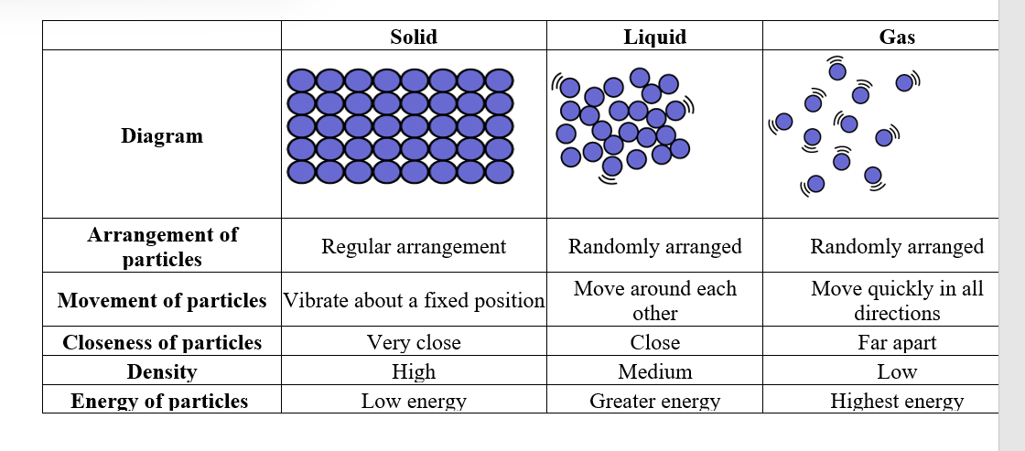
Summary of the properties of solids, liquids and gases

Slide 13
Phase Changes
Melting/Freezing
Boiling (vaporization)/Condensing
Sublimation
Evaporation

Slide 14
Melting/Freezing Point
Change from solid to liquid and liquid to solid.
Same temperature.; if melting, particles are gaining energy; if freezing, particles are losing energy.
The stronger the intermolecular forces (IF’s), the more energy needed to weaken the IF’s, therefore higher melting point temperature.

Slide 15
Melting/Freezing Continued
During the phase change, the temp. remains constant
After all the sample has changed phase, the temp. will change.
During the phase change, potential energy (P.E.) is changing, but K.E. is constant.

Slide 16
Boiling (Vaporization)/Condensation Point
Change from liquid to gas and gas to liquid.
Same temp.; if boiling, particles are gaining energy; if condensing, particles are losing energy
The stronger the IF’s, the more energy needed to break the IF’s, therefore higher boiling point temperature

Slide 17
Boiling (Vaporization)/Condensation Point
During the phase change, the temp. remains constant
After all the sample has changed phase, the temp. will change.
During the phase change, potential energy (P.E.) is changing, but K.E. is constant.

Slide 18
Sublimation
Changing directly from a solid to a gas.
Also, changing directly from a gas to a solid
Skipping the liquid state.

Slide 19
Evaporation
Liquid to gas but not necessarily at the boiling point temperature.
Some particles gain enough K.E. to overcome the IF’s and become a gas.
Remember, temperature is a measure of the average K.E.

Slide 20
Reading List:
Abass A. Olajire. Fundamental University Organic and Inorganic Chemistry. Sina 2tees publication. 2008.
Sachin Kr. Ghosh. Advanced General Organic Chemistry (A modern Approach). New Central Book Agency (P) Limited. 2007
Wong Y.C., Wong C.T., Onyinruka S.O., Akpanisi L.E. University General Chemistry Inorganic and Physical. Africana-FEP Publishers LTD

