Slide 1
BINOMIAL EXPANSION, THEOREM APPLICATION AND EXAMPLES
Prof. Amos Oladele POPOOLA and Joseph ADEDEJI
Department of Mathematical Sciences
Osun State University
Osogbo Nigeria.
JANUARY 2025

Slide 2

Definition: A binomial is an expression of the form ${\left(a+b\right)}^{n}$ where $a,b∈ℝ and n∈ℤ.$
Question: How do we expand a binomial?
There are two ways to it.

Slide 3
1. BINOMIAL EXPANSION BY USING PASCAL TRIANGLE
Preamble:
Blaise Pascal ( 19/06/1623 – 19/08/1662), a French Mathematician and a philosopher observed that a table of coefficient (know as Pascal triangle) to determine the coefficient of the expansion

Slide 4
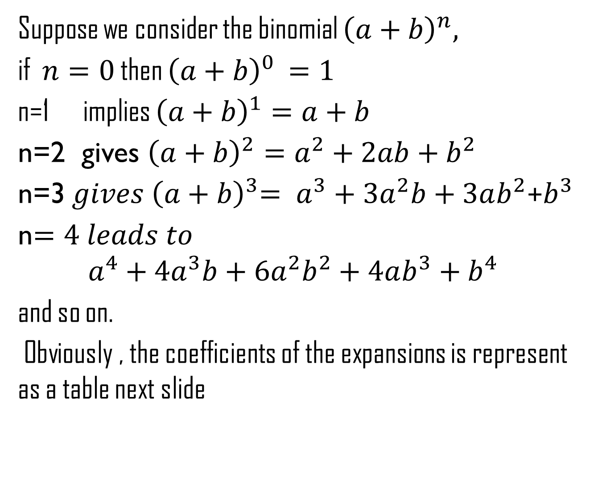
Suppose we consider the binomial ${\left(a+b\right)}^{n},$
if $n=0$ then ${\left(a+b\right)}^{0 }=1$
n=1 implies ${\left(a+b\right)}^{1}=a+b$
n=2 gives ${\left(a+b\right)}^{2}=a^{2}+2ab+b^{2}$
n=3${ gives \left(a+b\right)}^{3}= a^{3}+3a^{2}b+3ab^{2}$+$b^{3}$
n$=4 leads to$
$$a^{4}+4a^{3}b+6a^{2}b^{2}+4ab^{3}+b^{4}$$
and so on.
Obviously , the coefficients of the expansions is represent as a table next slide

Slide 5
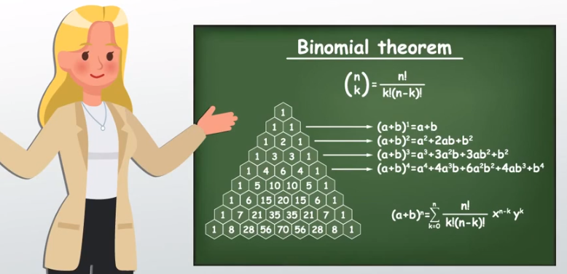

Slide 6
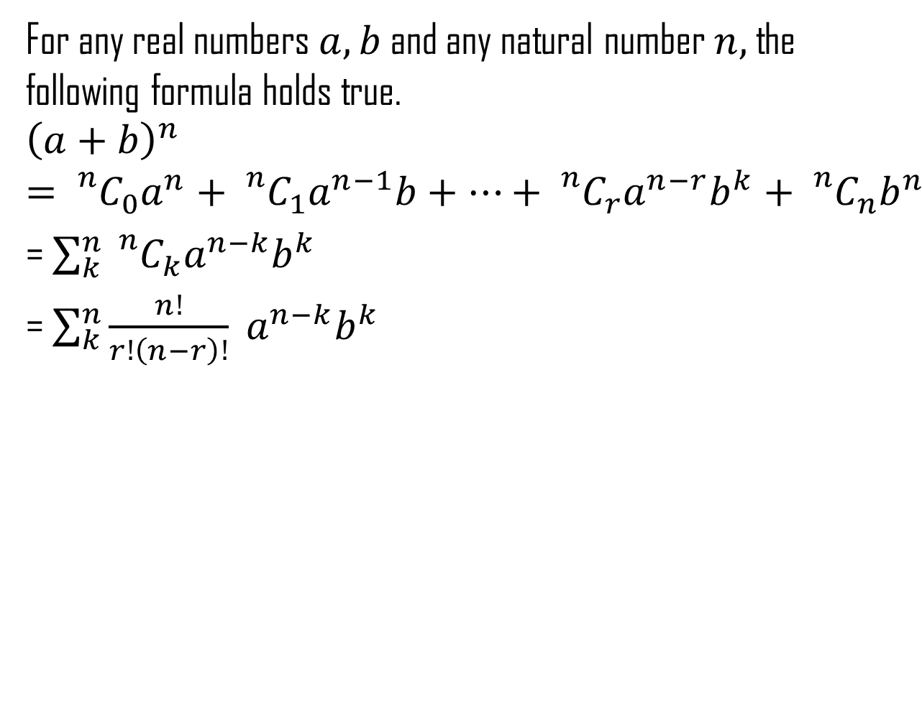
2. BINOMIAL EXPANSION BY USING THEOREM
For any real numbers $a,b$ and any natural number $n,$ the following formula holds true.
$${\left(a+b\right)}^{n}={}_{}^{n}{C_{0}a^{n}+{}_{}^{n}{C_{1}a^{n−1}b+…+{}_{}^{n}{C_{r}a^{n−r}b^{k}+{}_{}^{n}{C_{n}b^{n}}}}}$$
= $\sum_{k}^{n}{{}_{}^{n}{C_{k}a^{n−k}b^{k}}}$
=$\sum_{k}^{n}{\frac{n!}{r!\left(n−r\right)!} a^{n−k}b^{k}}$

Slide 7
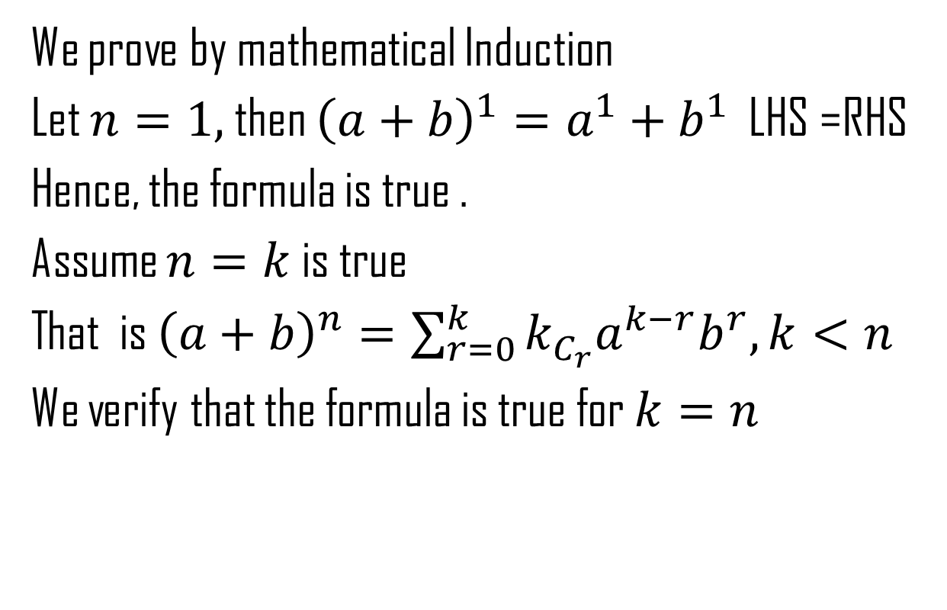
PROOF
We prove by mathematical Induction
Let $n=1,$ then ${\left(a+b\right)}^{1}=a^{1}+b^{1}$ LHS =RHS
Hence, the formula is true .
Assume $n=k$ is true
That is ${\left(a+b\right)}^{n}=\sum_{r=0}^{k}{k_{C_{r}}a^{k−r}b^{r},}k<n$
We verify that the formula is true for $k=n$

Slide 8
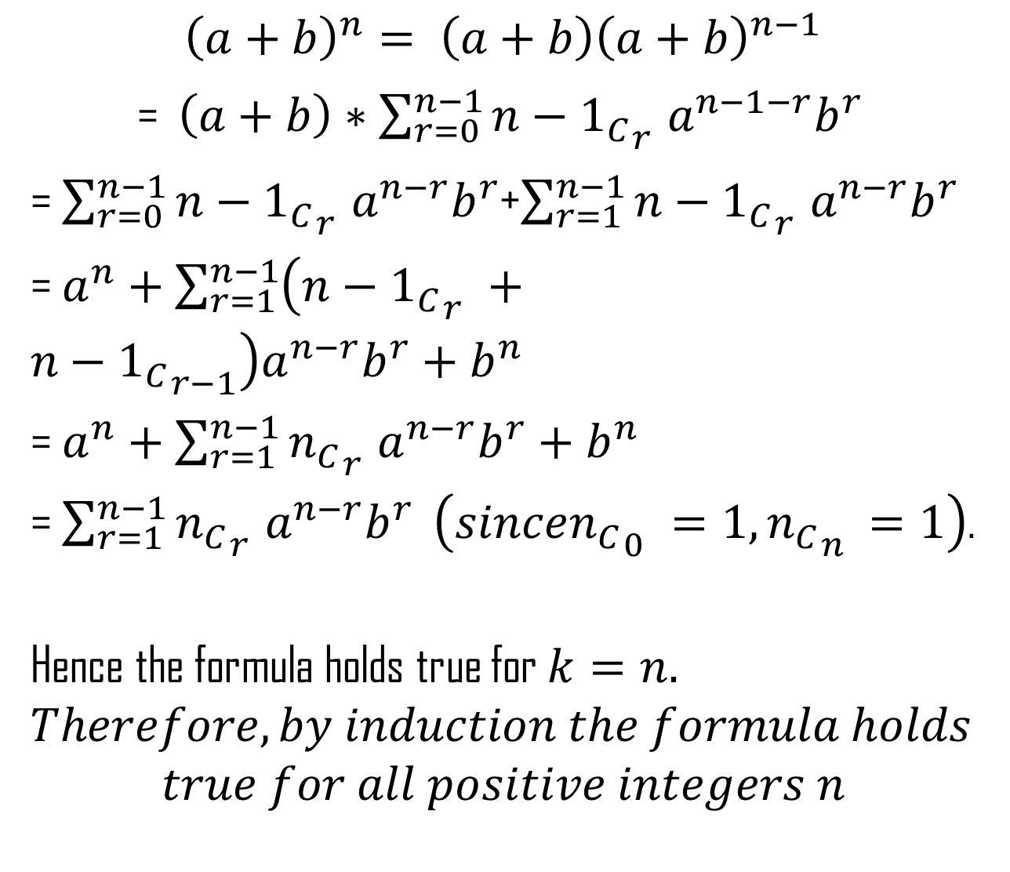
$${\left(a+b\right)}^{n}= \left(a+b\right){\left(a+b\right)}^{n−1}$$
= $\left(a+b\right)∗\sum_{r=0}^{n−1}{{{n−1}_{C}}_{r}^{}a^{n−1−r}b^{r}}$
= $\sum_{r=0}^{n−1}{{{n−1}_{C}}_{r}^{}a^{n−r}b^{r}}$+$\sum_{r=1}^{n−1}{{{n−1}_{C}}_{r}^{}a^{n−r}b^{r}}$
= $a^{n}+\sum_{r=1}^{n−1}{\left({{n−1}_{C}}_{r}^{}+{{n−1}_{C}}_{r−1}^{}\right)a^{n−r}b^{r}+b^{n}}$
=$a^{n}+\sum_{r=1}^{n−1}{{n_{C}}_{r}^{}a^{n−r}b^{r}+b^{n}}$
=$\sum_{r=1}^{n−1}{{n_{C}}_{r}^{}a^{n−r}b^{r}}$$\left(since{n_{C}}_{0}^{}=1,{n_{C}}_{n}^{}=1\right)$.
Hence the formula holds true for $k=n.$
$$Therefore, by induction the formula holds$$
$$true for all positive integers n$$

Slide 9
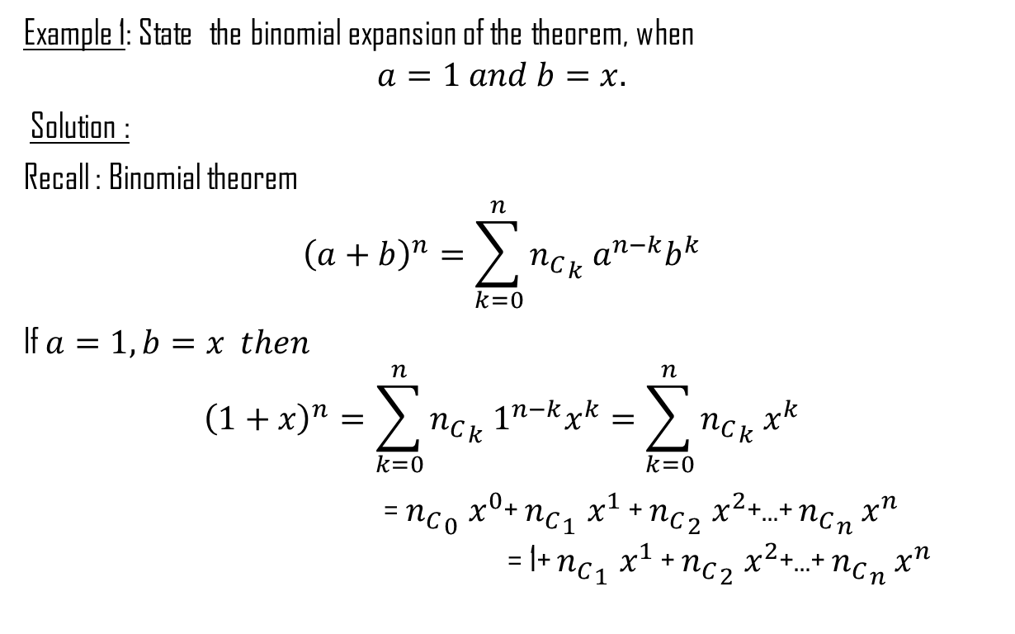
Worked Examples
Example 1: State the binomial expansion of the theorem, when
$$a=1 and b=x.$$
Solution :
Recall : Binomial theorem
$${\left(a+b\right)}^{n}=\sum_{k=0}^{n}{{n_{C}}_{k}^{}a^{n−k}b^{k}}$$
If $a=1,b=x then$
$${\left(1+x\right)}^{n}=\sum_{k=0}^{n}{{n_{C}}_{k}^{}1^{n−k}x^{k}}=\sum_{k=0}^{n}{{n_{C}}_{k}^{}x^{k}}$$
= ${n_{C}}_{0}^{}x^{0}$+${n_{C}}_{1}^{}x^{1}$ + ${n_{C}}_{2}^{}x^{2}$+…+${n_{C}}_{n}^{}x^{n}$ = 1+ ${n_{C}}_{1}^{}x^{1}$ + ${n_{C}}_{2}^{}x^{2}$+…+${n_{C}}_{n}^{}x^{n}$

Slide 10
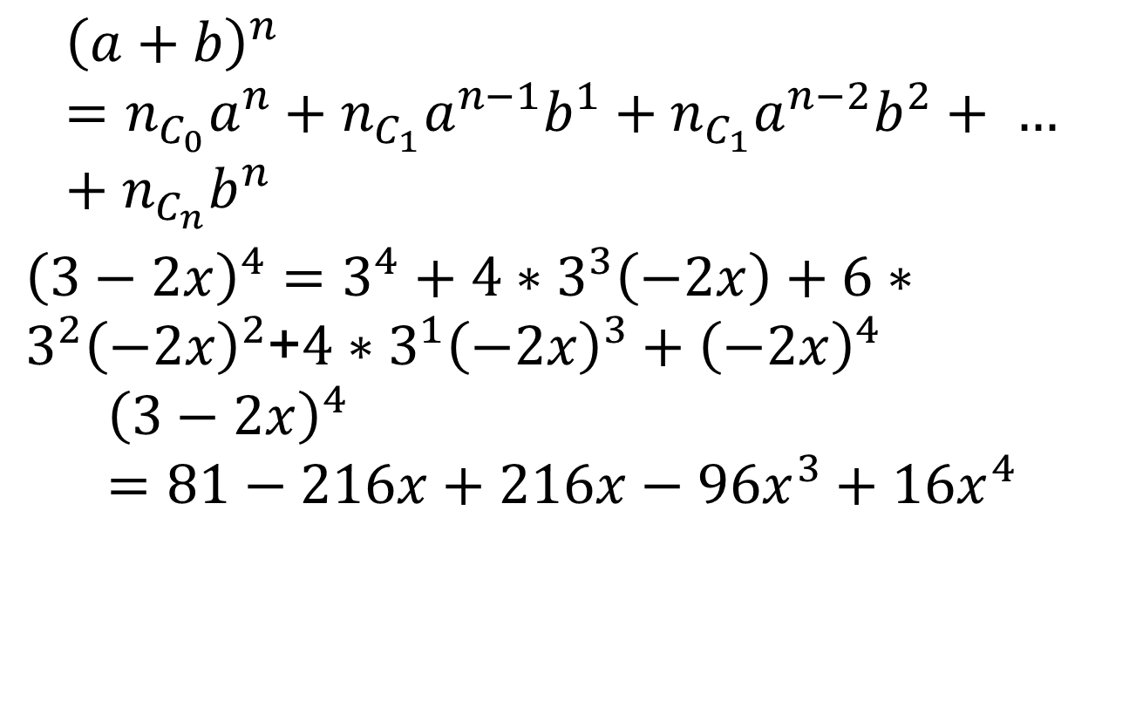
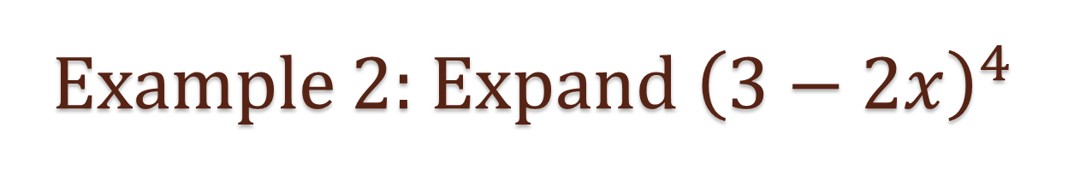
Example 2: Expand${\left(3−2x\right)}^{4}$
$${\left(a+b\right)}^{n}=n_{C_{0}}a^{n}+n_{C_{1}}a^{n−1}b^{1}+n_{C_{1}}a^{n−2}b^{2}+ …+n_{C_{n}}b^{n}$$
${\left(3−2x\right)}^{4}=3^{4}+4∗3^{3}\left(−2x\right)+6∗3^{2}{\left(−2x\right)}^{2}$+$4∗3^{1}{\left(−2x\right)}^{3}+{\left(−2x\right)}^{4}$
$${\left(3−2x\right)}^{4}=81−216x+216x−96x^{3}+{16x}^{4}$$

Slide 11
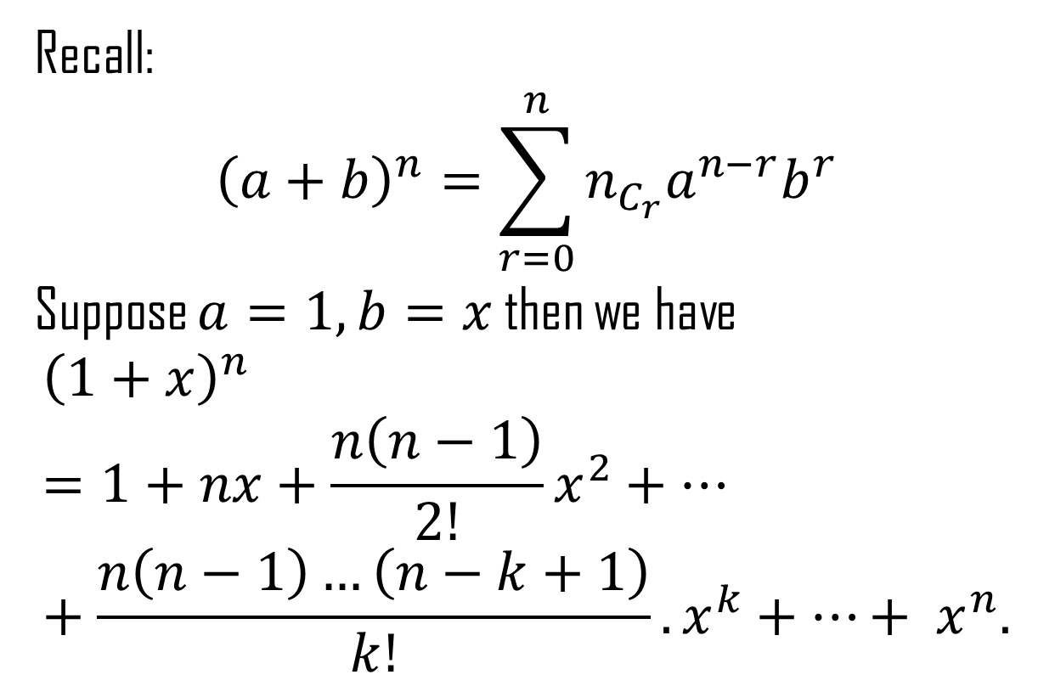
Binomial Expansion for negative Integers
Recall:
$${\left(a+b\right)}^{n}=\sum_{r=0}^{n}{n_{C_{r}}a^{n−r}b^{r}}$$
Suppose $a=1, b=x$ then we have
$${\left(1+x\right)}^{n}=1+nx+\frac{n\left(n−1\right)}{2!}x^{2}+…+\frac{n\left(n−1\right)…\left(n−k+1\right)}{k!}.x^{k}+…+ x^{n}.$$

Slide 12
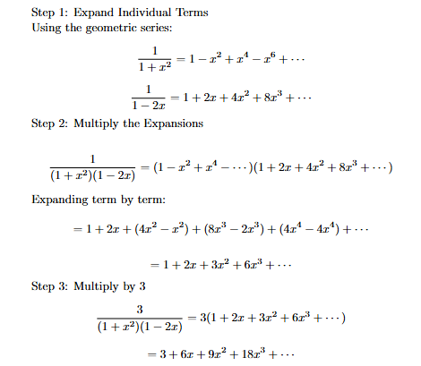

Example 3: Expand $\frac{3}{\left(1+x^{2}\right)\left(1−2x\right)}$ to the ascending power of $x^{2}.$

Slide 13
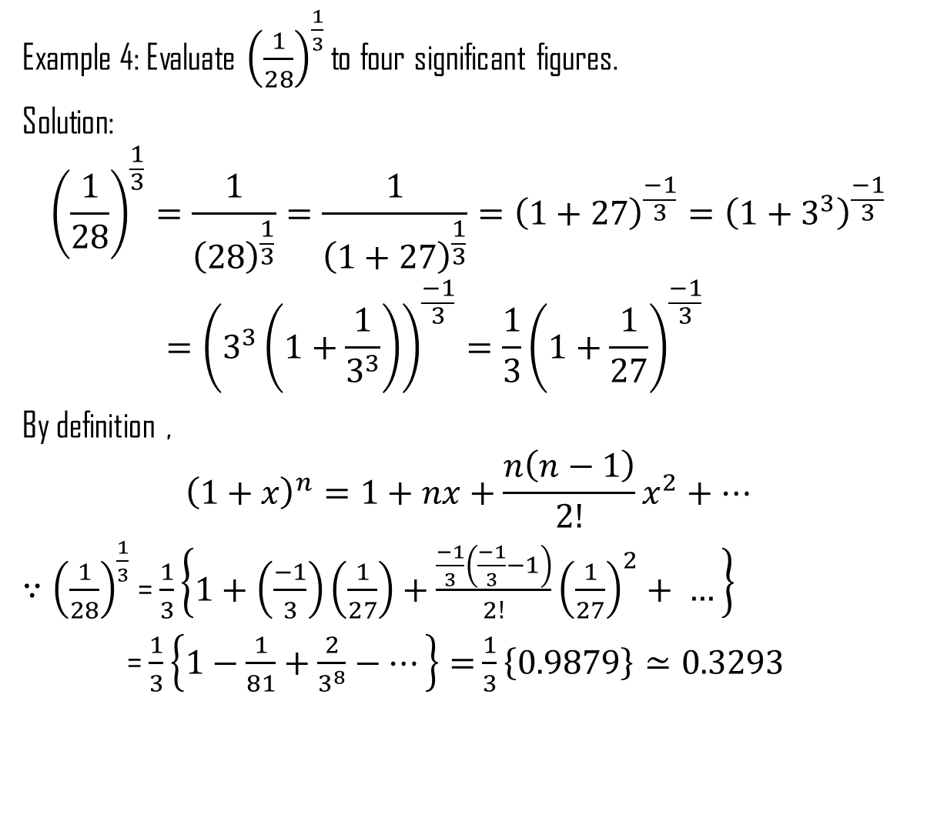
Evaluation with binomial expansion
Example 4: Evaluate ${\left(\frac{1}{28}\right)}^{\frac{1}{3}}$ to four significant figures.
Solution:
$${\left(\frac{1}{28}\right)}^{\frac{1}{3}}=\frac{1}{{\left(28\right)}^{\frac{1}{3}}}=\frac{1}{{\left(1+27\right)}^{\frac{1}{3}}}={\left(1+27\right)}^{\frac{−1}{3}}={\left(1+3^{3}\right)}^{\frac{−1}{3}}={\left(3^{3}\left(1+\frac{1}{3^{3}}\right)\right)}^{\frac{−1}{3}}=\frac{1}{3}{\left(1+\frac{1}{27}\right)}^{\frac{−1}{3}}$$
By definition ,
$${\left(1+x\right)}^{n}=1+nx+\frac{n\left(n−1\right)}{2!}x^{2}+…$$
$∵{\left(\frac{1}{28}\right)}^{\frac{1}{3}}$ = $\frac{1}{3}\left\{1+\left(\frac{−1}{3}\right)\left(\frac{1}{27}\right)+\frac{\frac{−1}{3}\left(\frac{−1}{3}−1\right)}{2!}{\left(\frac{1}{27}\right)}^{2}+ …\right\}$
=$\frac{1}{3}\left\{1−\frac{1}{81}+\frac{2}{3^{8}}−…\right\}=$$\frac{1}{3}\left\{0.9879\right\}≃0.3293$

Slide 14
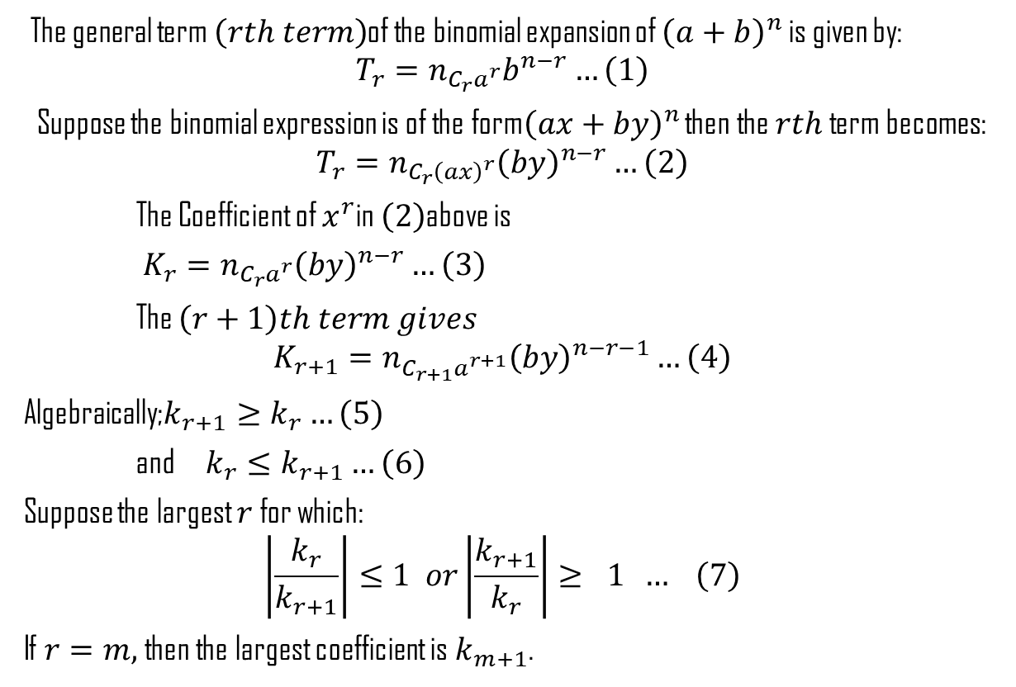
Largest Coefficient and Greatest Coefficient
The general term $\left(rth term\right)$of the binomial expansion of ${\left(a+b\right)}^{n}$ is given by:
$$T_{r}=n_{C_{r}a^{r}}b^{n−r}…\left(1\right)$$
Suppose the binomial expression is of the form${\left(ax+by\right)}^{n}$ then the $rth$ term becomes:
$$T_{r}=n_{C_{r}{\left(ax\right)}^{r}}{\left(by\right)}^{n−r}…\left(2\right)$$
The Coefficient of $x^{r}$in $\left(2\right)$above is
$K_{r}=n_{C_{r}a^{r}}{\left(by\right)}^{n−r}…\left(3\right)$
The $\left(r+1\right)th term gives$
$$K_{r+1}=n_{C_{r+1}a^{r+1}}{\left(by\right)}^{n−r−1}…\left(4\right)$$
Algebraically;$k_{r+1}≥k_{r}…\left(5\right)$
and $k_{r}≤k_{r+1}…\left(6\right)$
Suppose the largest $r$for which:
$$\left|\frac{k_{r}}{k_{r+1}}\right|≤1 or\left|\frac{k_{r+1}}{k_{r}}\right|≥ 1 … \left(7\right)$$
If $r=m,$ then the largest coefficient is $k_{m+1}$.

Slide 15
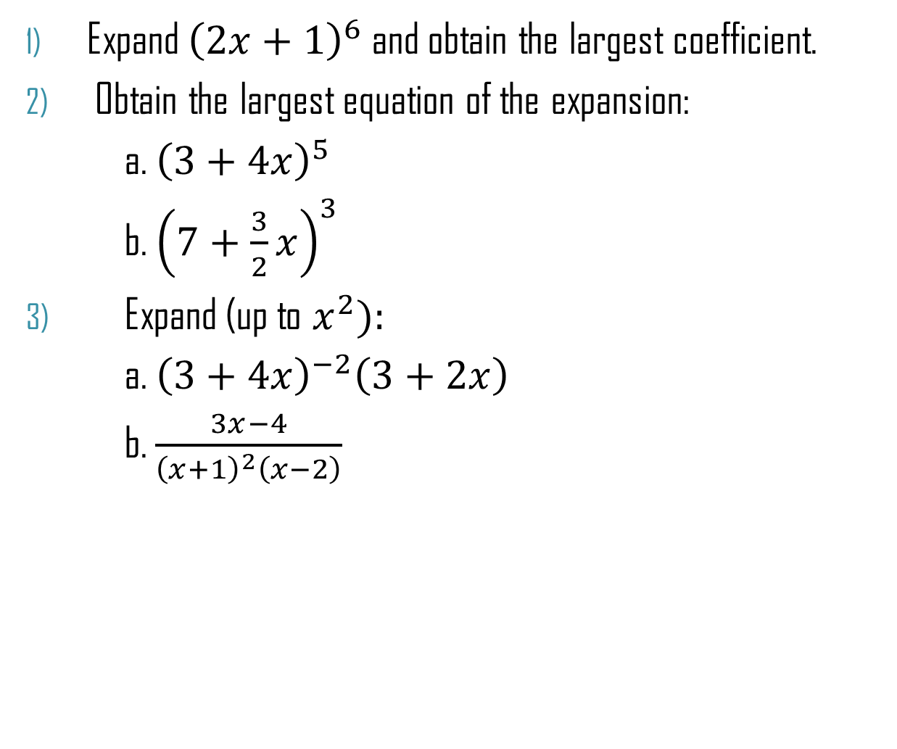
Worked Examples
Expand ${\left(2x+1\right)}^{6}$ and obtain the largest coefficient.
Obtain the largest equation of the expansion:
a. ${\left(3+4x\right)}^{5}$
b. ${\left(7+\frac{3}{2}x\right)}^{3}$
Expand (up to $x^{2}):$
a. ${\left(3+4x\right)}^{−2}\left(3+2x\right)$
b. $\frac{3x−4}{{\left(x+1\right)}^{2}\left(x−2\right)}$

Slide 16
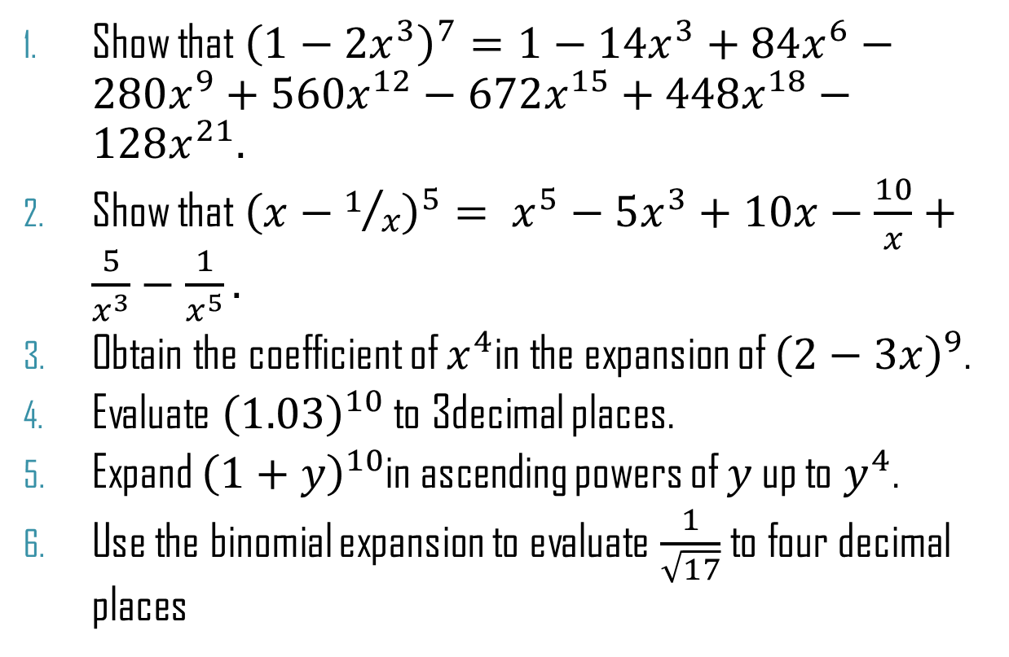
Tutorial Questions
Show that ${\left(1−2x^{3}\right)}^{7}=1−14x^{3}+84x^{6}−280x^{9}+560x^{12}−672x^{15}+448x^{18}−128x^{21}.$
Show that ${\left(x−1/x\right)}^{5}= x^{5}−5x^{3}+10x−\frac{10}{x}+\frac{5}{x^{3}}−\frac{1}{x^{5}}.$
Obtain the coefficient of $x^{4}$in the expansion of ${\left(2−3x\right)}^{9}$.
Evaluate ${\left(1.03\right)}^{10}$ to 3decimal places.
Expand ${\left(1+y\right)}^{10}$in ascending powers of $y$ up to $y^{4}$.
Use the binomial expansion to evaluate $\frac{1}{\sqrt{17}}$ to four decimal places

Slide 17
MATHEMATICAL INDUCTION
Principle of Mathematical Induction

Slide 18
Definition
Mathematical Induction (MI) is a technique or method of proving a statement/proposition that is asserted about every natural number.
MI is therefore, a tools/ technique for proving statement which in reality maybe too difficult to establish. It could be used to prove equations, theorms, formulas, inequalities and for solving problems in geometry.

Slide 19
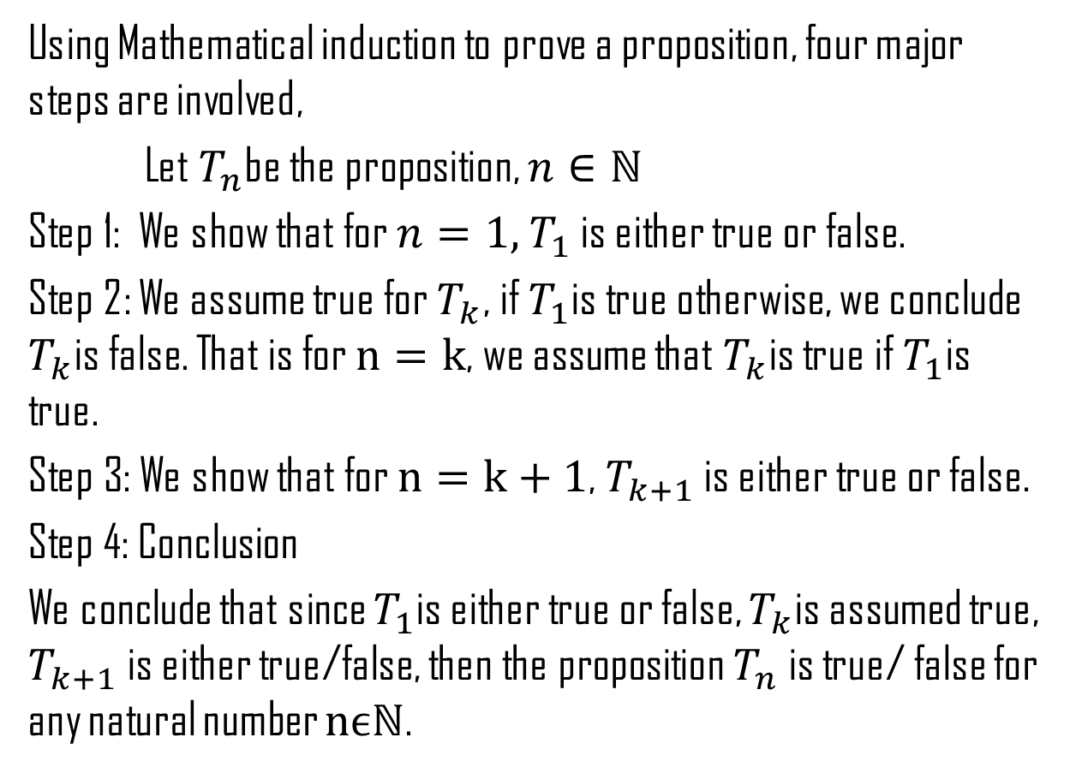
Principle of Mathematical Induction
Using Mathematical induction to prove a proposition, four major steps are involved,
Let $T_{n}$be the proposition, $n∈ℕ$
Step 1: We show that for $n=1,$$T_{1}$ is either true or false.
Step 2: We assume true for $T_{k}$, if $T_{1}$is true otherwise, we conclude $T_{k}$is false. That is for $n=k$, we assume that $T_{k}$is true if $T_{1}$is true.
Step 3: We show that for $n=k+1$, $T_{k+1}$ is either true or false.
Step 4: Conclusion
We conclude that since $T_{1}$is either true or false, $T_{k}$is assumed true, $T_{k+1}$ is either true/false, then the proposition $T_{n}$ is true/ false for any natural number $nϵℕ$.

Slide 20
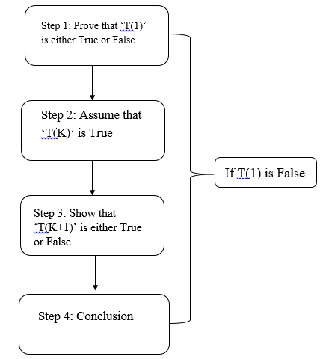

Slide 21
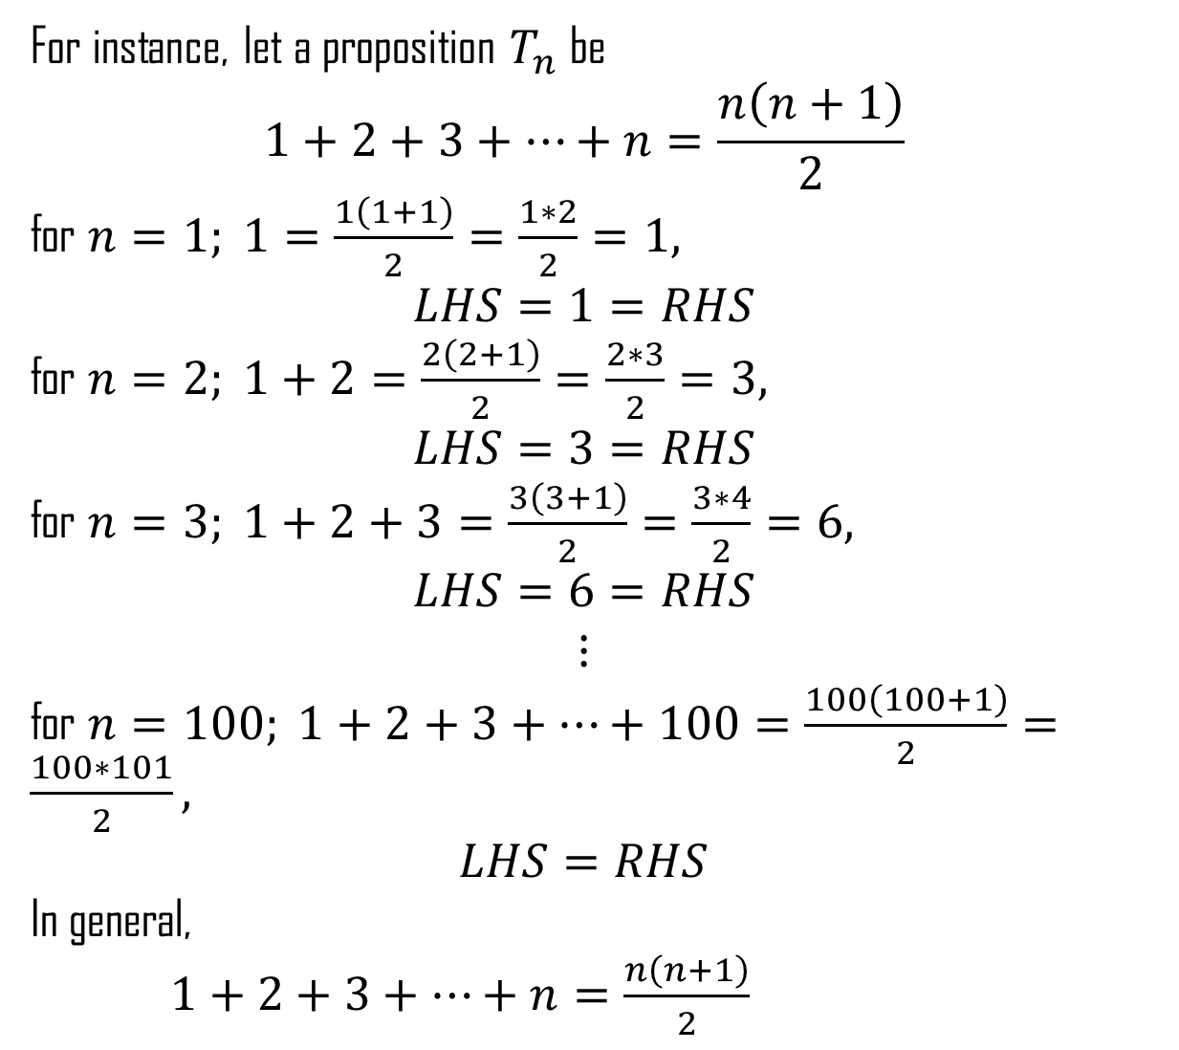
For instance, let a proposition $T_{n}$be
$$1+2+3+…+n=\frac{n\left(n+1\right)}{2}$$
for $n=1; 1=\frac{1\left(1+1\right)}{2}=\frac{1∗2}{2}=1,$
$$LHS=1=RHS$$
for $n=2; 1+2=\frac{2\left(2+1\right)}{2}=\frac{2∗3}{2}=3,$
$$LHS=3=RHS$$
for $n=3; 1+2+3=\frac{3\left(3+1\right)}{2}=\frac{3∗4}{2}=6,$
$$LHS=6=RHS$$
$$⋮$$
for $n=100; 1+2+3+…+100=\frac{100\left(100+1\right)}{2}=\frac{100∗101}{2},$
$$LHS=RHS$$
In general,
$1+2+3+…+n=\frac{n\left(n+1\right)}{2}$

Slide 22
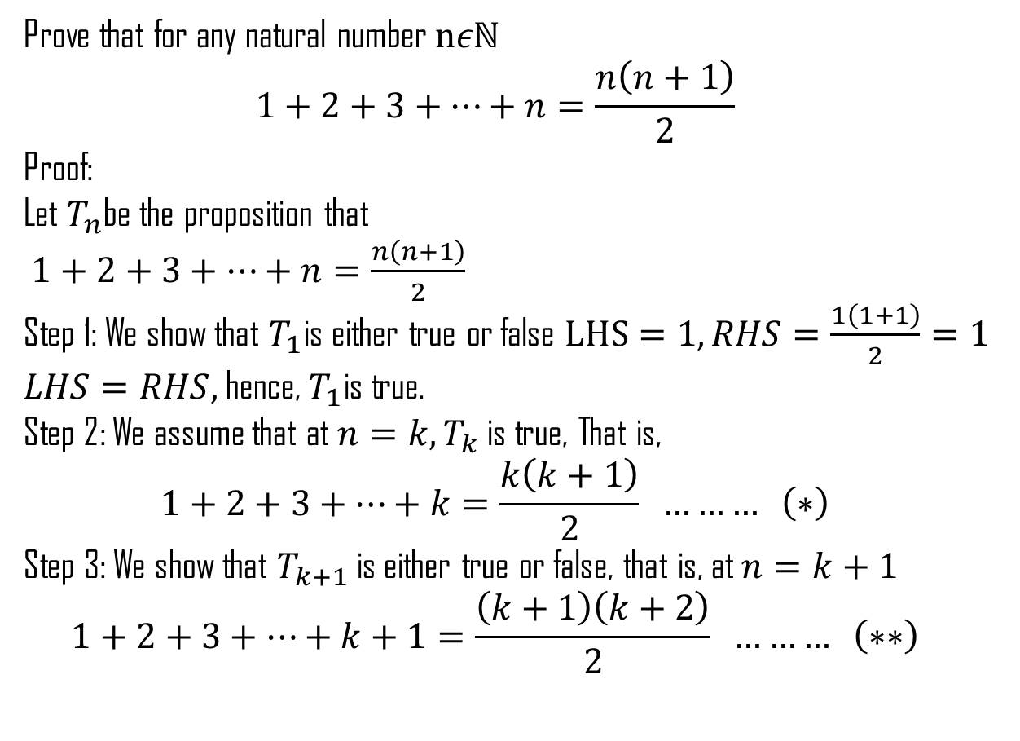
Worked Example
Prove that for any natural number $nεℕ$
$$1+2+3+…+n=\frac{n\left(n+1\right)}{2}$$
Proof:
Let $T_{n}$be the proposition that
$1+2+3+…+n=\frac{n\left(n+1\right)}{2}$
Step 1: We show that $T_{1}$is either true or false $LHS=1, RHS=\frac{1\left(1+1\right)}{2}=1$
$LHS=RHS,$ hence, $T_{1}$is true.
Step 2: We assume that at $n=k, T_{k}$ is true, That is,
$$1+2+3+…+k=\frac{k\left(k+1\right)}{2} ……… \left(∗\right)$$
Step 3: We show that $T_{k+1}$ is either true or false, that is, at $n=k+1$
$$1+2+3+…+k+1=\frac{\left(k+1\right)\left(k+2\right)}{2} ……… \left(∗∗\right)$$

Slide 23
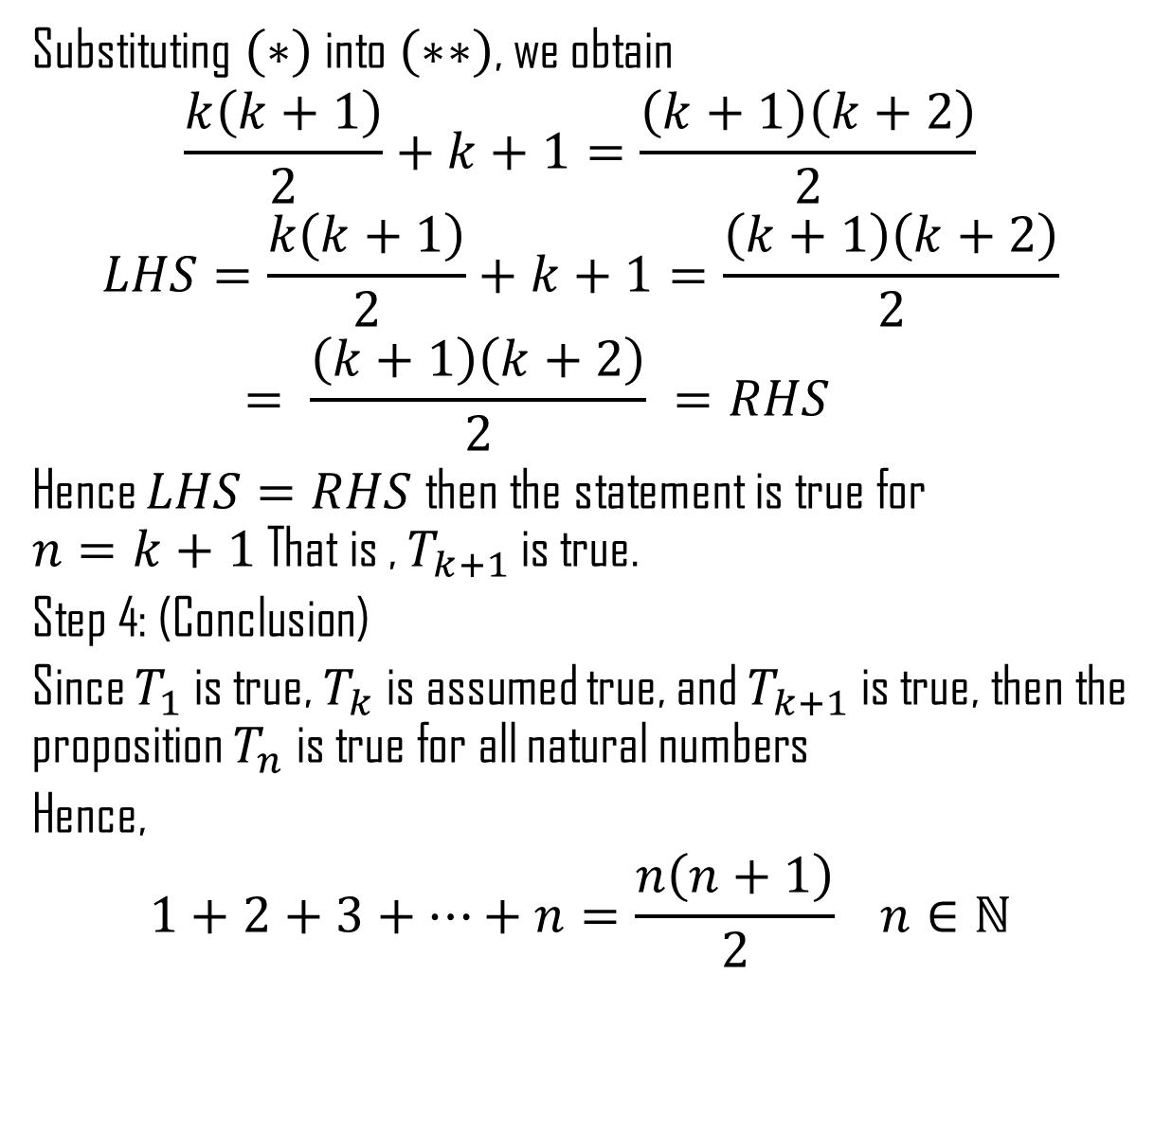
Substituting $\left(∗\right)$ into $\left(∗∗\right)$, we obtain
$$\frac{k\left(k+1\right)}{2}+k+1=\frac{\left(k+1\right)\left(k+2\right)}{2}$$
$$LHS=\frac{k\left(k+1\right)}{2}+k+1=\frac{\left(k+1\right)\left(k+2\right)}{2}= \frac{\left(k+1\right)\left(k+2\right)}{2} =RHS$$
Hence $LHS=RHS$then the statement is true for $n=k+1$ That is , $T_{k+1}$ is true.
Step 4: (Conclusion)
Since $T_{1}$ is true, $T_{k}$ is assumed true, and $T_{k+1}$ is true, then the proposition $T_{n}$ is true for all natural numbers
Hence,
$$1+2+3+…+n=\frac{n\left(n+1\right)}{2} n∈ℕ$$

Slide 24
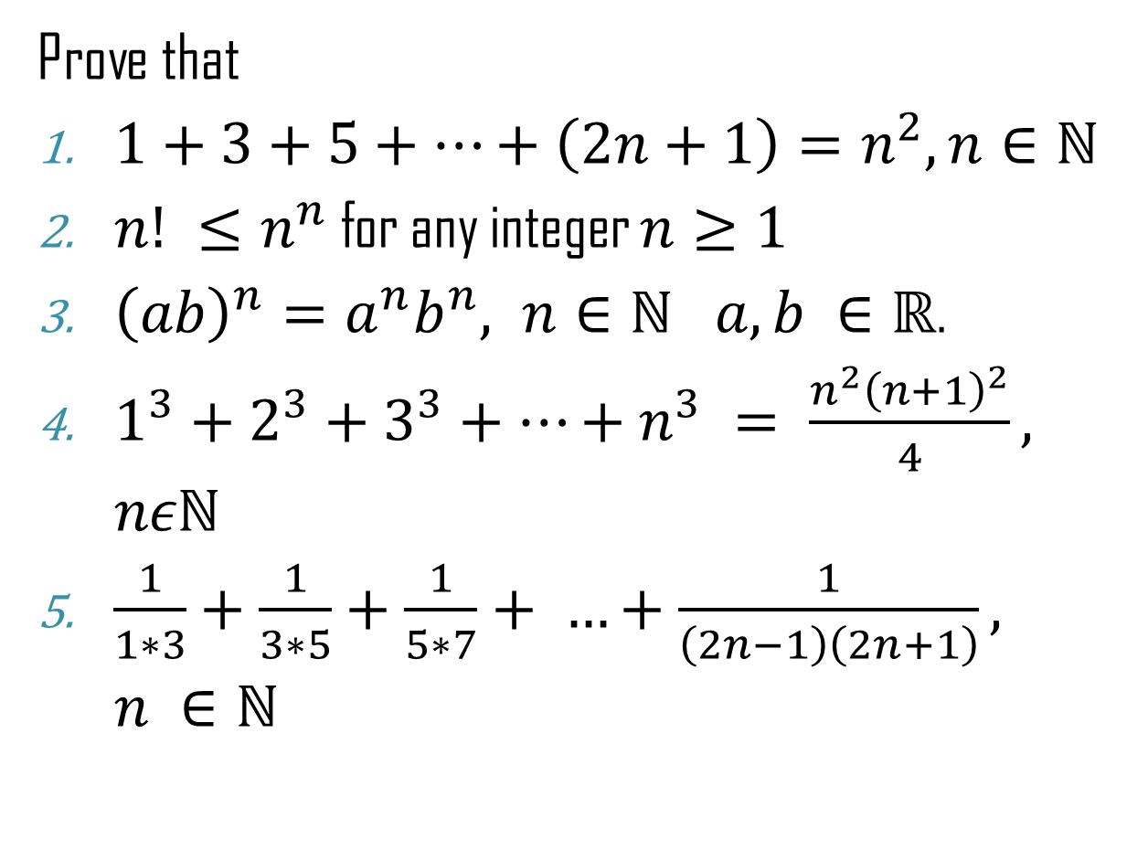
Tutorial Questions
Prove that
$1+3+5+…+\left(2n+1\right)=n^{2}, n∈ℕ$
$n! ≤n^{n}$ for any integer $n≥1$
${\left(ab\right)}^{n}=a^{n}b^{n}, n∈ℕ a,b ∈ℝ$.
$1^{3}+2^{3}+3^{3}+…+n^{3} = \frac{n^{2}{\left(n+1\right)}^{2}}{4}, nεℕ$
$\frac{1}{1∗3}+\frac{1}{3∗5}+\frac{1}{5∗7}+ …+\frac{1}{\left(2n−1\right)\left(2n+1\right)}, n ∈ℕ$

Slide 25
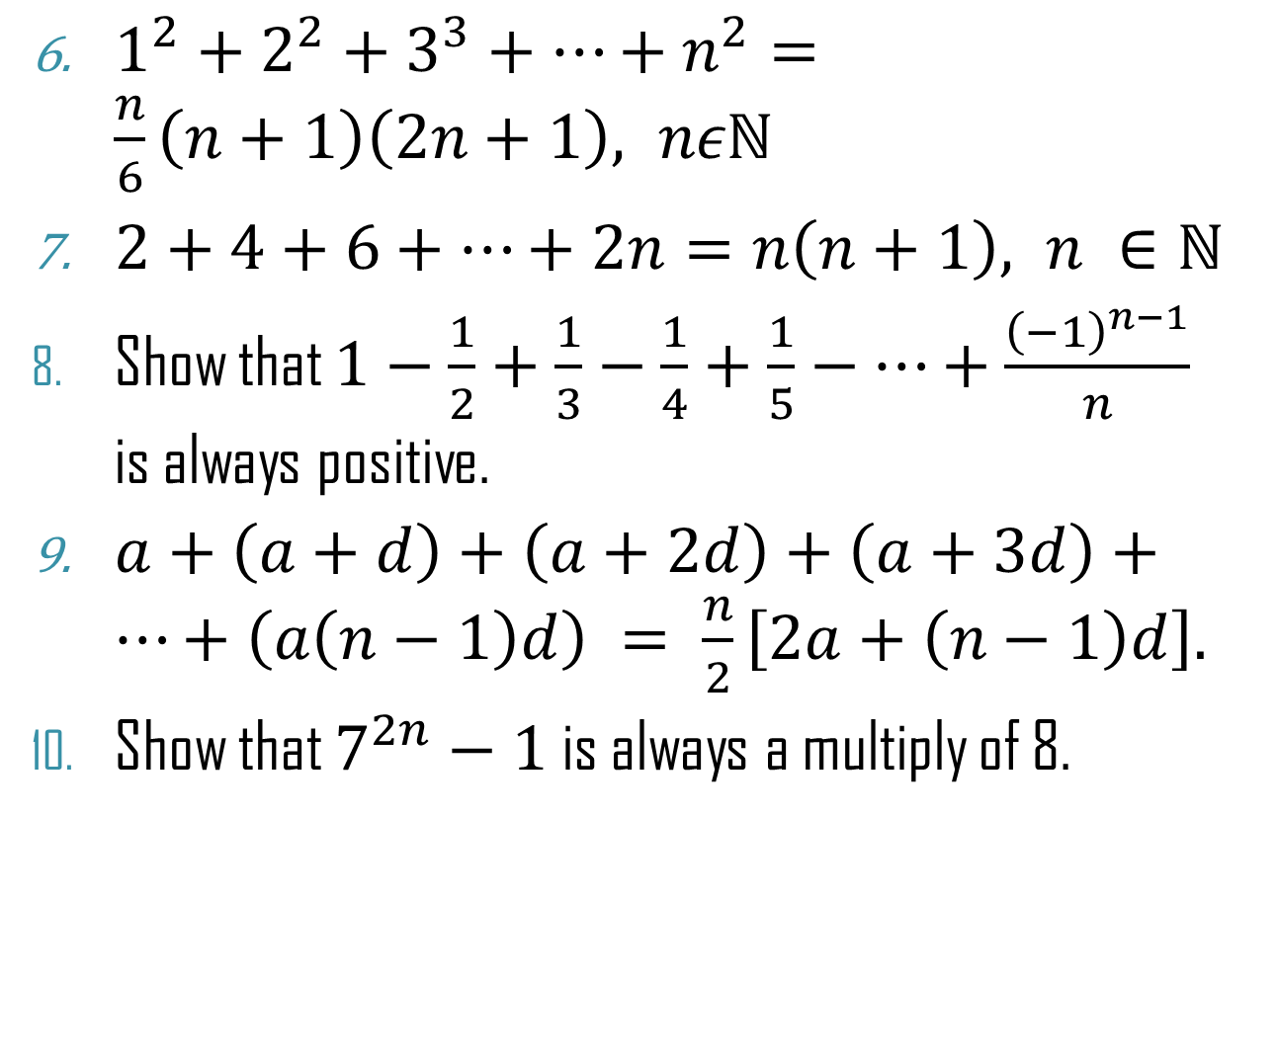
$1^{2}+2^{2}+3^{3}+…+n^{2}=\frac{n}{6}\left(n+1\right)\left(2n+1\right), nεℕ$
$2+4+6+…+2n=n\left(n+1\right), n ∈ℕ$
Show that $1−\frac{1}{2}+\frac{1}{3}−\frac{1}{4}+\frac{1}{5}−…+\frac{{\left(−1\right)}^{n−1}}{n}$ is always positive.
$a+\left(a+d\right)+\left(a+2d\right)+\left(a+3d\right)+…+\left(a\left(n−1\right)d\right) = \frac{n}{2}\left[2a+\left(n−1\right)d\right].$
Show that $7^{2n}−1$is always a multiply of 8.

