Slide 1

OSUN STATE UNIVERSITY COLLEGE OF SCIENCE, ENGINEERING AND TECHNOLOGY FACULTY OF BASIC AND APPLIED SCIENCES DEPARTMENT OF PHYSICS 2023/2024 HARMATTAN SEMESTER COURSE CODE: PHY 101 COURSE: GENERAL PHYSICS 1 UNIT: 3 LECTURERS: DR. J.T. ADELEKE
3080

Slide 2
WORK
3080
Work W is the energy transferred to or from an object by means of a force acting on the object. Energy transferred to the object is positive work, and energy transferred from the object is negative work. It is a scalar quantity
The work done by a force can be defined as the product of the magnitude of the displacement and the component of the force in the direction of the displacement. The unit of work in S.I. is the Joule (J). 1 J = 1 N.m other unit of work is foot-pound (ft.lb), although old use.

Slide 3


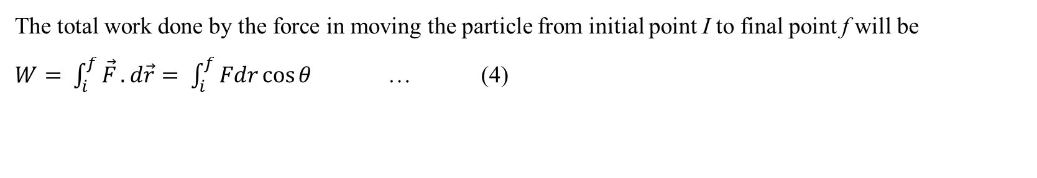
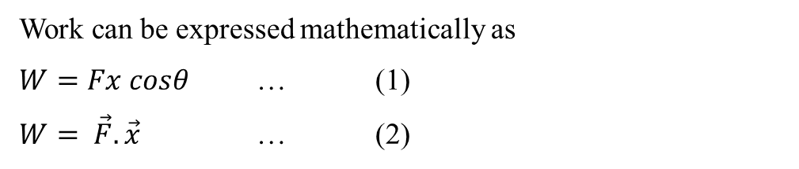




Mathematical expression of Work done
3080
F
$$\vec{F}$$
$$θ$$
$$x$$
$$θ$$
f
Fig. 1
$$x$$
$$\vec{dr}$$
Fig. 2
i
Work can be expressed mathematically as
$W=Fx cosθ$ … (1)
$W= \vec{F}.\vec{x}$ … (2)
Equation (2) is especially useful for calculating the work when $\vec{F} and \vec{x}$ are given in unit vector notations.
If a force displaces the particle through a distance dr, then the work done dW by the forced is
$dW= \vec{F}.d\vec{r}$ … (3)
The total work done by the force in moving the particle from initial point I to final point f will be
$W= \int_{i}^{f}{\vec{F}}.d\vec{r}= \int_{i}^{f}{Fdr\cos{θ}}$ … (4)

Slide 4
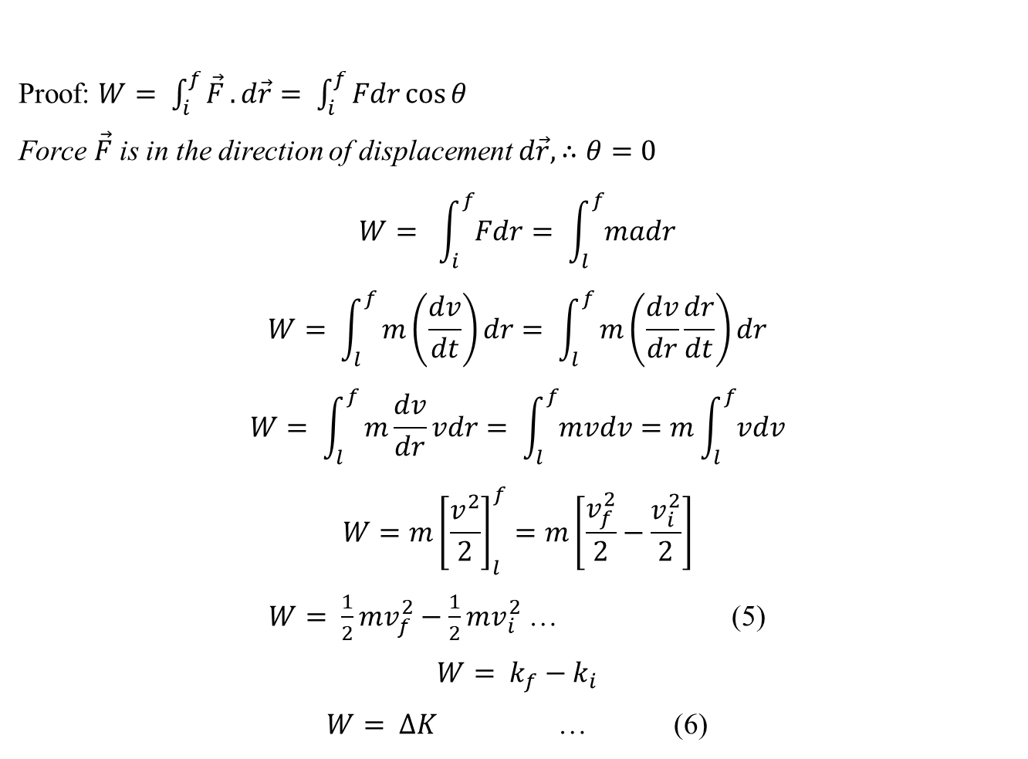
WORK-KINETIC ENERGY THEOREM
3080
The work-kinetic energy theorem states that: “when a body is acted upon by a force or resultant force, the work done by the force is equal to the change in kinetic energy of the body”.
Proof: $W= \int_{i}^{f}{\vec{F}}.d\vec{r}= \int_{i}^{f}{Fdr\cos{θ}}$
Force $\vec{F}$ is in the direction of displacement $d\vec{r}, ∴θ=0$
$$W= \int_{i}^{f}{Fdr}= \int_{l}^{f}{madr}$$
$$W= \int_{l}^{f}{m\left(\frac{dv}{dt}\right)dr}= \int_{l}^{f}{m\left(\frac{dv}{dr}\frac{dr}{dt}\right)dr}$$
$$W= \int_{l}^{f}{m\frac{dv}{dr}vdr}= \int_{l}^{f}{mvdv}=m\int_{l}^{f}{vdv}$$
$$W=m{\left[\frac{v^{2}}{2}\right]}_{l}^{f}=m\left[\frac{v_{f}^{2}}{2}−\frac{v_{i}^{2}}{2}\right]$$
$W= \frac{1}{2}mv_{f}^{2}−\frac{1}{2}mv_{i}^{2}$ … (5)
$$W= k_{f}−k_{i}$$
$W= ∆K$ … (6)

Slide 5
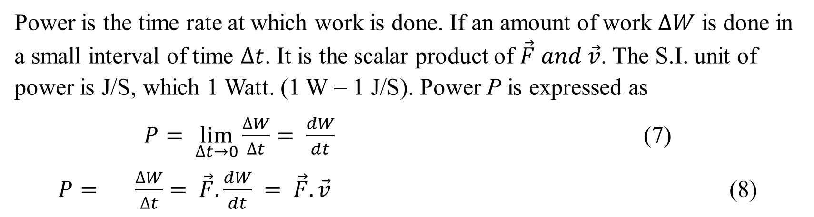
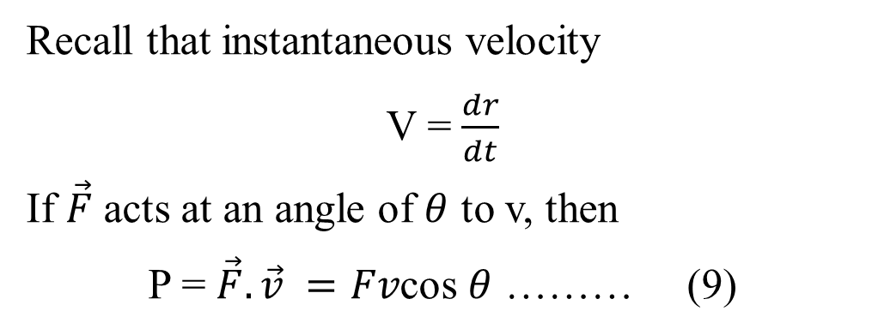
POWER
3080
Power is the time rate at which work is done. If an amount of work $∆W$ is done in a small interval of time $∆t$. It is the scalar product of $\vec{F} and \vec{v}$. The S.I. unit of power is J/S, which 1 Watt. (1 W = 1 J/S). Power P is expressed as
$P= \lim_{∆t→0}{\frac{∆W}{∆t}= \frac{dW}{dt} }$ (7)
$P= {\frac{∆W}{∆t}= \vec{F}.\frac{dW}{dt} }= \vec{F}.\vec{v}$ (8)
Recall that instantaneous velocity
V = $\frac{dr}{dt}$
If $\vec{F}$ acts at an angle of $θ$ to v, then
P = $\vec{F}.\vec{v} =Fv$cos $θ$ ……… (9)

Slide 6
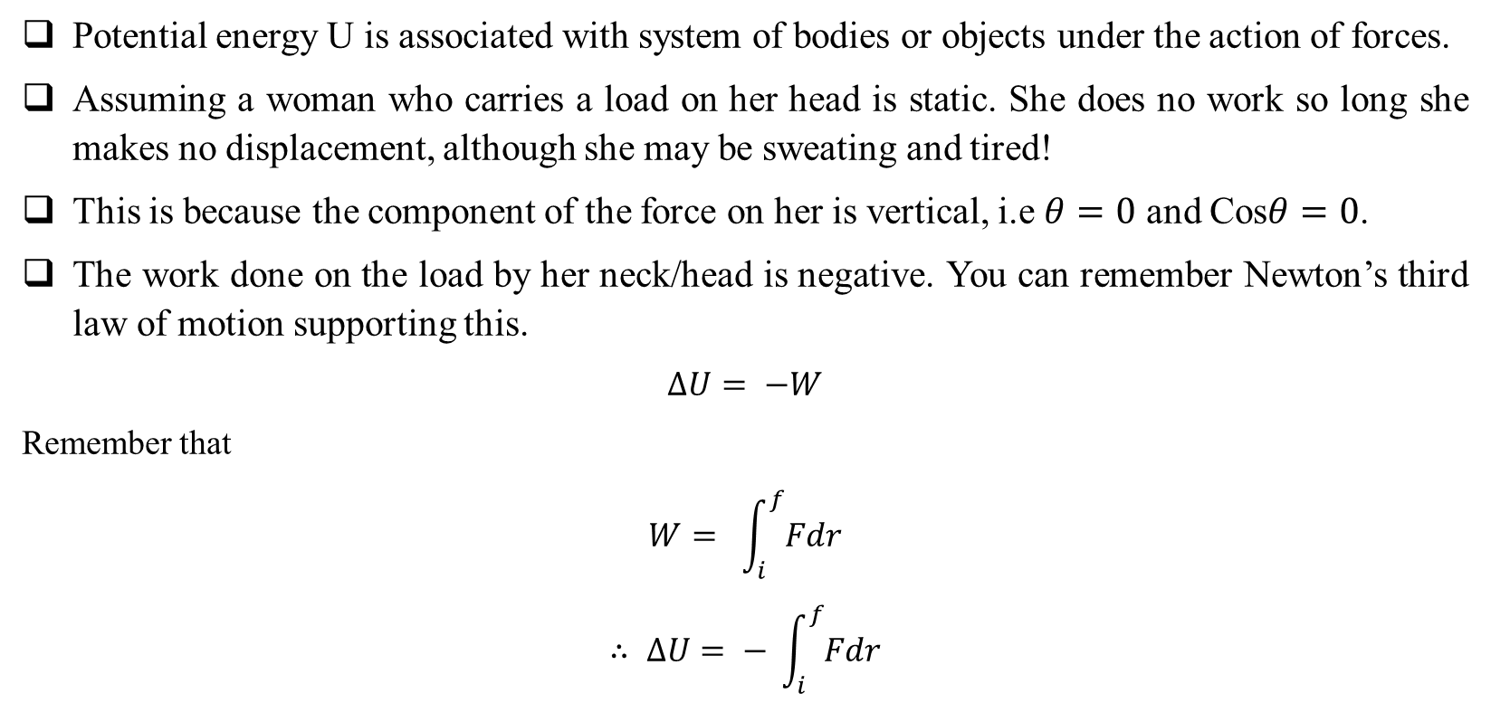
POTENTIAL ENERGY (U), POSITIVE, NEGATIVE AND ZERO WORK
3080
Potential energy U is associated with system of bodies or objects under the action of forces.
Assuming a woman who carries a load on her head is static. She does no work so long she makes no displacement, although she may be sweating and tired!
This is because the component of the force on her is vertical, i.e $θ=0$ and Cos$θ=0$.
The work done on the load by her neck/head is negative. You can remember Newton’s third law of motion supporting this.
$$∆U= −W$$
Remember that
$$W= \int_{i}^{f}{Fdr}$$
$$∴ ∆U= − \int_{i}^{f}{Fdr}$$

Slide 7
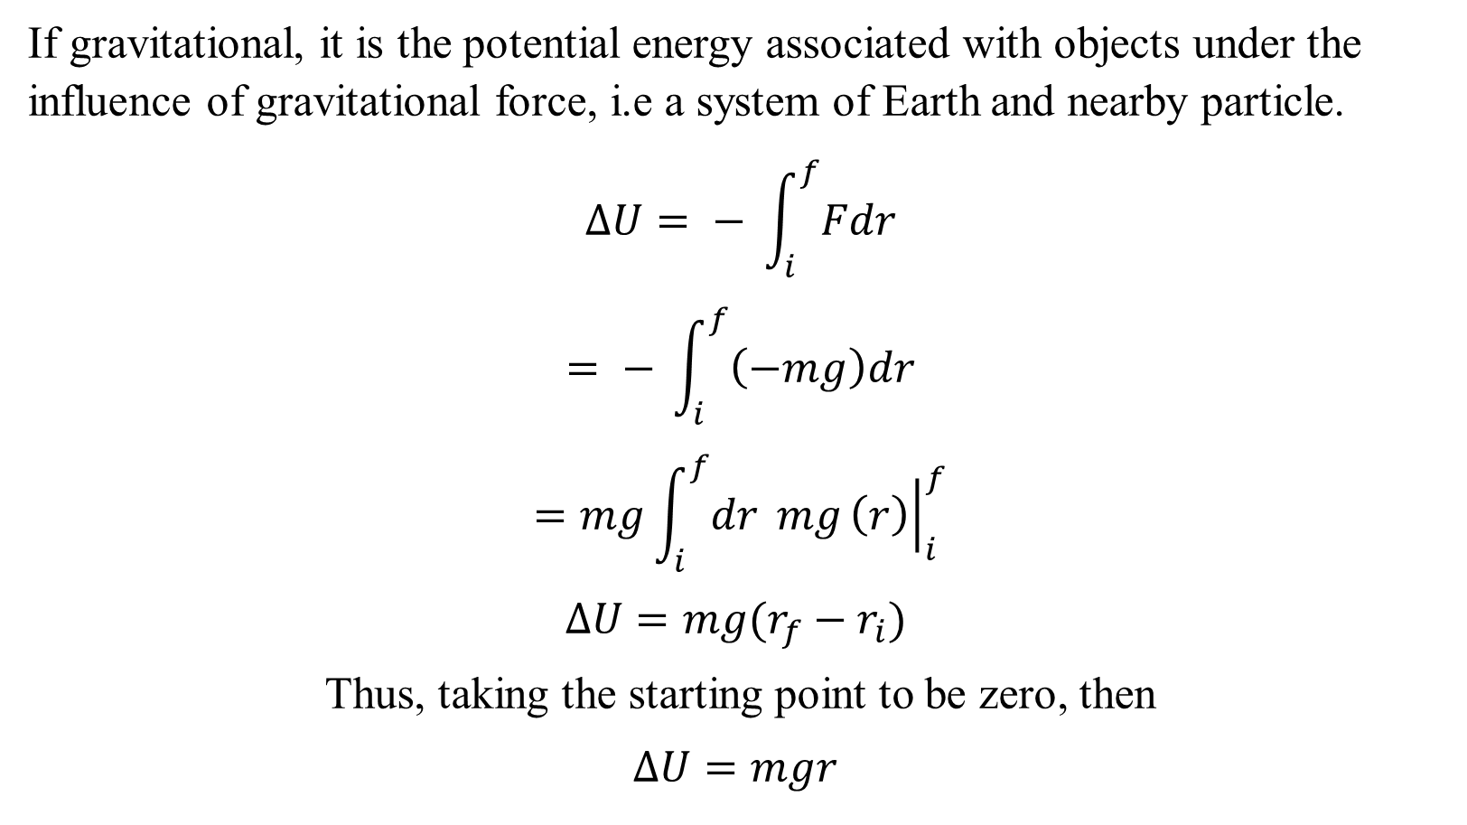
POTENTIAL ENERGY (U), POSITIVE, NEGATIVE AND ZERO WORK
3080
If gravitational, it is the potential energy associated with objects under the influence of gravitational force, i.e a system of Earth and nearby particle.
$$∆U= − \int_{i}^{f}{Fdr}$$
$$= − \int_{i}^{f}{\left(−mg\right)dr}$$
$$=mg\int_{i}^{f}{dr} mg{\left.\left(r\right)\right|}_{i}^{f}$$
$$∆U=mg(r_{f}−r_{i})$$
Thus, taking the starting point to be zero, then
$$∆U=mgr$$

Slide 8


ELASTIC POTENTIAL ENERGY
3080
Elastic potential energy is the energy stored up in elastic materials.
It is associated with the state of the object whether compressed or stressed.
For a spring which exerts a force $f= −kx$
$$∆U= − \int_{x_{i}}^{x_{f}}{Fdx}$$
$$= − \int_{x_{i}}^{x_{f}}{(−kx)dx}$$
$$= k\int_{x_{i}}^{x_{f}}{(x)dx}$$
= $k{\left[\frac{x^{2}}{2}\right]}_{x_{i}}^{x_{f}}$
= $\frac{1}{2}k{x_{f}}^{2}− \frac{1}{2}k{x_{i}}^{2}$

Slide 9
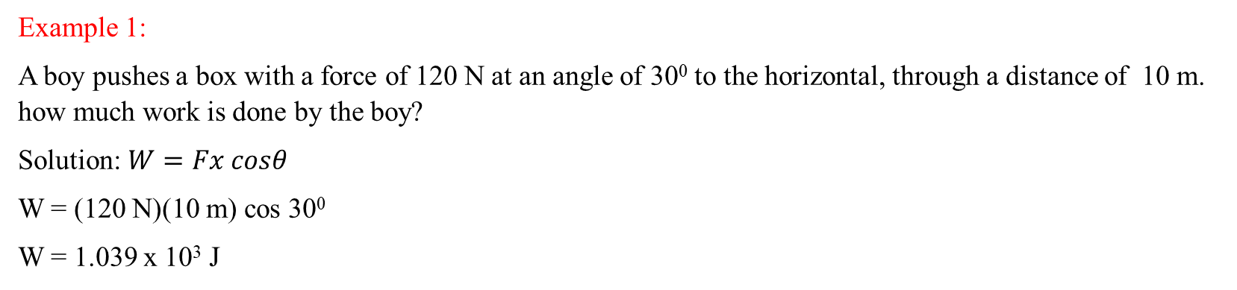
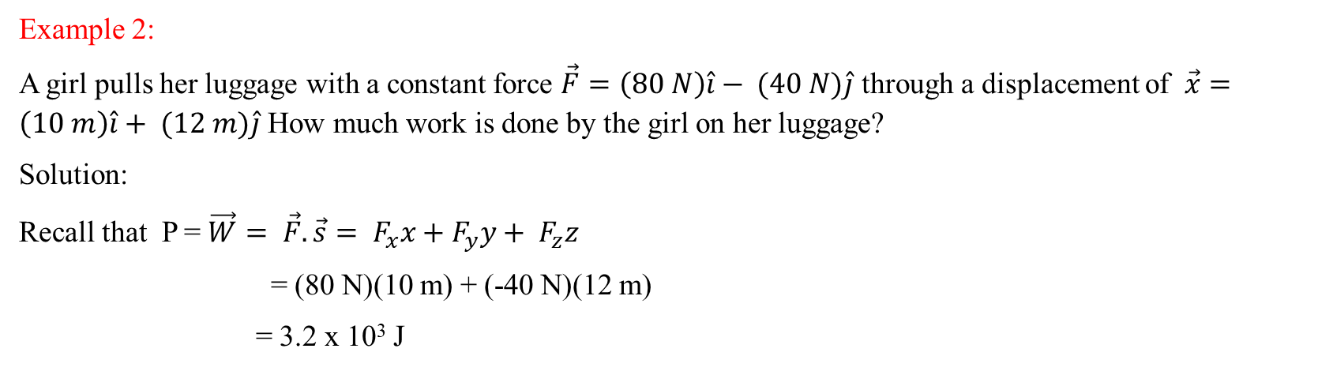
WORKED EXAMPLES
3080
Example 1:
A boy pushes a box with a force of 120 N at an angle of 30⁰ to the horizontal, through a distance of 10 m. how much work is done by the boy?
Solution: $W=Fx cosθ$
W = (120 N)(10 m) cos 30⁰
W = 1.039 x 10³ J
Example 2:
A girl pulls her luggage with a constant force $\vec{F}=\left(80 N\right)\hat{i}− (40 N)\hat{j}$ through a displacement of $\vec{x}=\left(10 m\right)\hat{i}+ (12 m)\hat{j}$ How much work is done by the girl on her luggage?
Solution:
Recall that P = $\vec{W}= \vec{F}.\vec{s}= F_{x}x+F_{y}y+ F_{z}z$
= (80 N)(10 m) + (-40 N)(12 m)
= 3.2 x 10³ J

Slide 10
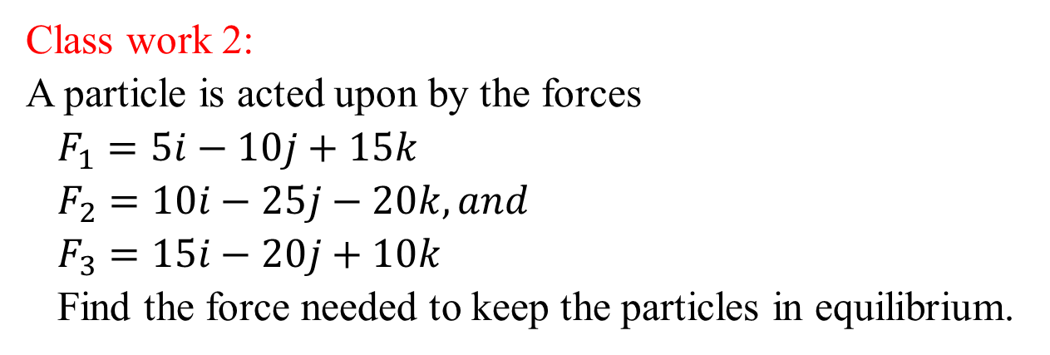
CLASS WORK
3080
Class work 1:
A student representative, drags a public address (PA) system weighing 7000 N through a distance of 20 m to the PHY 101 lecture theater. The student rep exerts a force of 3000 N at an angle of 40⁰ to the horizontal. If a 2000 N frictional force opposes the motion of the public address system, find the work done by each force acting on the PA and the total work done by all the forces.
Class work 2:
A particle is acted upon by the forces
$F_{1}=5i−10j+15k$
$F_{2}=10i−25j−20k, and$
$F_{3}=15i−20j+10k$
Find the force needed to keep the particles in equilibrium.

Slide 11
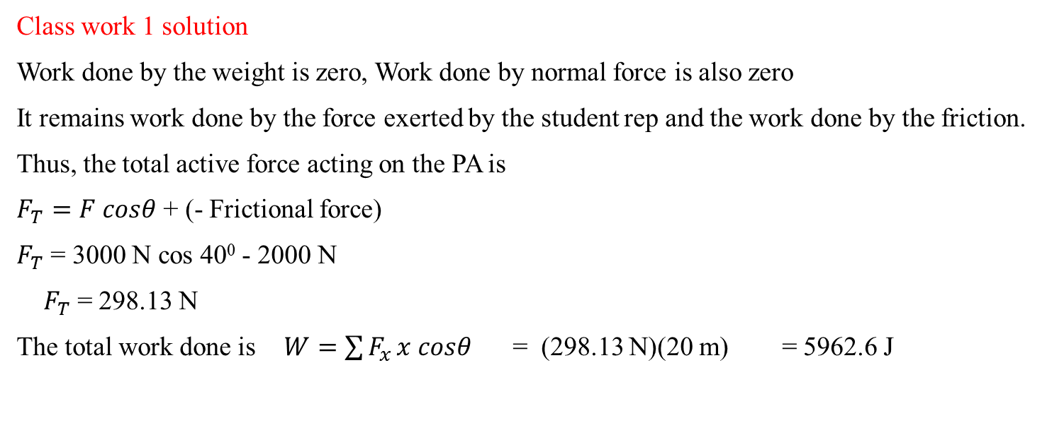
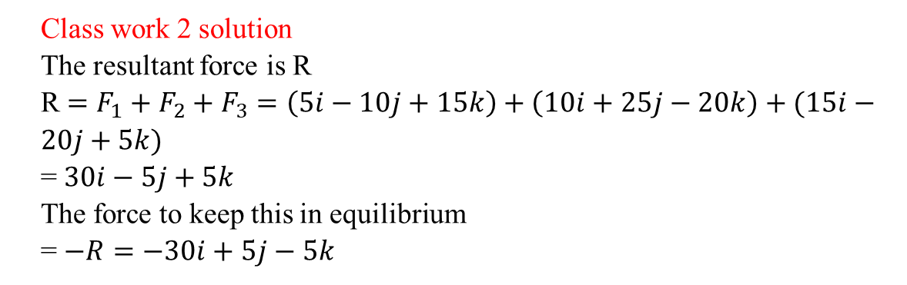
SOLUTION TO CLASS WORKS
3080
Class work 1 solution
Work done by the weight is zero, Work done by normal force is also zero
It remains work done by the force exerted by the student rep and the work done by the friction.
Thus, the total active force acting on the PA is
$F_{T}=F cosθ$ + (- Frictional force)
$F_{T}$ = 3000 N cos 40⁰ - 2000 N
$F_{T}$ = 298.13 N
The total work done is $W=\sum{F_{x}}x cosθ$ = (298.13 N)(20 m) = 5962.6 J
Class work 2 solution
The resultant force is R
R $=F_{1}+F_{2}+F_{3}$ $=\left(5i−10j+15k\right)+\left(10i+25j−20k\right)+(15i−20j+5k)$
= $30i−5j+5k$
The force to keep this in equilibrium
= $−R=−30i+5j−5k$

Slide 12
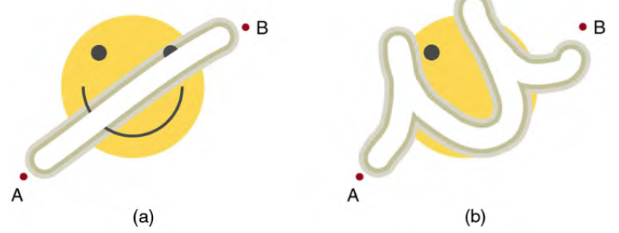
Nonconservative Forces
3080
A nonconservative force is one for which work depends on the path taken.
Friction is a good example of a nonconservative force.
An important characteristic is that the work done by a nonconservative force adds or removes mechanical energy from a system.
Friction, for example, creates thermal energy that dissipates, removing energy from the system.
The amount of the happy face erased depends on the path taken by the eraser between points A and B, as does the work done against friction. Less work is done and less of the face is erased for the path in (a) than for the path in (b). The force here is friction, and most of the work goes into thermal energy that subsequently leaves the system (the happy face plus the eraser). The energy expended cannot be fully recovered.

Slide 13
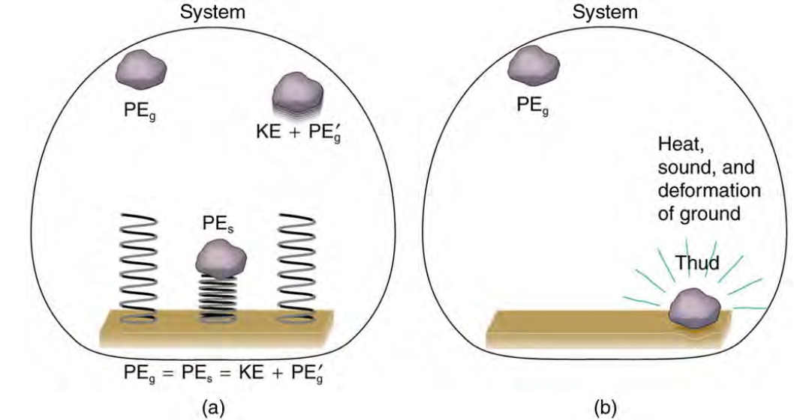
How Nonconservative Forces Affect Mechanical Energy
3080
Mechanical energy may not be conserved when nonconservative forces act.
For example, when a car is brought to a stop by friction on level ground, it loses kinetic energy, which is dissipated as thermal energy, reducing its mechanical energy.
Comparison of the effects of conservative and nonconservative forces on the mechanical energy of a system. (a) A system with only conservative forces. When a rock is dropped onto a spring, its mechanical energy remains constant (neglecting air resistance) because the force in the spring is conservative. The spring can propel the rock back to its original height, where it once again has only potential energy due to gravity. (b) A system with nonconservative forces. When the same rock is dropped onto the ground, it is stopped by nonconservative forces that dissipate its mechanical energy as thermal energy, sound, and surface distortion. The rock has lost mechanical energy.

Slide 14
Linear Momentum and Force
3080
Linear momentum is defined as the product of a system’s mass multiplied by its velocity. In symbols, linear momentum is expressed as p = mv.
The SI unit for momentum is kg · m/s
Example: (a) Calculate the momentum of a 110-kg football player running at 8.00 m/s. (b) Compare the player’s momentum with the momentum of a hardthrown 0.410-kg football that has a speed of 25.0 m/s.
Solution for (a)
To determine the momentum of the player, substitute the known values for the player’s mass and speed into the equation. p = mv
pplayer = (110 kg)(8.00 m/s) = 880 kg ·m/s
Solution for (b)
To determine the momentum of the ball, substitute the known values for the ball’s mass and speed into the equation. p = mv
pball = (0.410 kg)(25.0 m/s) = 10.3 kg ·m/s
Discussion
Although the ball has greater velocity, the player has a much greater mass. Thus the momentum of the player is much greater than the momentum of the football, as you might guess. As a result, the player’s motion is only slightly affected if he catches the ball. We shall quantify what happens in such collisions in terms of momentum in later sections.

Slide 15
Momentum and Newton’s Second Law
3080
Newton stated his second law of motion in terms of momentum: The net external force equals the change in momentum of a system divided by the time over which it changes. Using symbols, this law is
Fnet = Δp/Δt ,
where Fnet is the net external force, Δp is the change in momentum, and Δt is the change in time.
Linear Momentum and Force
Change in momentum Δp is given by Δp = Δ(mv).
If the mass of the system is constant, then Δ(mv) = mΔv.
So that for constant mass, Newton’s second law of motion becomes Fnet = Δp/Δt = mΔv/Δt .
Because Δv/Δt = a , :. Fnet=ma

Slide 16
WORKED EXAMPLES
3080
Example 1: During the in the US Open at USTA Billie Jean King National Tennis Center on September 8, 2022, Ons Jabeur of Tunisia hit the fastest recorded serve in a premier women’s match, reaching a speed of 58 m/s (209 km/h). What is the average force exerted on the 0.057-kg tennis ball by Ons Jabeur’s racquet, assuming that the ball’s speed just after impact is 58 m/s, that the initial horizontal component of the velocity before impact is negligible, and that the ball remained in contact with the racquet for 5.0 ms (milliseconds)?
Solution
When mass is constant, the change in momentum is given by Δp = mΔv = m(vf − vi).
To determine the change in momentum, substitute the values for the initial and final velocities into the equation, Δp = m(vf – vi)
= (0.057 kg)(58 m/s – 0 m/s)
= 3.306 kg · m/s ≈ 3.3 kg · m/s
Now the magnitude of the net external force can determined by using Fnet = Δp/Δt :
Fnet = Δp/Δt = 3.306 (kg⋅m/s)/5.0×10⁻³ s
= 661 N ≈ 660 N

Slide 17
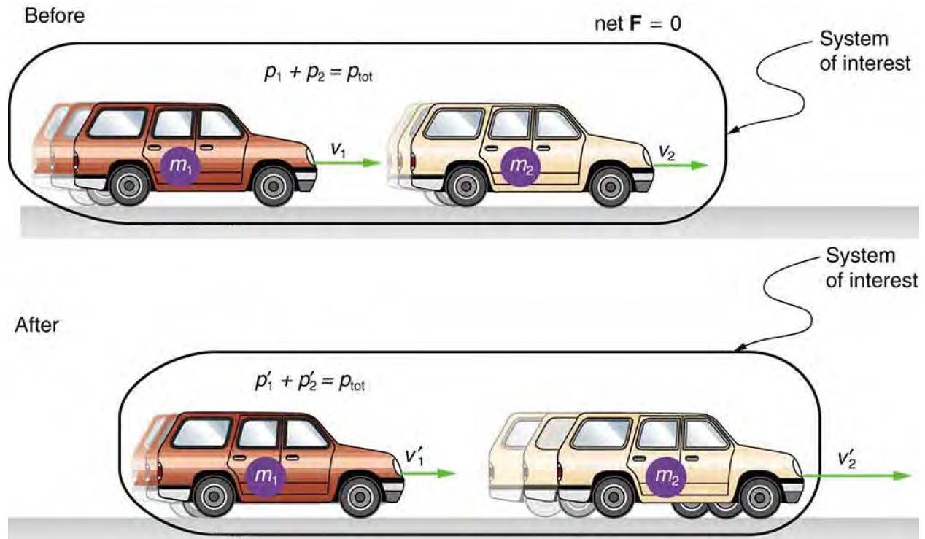
Conservation of Momentum
3080
Consider what happens if the masses of two colliding objects are more similar than the masses of a football player and Earth—for example, one car bumping into another
A car of mass m₁ moving with a velocity of v₁ bumps into another car of mass m₂ and velocity v₂ that it is following. As a result, the first car slows down to a velocity of v′1 and the second speeds up to a velocity of v′2 . The momentum of each car is changed, but the total momentum ptot of the two cars is the same before and after the collision (if you assume friction is negligible).

Slide 18
Change in Momentum
3080
Δp1 = F1Δt,
Δp2 = F2Δt
where F2 is the force on car 2 due to car 1, and we assume the duration of the collision Δt is the same for both cars.
We know from Newton’s third law that F2 = – F1 ,
and so Δp2 = −F1Δt = −Δp1
Thus, the changes in momentum are equal and opposite, and Δp1 + Δp2 = 0.
Because the changes in momentum add to zero, the total momentum of the two-car system is constant. That is,
p1 + p2 = constant,
p1 + p2 = p′1 + p′2,
where p′1 and p′2 are the momenta of cars 1 and 2 after the collision.
In equation form, the conservation of momentum principle for an isolated system is written
ptot = constant,
Or ptot = p′tot,
where ptot is the total momentum and p′tot is the total momentum some time later. An isolated system is defined to be one for which the net external force is zero Fnet = 0.

Slide 19

Elastic Collision
3080
An elastic collision is one that conserves internal kinetic energy.
CONSERVATION OF MOMENTUM
When a collision occurs in an isolated system, the total momentum of the system doesn’t change with the passage of time. Instead, it remains constant both in magnitude and in direction. The momenta of the individual objects in the system may change, but the vector sum of all the momenta will not change. The total momentum, therefore, is said to be conserved.
When no net external force acts on a system, the total momentum of the system remains constant in time.

Slide 20
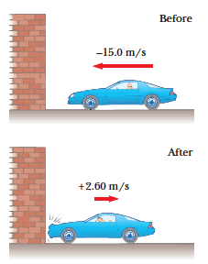
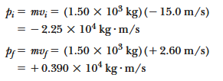



WORKED EXAMPLE
3080
A 0.150-kg baseball, thrown with a speed of 40.0 m/s, is hit straight back at the pitcher with a speed of 50.0 m/s.
What is the impulse delivered by the bat to the baseball?
(b) Find the magnitude of the average force exerted by the bat on the ball if the two are in contact for 2.00 103 s.
Solution (a) Find the impulse delivered to the car. Calculate the initial and final momenta of the car:
(b) Find the average force exerted on the car.
Apply Equation 6.6, the impulse–momentum theorem:
The impulse is just the difference between the final and initial momenta:

Slide 21
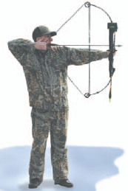
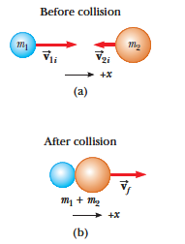
CLASS WORK
3080
1. An archer stands at rest on frictionless ice and fires a 0.500-kg arrow horizontally at 50.0 m/s.
(See Fig.6) The combined mass of the archer and bow is 60.0 kg. With what velocity does the archer move across the ice after firing the arrow?
(Fig.6)
2. A 70.0-kg man and a 55.0-kg woman on ice skates stand facing each other. If the woman pushes the man backwards so that his final speed is 1.50 m/s, at what speed does she recoil?
3. A car and a large truck traveling at the same speed collide head-on and stick together. Which vehicle experiences the larger change in the magnitude of its momentum? (a) the car (b) the truck (c) the change in the magnitude of momentum is the same for both (d) impossible to determine
FIG. 7 (a) Before and (b) after a perfectly inelastic head-on collision between two objects.

Slide 22
CENTER OF MASS AND SYSTEMS OF PARTICLES
The center of mass of a body is defined as a point where the entire mass of the body appears to be concentrated.
Therefore, this point can represent the entire body.
For bodies of regular shape and uniform mass distribution, the center of mass is at the geometric center of the body. Some examples are tabulated below:
Bodies of regular shape and uniform mass distribution | Geometric center of the body
circle and sphere | Centers of the circle and sphere
square and rectangle | Point of intersection of their diagonals
cube and cuboid | Point of intersection of their body diagonals

Slide 23
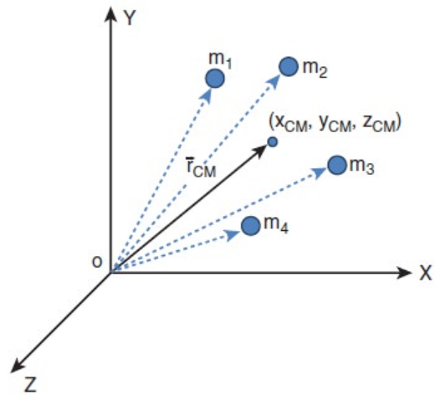
Center of Mass for Distributed Point Masses
A point mass is a hypothetical point particle which has nonzero mass and no size or shape.
To find the center of mass for a collection of n point masses, say, m₁, m₂, m₃ . . . m_{n} we have to first choose an origin and an appropriate coordinate system as shown in Fig. C1
Let, x₁, x₂, x₃ . . . x_{n} be the X-coordinates of the positions of these point masses in the X direction from the origin.
Fig. C1: center of mass for a collection of n point masses

Slide 24

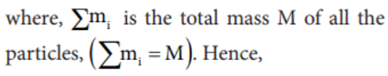

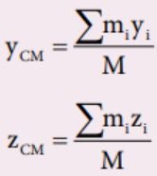
Center of Mass for Distributed Point Masses Cont.
The equation for the X coordinate of the center of mass is,
Hence, the position of center of mass of these point masses in a Cartesian coordinate system is (x_{CM}, y_{CM}, z_{CM}).

Slide 25

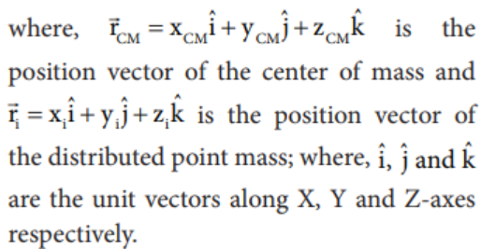
Position of Center of Mass
Generally, the position of center of mass can be written in a vector form as,

Slide 26



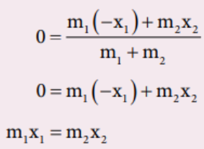
Center of Mass of Two Point Masses
The center of mass of two point masses m₁ and m₂, which are at positions x₁ and x₂ respectively on the X-axis.
(i) When the masses are on positive X-axis:
(ii) When the origin coincides with any one of the masses:
(iii) When the origin coincides with the center of mass itself:
The equation is principle of moments.

Slide 27
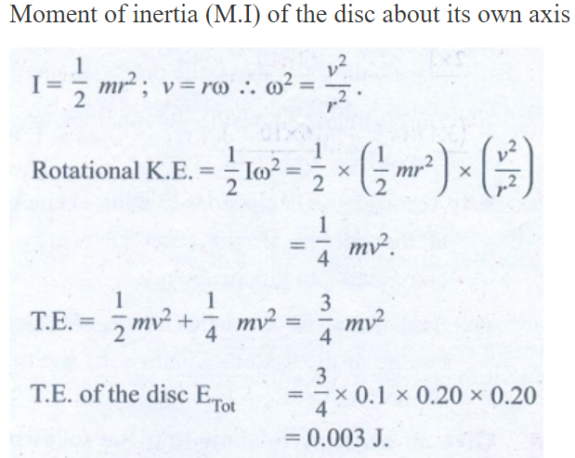
Ex 1. A uniform disc of mass 100g has a diameter of 10 cm. Calculate the total energy of the disc when rolling along a horizontal table with a velocity of 20 cms-1. (take the surface of table as reference)
Mass of the disc m = 100 g = 0.1 kg.
Diameter of the disc d = 10 cm
Radius of the disc r = 5 cm = 0.05m
Rolling with a velocity v = 20 cms-1 = 0.20 ms-1
Total energy of the disc ETot = ?
ETot = Translational K.E. + rotational K.E.
Moment of inertia (M.I) of the disc about its own axis
:. I = 1.028 units

Slide 28
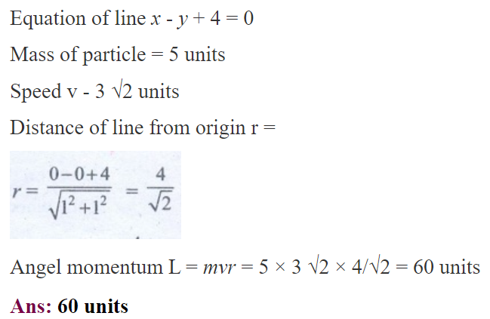
Ex 2. A particle of mass 5 units is moving with a uniform speed of v = 3√2 units in the XOY plane along the line y = x + 4. Find the magnitude of angular momentum.

Slide 29
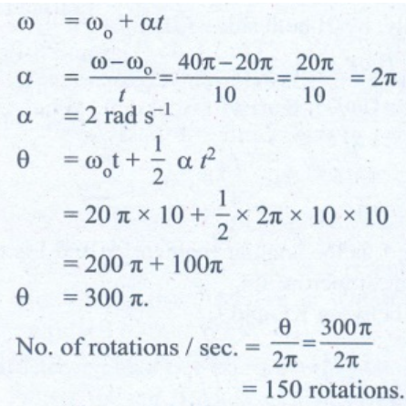
Ex 3. A fly wheel rotates with a uniform angular acceleration. If its angular velocity increases from 20π rad/s to 40π rad/s in 10 seconds. Find the number of rotations in that period.
Initial Angular Velocity ω0 = 20π rad s-1
Final Angular velocity ω = 40 π rad s-1
time taken, t = 10 s
No. of rotations / s = ?

Slide 30
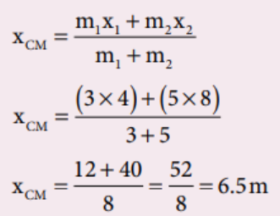
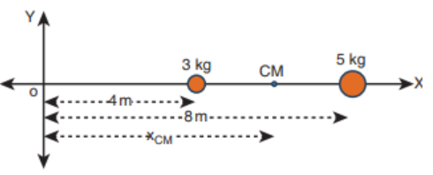
Solved Problems
Ex.1. Two point masses 3 kg and 5 kg are at 4 m and 8 m from the origin on X-axis. Locate the position of center of mass of the two point masses (i) from the origin and (ii) from 3 kg mass.
Solution
Let us take, m1 = 3 kg and m2= 5 kg
(i) To find center of mass from the origin:
The point masses are at positions, x1 = 4 m, x2 = 8 m from the origin along X axis.

Slide 31
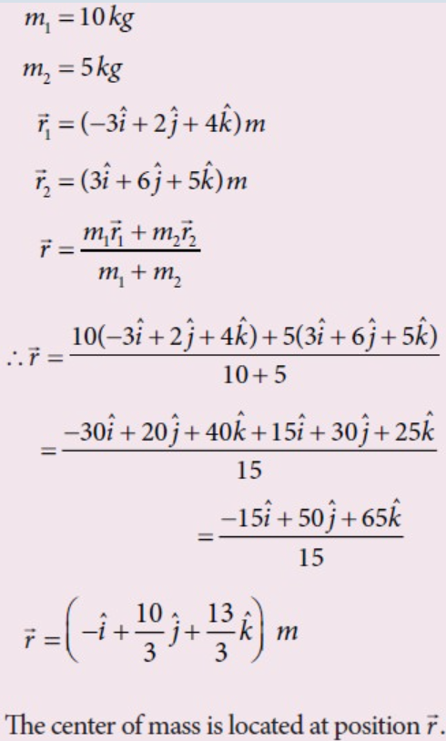
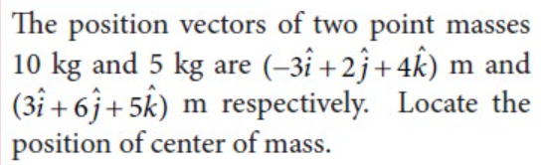

Slide 32
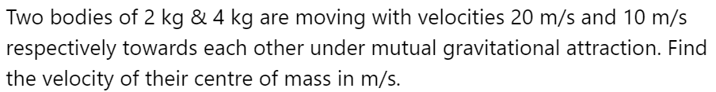
CLASS WORK 1
No 1
A. 0 B. 6 C. 8 D. 2 E. 1

Slide 33
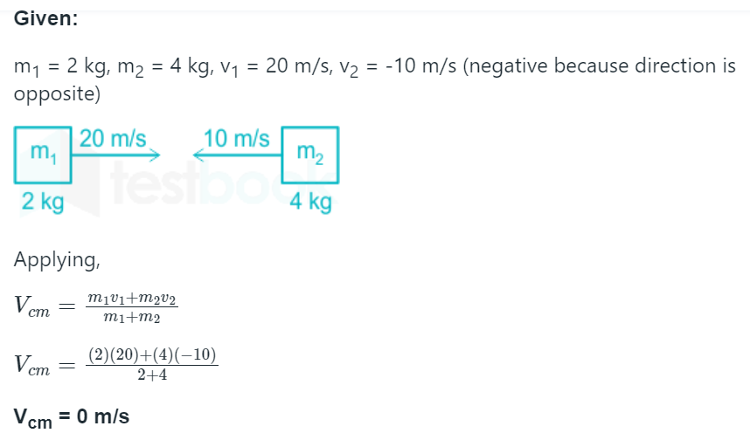
SOLTION TO CLASS WORK 1

Slide 34
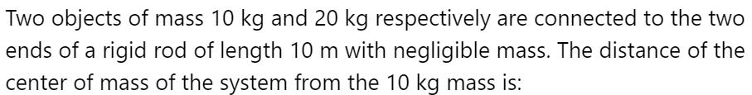
CLASS WORK 2
A. 5 m B. 10/3 m C. 20/3 m D. 10 E. 2

Slide 35
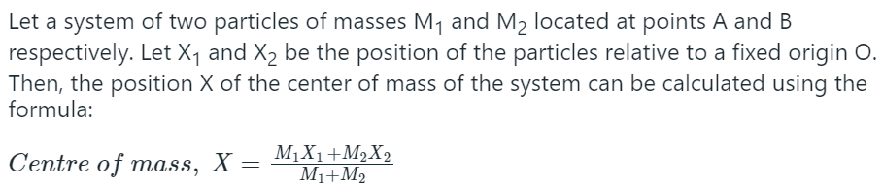
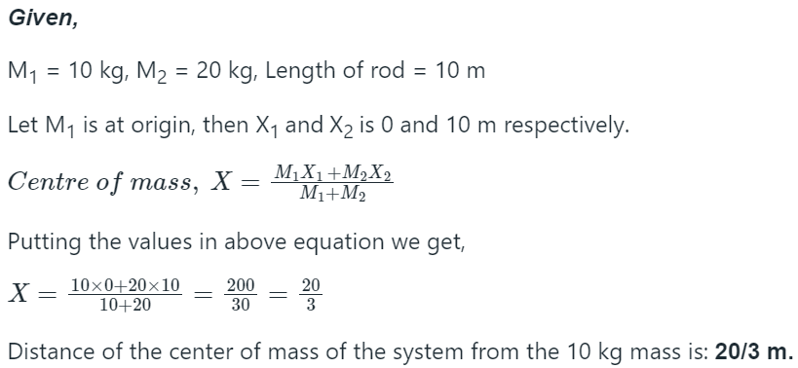
SOLTION TO CLASS WORK 2

