Slide 1
Introduction to upper limb/pectoral region,
Osteology of the pectoral girdle and free limb bones
BY
DR B.J DARE

Slide 2
The upper limb is divided into the shoulder (junction of the trunk with the arm), arm, elbow, forearm, wrist, and hand.
The upper limb is attached to the axial skeleton by the scapula and clavicle.
Two small joints are acromioclavicular and sternoclavicular joints.
The main attachment between the upper limb and the axial skeleton is muscular.
The clavicle
Is the first bone to ossify in the foetus (6 weeks).
It develops in membrane and not in cartilage.
It is subcutaneous throughout its length and transmits forces from the arm to the axial skeleton.
The medial two-thirds are circular in cross-section and curved convex forwards.
The lateral third is flat and curved convex backwards.
The clavicle articulates medially with the sternum and 1st costal cartilage at the sternoclavicular joint.
The clavicle is also attached medially to the 1st rib by strong costoclavicular ligaments and to the sternum by sternoclavicular ligaments

Slide 3
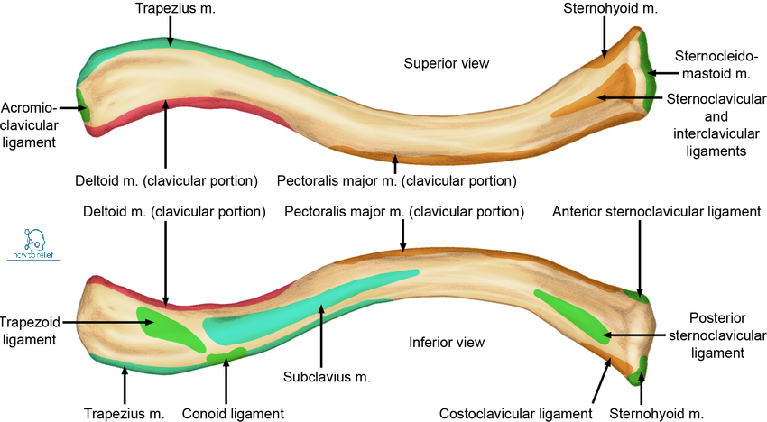

Slide 6
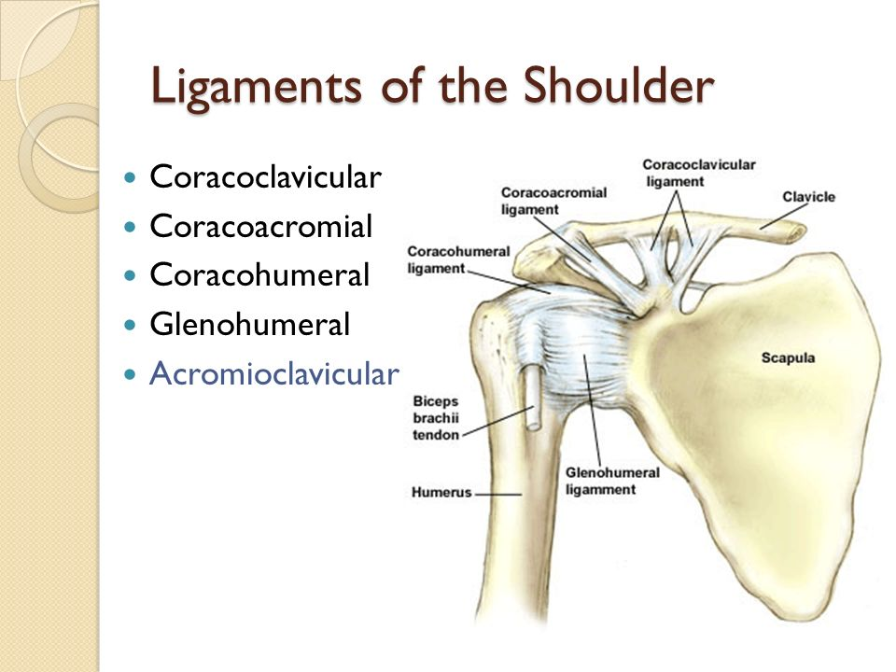
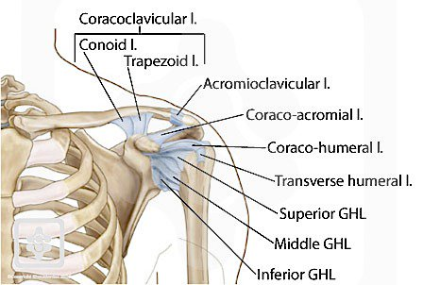

Slide 7
The clavicle articulates laterally with the acromion process of the scapula a the acromioclavicular joint.
The coracoclavicular ligaments secure the clavicle infero-laterally to the coracoid process of the scapula.
This ligament has two components at the conoid and trapezoid ligaments which are attached to the conoid tubercle and trapezoid line of the clavicle, respectively.
The clavicle is the most commonly fractured bone in the body.
The weakest point of the bone is the junction of the middle and outer thirds
The scapula
The scapula is triangular in shape.
It provides an attachment for numerous muscles.
The glenoid fossa articulates with the humeral head (gleno-humeral joint),
The acromion process with the clavicle (acromioclavicular joint).

Slide 10
The coracoid process projects upward and forward above the glenoid cavity and provides attachment for muscles and ligaments.
Medial to the base of the coracoid process is the suprascapular notch.
The anterior surface of the scapula is concave and forms the shallow subscapular fossa.
The posterior surface of the scapula is divided by the spine into the supraspinous fossa above and an infraspinous fossa below
The inferior angle of the scapula can be palpated easily in the living subject and marks the level of the seventh rib and the spine of the seventh thoracic vertebra.
The scapula is a flat triangular bone
Lies on the posterior chest wall between the second and the seventh ribs.
The lateral end of the spine is free and forms the acromion on its posterior surface, which articulates with the clavicle.
The superolateral angle of the scapula forms the pear-shaped glenoid cavity, or fossa, which articulates with the head of the humerus at the shoulder joint.

Slide 11
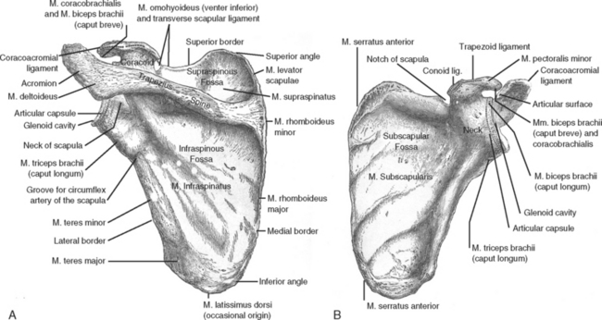

Slide 12
Muscle | Origin | Insertion | Nerve Supply | Nerve Rootsa | Action
Pectoralis major | Clavicle, sternum, and upper six costal cartilages | Lateral lip of bicipital groove of humerus | Medial and lateral pectoral nerves from brachial plexus | C5, 6, 7, 8; T1 | Adducts arm and rotates it medially; clavicular fibers also flex arm
Pectoralis minor | Third, fourth, and fifth ribs | Coracoid process of scapula | Medial pectoral nerve from brachial plexus | C6, 7, 8 | Depresses point of shoulder; if the scapula is fixed, it elevates the ribs of origin
Subclavius | First costal cartilage | Clavicle | Nerve to subclavius from upper trunk of brachial plexus | C5, 6 | Depresses the clavicle and steadies this bone during movements of the shoulder girdle
Serratus anterior | Upper eight ribs | Medial border and inferior angle of scapula | Long thoracic nerve | C5, 6, 7 | Draws the scapula forward around the thoracic wall; rotates scapula

Slide 13
Muscle | Origin | Insertion | Nerve Supply | Nerve Rootsa | Action
Trapezius | Occipital bone, ligamentum nuchae, spine of seventh cervical vertebra, spines of all thoracic vertebrae | Upper fibers into lateral third of clavicle; middle and lower fibers into acromion and spine of scapula | Spinal part of accessory nerve (motor) and C3 and 4 (sensory) | XI cranial nerve (spinal part) | Upper fibers elevate the scapula; middle fibers pull scapula medially; lower fibers pull medial border of scapula downward
Latissimus dorsi | Iliac crest, lumbar fascia, spines of lower six thoracic vertebrae, lower three or four ribs, and inferior angle of scapula | Floor of bicipital groove of humerus | Thoracodorsal nerve | C6, 7, 8, | Extends, adducts, and medially rotates the arm
Levator scapulae | Transverse processes of first four cervical vertebrae | Medial border of scapula | C3 and 4 and dorsal scapular nerve | C3, 4, 5 | Raises medial border of scapula
Rhomboid minor | Ligamentum nuchae and spines of seventh cervical and first thoracic vertebrae | Medial border of scapula | Dorsal scapular nerve | C4, 5 | Raises medial border of scapula upward and medially
Rhomboid major | Second to fifth thoracic spines | Medial border of scapula | Dorsal scapular nerve | C4, 5 | Raises medial border of scapula upward and medially

Slide 14
Muscle | Origin | Insertion | Nerve Supply | Nerve Rootsa | Action
Deltoid | Lateral third of clavicle, acromion, spine of scapula | Middle of lateral surface of shaft of humerus | Axillary nerve | C5, 6 | Abducts arm; anterior fibers flex and medially rotate arm; posterior fibers extend and laterally rotate arm
Supraspinatus | Supraspinous fossa of scapula | Greater tuberosity of humerus; capsule of shoulder joint | Suprascapular nerve | C4, 5, 6 | Abducts arm and stabilizes shoulder joint
Infraspinatus | Infraspinous fossa of scapula | Greater tuberosity of humerus; capsule of shoulder joint | Suprascapular nerve | (C4), 5, 6 | Laterally rotates arm and stabilizes shoulder joint
Teres major | Lower third of lateral border of scapula | Medial lip of bicipital groove of humerus | Lower subscapular nerve | C6, 7 | Medially rotates and adducts arm and stabilizes shoulder joint
Teres minor | Upper two thirds of lateral border of scapula | Greater tuberosity of humerus; capsule of shoulder joint | Axillary nerve | (C4), C5, 6 | Laterally rotates arm and stabilizes shoulder joint
Subscapularis | Subscapular fossa | Lesser tuberosity of humerus | Upper and lower subscapular nerves | C5, 6, 7 | Medially rotates arm and stabilizes shoulder joint

Slide 15
The humerus
The rounded head articulates with the shallow glenoid and permits a wide range of shoulder movement.
The anatomical neck separates the head from the greater and lesser tubercles.
The surgical neck lies below the anatomical neck between the upper end of the humerus and shaft.
The axillary nerve and circumflex vessels wind around the surgical neck of the humerus.
These are at risk of injury in shoulder dislocations and humeral neck fractures
The greater and lesser tubercles provide attachment for the rotator cuff muscles.
The tubercles are separated by the intertubercular sulcus in which the long head of biceps tendon courses.
The posterior aspect of the shaft bears the faint spiral groove, demarcating the origins of the medial and lateral heads of the triceps between which wind the radial nerve and the profunda vessels

Slide 16
The medial and lateral
heads of triceps originate on either side of this groove. The radial nerve passes between the two heads.
The ulnar nerve winds forwards in a groove behind the medial epicondyle.
•The elbow joint: the trochlea articulates with the trochlear notch of the ulna; and the rounded capitulum with the radial head.
The medial border of the trochlea projects inferiorly a little further than the lateral border.
This accounts for the carrying angle, i.e. the slight lateral angle made between the arm and forearm when the elbow is extended.
The lower end of the humerus bears the rounded capitulum laterally, for articulation with the radial head, and the spool-shaped trochlea
Medially, articulating with the trochlear notch of the ulna.
Three important nerves thus come into close contact with the humerus
      The axillary,
      radial and
      ulnar

Slide 19
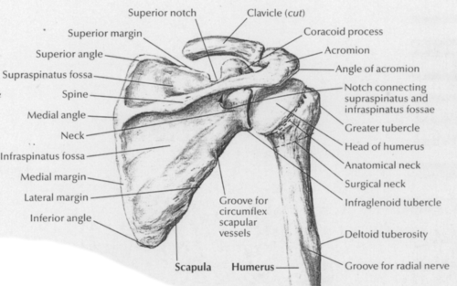

Slide 20
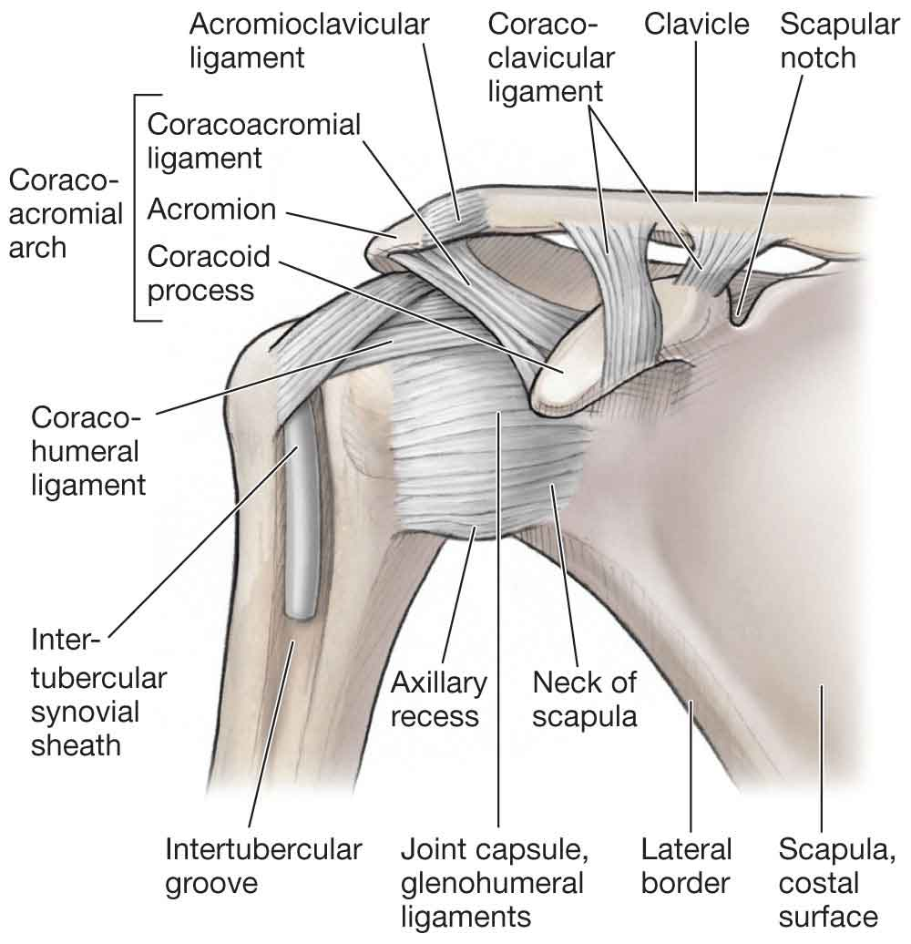

Slide 21
Three important nerves contact with the humerus
-axillary,
-radial and
-ulnar;
the lower end of the humerus is angulated forward 45° on the shaft

Slide 25
The radius and ulna
The radius consists of the head, neck, shaft (with its radial tuberosity) and expanded distal end.
The ulna comprises olecranon, trochlear fossa, coronoid process (with its radial notch for articulation with the radial head), shaft and small distal head, which articulates with the medial side of the distal end of the radius at the inferior radio-ulnar joint.
In pronation and supination, the head of the radius rotates against the radial notch of the ulna,
The shaft of the radius swings round the relatively fixed ulnar shaft (the two bones being connected by a fibrous interosseous ligament) and the distal end of the radius rotates against the head of the ulna.
This axis of rotation passes from the radial head proximally to the ulnar head distally

Slide 26
Both the radius and ulna have interosseous, anterior and posterior borders.
The biceps tendon inserts into the roughened posterior part of the radial tuberosity.
The anterior part of the tuberosity is smooth where it is covered by a bursa.
The radial head is at its proximal end whilst the ulnar head is at its distal end.
The lower end of the radius articulates with the scaphoid and lunate carpal bones at the wrist joint.
The distal ulna does not participate directly in the wrist joint.
The dorsal tubercle (of Lister) is located on the posterior surface of the distal radius.

Slide 28
In pronation/supination movements the radial head rotates in the radial notch of the ulna and the radial shaft pivots around the relatively fixed ulna (connected by the interosseous ligament).
The distal radius rotates around the head of the ulna.
A Colles fracture is a common injury occurring at the wrist in the elderly and usually osteoporotic population.
It classically follows a fall on the outstretched hand.
The fracture line is usually about 2.5 cm proximal to the wrist and the distal fragment displaces posteriorly (dinner fork deformity) and radially.

Slide 29
The hand
The carpal bones are arranged into two rows.
The palmar aspect of the carpus is concave.
This is brought about by the shapes of the constituent bones and the flexor retinaculum bridging the bones anteriorly to form the carpal tunnel
The scaphoid may be fractured through a fall on the outstretched hand.
This injury is common in young adults and must be suspected clinically when tenderness is elicited by deep palpation in the anatomical snuffbox.
The blood supply to the scaphoid enters via its proximal and distal ends.

Slide 31
The muscles of the outer chest wall
Muscles of the outer anterior chest wall include
  pectoralis major and pectoralis minor.
Muscles of the back and shoulder include:
  latissimus dorsi, trapezius, deltoid, levator scapulae, serratus anterior, teres major and minor, rhomboids major and minor, subscapularis, supraspinatus and infraspinatus.
The sternoclavicular joint
Type: atypical synovial joint.
The articulation is between the sternal end of the clavicle and the manubrium.
The articular surfaces are covered with fibrocartilage as opposed to the usual hyaline.
A fibrocartilaginous articular disc separates the joint into two cavities.
The fulcrum of movement at this joint is the costoclavicular ligament,
i.e. when the lateral end of the clavicle moves upwards the media end moves downwards.

Slide 32
The anterior (flexor) compartment contents of the arm include
The flexor muscles:
coracobrachialis, biceps and brachialis brachial artery and branches
median nerve
ulnar nerve
musculocutaneous nerve and branches which become the lateral cutaneous nerve of the forearm.
basilic vein
The posterior (extensor) compartment contents include
The extensor muscles: triceps
The radial nerve and branches.
The profunda brachii artery:.
The ulnar nerve (in the lower arm only):

Slide 34
The elbow joint
Type: synovial hinge joint.
At the elbow the humeral capitulum articulates with the radial head, and the trochlea of the humerus with the trochlear notch of the ulna.
Fossae immediately above the trochlea
and capitulum admit the coronoid process of the ulna and the radial head, during full flexion.
Similarly the olecranon fossa admits the olecranon process during full elbow extension.
The elbow joint communicates with the superior radio-ulnar joint.
Capsule: the capsule is lax in front and behind to permit full elbow flexion and extension.
The non-articular medial and lateral epicondyles are extracapsular.
Ligaments
The capsule is strengthened medially and laterally by collateral ligaments.
The medial collateral ligament is triangular and consists of anterior, posterior and middle bands.
It extends from the medial epicondyle of the humerus and the olecranon to the coronoid process of the ulna.
The ulnar nerve is adjacent to the medial collateral ligament as it passes forwards below the medial epicondyle.

Slide 36
The lateral collateral ligament extends from the lateral epicondyle of the humerus to the annular ligament.
The annular ligament is attached medially to the radial notch of the ulna and clasps, but does not attach to, the radial head and neck.
As the ligament is not attached to the head this is free to rotate within the ligament.
Movements at the elbow
Flexion/extension occur at the elbow joint.
Supination/pronation occur mostly at the superior radio-ulnar joint (in conjunction with movements at the inferior radio-ulnar joint).
Flexion (140°): biceps, brachialis, brachioradialis and the forearm flexor muscles.
Extension (0°): triceps and to a lesser extent anconeus.
Pronation (90°): pronator teres and pronator quadratus.
Supination (90°): biceps is the most powerful supinator.
This movement is afforded by the insertion of the muscle on the posterior aspect of the radial tuberosity. Supinator, extensor pollicis longus and brevis are weaker supinators.

Slide 37
The cubital fossa
This fossa is defined by: a horizontal line joining the two epicondyles;
the medial border of brachioradialis; and the lateral border of pronator teres.
The floor of the fossa consists of brachialis muscle and
The overlying roof of superficial fascia.
The median cubital vein runs in the superficial fascia and connects the basilic to cephalic veins.
Contents
Within the fossa the biceps tendon can be palpated.
Brachial artery and the median nerve.
The radial and ulnar nerves lie outside the cubital fossa.
The radial nerve passes anterior to the lateral epicondyle between brachialis and
brachioradialis muscles.
The ulnar nerve winds behind the medial epicondyle

Slide 40
The contents of the anterior (flexor) compartment of the forearm
Muscles:
the muscles within this compartment are considered
superficial, intermediate and deep layers.
All of the muscles of the superficial group and part of flexor digitorum superficialis arise from the common flexor origin on the medial epicondyle of the humerus.
With the exceptions of flexor carpi ulnaris and the ulnar half of flexor digitorum profundus,
All of the muscles of the anterior compartment are supplied by the median nerve or its anterior interosseous branch
Arteries ulnar artery and its anterior interosseous branch (via the common interosseous artery); radial artery.
Nerve supply median nerve and its anterior interosseous branch; ulnar nerve; superficial radial nerve.

Slide 43
The contents of the posterior fascial (extensor) compartment of the forearm
Muscles
brachioradialis and extensor carpi radialis longus arise separately from the lateral supracondylar ridge of the humerus.
They are innervated by the radial nerve.
The remaining extensor muscles are considered in superficial and deep layers which are innervated by the posterior interosseous branch of the radial nerve.
The muscles of the superficial layer arise from the common extensor
origin on the lateral epicondyle of the humerus.
The muscles of the deep layer arise from the backs of the radius, ulna and interosseous membrane
Arteries: posterior interosseous artery (branch of the common interosseous artery).
Nerve supply: posterior interosseous nerve (branch of the radial nerve)

Slide 45
The flexor retinaculum and carpal
The carpal tunnel is formed by the carpal bones and the overlying flexor
retinaculum. It is through this tunnel that most, but not all, of the forearm
tendons and the median nerve pass.
The flexor retinaculum is attached to four bony points at the pisiform, the hook of the hamate, the scaphoid and the trapezium.
The carpal tunnel is narrow and no arteries or veins are transmitted
through it for risk of potential compression. ‘The median nerve is however at risk of compression when the tunnel is narrowed for any reason.
This is the carpal tunnel syndrome and results in signs of median nerve
motor and sensory impairment. Note that the ulnar nerve and artery
pass over the retinaculum and are thus outside the carpal tunnel.

Slide 49
The wrist (radiocarpal) joint
Type: the wrist is a condyloid synovial joint.
The distal radius and a triangular disc of fibrocartilage covering the distal ulna form the proximal articulating surface.
This disc is attached to the edge of the ulnar notch of the radius and to the base of the styloid process of the ulna and separates the wrist joint from the inferior radio-ulnar joint.
The distal articulating surface is formed by the scaphoid and lunate bones with the triquetral participating in adduction.
Capsule: a defined capsule surrounds the joint. It is thickened on either side by the radial an ulnar collateral ligaments.
Nerve supply: from the anterior interosseous (median) and posterior interosseous (radial) nerves.

Slide 50
Wrist movements
Flexion/extension movements occurring at the wrist are accompanied by movements at the midcarpal joint.
Of a total of 80° of wrist flexion the majority occurs at the midcarpal joint whereas in extension a corresponding increased amount occurs at the wrist joint.
The muscles acting on the wrist joint include:
Flexion: all long muscles crossing the joint anteriorly.
Extension: all long muscles crossing the joint posteriorly.
Abduction: flexor carpi radialis and extensors carpi radialis longus and brevis.
Adduction: flexor carpi ulnaris and extensor carpi ulnaris.

