Slide 1

Course Code: GST 111 Department of English & Literary Studies, College of Humanities & Culture, Ikire Campus, Osun State University Harmattan Semester, 2025/2026 Course Unit: 2

Slide 2
Sounds and Letters
English Letters
Aa ,Bb, Cc, Dd, Ee, Ff, Gg, Hh, Ii, Jj, Kk, Ll, Mm, Nn, Oo, Pp, Qq, Rr, Ss, Tt, Uu, Vv, Ww, Xx, Yy, Zz

Slide 3
The sounds of English refer to the distinct units of sound that make up the language. These sounds are the building blocks of spoken English and are used to form words, phrases, and sentences. There are two main categories of sounds in English; these are the vowels and consonant sounds.

Slide 4
Consonant Sounds: These are the sounds made by blocking the airflow in the mouth. English has approximately 24 consonant sounds

Slide 5
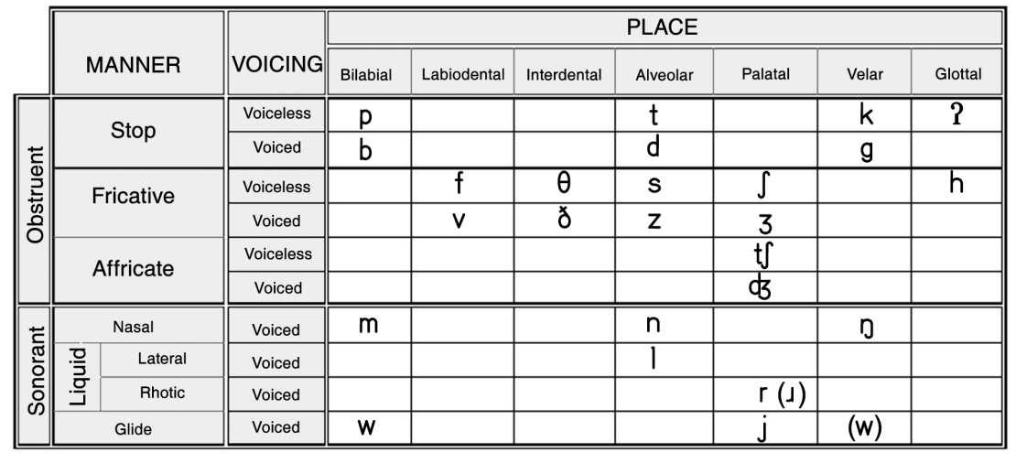

Slide 6
English Consonant Chart
Manner of Articulation | State of the Glottis | Place of Articulation
 | Voiceless Voiced
Stop (plosive) | p k b g t d d k g | Bilabial Alveolar Velar
Fricative | f v θ ð s z ʃ ʒ h | Labio-dental Dental Alveolar Palato-alveolar Glottal
Affricate | tʃ dʒ | Palate- Alveolar
Lateral | l | Alveolar
Semi-vowel | W J | Bilabial Palatal
Nasal/roll | M r n ŋ | Bilabial Alveolar Velar

Slide 7
Vowel Sounds: These are the sounds made without blocking the airflow in the mouth. English has approximately 20 vowel sounds, including:
Monophthongs (pure vowels): /i/, /ɪ/, /ɛ/, /æ/, /ɑ/, /ɔ/, /ʊ/, /u/
Monophthong Vowels/ Short vowels
/i/ (beat) - high front unrounded (Jones, 1956)
/ɪ/ (bit) - near-high near-front unrounded (Gimson, 1962)
/ɛ/ (bet) - mid front unrounded (Kenyon, 1950)
/æ/ (bat) - near-low front unrounded (Trager & Smith, 1951)
/ɑ/ (car) - low back unrounded (Jones, 1956)
/ɔ/ (law) - mid back rounded (Gimson, 1962)
/ʊ/ (boot) - high back rounded (Kenyon, 1950)
/u/ (boot) - high back rounded (Jones, 1956)

Slide 8
Long Vowels
Long vowels in English are vowels that are pronounced for a longer duration than short vowels. They are typically marked by a macron (ā, ē, ī, ō, ū) or a colon (a:, e:, i:, o:, u:) in phonetic transcriptions. Below are the long vowels in English:
/ɑː/ (car, father)
/ɛː/ (pair, fare)
/iː/ (beat, seat)
/ɔː/ (law, saw)
/uː/ (boot, new)

Slide 9
English Vowel Chart
English Short Vowels | English Long Vowels | Diphthongs
/I/ | /i:/ | /ei/
/æ/ | /u:/ | /ai/
/ɔ/ | /a:/ | /ɔi/
/u/ | /ɔ:/ | /əu/
/∧/ | / ə:/ | /au/
/a/ |  | /iə /
/e/ |  | /eə/
 |  | /uə/

Slide 10
Consonants and consonant contrast minimal pair/set drills in syllable – initial, medial and final positions i. pin – bin, ii. sip-zip, iii. pig-big, iv. pet- bet, v. set-get, vi. met- wet,vii. fine – vine, viii. seal-zeal, ix. true-through x. tie-thigh, xi. define-divine etc

Slide 11
RECOMMEDED REFERENCES/MATERIALS
J. D. O’Connor (2000). Better English Pronunciation. Cambridge, Cambridge University Press.
Aremo, W. B. (2001): Revision Spoken English. Lagos: Scribo Educational Books.
Jowitt, David (1996): Oral English. Ibadan: Spectrum Books Limited. The Oxford Talking Dictionary – CD
Gimson, A. C. (1975: A Practical Course of English Pronunciation. London: Edward Arnold (Publishers) Limited.

Slide 12
RECOMMEDED REFERENCES/MATERIALS cont.
Atoye, R. O. (1997) Certificate Oral English, Jola Publishers, Ilesa, Nigeria.
J.A Akindele: Phonetics and Phonology: A guide for University English-as-Second Language Learners
The Oxford English Talking Dictionary – computer CD/Audio tapes from native English speakers
Osinsanwo, A. 2012. Fundamentals of English phonetics and Phonology. Lagos: Femolus-Fetop Publishers.
Phonetics, Phonology and Sociolinguistics in the Nigerian Context: A Festschrift for Adenike Akinjobi (Eds.) R. Oladipupo J. Akindele & A. Osisanwo. Stirling Horden Publishers, Ibadan: 193 -203.

Slide 13
Thank You

