Slide 1

GNS 203/ENT 211 INTRODUCTION TO ENTREPRENEURIAL SKILLS/ENTREPRENEURSHIP AND INNOVATION
TOPIC
BUSINESS PLAN
Business Plan Defined
Reason for preparing business plan
Components of a business plan
Scope and value of business plan to investors, employees etc.
Guidelines for writing a business plan

Slide 2

Introduction This study session introduces you to how to write a business plan. The business plan is like the life plan for an individual.
Before you begin writing your business plan you need to identify how, where, and to whom you intend to sell a product or provide a service.
You also need to assess your competitive environment and understand how much money you need to start your business and keep it running until it is established.

Slide 3
DEFINE BUSINESS PLAN
Business plan The term “business plan” has different meanings to different people;
Banks that release their own planning guidelines consider formal business loan applications to be synonymous with business plans.
Venture capitalists see them as investment proposals, purely fun raising documents.
Corporate managers think of them in terms of departmental budgets and financial forecasts.(Touchie, 2005).
According to Kuratko and Hodgetts (1998), the business plan describes to the investors as financial sources of all the events that are likely to affect the proposed venture.

Slide 4
REASONS FOR PREPARING BUSINESS PLAN
Details are required for various projected actions of the venture, with associated revenues and costs outlined.
A Business Plan describes a business opportunity.
It is like a road map because it tells you what to expect and what alternative routes you can take to arrive at your destination.
Planning helps you to work smarter rather than harder.
It keeps you future oriented and motivates you to achieve the results you want.
Perhaps most importantly, the process of completing a Business Plan enables you to determine what commitment you need to make to the venture (Department of Trade and Economic Development, 2010)
Taking cognizance of that, there are particular events that spur the need for a full-scale business plan. According to Cagan (2006), they include the following:

Slide 5
REASONS FOR PREPARING BUSINESS PLAN CONTD……
You plan to launch a new business.
Your business has grown substantially.
You want to expand your existing business into new markets.
You want to add a new product or product line.
You are thinking about buying a business.
Other reasons why business plan is necessary according to Department of Trade and Economic Development (2010) are to:
Control future risks
Prepare for future uncertainty
Control business environment
Control business growth
Avoid sales crises Avoid liquidity crises Avoid succession crises
Ensure people development
Ensure work space available
Avoid stock buying crises

Slide 6
COMPONENTS OF BUSINESS A PLAN
A written Business Plan should contain the following: 1. The Business Idea: An outline and description of the product or service and background on the industry.
2. The Entrepreneurs: A history of the founders of the business including their skills, abilities and proposed ownership structure.
3.BusinessObjectives: ·What the business intends to achieve including long range goals ·The advantage of the product or service over existing competitors ·The image and character of the business to be developed.

Slide 7
SCOPE AND VALUE OF BUSINESS PLAN TO INVESTORS, LENDERS, EMPLOYEES etc.
1. Description of the business: · What type of business are you planning (retail, wholesale, manufacturing, tourism, hospitality, service)? · What products or services will you sell? · What type of business is it (new, part-time, expansion, seasonal)? · Why does it promise to be successful? 2. Marketing: · Who are your potential customers? · How will you attract and hold your share of the market? · Who are your competitors? How are their businesses prospering? · How will you promote sales? · Who will be your best suppliers and why? · Where will the business be located? · What factors will influence your choice of location? · What features will your location have? · How will your building contribute to your marketing strategy? · What will your building layout feature?

Slide 8
SCOPE AND VALUE OF BUSINESS PLAN TO INVESTORS, LENDERS, EMPLOYEES etc. Contd….
3. Organisation: · Who will manage the business? · What qualifications will you look for in a manager? · How many employees will you need and what are their job descriptions? · What are your plans for employees’ hiring, salaries and wages, benefits, training and supervision? · How will you manage finances? · How will you manage record-keeping? · What consultants or specialists will you need? · What legal form of ownership will you choose? · What licences and permits will you need? · What regulations will affect your business?

Slide 9
GUIDELINES FOR WRITING A BUSINESS PLAN
INTRODUCTION; (POULTRY FARMING)
The profile of the type of the establishment.
Name of the Entrepreneur(s)
Location of the establishment
Likely take off capital say #7,000,000 for poultry business
I THE BUSINESS PREAMBLE IN RELATIONSHIP WITH SOCIAL ECONOMIC JUSTIFICATIONS
THE PROJECT IDEA
The need for quality services
Moderate demand for poultry products
Inadequate services/supply of poultry products
ii. THE SERVICES ITSELF
Standby vehicle for delivery
Normal services

Slide 10
GUIDELINES FOR WRITING A BUSINESS PLAN contd……….
iii. ECONOMIC AND SOCIAL JUSTIFICATION OF THE PROJECT
Employment generation
Increase a bit of gross domestic product (GDP) i.e Market value of all goods and services within a country by the aids of the country resources.
Increase in the level of the of the investment
Increase in the service delivery
Increase in the standard of living
A rise in the productivity of farming sector
A rise in the domestic production of chickens, and eggs and manure for planting farming
Utilisation of locally fabricated equipments.
iv. MARKET SHARE
The population of the area divided by the number of competitors will give the exact market share.
Mathematically:
Market share = Population/Number of competitors.

Slide 11
GUIDELINES FOR WRITING A BUSINESS PLAN contd……….
v. PROMOTIONAL TECHNIQUE
Legible signboards ( advertising), to be placed at strategic places
Good farm location
Handbills/flyers to be distributed to prospective individuals
vi. MAP OF THE LOCATED AREA, INDICATING THE LOCATION OF THE COMPETITORS.
Poultry farmers association are in place, therefore, we shall be part of them.
vii. REGULATORY REQUIREMENTS
The entrepreneur shall comply with all regulatory agencies in the farming industry, such as regulatory board, if need be other agencies like ministry of physical planning & Urban development, Nigeria Institute of building and so on.
viii. FACTORS AFFECTING THE POULTRY FARMING
Population size
Pricing
Competitors
Disposable income of the populace

Slide 12
GUIDELINES FOR WRITING A BUSINESS PLAN contd……….
II. BREAKDOWN OF THE COST ITEMS
This segment exhaustively talked about various cost implications upon this poultry farming business, thus;
1. Fixed costs : Land, and a Structure to be constructed on it.
2. Supporting equipment : Like Wheel Barrow, Drums, Well water, Digging shovels, Head pans, Feeders, Drinkers, Water bowls, Sawdust, and Generator etc.
3. Furniture and fittings
4. Vehicle : either by rent
5. Administrative costs : Employees- Manager, and temporary workers
6. Entrepreneur remuneration
7. Raw Materials : Day old chickens, Starter feeds, Grower feeds, Finisher feeds, and Drugs & Vaccines
*NOTE : Note that broiler DOC is only practicable for this entrepreneur, there is another form of this poultry farming called layers, this form of poultry farming could only be guarantee for practicing in large scale because of longevity (21 weeks) of maturity before eggs laying. The eggs laying duration could also be between 15-18 months only before the sales of the birds.
8. Production : Sizes of the Broilers with their cost (1.9kg say 800 birds @ #4,000 each),
(1.7kg say 400 birds @ #3,500 each),
(1.5kg say 300 birds @ #3,000 each),
(Litter –feaces- 2000kg @ 100kg for #1,000)
9.Vehicle for haulaging

Slide 13
GUIDELINES FOR WRITING A BUSINESS PLAN contd……….
II. BREAKDOWN OF THE COST ITEMS
10. Utilities : Miscellaneous expenses (#100,000)
PHCN bill #7,000 per month
Fuel (PMS) for generator (#60, 000)
11. Depreciation : Building- 10% on cost
Wheel Barrow- 5% on cost
Furniture & Fittings- 10% on cost
Head pan/Shovels- 5% on cost
Generator- 5% on cost
Feeders & Drinkers- 5% on cost
Drum- 5% on cost
12. Tax and Duty : Tax rate is 30% - Negotiable
Tenement rate
Association subscription
13. Subsequent year estimate- For the following year, there is no additional expenses on fixed cost, administrative cost is expected to increase by 5% in 3 years, and 10% as from 4th & 5th years as the case be.
Vision : We wish to be in business as long as there is life, business is going concern.

Slide 14
GUIDELINES FOR WRITING A BUSINESS PLAN contd……….
*3 years and 5th year computation on Administrative cost*
14. Advertising cost is constant
15. Entrepreneur remuneration on 5% increase or as others as the case may be.
16. Operating cost increase by 10% in first 2 years and 5% in the 4th and 5th years, like (Materials) Drug Vaccines, Day old chickens, Starter feeds, Grower feeds, Finisher feeds….(Utilities) Miscellaneous, PHCN, Fuel PMS
17. Utilities cost may be like operating cost or 1% annually for 5 years.
18. Vehicle for haulaging may be like operating cost or be constant for 5 years :
*Computation on depreciation* like Building & land, Wheel Barrows, Furniture & fittings, Generator set, Drinkers & feeders water bowls, Head pans & shovels, Drums etc.

Slide 15
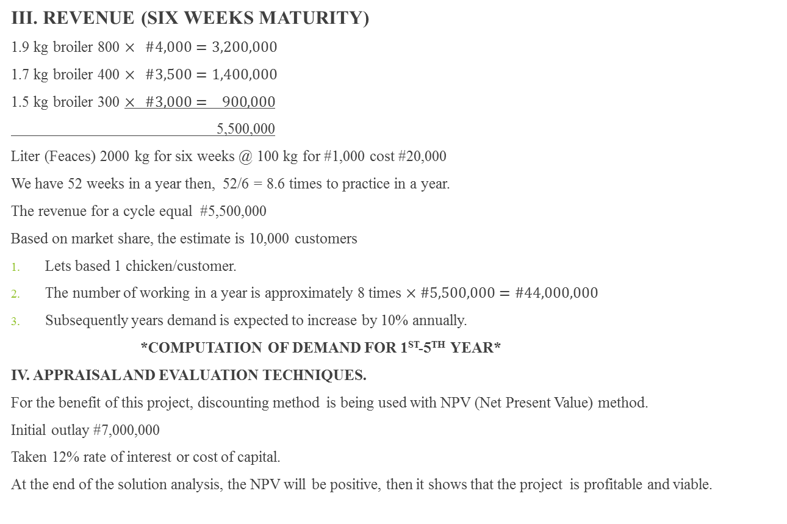
GUIDELINES FOR WRITING A BUSINESS PLAN contd……….
III. REVENUE (SIX WEEKS MATURITY)
1.9 kg broiler 800 $× \#4,000=3,200,000$
1.7 kg broiler 400 $× \#3,500=1,400,000$
1.5 kg broiler 300 $× \#3,000= 900,000$
5,500,000
Liter (Feaces) 2000 kg for six weeks @ 100 kg for #1,000 cost #20,000
We have 52 weeks in a year then, 52/6 = 8.6 times to practice in a year.
The revenue for a cycle equal #5,500,000
Based on market share, the estimate is 10,000 customers
Lets based 1 chicken/customer.
The number of working in a year is approximately 8 times $×\#5,500,000=\#44,000,000$
Subsequently years demand is expected to increase by 10% annually.
*COMPUTATION OF DEMAND FOR 1ST-5TH YEAR*
IV. APPRAISAL AND EVALUATION TECHNIQUES.
For the benefit of this project, discounting method is being used with NPV (Net Present Value) method.
Initial outlay #7,000,000
Taken 12% rate of interest or cost of capital.
At the end of the solution analysis, the NPV will be positive, then it shows that the project is profitable and viable.

Slide 16
THANK YOU FOR LISTENING
DR D. A. MORAKINYO
Osun State University, Osogbo, Okuku Campus

