Slide 1

OSUN STATE UNIVERSITY, OSOGBO
COLLEGE OF SCIENCE, ENGINEERING AND TECHNOLOGY
FACULTY OF BASIC SCIENCE
DEPARTMENT OF PHYSICS
PHYSICS 101
Lecture Note Prepared
By
DR. M.A. FAKUNLE
3080

Slide 2
COURSE CONTENT AREA TO COVER INCLUDE:
Space and Time
Units and Dimensions
Vectors and Scalars,
Differentiation of Vectors (Displacement, Velocity and Acceleration)

Slide 3
Physical Quantity and Dimensions
When we say quantity in the literary sense of it, it may mean an amount or a number of something. By amount, we use words such as large, small, enormous, vast, huge, sufficient, and limited to describe a quantity. For example, we can say the material is available in sufficient or limited quantity.
In science, quantity is defined either by specifying how it is measured or by stating how it is calculated.
Quantity is the property of things which can be measured. The term also bring to mind the questions such as what is the distance of your friend’s house to your school, how big is the fish or yam and what is the time it will take you to walk from your house to your friend’s house.
You can also calculate the speed of an athlete by dividing the total distance covered by the time of running.

Slide 4
In Physics, physical quantity is used to describe any quantity that we might come across during our studying the subject. There are two types of physical quantity that can be distinguished
(a) Base quantities and
(b) Derived quantities.
Base Quantities are those that were defined through measurement process. The measurement of these quantities is independent of each other and all other quantities can be derived from them. The measurement of base quantities should be accurate and precise. The reason for this is because all other quantities are expressed as algebraic combination of the base quantities.
Base on this, the International Standards Organization recommends seven based Quantities which form the international system of Quantities (ISQ).
These ISQ base quantities and their symbols are listed in table 1 (a)

Slide 5
Table 1: Fundamental Quantity and their Symbol
S/N | Fundamental quantity | Symbol | Fundamental
1 | Mass | M | Kilogramme(kg)
2 | Length | L | Metre(m)
3 | Time | T | Second (s)
4 | Angle | θ | Radian (rad)
5 | Amount of substance | N | Mole (mol.)
6 | Thermodynamic temperature | T | Kelvin (k)
7 | Electric current | I | Ampere (A)
8 | Luminous intensity | E | Candela (cd)

Slide 6
Units
Measurements of physical quantities are expressed in terms of units, which are standardized values. For example, an athlete in a competition would cover length of a race, which is a physical quantity, can be expressed in units of meters (for sprinters) or kilometers (for distance runners). Without standardized units, it would be extremely difficult for scientists to express and compare measured values in a meaningful way.
There are two major systems of units used in the world: SI units (also known as the metric system) and English units (also known as the customary or imperial system). English units were historically used in nations once ruled by the British Empire and are still widely used in the United States. Virtually every other country in the world now uses SI units as the standard; the metric system is also the standard system agreed upon by scientists and mathematicians. The acronym “SI” is derived from the French Système International. The units of these fundamental quantities are called fundamental units. These fundamental quantities, their symbols and units are listed in Table 1.1

Slide 7
Derived quantities
As the name implies they are derived/obtained from the base quantities. Their derivation is as a result of calculations done on base quantities.
These calculations can be multiplication of two or more base quantities together or the division of two base quantities or it can be combinations of both operators.
The process of derivation can also be by multiplying or dividing one derived and a base quantity.
Examples of derived quantities, their derivation processes and unit are listed in Table 1.2. The unit of the derived quantity is called derived unit.

Slide 8
Table 2: Derived quantities, derivation processes and their units

Slide 9
Metric Prefixes
SI units are part of the metric system. The metric system is convenient for scientific and engineering calculations because the units are categorized by factors of 10. Table 1.3 gives metric prefixes and symbols used to denote various factors of 10.
Metric systems have the advantage that conversions of units involve only powers of 10. There are 100 centimeters in a meter, 1000 meters in a kilometer, and so on.
In nonmetric systems, such as the system of U.S. customary units, the relationships are not as simple—there are 12 inches in a foot, 5280 feet in a mile, and so on.
Another advantage of the metric system is that the same unit can be used over extremely large ranges of values simply by using an appropriate metric prefix. For example, distances in meters are suitable in construction, while distances in kilometers are appropriate for air travel, and the tiny measure of nanometers are convenient in optical design. With the metric system there is no need to invent new units for particular applications.

Slide 10
Table 3: Metric Prefixes for Powers of 10 and their Symbols
Prefix | Symbol | Value
yotta- | Y | 10²⁴
zetta- | Z | 10²¹
exa | E | 10¹⁸ | exameter | Em
peta | P | 10¹⁵ | petasecond | Ps
tera | T | 10¹² | terawatt | TW
giga | G | 10⁹ | gigahertz | GHz
mega | M | 10⁶ | megacurie | MCi
kilo | k | 10³ | kilometer | km
hecto | h | 10² | hectoliter | hL
deka | da | 10¹ | dekagram | dag

Slide 11
Table 4: Metric Prefixes for sub multiples of 10 and their Symbols
Prefix | Symbol | Value
yocto- | y | 10⁻²⁴
zepto- | z | 10⁻²¹
atto | a | 10⁻¹⁸ | attosecond | as
femto | f | 10⁻¹⁵ | femtometre | fm
pico | p | 10⁻¹² | picofarad | pF
nano | n | 10⁻⁹ | nanogram | ng
micro | μ | 10⁻⁶ | micrometer | μm
milli | m | 10⁻³ | millimeter | mm
centi | c | 10⁻² | centimeter | cm
deci | d | 10⁻¹ | deciliter | dL

Slide 12
Dimensional Analysis
The dimension of any physical quantity expresses its dependence on the base quantities as a product of symbols (or powers of symbols) representing the base quantities.
Table 5 lists the base quantities and the symbols used for their dimension.
For example, a measurement of length is said to have dimension L or L¹, a measurement of mass has dimension M or M¹, and a measurement of time has dimension T or T¹.
Like units, dimensions obey the rules of algebra. Thus, area is the product of two lengths and so has dimension L², or length squared.
Similarly, volume is the product of three lengths and has dimension L³, or length cubed.
Speed has dimension length over time, L/T or LT ^{–1}.
Volumetric mass density has dimension M/L³ or ML^{–3}, or mass over length cubed.
In general, the dimension of any physical quantity can be written as LªM^{b}T^{c}I^{d}Θ^{e}N^{f}J^{g} for some powers a, b, c, d, e, f, and g. We can write the dimensions of a length in this form with and the remaining six powers all set equal to zero:
Any quantity with a dimension that can be written so that all seven powers are zero (that is, its dimension is ) is called dimensionless (or sometimes “of dimension 1,” because anything raised to the zero power is one). Physicists often call dimensionless quantities pure numbers.

Slide 13
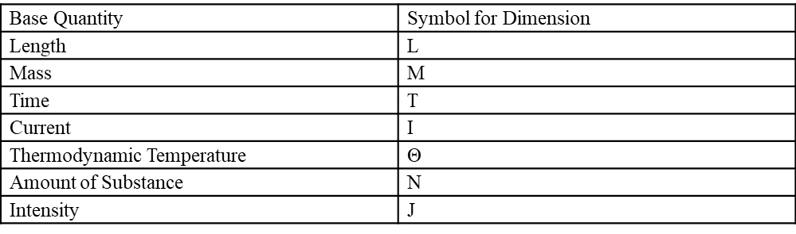
Table 5: Base Quantities and Their Dimensions

Slide 14
Physicists often use square brackets around the symbol for a physical quantity to represent the dimensions of that quantity. For example, if is the radius of a cylinder and is its height, then we write [r] = L and [h] = L to indicate the dimensions of the radius and height are both those of length, or L. Similarly, if we use the symbol A for the surface area of a cylinder and V for its volume, then [A] = L² and [V] = L³ If we use the symbol m for the mass of the cylinder and ρ for the density of the material from which the cylinder is made, then [m] = M and [ρ] = ML⁻³
The importance of the concept of dimension arises from the fact that any mathematical equation relating physical quantities must be dimensionally consistent, which means the equation must obey the following rules:
• Every term in an expression must have the same dimensions; it does not make sense to add or subtract quantities of differing dimension (think of the old saying: “You can’t add apples and oranges”). In particular, the expressions on each side of the equality in an equation must have the same dimensions.

Slide 15
The arguments of any of the standard mathematical functions such as trigonometric functions (such as sine and cosine), logarithms, or exponential functions that appear in the equation must be dimensionless.
These functions require pure numbers as inputs and give pure numbers as outputs.
If either of these rules is violated, an equation is not dimensionally consistent and cannot possibly be a correct statement of physical law. This simple fact can be used to check for typos or algebra mistakes, to help remember the various laws of physics, and even to suggest the form that new laws of physics might take. This last use of dimensions is beyond the scope of this text, but is something you will undoubtedly learn later in your academic career.

Slide 16
Using Dimensions to Remember an Equation
Suppose we need the formula for the area of a circle for some computation.
Two expressions may pop into our mind when we think of circles: and one expression is the circumference of a circle of radius r and the other is its area. But which is which?
If either expression does not have the same dimensions as area, then it cannot possibly be the correct equation for the area of a circle
Solution
We know the dimension of area is L². Now, the dimension of the expression πr² is
[πr²] = [π]. [r²] = 1. [L²] = L²
since the constant is a pure number and the radius is a length. Therefore, πr² has the dimension of area. Similarly, the dimension of the expression 2πr is
[2πr] = [2].[π]. [r] = 1. 1. L = L
since the constants 2 and π are both dimensionless and the radius is a length. We see that has the dimension of length, which means it cannot possibly be an area.
We rule out because it is not dimensionally consistent with being an area. We see that is dimensionally consistent with being an area, so if we have to choose between these two expressions, is the one to choose.

Slide 17
Checking Equations for Dimensional Consistency
Consider the physical quantities s, v, a and t with dimensions [s] = L, [v] = LT⁻¹, [a] = LT⁻² and [t] = T. Determine whether each of the following equations is dimensionally consistent: (a) s=ut+0.5at², (b) s = ut²+0.5t and (c) v = sin (at²/s)
Strategy
By the definition of dimensional consistency, we need to check that each term in a given equation has the same dimensions as the other terms in that equation and that the arguments of any standard mathematical functions are dimensionless.
Solution
(a.) There are no trigonometric, logarithmic, or exponential functions to worry about in this equation, so we need only look at the dimensions of each term appearing in the equation. There are three terms, one in the left expression and two in the expression on the right, so we look at each in turn:
[s] = L [vt] = [v]. [t] = LT⁻¹.T = LT⁰ = L
[0.5at²] = [a].[t²] = LT⁻².T² = LT⁰ = L
All three terms have the same dimension, so this equation is dimensionally consistent.
(b(. Again, there are no trigonometric, exponential, or logarithmic functions, so we only need to look at the dimensions of each of the three terms appearing in the equation:
[s] = L [vt²] = [v}. [t²] = LT⁻¹.T² = LT
[at] = [a]. [t] = LT⁻². T = LT⁻¹
None of the three terms has the same dimension as any other, so this is about as far from being dimensionally consistent as you can get. The technical term for an equation like this is nonsense

Slide 18


Dimensions are also used to indicate relationships among physical quantity. For example, the velocity V of a transverse wave along a stretched string depends on the
Tension F in the string, Its length l and Its mass m. Find the actual equation
The relationship can be written as
(1.8)
Where a, b and c are numbers we will find by dimension and k as a constant
The dimension of velocity v = LT^{-1,} The dimension of tension F = MLT⁻²
The dimension of length (l) = L, The dimension of mass (m) = M
From (1.8)
LT⁻¹ = (MLT⁻²) ª L^{b} M^{c}
Equating indices of M, L and T on both sides (1.9)
1 = a + b (1.10)
-1 = -2a (1.11)

Slide 19


(c). This equation has a trigonometric function in it, so first we should check that the argument of the sine function is dimensionless:
The argument is dimensionless. So far, so good. Now we need to check the dimensions of each of the two terms (that is, the left expression and the right expression) in the equation:
[v] = LT⁻¹
The two terms have different dimensions—meaning, the equation is not dimensionally consistent. This equation is another example of “nonsense.”

Slide 20

One further point that needs to be mentioned is the effect of the operations of calculus on dimensions. We have seen that dimensions obey the rules of algebra, just like units, but what happens when we take the derivative of one physical quantity with respect to another or integrate a physical quantity over another? The derivative of a function is just the slope of the line tangent to its graph and slopes are ratios, so for physical quantities v and t, we have that the dimension of the derivative of v with respect to t is just the ratio of the dimension of v over that of t:
Similarly, since integrals are just sums of products, the dimension of the integral of v with respect to t is simply the dimension of v times the dimension of t:
By the same reasoning, analogous rules hold for the units of physical quantities derived from other quantities by integration or differentiation.

Slide 21
VECTOR
INTRODUCTION
Apart from classifying quantities into fundamental and derived quantities, quantities in physics can also be categorized into scalar quantity and vector quantity.Vectors are essential to physics and engineering. Many fundamental physical quantities are vectors, including displacement, velocity, force, and electric and magnetic vector fields. Scalar products of vectors define other fundamental scalar physical quantities, such as energy. Vector products of vectors define still other fundamental vector physical quantities, such as torque and angular momentum. In other words, vectors are a component part of physics in much the same way as sentences are a component part of literature.
Scalars and Vectors
Many familiar physical quantities can be specified completely by giving a single number and the appropriate unit. For example, “a class period lasts 50 min” or “the gas tank in my car holds 65 L” or “the distance between two posts is 100 m.” A physical quantity that can be specified completely in this manner is called a scalar quantity. Scalar is a synonym of “number.” Time, mass, distance, length, volume, temperature, and energy are examples of scalar quantities.
Scalar quantities that have the same physical units can be added or subtracted according to the usual rules of algebra for numbers.

Slide 22
Similarly, a 60-cal serving of corn followed by a 200-cal serving of donuts gives of energy. When we multiply a scalar quantity by a number, we obtain the same scalar quantity but with a larger (or smaller) value. For example, if yesterday’s breakfast had 200 cal of energy and today’s breakfast has four times as much energy as it had yesterday, then today’s breakfast has of energy. Two scalar quantities can also be multiplied or divided by each other to form a derived scalar quantity. For example, if a train covers a distance of 100 km in 1.0 h, its speed is 100.0 km/1.0 h = 27.8 m/s, where the speed is a derived scalar quantity obtained by dividing distance by time

Slide 23
Vectors
Many physical quantities, however, cannot be described completely by just a single number of physical units. For example, when the U.S. Coast Guard dispatches a ship or a helicopter for a rescue mission, the rescue team must know not only the distance to the distress signal, but also the direction from which the signal is coming so they can get to its origin as quickly as possible.
Physical quantities specified completely by giving a number of units (magnitude) and a direction are called vector quantities.
Examples of vector quantities include displacement, velocity, position, force, and torque. In the language of mathematics, vector quantities are represented by mathematical objects called vectors (Figure 2.2).
We can add or subtract two vectors, and we can multiply a vector by a scalar or by another vector, but we cannot divide by a vector. The operation of division by a vector is not defined.

Slide 24
1 Vector Addition
The addition, subtraction and multiplication of vectors are not the same as those of ordinary number. For example, if a long – distance runner runs 15 km east, 7km west and finally 4 km north. The net displacement is not 26 km. The computation has to take direction into account. Because of this, and for convenience’s sake, we need to represent a vector by a line and an arrow. The length here denotes the magnitude of the vector while the arrow on it indicates direction.

Slide 25




Algebra Vectors in One Dimension
The addition of two vectors which are not inclined to each other but are parallel or anti parallel is as shown in the fig. 6 below

Slide 26
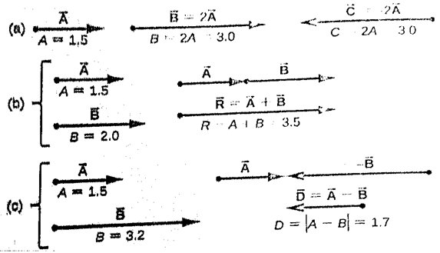

Slide 27

Algebra of Vectors in Two Dimensions
When the two vectors are at angle 90o or orthogonal, we complete the square or rectangle, then their addition called the resultant is the diagonal that is drawn from where the two tails of the vector meet.
The Two methods of adding or subtracting vectors in two dimensions are Geometrical and analytical methods

Slide 28
Geometrical Method:
This method can be by construction of a Triangle or a Parallelogram.
To be able to do this, two given vectors A and B that are at a particular angle to each other, will be represented by two adjacent sides of a triangle inclined to each other at the angle between the two vectors.
The third side R of the triangle is the sum or resultant of the two vectors.
This is a triangle way of adding two vectors.
The parallelogram method is to draw the two vectors by two sides of the parallelogram and then, we complete the parallelogram.
The line drawn from where the two tails of the vectors joined called the diagonal is then the addition or the resultant of the two vectors in question. The triangle and parallelogram way of addition gives the same answer for the resultant or sum of the two vectors

Slide 29
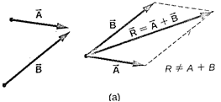
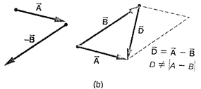

Slide 30

If we have more than two vectors A, B. and C their addition by construction is as indicated in Fig. 1.3

Slide 31
Multiplication of Vectors
As mentioned earlier, derived quantity is formed when two or more quantities are multiplied together. For example, multiplication of distance by force gives work and again the multiplication of distance by force also give moment or torque. Certainly, there must be difference in these two multiplication operations. There are generally the
(a) Multiplication of vector by a scalar will produce a vector
(b) Multiplication of a vector by a vector will produce a scalar (dot product)
Multiplication of a vector by a vector will produce a vector (cross product).

Slide 37
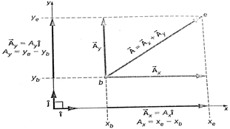

Slide 41
Mathematical Tools
Introduction
In physics, the knowledge of mathematical tool is necessary and important in order to treat and explain many concepts so that their meaning can be clearly explained. Such mathematical tools include derivatives (i.e. differentiation and integration) and trigonometric functions. These tools are only highlighted since their complete treatment is obtained in the relevant mathematics courses that we have offered or come across as we progress in our study of physics. So their treatment is beyond the scope of this course

Slide 44
THANK YOU FOR LISTENING

