Slide 1
Introduction to Physiology
L.O. Adegbite

Slide 2
Outline
Introduction to Physiology and its place in Medicine
The composite cell, Cell membrane and Transport Mechanisms
Body Fluid Compartment and homeostasis

Slide 3
Introduction to Physiology and its place in Medicine

Slide 4
What is Physiology?
Physiology is the scientific study of a living organism from the basis of cell function to the integrated functions of the organism as a whole and the influence of the external environment.
The word “ Physiology” is derived from two Greek words: Physis (nature) and logos (study).
The word “Physiology” was first coined in 1542 by a french physician known as Jean Fernel. It later came into common use in the 19th century.

Slide 5
Branches of Physiology
Human Physiology: study of the functions of human body from cellular level to the integrated systems of the body.
Animal Physiology: study of the functions of animals.
Plant Physiology: study of the functions of plants.
Microbial Physiology: study of the functions of microorganisms.
Though there are many branches of Physiology as listed above, our major focus is on Human Physiology.

Slide 6
History and early contributions to human physiology
 | Name | Discoveries
 | Alcmaeon and Empedocles, Hippocrates and his followers (450 BCE) | Proposed and wrote extensively on the concept of fluid-like substances (humors) in the body
 | Ebers Papyrus (1550 BCE) | Describes the concepts of blood circulation and nervous system function
 | Galen (129 - 216 CE) | Describes the concept of “Pneuma” i.e. life-giving spirit
 | Ibn Sina and Ibn Rushd (980 - 1198 CE) | Describes the concept of canalicular system
 | William Harvey (1578 - 1657 CE) | Revolutionized the concept of circulatory system and published “De Motu Cordis” in 1628 CE
 | Theodor Schwann and Matthias Jakob Schleiden (1804 - 1882) | Developed the cell theory which laid the foundation for modern physiology
 | Walter Canon (1871 - 1945 CE) | Introduced the concept of homeostasis
 | Claude Bernard (1813 - 1878 CE) | Introduced the concept of the “milieu interieur” (i.e. internal environment)
 | Ivan Pavlov (1849 - 1936 CE) | Discovered the concept of classical conditioning
 | Otto Loewi (1873 - 1961 CE) | Discovered the role of neurotransmitters in the nervous system

Slide 7
Nobel Prizes in Physiology or Medicine
Nobel society is a global society which awards excellence to a groundbreaking discoveries in various fields.
A sweedish chemist, Alfred Nobel (1833-1896) who made his fortune through invention of explosives including dynamite wrote his will in 1895.
In his will, he left majority of his properties for the establishment of the Nobel Prizes which should be awarded annually to those who have “conferred the greatest benefit to mankind” in the fields of: Physics, Chemistry, Literature, Peace and Physiology or Medicine.

Slide 8
These awards have been conferred meritoriously to individuals/organizations annually since 1901 till date (except during Worl War I and World War II).
Economic science was added as the 6th category in 1968.
The youngest recipient of the Nobel Prize is Malala Yousafzai at the age of 17 in 2014. She was recognized for her courageous advocacy for girl’s education and her award was seen as a powerful symbol of the significance of education and human rights.
The youngest recipient in Physiology or Medicinen is Frederick G. Banting at age 31 in 1923 for his discovery of insulin.

Slide 9
The place of Physiology in the field of Medicine
Physiology is the bedrock and father of medicine.
Many unfavourable factors can change the normal state of the body system (the relm of Physiology) to abnormal state (the relm of Pathology) leading to a disease.
The field of medicine ensures resetting the abnormal back to normal. In order to achieve this, core understanding of the normal functions of the body system is compulsory

Slide 10
Understanding physiological processes is important in diagnosing and treating diseases
The application of physiological principles is essential to promote healthy lifestyles

Slide 11
The composite cell, Cell membrane and Transport Mechanisms

Slide 12
The Composite Cell
What is cell?
Cells are the microscopic fundamental units of all living things.
Every living organism ranging from microorganism (e.g. bacteria, protozoans, fungi e.t.c.), plant and animals has cells.
Some organisms are made up of just one cell and are called unicellular organism (e.g. bacteria and protozoans) while some are made up of many cells of different types and are reffered as multicellular organisms ( e.g. animals, including human beings).
An adult human body is composed of about 100,000,000,000,000 cells

Slide 13
Each cell in human has basic requirements to keep it alive (such as oxygen, food, and waste removal).
The body's organ systems are largely built around providing the many trillions of cells with those basic needs.

Slide 14
Basic features in human cell
Cell membrane
Cytoplasm
Organelles
- Nucleus: houses the cell's genetic materials
- Mitochondria: generate the cell's energy by oxidative phosphorylation using oxygen.
- Endoplasmic reticulum: is the transport network for molecules targeted for certain modifications and specific destinations, as compared to molecules that float freely in the cytoplasm.

Slide 15
  - Golgi apparatus: process and package the macromolecules such as proteins and lipids that are synthesized by the cell.
  -Ribosomes: act as an assembly line where RNA from the nucleus is used to synthesise proteins from amino acids.
    -lysosomes: contain digestive enzymes (acid hydrolases) which helps in digesting excess or worn-out organelles, food particles, and engulfed viruses or bacteria.

Slide 16
Specialized Cells in Human Body
Nerve Cells
Epithelial cells
Exocrine cells
Endocrine cells
Blood Cells
Germ cells

Slide 17
Cell membrane, transport mechanisms and membrane potentials

Slide 18
CELL MEMBRANE
The cell membrane (also known as the plasma membrane or cytoplasmic membrane) is a biological membrane that separates the interior of all cells from the outside environment. The cell membrane is selectively permeable to ions and molecules because of its thin, pliable and elastic structure which is 7.5 to 10 nanometers thick.

Slide 19
CELL MEMBRANE
The cell membrane (also known as the plasma membrane or cytoplasmic membrane) is a biological membrane that separates the interior of all cells from the outside environment. The cell membrane is selectively permeable to ions and molecules because of its thin, pliable and elastic structure which is 7.5 to 10 nanometers thick.

Slide 20
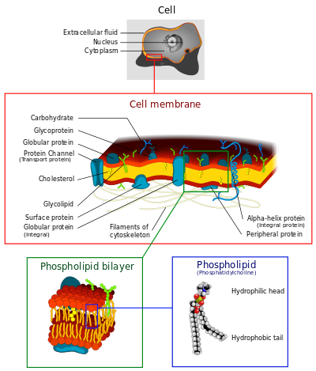
Illustration of a Eukaryotic cell membrane

Slide 21
COMPOSITION
Proteins- 55%.
Phospholipids- 25% and other lipids are about 4%.
Cholesterol- 13%.
Carbohydrate- About 3%, predominantly glycoproteins, but with some glycolipids (cerebrosides and gangliosides).

Slide 22
Fluid mosaic model: in 1972 by SJ Singer and GL Nicholson. According to them, the membrane is a fluid with mosaic of proteins. The proteins are found to float in the lipid layer instead of forming layers of sandwich-type model. This model is accepted by scientists till now.

Slide 23
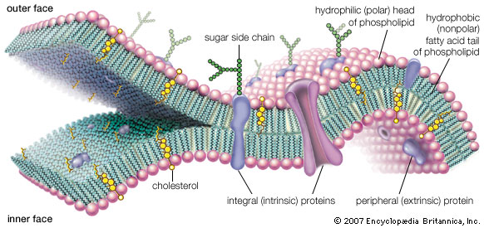
Fluid Mosaic Model

Slide 24
FUNCTIONS OF CELL MEMBRANE
1. Passive osmosis and diffusion: Some substances (small molecules, ions) such as carbon dioxide (CO₂) and oxygen (O₂), can move across the plasma membrane by diffusion, which is a passive transport process.
2. Transmembrane protein channels and Transporter: Nutrients, such as sugars or amino acids, must enter the cell, and certain products of metabolism must leave the cell.

Slide 25
Cont’d
3. Endocytosis: In this process, the cells absorb molecules by engulfing them.
4. Exocytosis: the membrane of a vesicle can be fused with the plasma membrane, extruding its contents to the surrounding medium.

Slide 26
PERMEABILITY
It is the rate of passive diffusion of molecules through the membrane.
Permeability depends on electric charge and polarity of molecules and to a lesser extent, molar mass of the molecules.

Slide 27
MEMBRANE TRANSPORT

Slide 28
MEMBRANE TRANSPORT
In cellular biology the term membrane transport refers to the collection of mechanisms that regulate the passage of solutes such as ions and small molecules through biological membranes namely lipid bilayers that contain proteins embedded in them.
The regulation of passage through the membrane is due to selective membrane permeability - a characteristic of biological membranes which allows them to separate substances of distinct chemical nature.
In other words, they can be permeable to certain substances but not to others.

Slide 29
MEMBRANE TRANSPORT
The movements of most solutes through the membrane are mediated by membrane transport proteins which are specialized to varying degrees in the transport of specific molecules.
As the diversity and physiology of the distinct cells is highly related to their capacities to attract different external elements, it is postulated that there is a group of specific transport proteins for each cell type and for every specific physiological stage.
This differential expression is regulated through the differential transcription of the genes coding for these proteins and its translation, for instance, through genetic-molecular mechanisms, but also at the cell biology level: the production of these proteins can be activated by cellular signaling pathways, at the biochemical level, or even by being situated in cytoplasmic vesicles.

Slide 30
MEMBRANE TRANSPORT PROTEINS
A membrane transport protein (or simply transporter) is a membrane protein involved in the movement of ions, small molecules, or macromolecules, such as another protein across a biological membrane.
Transport proteins are integral membrane proteins; i.e. they exist within and span the membrane across which they transport substances.
The proteins may assist in the movement of substances by facilitated diffusion or active transport. These mechanisms of action are known as carrier-mediated transport.

Slide 31
TYPES OF MEMBRANE TRANSPORT PROTEINS
Channels/Pores
- facilitated diffusion
Electrochemical Potential-driven transporters
- Mitochondrial membrane transport protein
- Glucose transporter
- Neurotransmitter transporters
  - Glutamate/aspartate transporters
    - GABA transporters
  - Glycine transporters
  - Monoamine transporters, including:
    Dopamine transporter (DAT)
    Norepinephrine transporter (NET)
    Serotonin transporter (SERT)
    Vesicular monoamine transporters (VMAT)
  - Adenosine transporters
  - Vesicular acetylcholine transporter (VAChT)

Slide 32
TYPES OF MEMBRANE TRANSPORT PROTEINS
Primary Active Transporters
- ATP-binding cassette transporter genes
  P-glycoprotein
  CD98
V-ATPase
- Ion transporters
  Na⁺/K⁺-ATPase
  Plasma membrane Ca²⁺ ATPase
  Proton pump
  Hydrogen potassium ATPase
  Sodium-chloride symporter
Co-transporters
- Symporters: transport two or more ions together in the same direction.
- Antiporters: in the opposite direction.

Slide 33
Plasma Membrane Transport
Molecules move across the plasma membrane by:
  - Passive Transport
  - Active Transport
The three types of passive transport are:
- Diffusion
- Facilitated Diffusion
- Osmosis
In passive transport, ATP energy is not needed to move the molecules through.

Slide 34
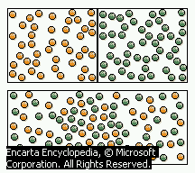
Passive Transport 1: Diffusion
Molecules can move directly through the phospholipids of the plasma membrane. This is called diffusion.
Diffusion is the net movement of
molecules from a high concentration to a low
concentration until equally distributed.
Diffusion rate is related to temperature, pressure, state of matter, size of concentration gradient, and surface area of membrane.
Molecules that pass through the plasma membrane by diffusion are: Gases (oxygen, carbon dioxide), Water molecules (rate slow due to polarity), Lipids (steroid hormones), Lipid soluble molecules (hydrocarbons, alcohols, some vitamins), Small non charged molecules (NH₃)

Slide 35
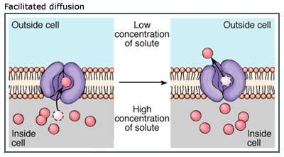
Passive Transport 2: Facilitated Diffusion
Molecules can move through the plasma membrane with the aid of transport proteins.
Facilitated diffusion is the net movement of molecules from a high concentration to a low concentration with the aid of channel or carrier proteins.
Molecules that move through
the Plasma membrane by
facilitated diffusion are: Ions (Na⁺, K⁺, Cl⁻), Sugars (Glucose), Amino Acids, Small water soluble molecules, Water (faster rate)

Slide 36
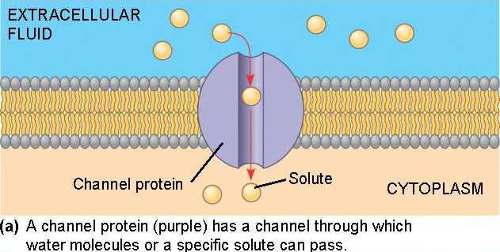
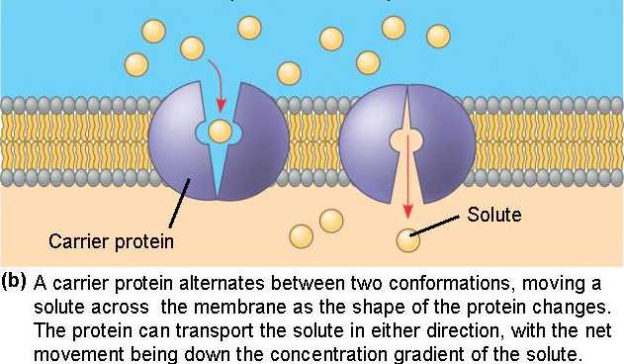
How do molecules move through the plasma membrane by facilitated diffusion?
Channel and Carrier proteins are specific:
Channel Proteins allow ions, small solutes, and water to pass.
Carrier Proteins move glucose and amino acids.
Facilitated diffusion is rate limited, by the number of proteins channels/carriers present in the membrane.

Slide 37
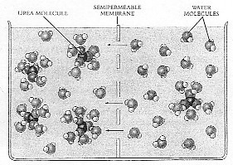
Passive Transport 3: Osmosis
Water Molecules can move directly through the phospholipids of the plasma membrane.
Osmosis is the diffusion of water through a semipermeable membrane.
Water molecules bound to solutes cannot pass due to size, only unbound molecules.
Free water molecules collide, bump into the membrane, and pass through.

Slide 38
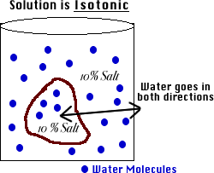
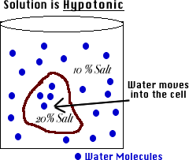
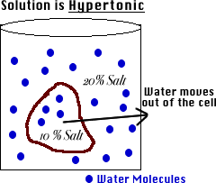
Osmosis and Tonicity
Tonicity refers to the total solute concentration of the solution outside the cell.
What are the three types of tonicity?
Isotonic 2) Hypotonic 3) Hypertonic
No net movement cell gains H₂O cell loses H₂O
of H₂O (same size) (Burst) (Shrinks)

Slide 39
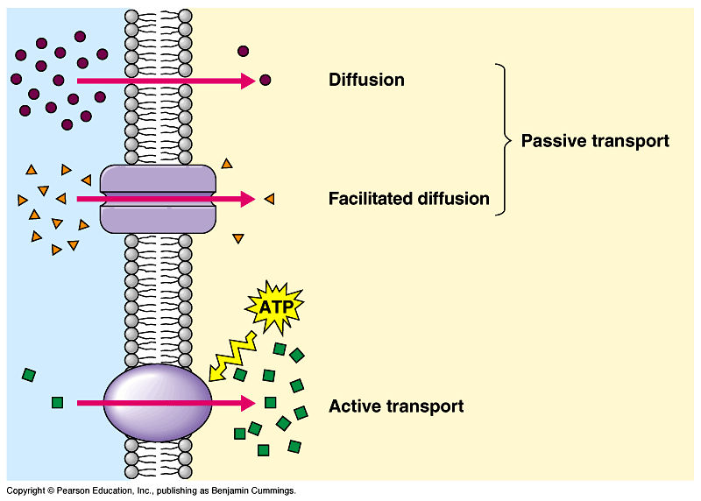
Active Transport
Active Transport
- Primary
- Secondary (no ATP)
Bulk Transport
- Exocytosis
- Endocytosis
- Phagocytosis
- Pinocytosis
- Receptor-Mediated endocytosis
In primary active transport, ATP energy is required to move the molecules through.
Molecules move from areas of low concentration to areas of high concentration with the aid of ATP energy.
Requires protein carriers called Pumps.

Slide 40
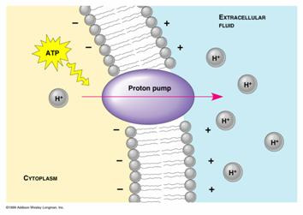
The Importance of Active Transport
Bring in essential molecules: ions, amino acids, glucose, nucleotides.
Rid cell of unwanted molecules (e.g. sodium from urine in kidneys).
Maintain internal conditions
different from the environment.
Regulate the volume of cells
by controlling osmotic potential.
Control cellular pH.
Re-establish concentration gradients to run facilitated diffusion (e.g. Sodium-Potassium pump and Proton pumps)

Slide 41
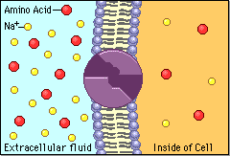
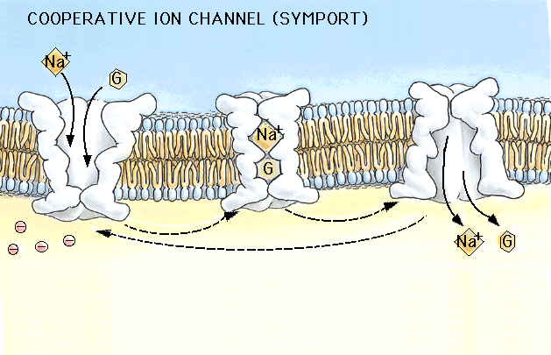
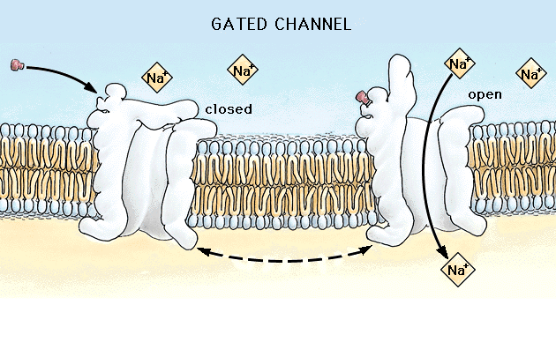
Secondary Active Transport
Via facilitated diffusion of Na
Counter Transport – the transport
of two substances at the same time
in opposite directions, without ATP.
Protein carriers are called Antiports.
Co-transport – the transport of
two substances at the same time in
the same direction, without ATP.
Protein carriers are called Symports.
Gated Channels – receptors
combined with channel proteins.
When a chemical messenger binds
to a receptor, a gate opens to allow
Ions to flow through the channel.

Slide 42
Bulk Transport: Exocytosis
Movement of large molecules bound in vesicles out of the cell with the aid of ATP energy. Vesicle fuses with the plasma membrane to eject macromolecules. e.g. Proteins, polysaccharides, polynucleotides, whole cells, hormones, mucus, neurotransmitters, waste.
Bulk Transport: Endocytosis
Movement of large molecules into the cell by engulfing them in vesicles, using ATP energy.
Three types of Endocytosis:
– Phagocytosis
– Pinocytosis
– Receptor-mediated endocytosis

Slide 43
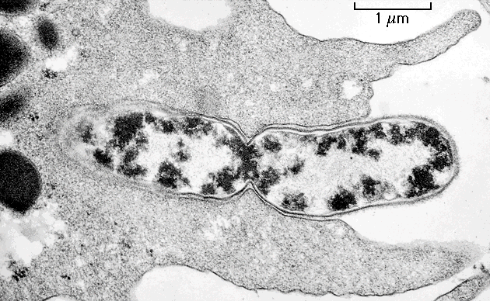
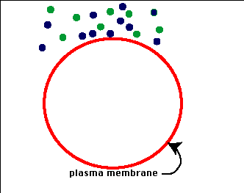
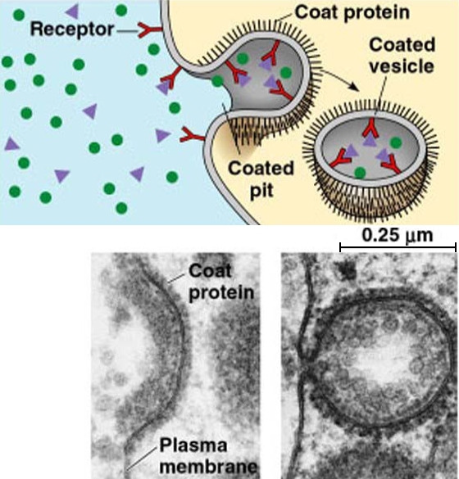
Phagocytosis: “Cellular Eating”
– engulfing large molecules,
whole cells, bacteria.
Pinocytosis: “Cellular Drinking”
– engulfing liquids and
small molecules dissolved
in liquids; unspecific what enters.
Receptor-Mediated Endocytosis:
Movement of very specific
molecules into the cell with the
use of vesicles coated with the
protein clathrin.

Slide 44
DISEASES ASSOCIATED WITH THE MEMBRANE
Ion channel Affected gene Disease
Na⁺ (voltage-gated, SCN4A Hyperkalemic periodic paralysis
skeletal muscle)
Na⁺ (voltage-gated, SCN1A Generalized epilepsy with febrile neuronal ) seizures
Na⁺ (voltage-gated, SCN5A Long QT syndrome 3
cardiac muscle)
Ca²⁺ (neuronal) CACNA1A Familial hemiplegic migraine
Ca²⁺ (voltage-gated, CACNA1F Congenital stationary night
retina) blindness
Ca²⁺ (polycystin-1) PKD1 Polycystic kidney disease

Slide 45
Ion channel Affected gene Disease
K⁺ (neuronal) KCNQ4 Dominant deafness
K⁺ (voltage-gated, neuronal) KCNQ2 Benign familial neonatal convulsions
Cl ⁻ CFTR Cystic fibrosis
Others are:
Hartnup Disease – a metabolic disorder affecting the absorption of non-polar amino acids (particularly tryptophan). The defective gene is SLC6A19. SLC6A19 is a sodium-dependent and chloride-independent neutral amino acid transporter, expressed predominately in the kidneys and intestine.
Salla Disease - is caused by a mutation in the SLC17A5 gene. This gene codes for sialin, a lysosomal membrane protein that transports the charged sugar, N-acetylneuraminic acid (sialic acid), out of lysosomes. The mutation causes sialic acid to build up in the cells.

Slide 46
Tangier Disease - People with Tangier disease have defective ABCA1 transporters resulting in a greatly reduced ability to transport cholesterol out of their cells, which leads to an accumulation of cholesterol in many body tissues.
Paroxysmal Nocturnal Hemoglobinuria – Mutation resulting in deficient attachment of the GPI anchor to certain proteins of the red cell membrane.
Hereditary Spherocytosis – Mutations in the genes encoding spectrin or other structural proteins in the red cell membrane.
Wilson Disease – Mutations in the gene encoding a copper-dependent ATPase.
Familial Hyperccholesterolemia – Mutations in the gene encoding the LDL receptor.

