Slide 1
Cell division
The process by which a cell divides to form two or more new cells.
Among Prokaryotes, cell division occurs by simple fission.
Among Eukaryotes, the cell nucleus divides first, and the cytoplasm to form the new cell.
Cell division is used as a means of reproduction in organisms asexually( fission/spore formation) and sexually(gametes formation).
Cell division is also the source of tissue growth and repair in multicellular organisms.
The two types -in eukaryotic organisms are mitosis and meiosis.

Slide 2
MITOSIS
A nuclear division with cytokinesis, produces two identical daughter cells from a single parent cell.
Involves separation of the chromosomes in the nucleus into two identical sets of two daughter nuclei.
This is generally followed immediately by cytokinesis, which divides cytoplasm into two daughter cells.
However, there are many cells where karyokinesis and cytokinesis occur separately, forming single cells with multiple nuclei as in fungi and slime molds.
Upon completion of the process, each daughter cell contains the same genetic material as the original cell and roughly half of its cytoplasm.

Slide 3
Phases of Mitosis
Four main phases: - prophase, metaphase, anaphase, and telophase
Interphase
Interphase is often included in discussions of mitosis, but interphase is technically not part of mitosis.
The cell engages in metabolic activity and gets prepared for mitosis.
Chromosomes are not seen in the nucleus, although a dark spot called the nucleolus may be visible.
The cell may contain a pair of centrioles (or microtubule organizing centres in plants) both of which are organizational sites for microtubules.
Each chromosome is duplicated as two chromatins

Slide 4
Mitotic cell division consists of four main stages, collectively called mitosis, followed by cytokinesis.
1. Prophase
Chromatin condenses into visible chromosomes.
Each chromosome consists of two sister chromatids joined at a centromere.
The nuclear envelope begins to break down.
Spindle fibers start forming from centrosomes.
2. Metaphase
Chromosomes align at the cell's equatorial plane (metaphase plate).
Spindle fibers attach to the centromeres via kinetochores.

Slide 5
3. Anaphase
Sister chromatids are pulled apart by the spindle fibres.
Chromatids (now individual chromosomes) move to opposite poles of the cell. (a) Metaphase (b) Anaphase
4. Telophase
Chromosomes decondense back into chromatin.
Nuclear envelopes reform around the two sets of chromosomes.
Spindle fibers disassemble.
Cytokinesis
The cytoplasm divides, forming two daughter cells.
In animal cells: A cleavage furrow forms.
In plant cells: A cell plate develops into a new cell wall.
Result: Two genetically identical daughter cells.

Slide 6
Diagrams illustrating mitotic cell division: A Interphase; B, C, D and E Prophase; F Metaphase. G, Anaphase

Slide 7
Diagrams illustrating mitotic cell division: H and I Anaphase; J and K Telophase

Slide 8
Mitosis in an Animal Cell

Slide 9
MEIOSIS (Reductional Cell Division)
Meiosis is a specialized type of cell division that reduces the chromosome number by half, producing four genetically unique haploid cells.
This process occurs in germ cells to produce gametes (sperm and eggs)
In Meiosis, the cell divides into sex cells with half the number of chromosomes.
The sex cells can later combine to form offspring with the full number of chromosomes.
Meiosis consists of two consecutive cell divisions (Meiosis I and meiosis II)
.

Slide 10
Phases of Meiosis I
There are 4 stages of meiosis I; prophase I is the longest meiosis stage and comprises 5 sub-phases.
1) Prophase 1 –
Prophase 1 is the longest phase of meiosis, where three primary aspects are taking place.
The first is the condensation of chromatin into chromosomes,
the second aspect is the physical contact between homologous chromosomes, and
the third aspect is the transmission of genetic information between synapsed chromosomes.
All these aspects occur in five sub-phases.

Slide 11
The following are the five sub-phases under prophase 1:
Leptotene: The chromosomes start to condense and become visible as thin threads. Homologous chromosomes start searching for each other.
Zygotene: Here the chromosomes start pairing and Homologous chromosomes pair up in a process called synapsis.
The paired chromosomes are called bivalent,
Each bivalent consists of tetrad of chromatids
Pachytene: Homologous chromosomes complete synapsis, and crossing over begins.
Non-sister chromatids exchange segments, forming chiasmata at the crossover points.
Synapsis later loosens as crossing over is completed.

Slide 12
Diplotene: The synaptonemal complex disintegrates, and homologous chromosomes begin to separate but remain connected at chiasmata, which become clearly visible. Chromosomes slightly decondense, allowing limited transcription.
Diakinesis: Chromosomes reach maximum condensation. The nuclear envelope breaks down, the nucleolus disappears, and spindle fibers begin to form as centrioles move to opposite poles. Chiasmata shift terminally before chromatids finally separate.

Slide 13
Metaphase I:Homologous chromosome pairs align randomly along the metaphase plate. This independent (random) assortment places maternal and paternal chromosomes on either side of the equator, contributing to genetic variation.
Anaphase 1:
The two chromosomes of bivalent separate and move to the opposite sides of the cell. Sister chromatids stay connected whereas homologous chromosomes are separated.
4) Telophase 1:
In this meiosis phase, the decondensation of chromosomes occurs. The nuclear envelope forms and Cytokinesis occurs.

Slide 14
Phases of Meiosis II
In this meiosis phase II, the sister chromatids completely separate. The stages of meiosis II are as follows:
Prophase II : The nucleoli and nuclear membrane disappear again. The chromatids get shorter and thicker. Chromosomes condense and centrosomes move to the opposite sides of the cell.
Metaphase II : Chromosomes align at the cell's equatorial plane (metaphase plate). Spindle fibres attach to the centromeres via kinetochores.
Anaphase II: The spindle fibres contract and separate from sister chromatids. These separated chromatids move to the opposite ends of the cell. The chromatids are now called sister chromosomes as they are at the equator of the cell.

Slide 15
Telophase II: This stage is similar to the telophase 1 stage in Meiosis 1. Here, the chromosomes decondense, the nuclear membrane reforms and cell plate formation creates four haploid daughter cells.
Key Features of Meiosis
- Consists of two successive divisions: Meiosis I and Meiosis II.
- Produces four non-identical haploid cells (n).
- Reduces chromosome number from diploid (2n) to haploid (n).
- Involves processes like crossing over and independent assortment, leading to genetic variation.

Slide 16
Stages of Meiosis
1. Meiosis I (Reductional Division)
In this stage, homologous chromosomes are separated, reducing the chromosome number by half.
1. Prophase I
- Chromatin condenses into visible chromosomes.
- Homologous chromosomes pair up in a process called synapsis, forming bivalents or tetrads.
- Crossing over occurs: Homologous chromosomes exchange segments at points called chiasmata, introducing genetic variation.
- The nuclear envelope breaks down, and spindle fibers begin to form.

Slide 17
Metaphase I
- Homologous chromosome pairs (tetrads) align at the metaphase plate.
- Spindle fibers attach to kinetochores of each homologous chromosome.
3. Anaphase I
- Homologous chromosomes are pulled apart to opposite poles of the cell.
- Sister chromatids remain attached at the centromere.
4. Telophase I and Cytokinesis
- Chromosomes decondense slightly, and the nuclear membrane may reform.
- The cell divides into two haploid cells. Each daughter cell has half the number of chromosomes but with sister chromatids still attached.

Slide 18
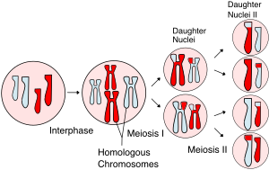

Slide 19
2. Meiosis II (Equational Division)
This division resembles mitosis but occurs in the haploid cells formed in Meiosis I. The sister chromatids are separated.
1. Prophase II
Chromosomes condense again, and the nuclear envelope dissolves if reformed. Spindle fibres reform and attach to the sister chromatids.
2. Metaphase II
Chromosomes align along the metaphase plate. Each chromosome consists of two sister chromatids.
3. Anaphase II
Sister chromatids are pulled apart as the spindle fibers shorten. Each chromatid (now a chromosome) moves toward opposite poles.

Slide 20
4. Telophase II and Cytokinesis
- Chromosomes decondense, and the nuclear membrane reforms.
- The cells divide, resulting in four genetically distinct haploid cells
Summary of Meiotic Division
Meiosis I: Separates homologous chromosomes → produces two haploid cells.
Meiosis II: Separates sister chromatids → produces four haploid cells.
Significance of Meiosis
1. Genetic Variation: Crossing over during Prophase I. independent assortment of homologous chromosomes during Metaphase I.
2. Reduction of Chromosome Number: Maintains the chromosome number in sexually reproducing species.
3. Gamete Formation: Produces sperm and egg cells for sexual reproduction.

Slide 21
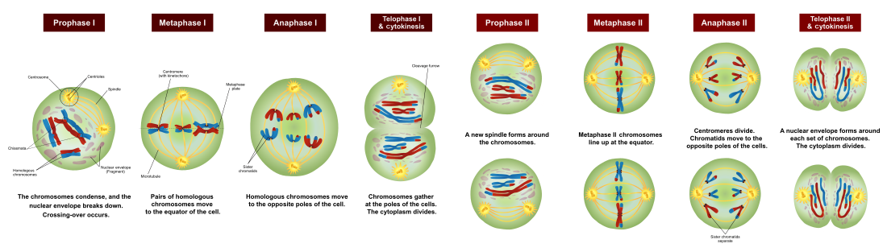

Slide 22
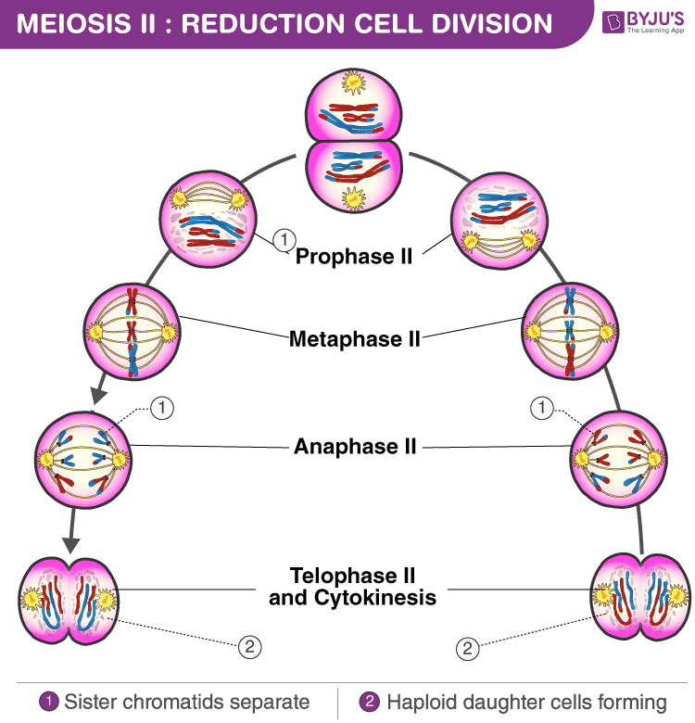

Slide 23
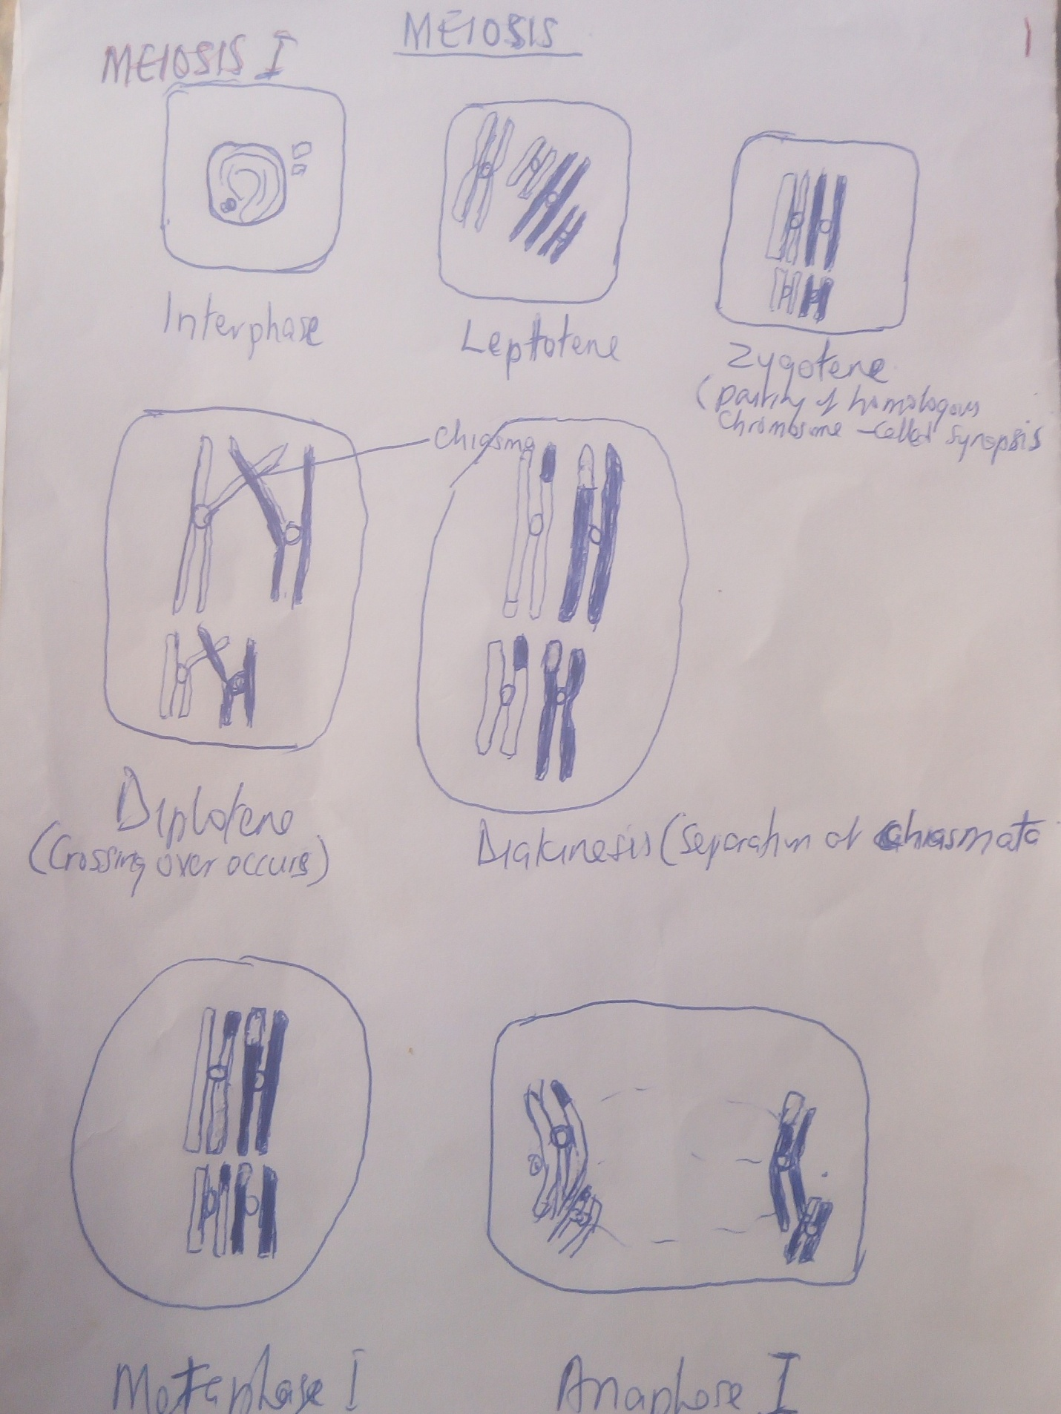

Slide 24
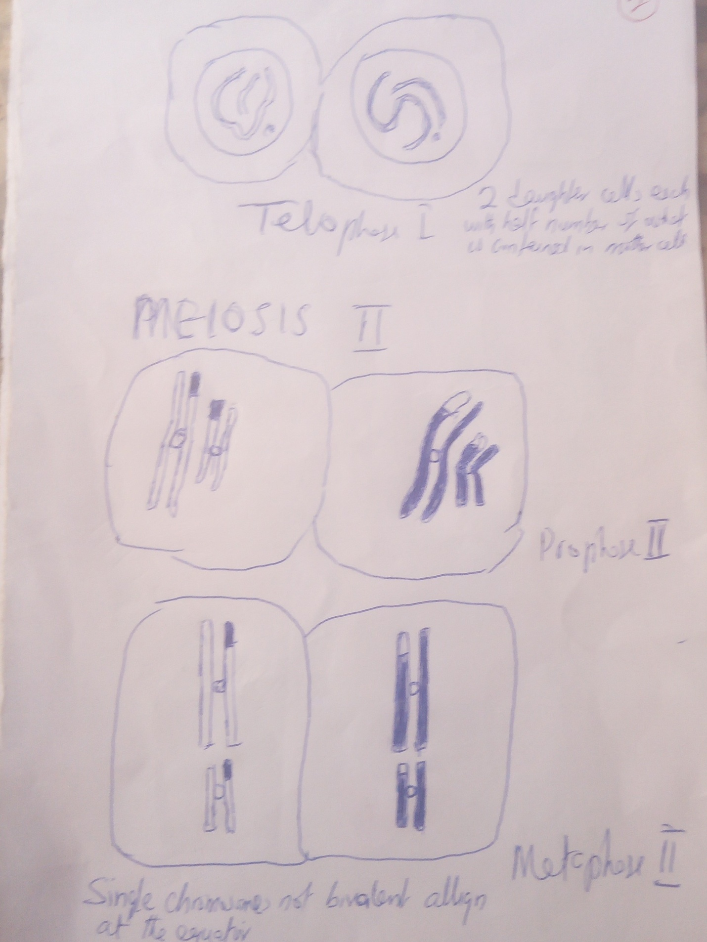

Slide 25
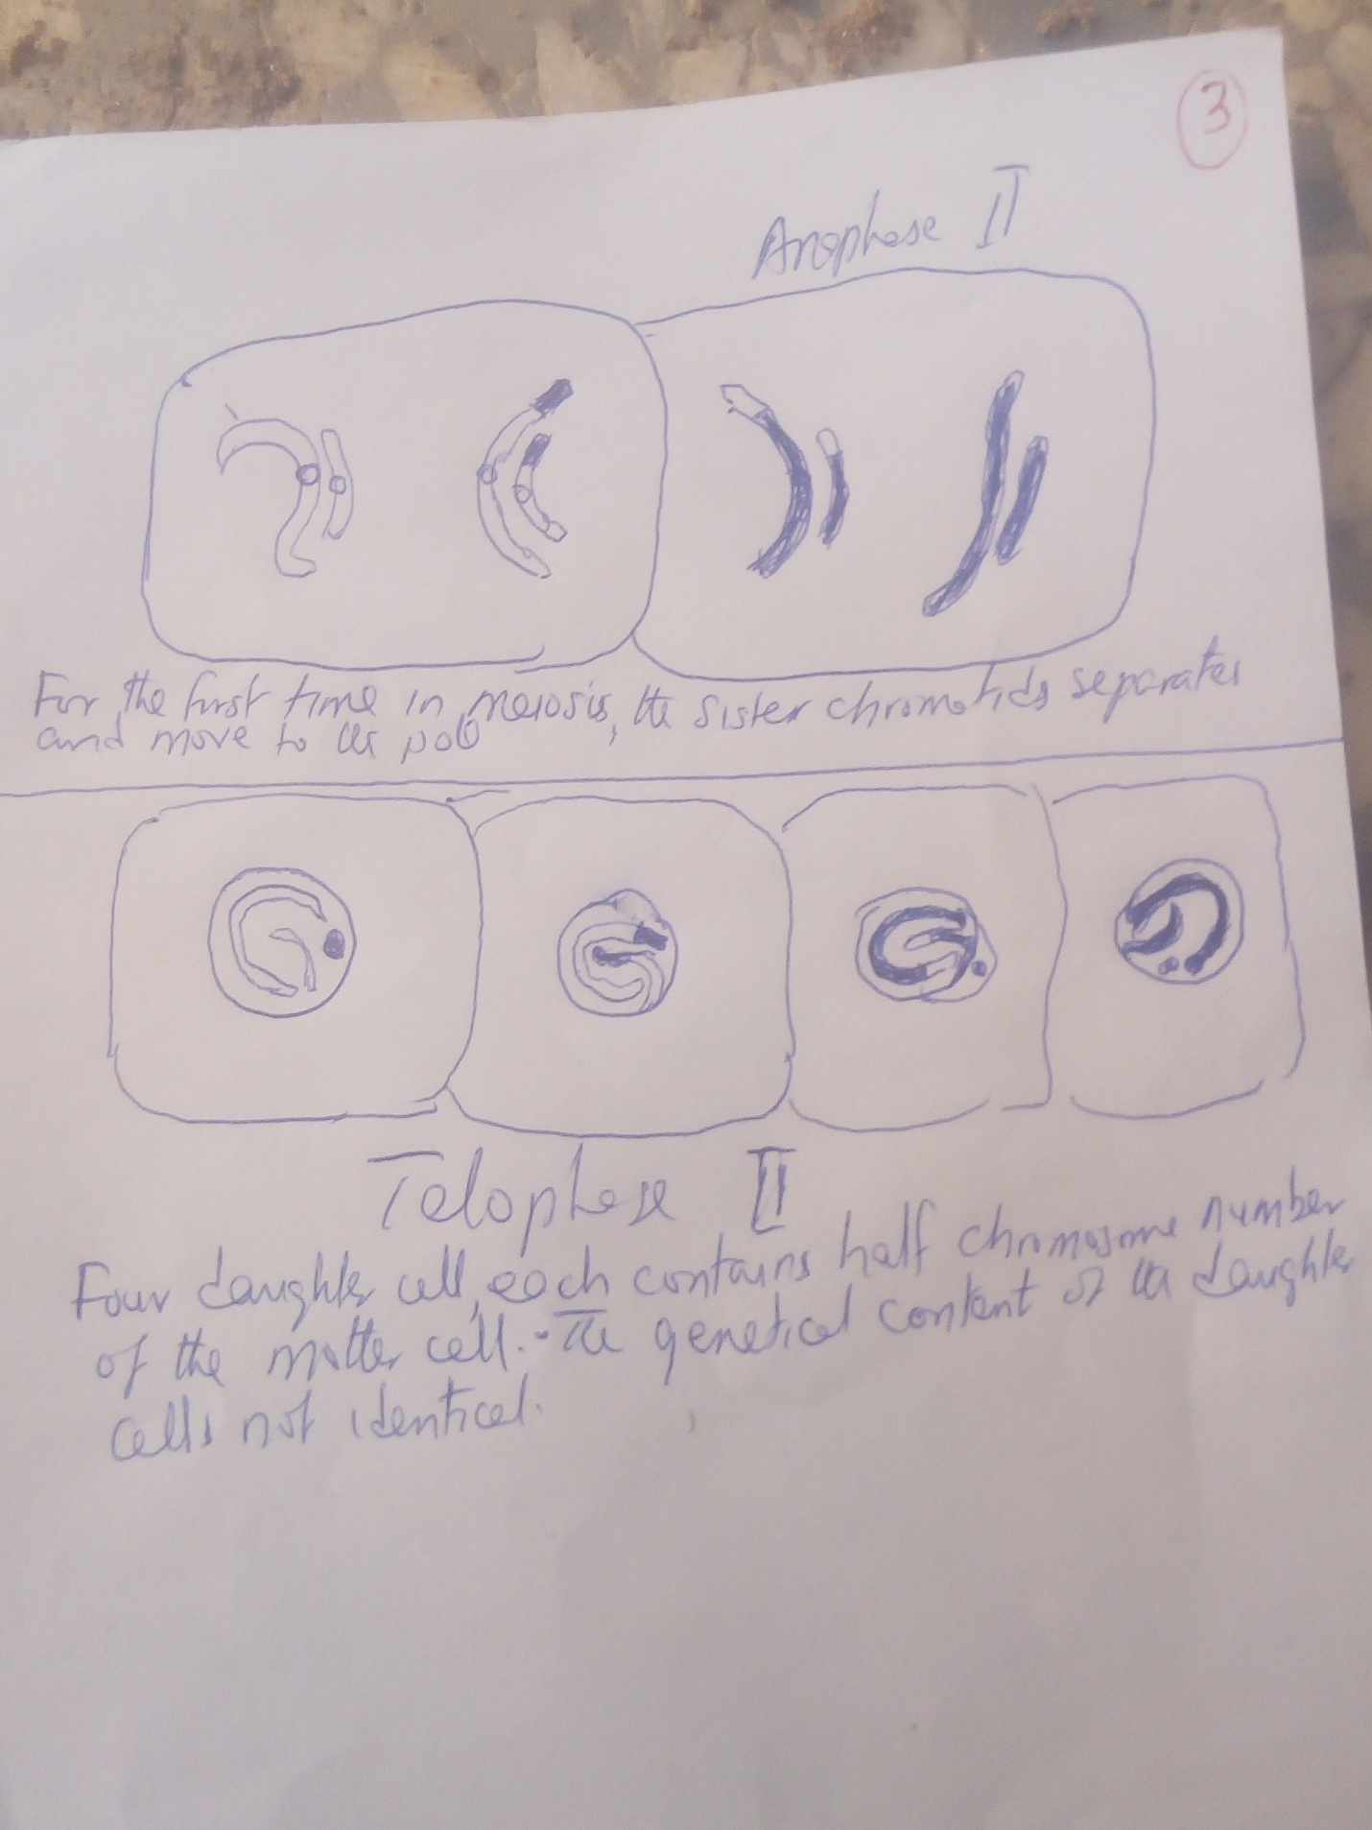

Slide 26
The original diploid cell with 4 chromosomes has undergone meiosis to form four haploid daughter cells, each containing 2 chromatids.
It is now possible for two haploid sex cells to join during fertilization to form one egg cell with the normal diploid number of chromatids.
After fusion and DNA replication, two haploid cells will yield one diploid egg cell with 2 pairs of chromosomes.
In humans' meiosis occurs only in the reproductive organs, the testes in males and the ovaries in females.
In males, each of the meiotic divisions result in four equally sized haploid cells that mature into functional sperm cells.
In females, the meiotic divisions are uneven, resulting in three tiny cells called polar bodies and one large egg that can be fertilized.

Slide 27
DIFFERENCES BETWEEN MITOSIS AND MEIOSIS
1 | Common type of cell division | It is not a common type of cell division
2 | Occurs in all somatic cells | Occurs only in specialized germ cells
3 | One division per circle | Two per cycle
4 | An equational division | A reductional division
5 | Two daughter cells formed per cycle | Four daughter cells formed per cycle
6 | Chromosomes number of daughter cell same as the parent cell | Chromosomes number of daughter cell half that of parent cell
7 | Synapsis, crossing over, chiasmata or genetic exchange of chromosomes not occur here | Synapsis, crossing over, chiasmata or genetic exchange of chromosomes occur here
8 | Genetic content of products identical | Genetic content of products not identical
9 | Products of mitosis are capable of undergoing further mitosis | Products of meiosis cannot undergo mitosis, but can undergo mitosis
10 | Mitosis begins at zygote stage and continues throughout life | Meiosis begins only when the organism is matured

Slide 28
Frequently Asked Questions – FAQs
Q1
Why is meiosis II considered similar to mitosis?
Mitosis occurs in the somatic cells and here, a parent cell divides to form two daughter cells while retaining the same number of chromosomes as the parent cell. However, meiosis takes place in the germinal cells. There are 2 types of divisions in meiosis- Meiosis-I and Meiosis-II. When a germinal cell, after completing meiosis-I, enters into Meiosis-II, there is no change in the number of chromosomes, just like in mitosis. Hence, it is considered similar to mitosis.
Q2
How do the haploid cells form during meiosis but why is this not happening in mitosis?
After mitosis, two identical cells are created with the same original number of chromosomes, 46. Haploid cells that are generated through meiosis, such as eggs and sperm, only have 23 chromosomes, because, remember, meiosis is a “reduction division.” Makes all cells other than gametes.
Meiosis produces 4 haploid cells. Mitosis produces 2 diploid cells. The old name for meiosis was reduction/ division. Meiosis I reduces the ploidy level from 2n to n (reduction) while Meiosis II divides the remaining set of chromosomes in a mitosis-like process (division).

