Slide 1
What is cell?
Smallest, basic, fundamental, and structural unit of life.
Capable of basic life processes.
All living things are composed of cells.
It can function independently.
It consists of protoplasm enclosed within a cell membrane.
All cells except bacterial cells have a distinct nucleus.

Slide 2
Main source of energy for cell's biological processes is
Adenosine triphosphate (ATP)
Cells carry out thousands of biochemical reactions to ensure the perpetuation of life.
Some organisms are unicellular e. g. bacteria and protozoa
Plants, animals, and fungi are multicellular.
The paramecium is a single-celled organism.
Erythrocytes (RBC) -the primary carriers of oxygen to the cells and tissues of the body.

Slide 3
Human smooth muscle is composed of slender, spindle-shaped cells.
An examination of leaves, stems, and other types of plant tissue reveals the presence of chloroplasts which are essential to the process of photosynthesis .
Diatoms- single-celled algae with a cell wall made of silica

Slide 4
A cell has three main parts:
The cell membrane: It surrounds the cell and regulates the exchange of substances.
The nucleus: It is a structure inside the cell that contains most of the cell’s DNA (the hereditary material
The cytoplasm: The cytoplasm is the fluid inside the cell that contains organelles for various functions (e.g., mitochondria for energy, ribosomes for protein synthesis

Slide 5
Cells vary considerably in size
The smallest cell, a bacterium (Mycoplasma), measures 0.0001mm in diameter.
Among the largest cells are the nerve cells that run down a giraffe’s neck; these cells can exceed 3m in length.
Human cells also display a variety of sizes, from small red blood cells that measure 0.00076 mm to liver cells that may be ten times larger.

Slide 6
Cells present an array of shapes
Bacterium Escherichia coli, resemble rods.
Paramecium---- slipper shaped
Amoeba ----- irregular form that changes shape.
Plant cells typically resemble boxes or cubes.
In humans, skin (cells are flat), and muscle cells (long and thin). nerve cells ( with their elongated, tentacle-like extensions).

Slide 7
Organization into tissues, organs, and Systems.
Different cells are organized into tissues specialized to perform particular functions.
Tendons and bones, for example, are composed of connective tissue skin and mucous membranes are built from epithelial tissue.
Different tissue types are assembled into organs- specialized to perform particular functions. Examples of organs- the heart, stomach, and brain.
Organs, in turn, are organized into systems such as the circulatory, digestive, or nervous systems.
All together, these assembled organ systems form the human body.

Slide 8
The components of a cell
Molecules- formed by the union of atoms. Small molecules serve as building blocks for larger molecules. Proteins, nucleic acids, carbohydrates, and lipids are the four major molecules that underlie cell structure and also participate in cell functions.
Organelles-membrane-bound compartments in cells, built largely from proteins.
Enzymes- Biochemical reactions in cells are guided by enzymes, specialized proteins that speed up chemical reactions.
The nucleic acid- DNA which contains the hereditary information for cells, and RNA, which works with DNA to build the thousands of proteins.

Slide 9
Cell Theory
Cell theory is one of the fundamental principles of biology, and was formulated based on observations by scientists like Matthias Schleiden, and Theodor Schwann,
Its main tenets are:
1. All living organisms are composed of cells.
2. The cell is the basic unit of structure and function
3. All cells arise from pre-existing cells.
4. Cells contain hereditary information.
5. All cells share basic chemical composition (e.g., lipids, proteins, nucleic acids)

Slide 10
CELL TYPES AND STRUCTURE
Cells fall into one of two categories: Prokaryotic or Eukaryotic.
The term prokaryote comes from Greek words that mean “before nucleus” or “prenucleus,” while eukaryote means “true nucleus.
Prokaryotic cells: Simple, lacking a nucleus and membrane-bound organelles (e.g., bacteria, archaebacteria, and cyanobacteria).
In a prokaryotic cell, all the components, including the DNA, mingle freely in the cell’s interior.

Slide 11
Eukaryotic cells: Complex, with a defined nucleus and membrane-bound organelles
The organelles perform specialized functions.
The DNA in eukaryotic cells is enclosed in the nucleus, the cell’s command centre and information library.

Slide 12
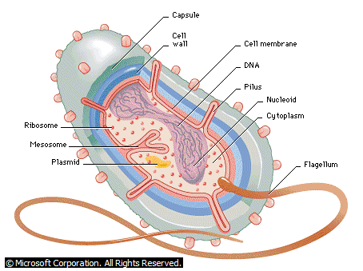
A typical Prokaryotic cell

Slide 13
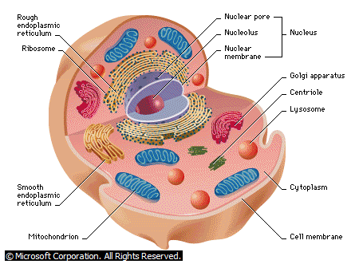
A typical Animal Cell

Slide 14
Nucleus of a cell
The nucleus directs activities of the cell and carries genetic information from generation to generation
It contains chromosomes, which hold the genetic information for the cell.
It is enclosed by a double-layered membrane, the nuclear envelope.
Nuclear content is called nucleoplasm.
Nuclear pores around the circumference of the nuclear membrane allow the exchange of cellular materials between the nucleoplasm and the cytoplasm.

Slide 15
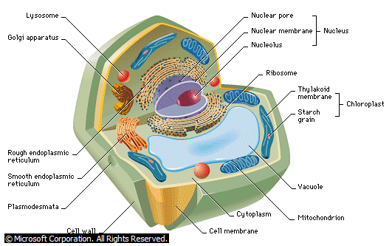
A typical plant cell

Slide 16
Plant Cells
Plant cells like animal cells contain a variety of organelles which include:
the nucleus that carries genetic material
mitochondria that generate energy
ribosomes that manufacture proteins
SER that manufactures lipids used for making membranes and storing energy; and a thin lipid membrane that surrounds the cell.

Slide 17
Plant Cell
Plant cells have all the components of animal cells and boast several added features, including a cell wall, chloroplasts, and a central vacuole
Chloroplasts capture energy from sunlight
The fluid-filled vacuole stores compounds and helps in plant growth
The rigid cell wall protects the cell and maintains its shape.

Slide 18
Typical Plant and Animal cells

Slide 19
Cellular Organelles and their functions
Cell wall ---support (growth) protection
allows water, oxygen, and carbon dioxide to pass into and out of the cell
Cell membrane—selectively permeable support protection controls movement of materials in/out of cell barrier between cell and its environment maintains homeostasis
Nucleus --controls cell activities
Nuclear membrane – selectively permeable Controls movement of materials in/out of the nucleus

Slide 20
Cellular Organelles and their functions
Cytoplasm –supports /protects cell organelles
Endoplasmic Reticulum (E.R.) –network of tubes or membranes carries materials through cell
Ribosme --produces proteins
Mitochondrion breaks down sugar molecules into energy
Vacuole---store food, water, and waste (plants need to store large amounts of food
Lysosome---breaks down larger food molecules into smaller molecules digests old cell parts

Slide 21
The components of a cell
Molecules- are formed by the union of atoms. Small molecules serve as building blocks for larger molecules. Proteins, nucleic acids, carbohydrates, and lipids are the four major molecules that underlie cell structure and also participate in cell functions.
Organelles-membrane-bound compartments in cells are built largely from proteins.
Enzymes- Biochemical reactions in cells are guided by enzymes, specialized proteins that speed up chemical reactions.
The nucleic acid- DNA which contains the hereditary information for cells, and RNA, which works with DNA to build the thousands of proteins.

