Slide 1
ANATOMY OF THE BREAST
TOKUNBO O.S
NEUROSCIENCE UNIT, ANATOMY DEPARTMENT, UNIOSUN

Slide 2
Intro
The breasts are paired structures located on the anterior thoracic wall, in the pectoral region. They are present in both males and females, yet are more prominent in females following puberty.
The female breast in humans contain mammary glands that produce milk for nursing their young. The latin name for the breast is mamma, thus it is clear why we belong to the class of mammals together with many other animal species.

Slide 3
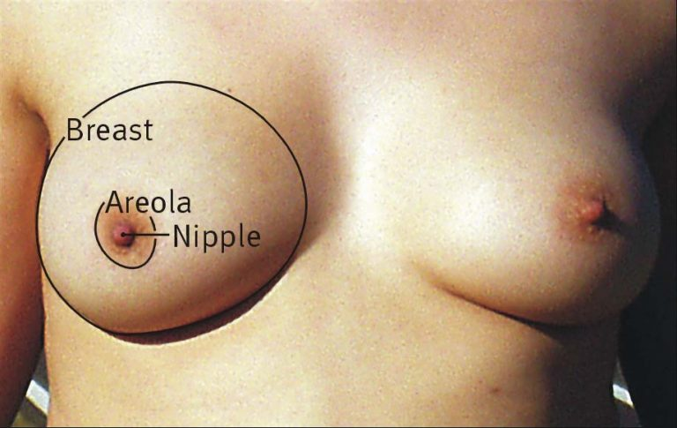
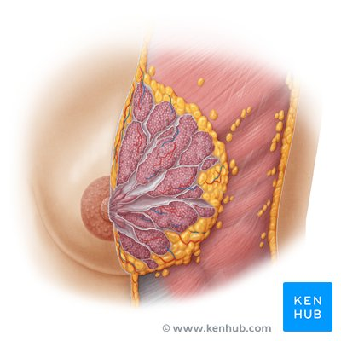

Slide 4
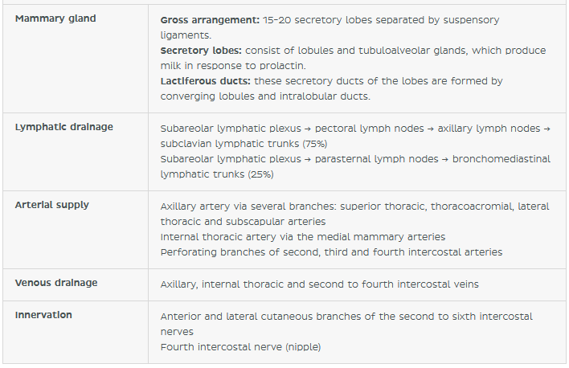
Key facts

Slide 5
SURFACE ANATOMY
The breast is located on the anterior thoracic wall. It extends horizontally from the lateral border of the sternum to the mid-axillary line. Vertically, it spans between the 2nd and 6th costal cartilages. It lies superficially to the pectoralis major and serratus anterior muscles.
The breasts are found at the anterior thoracic wall, anterior to the deep fascia and pectoral muscles; separated from them by the retromammary space. Each breast consists of mammary glands and surrounding connective tissue.

Slide 6
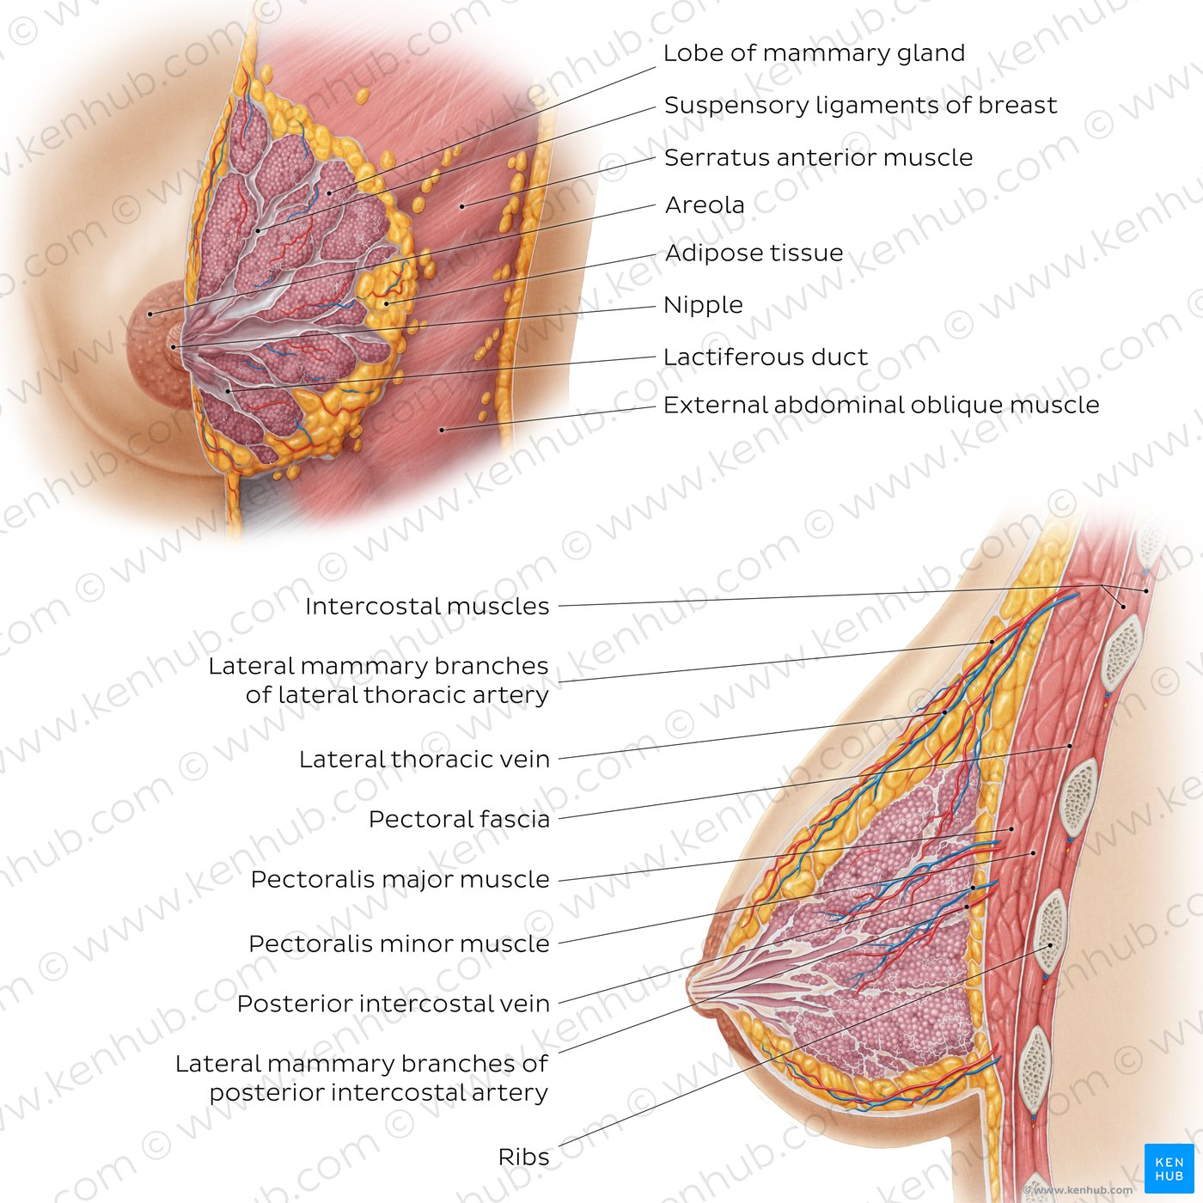

Slide 7
The breast can be considered to be composed of two regions:
Circular body – largest and most prominent part of the breast.
Axillary tail – smaller part, runs along the inferior lateral edge of the pectoralis major towards the axillary fossa.
At the centre of the breast is the nipple, composed mostly of smooth muscle fibres. Surrounding the nipple is a pigmented area of skin termed the areolae. There are numerous sebaceous glands within the areolae – these enlarge during pregnancy, secreting an oily substance that acts as a protective lubricant for the nipple.

Slide 8
MAMMARY GLANDS
The mammary glands are modified apocrine sweat glands. They are structurally dynamic, meaning that the anatomy changes depending on a woman’s age, menstrual cycle phase and reproductive status.
The glands are active in adult women after childbirth (postpartum period). In this period, the pituitary hormone prolactin stimulates the glands to produce milk, while the hypothalamic hormone oxytocin stimulates the ejection of milk through the nipple.
Outside of the postpartum period, the glands are less abundant with most of the breast tissue being filled with adipose

Slide 9
The gland is comprised of 15-20 secretory lobes which are separated by fibrous bands called the suspensory ligaments of the breast (of Cooper). These ligaments originate from the underlying clavipectoral fascia and insert to the dermis of the overlying skin, suporting the non-ptotic shape of the breasts.
The secretory lobes contain numerous lobules comprised of the tubuloalveolar glands. The secretory ducts of the lobes, called the lactiferous ducts, converge and open into the nipple.
The nipple anatomy is adjusted to support the function of the breast. They are surrounded by a pigmented circular region of skin called the areola, which becomes even more pigmented and prominent during puberty. The areola shows small punctual elevations on its surface, which are produced by the many areolar glands.

Slide 10
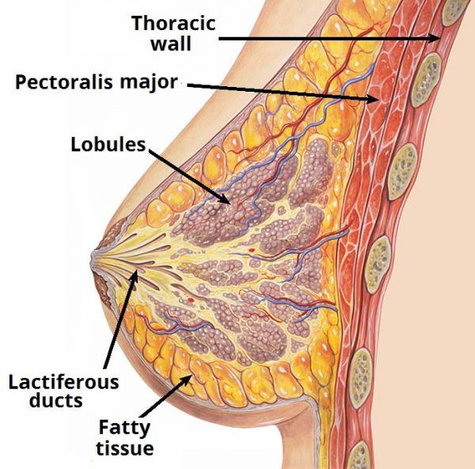
These are mostly sweat and sebaceous glands, as well as the modified mammary glands called areolar glands (of Montgomery). Their function is to produce an antimicrobial secretion that protects the surface of areola.

Slide 11
LYMPHATIC DRAINAGE
The lymphatic drainage of the breast is very important, especially from the aspect of pathology. This is because breast carcinomas tend to spread by travelling through the lymphatic vessels, creating metastatic deposits in distant parts of the body.
Lymph from the breast lobules, nipple and areola areas collect into the subareolar lymphatic plexus. From here, around 75% of lymph (mostly from the lateral quadrants of the breast) drains into the pectoral lymph nodes, and then into the axillary lymph nodes.
Whilst the remainder drains into the parasternal lymph nodes.

Slide 12
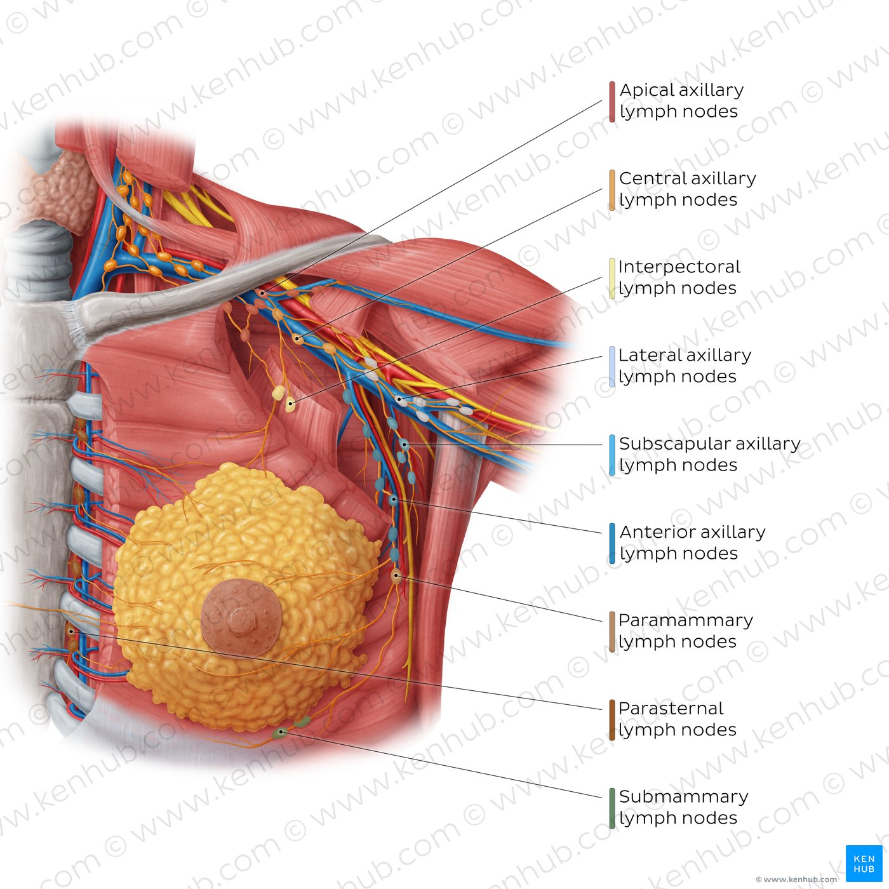
This is why axillary lymph nodes are the first to be surgically removed in certain stages of breast cancer. The axillary lymph nodes drain into the subclavian lymphatic trunks, which also drain the upper limbs.
The parasternal nodes drain into the bronchomediastinal trunks, which also drain the thoracic organs.
Besides the axillary and parasternal nodes, some drainage of the breast can occur via the intercostal lymph nodes which are located around the heads and necks of the ribs. The intercostal lymph nodes drain either into the thoracic lymph duct or the bronchomediastinal lymph trunks.

Slide 13
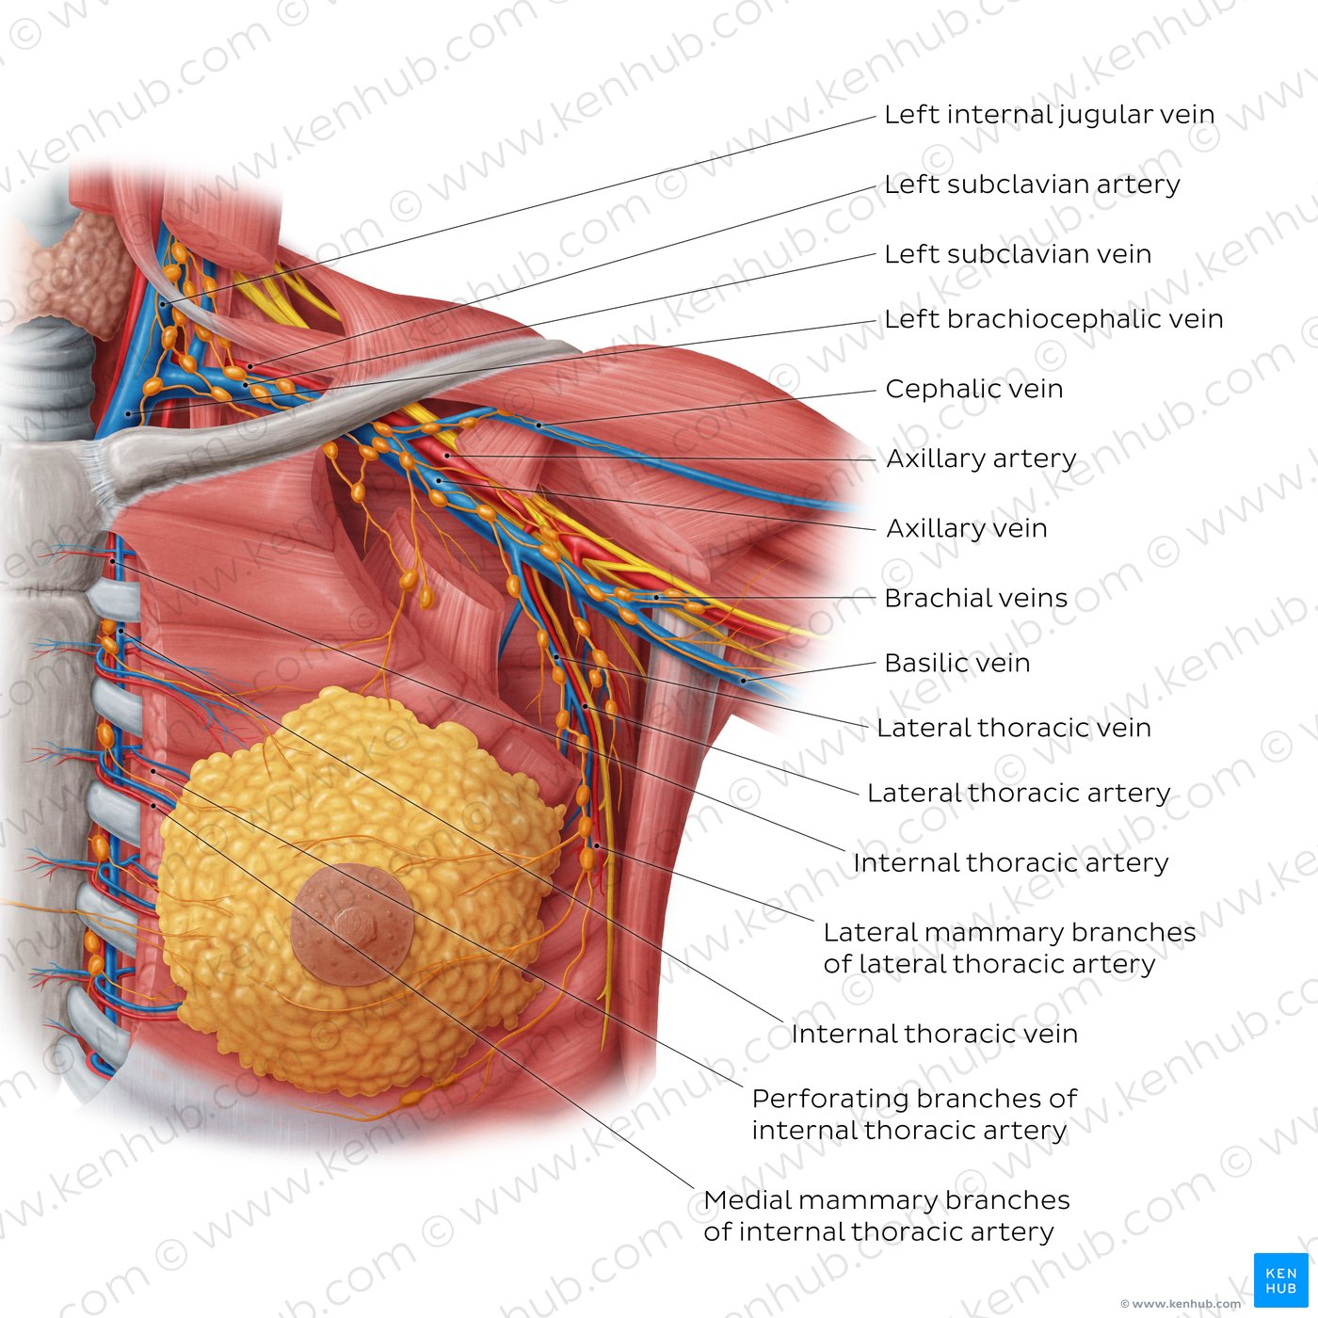
BLOOD SUPPLY

Slide 14
Breast blood supply comes from three sources:
Branches of the axillary artery supply the lateral part of the breast. These are the superior thoracic, thoracoacromial, lateral thoracic and subscapular arteries.
Branches of the internal thoracic artery, supply the medial part of the breast as the medial mammary arteries.
Perforating branches of second, third and fourth intercostal arteries contribute to the supply of the entire breast.
Breast veins follow the mentioned arteries. They drain into the axillary, internal thoracic and second to fourth intercostal veins.

Slide 15
INNERVATION
The anterior and lateral cutaneous branches of the second to sixth intercostal nerves are responsible for breast innervation. Note that the nipple is supplied by the fourth intercostal nerve.

Slide 16
Clinical Correlates
Mastectomy
The extensive removal of the breast and adjacent tissues for carcinoma which was very common in earlier decades has now given place in many cases to local excision supplemented by radiotherapy and chemotherapy. If simple mastectomy is required, the breast is stripped-off the pectoralis fascia and adjacent muscles, together with axillary fat and lymph nodes. For more radical procedures, one or both pectoral muscles can be removed as well.

Slide 17
Changes in Breast
Changes such as branching of the lactiferous duct occur in the breast tissue during menstrual periods and in pregnancy. Although mammary glands are prepared for secretion by mid-pregnancy, they do not produce milk until shortly after the baby is born. Colostrum, a creamy white to yellowish pre-milk fluid, may secrete from the nipples during the last trimester of pregnancy and during initial episodes of nursing. Colostrum is believed to be especially rich in protein, immune agents and a growth factor affecting the infant’s intestines. In multiparous women, the breast often becomes large and pendulous. The breasts in elderly women are usually small because of the decrease in fat and the atrophy of glandular tissue.

Slide 18
Gynecomastia
Gynecomastia is swelling of the breast tissue in boys or men, caused by an imbalance of the hormones estrogen and testosterone. Slight temporary enlargement of the breast is a normal occurrence with a frequency of 70% in males at puberty. Breast hypertrophy in males after puberty is relatively rare, and may be age related or drug related, for example the use of anabolic steroids.
Gynecomastia may also result from an imbalance between estrogenic and androgenic hormones or from a change in the metabolism of sex hormones by the liver. It can affect one or both breasts, sometimes unevenly. Newborns, boys going through puberty and older men may develop gynecomastia as a result of normal changes in hormone levels. Generally, gynecomastia is not a serious problem, but it can be tough to cope with the condition. Men and boys with gynecomastia sometimes have pain in their breasts and may feel embarrassed. Gynecomastia may go away on its own. If it persists, medication or surgery may help.

Slide 19
Breast Cancer
Breast cancer is the most common type of cancer to be diagnosed within the UK. After lung cancer it has the second highest death rate due to cancer. It is more common in women than men.
Common presentations associated with breast cancer are due to blockages of the lymphatic drainage. Excess lymph builds up in the subcutaneous tissue, resulting in clinical features such as nipple deviation and retraction, and prominent skin between small dimpled pores (peau d’orange). Larger dimples are generally caused by cancerous invasions and fibrosis. This causes traction of the suspensory ligaments, causing them to shorten.
Metastasis commonly occurs through the lymph nodes. It is most likely to be the axillary lymph nodes that are involved. They become stony hard and fixed. Following this, the cancer can spread to distant places such as the liver, lungs, bones and ovary.
To assess a suspected breast cancer a triple assessment is carried out. This involves clinical examination, imaging using a mammogram and ultrasound scan and finally a biopsy.

Slide 20


