Slide 1
Department of Medical Biochemistry, Osun State University, Osogbo BCM 201: Amino Acids Chemistry: Peptides

Slide 2
INTRODUCTION
Peptides are short chains of amino acids linked by peptide bonds. They can play various roles in the body.
Generally, the term ‘peptide’ is applied when the number of constituent amino acids is less than 10.
How are peptides formed? They are formed by either:
Enzymatic Synthesis - the joining of 2 or more amino acids, with loss of water, or
Enzymatic or Chemical Degradation - breakdown of proteins/polypeptides into smaller peptides
Several biologically important peptides are known in living organisms, and we shall be considering a few of them in this lecture.

Slide 3
Peptide Bond
The amino acids are held together in a protein by covalent peptide (or amide) bonds or linkages.
These bonds are rather strong and serve as the cementing material between the individual amino acids (considered as bricks).
Formation of a peptide bond:
When the amino group of an amino acid combines with the carboxyl group of another amino acid, a peptide bond is formed (see the Figure below).
Note that a dipeptide will have two amino acids and one peptide (not two) bond.
Peptides containing more than 10 amino acids (decapeptides) are referred to as polypeptides.

Slide 4
Characteristics of peptide bonds
The peptide bond is:
Rigid
Planar – the 6 atoms Cα1,C,O,N,H,Cα2, lie on the same plane
Exhibits partial double bond character, meaning the bond between the carbonyl carbon (C=O) and the amide nitrogen (N-H) isn't a pure single or double bond, but an intermediate (about 40% double-bond character). This makes the bond shorter, stronger, and more rigid than a typical single bond. It also restricts rotation and creates a planar structure crucial for protein folding
Exists in a trans configuration – the carbonyl oxygen and the amide nitrogen lie on opposite sides of the plane.
Both –C=O and -NH groups of peptide bonds are polar and are involved in hydrogen bond formation.

Slide 5
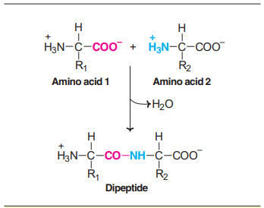
Writing of peptide structures:
Conventionally, the peptide chains are written with the free amino end (N-terminal residue) at the left, and the free carboxyl end (C-terminal residue) at the right.
The amino acid sequence is read from the N-terminal end to C-terminal end.
Incidentally, protein biosynthesis also starts from the N-terminal amino acid.
Formation of a peptide bond

Slide 6
Shorthand to read peptides:
Recall from the previous lecture that the amino acids in a peptide or protein are represented by the 3-letter or one-letter abbreviation. This is the chemical shorthand to write proteins.
Naming of peptides:
For naming peptides, the amino acid suffixes -ine (glycine), -an (tryptophan), -ate (glutamate) are changed to –yl, with the exception of the C-terminal amino acid.
Thus, a tripeptide composed of an N-terminal glutamate, a cysteine, and a C-terminal glycine is called glutamyl-cysteinyl-glycine.
In the Figure below, the naming and representation of a tripeptide are shown

Slide 7
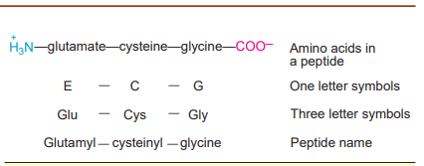
Naming and representation of a tripeptide

Slide 8
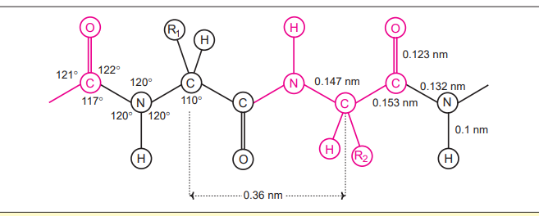
Dimensions of a peptide chain:
The dimensions of a fully extended polypeptide chain are depicted in the Figure below.
The two adjacent α-carbon atoms are placed at a distance of 0.36 nm.
The interatomic distances and bond angles are also shown in this Figure

Slide 9
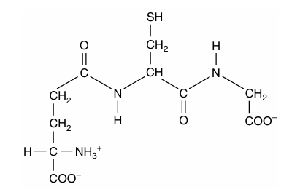

BIOLOGICALLY IMPORTANT PEPTIDES
Several peptides occur in living organisms and display a wide spectrum of biological functions. See examples of biologically active peptides and their functions below.
Glutathione: It is a tripeptide composed of 3 amino acids. Chemically, glutathione is γ-glutamyl-cysteinyl-glycine. It is widely distributed in nature and exists in reduced or oxidized states.
Glutathione (γ-glutamyl-cysteinyl glycine)

Slide 10
Functions of Glutathione:
In a steady state, the cells generally maintain a ratio of about 100/1 of GSH to G-S-S-G. The reversible oxidation-reduction of glutathione is important for many of its biological functions. These include:
As a coenzyme for certain enzymes, e.g., prostaglandin PGE2 synthetase and glyoxylase.
It prevents the oxidation of sulfhydryl (-SH) groups of several proteins to disulfide (-S-S-) groups.
In association with glutathione reductase, it participates in the formation of correct disulfide bonds in several proteins.
Specialized functions in erythrocytes: Reduced glutathione helps in the:
a) Maintenance of the RBC membrane structure and integrity.
b) Protection of haemoglobin from oxidation by agents such as H2O2.

Slide 11
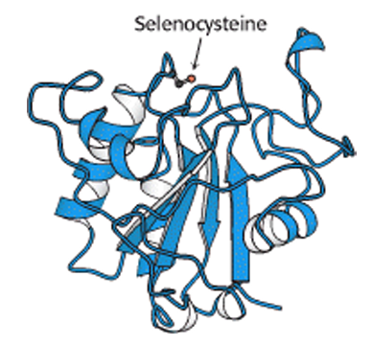

The transport of amino acids in the intestine and kidney tubules via the γ-glutamyl cycle or Meister cycle
Detoxification process. The toxic substances (organophosphates, nitro compounds) are converted to mercapturic acids.
Toxic amounts of peroxides and free radicals produced in the cells are scavenged by glutathione peroxidase (a selenium-containing enzyme).
Glutathione Peroxidase

Slide 12
2. Thyrotropin-releasing hormone (TRH): It is a tripeptide secreted by hypothalamus. TRH stimulates the pituitary gland to release the thyrotropic hormone.
3. Oxytocin: It is a hormone secreted by the posterior pituitary gland and contains 9 amino acids (nonapeptide). Oxytocin causes contraction of uterus, thus aiding control of blood loss after delivery.
4. Vasopressin (antidiuretic hormone, ADH): ADH is also a nonapeptide (containing 9 amino acids like oxytocin) produced by the posterior pituitary gland. It stimulates kidneys to retain water and thus increases the blood pressure.
5. Angiotensins: Angiotensin I is a decapeptide (10 amino acids) which is converted to angiotensin II (8 amino acids). The latter has a more hypertensive effect. Angiotensin II also stimulates the release of aldosterone from the adrenal gland.

Slide 13
6. Methionine enkephalin: It is a pentapeptide (5 amino acids) found in the brain and has opiate-like function. It inhibits the sense of pain.
7. Bradykinin and kallidin: They are nona- (9 amino acid) and deca – (10 amino acid) peptides, respectively. Both of them act as powerful vasodilators. They are produced from plasma proteins by snake venom enzymes.
8. Peptide antibiotics: Antibiotics such as gramicidin, bacitracin, tyrocidin, and actinomycin are peptide in nature
9. Aspartame: It is a dipeptide (aspartylphenylalanine methyl ester), produced by a combination of aspartic acid and phenylalanine. Aspartame is about 200 times sweeter than sucrose, and is used as a low-calorie artificial sweetener in soft drink industry.
10. Gastrointestinal hormones: Gastrin, secretin, etc., are the gastrointestinal peptides that serve as hormones

Slide 14
Uses and Benefits of Peptides
Skincare: Peptides can be incorporated into skincare products to help stimulate collagen production, improve skin elasticity, and reduce the appearance of fine lines and wrinkles. Some peptides can also help transport copper and magnesium into the skin
Supplements: Some peptide supplements may help with muscle growth and fat loss. Studies suggest that combining peptide supplements with resistance training can be more effective for increasing muscle strength than exercise alone.
Medicine: Many medical treatments use peptides. Insulin for managing blood sugar and semaglutide (Ozempic, Wegovy) for weight loss are two examples of FDA-approved peptide drugs.
Bone health: Research suggests that collagen peptides can increase bone mineral density and improve bone health, particularly in postmenopausal individuals with low bone density.

Slide 15
Biomedical Importance of Amino Acids and Peptides: A summary
In addition to providing the monomer units from which the long polypeptide chains of proteins are synthesised, L-α-amino acids and their derivatives participate in cellular functions, including:
Nerve transmission
Biosynthesis of porphyrins,
Biosynthesis of purines, pyrimidines, and urea.
Short polymers of amino acids called peptides perform prominent roles in the neuroendocrine system as
Hormones,
Hormone-releasing factors,
Neuromodulators, or
Neurotransmitters.

Slide 16
While proteins contain only L-α-amino acids, microorganisms elaborate peptides that contain both D- and L-α-amino acids.
Several of these peptides are of therapeutic value, including the antibiotics bacitracin and gramicidin A and the antitumor agent bleomycin.
Certain other microbial peptides are toxic. The cyanobacterial peptides microcystin and nodularin are lethal in large doses, while small quantities promote the formation of hepatic tumours.
Humans and other higher animals cannot synthesize 10 of the 20 common L-α-amino acids in amounts adequate to support infant growth or maintain health in adults, hence must be supplied in the diet. These are called essential amino acids.

